Slide 1
What keeps you up at night: a Survey of Campus Leaders
Webinar on Inside Higher Ed’s 2017 Survey of College and University Presidents
Tuesday, March 28, 2017, 2 p.m. Eastern

Slide 2
Presenters
Doug Lederman, editor, Inside Higher Ed
doug.lederman@insidehighered.com
Scott Jaschik, editor, Inside Higher Ed
scott.jaschik@insidehighered.com

Slide 3
Methodology
Survey conducted by Gallup in Jan.-Feb. 2017
Responses from 706 presidents/chancellors
Responses coded to allow for analysis by sector
Complete anonymity for individuals and institutions

Slide 4
Key Findings
Majority say 2016 election exposed a disconnect between higher ed and much of American society. Nearly 7 in 10 perceive growing anti-intellectual sentiment in U.S.
Nearly 2/3 of presidents say their college will be financially stable over 5 years, and 52% take that view over 10 years. Both numbers up from 2016.
Most presidents describe race relations at their college as excellent” (20%) or “good” (63%). Majority say race relations at American colleges in general are “fair.”
Just 12% of presidents say most Americans understand purpose of higher education.

Slide 5
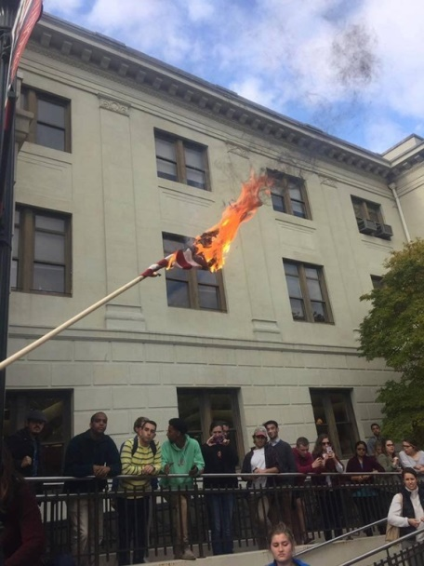
Election and Aftermath: Image of Higher Ed
69% say results showed “anti-intellectual sentiment is growing” in U.S.
54% say election “exposed that academe is disconnected from much of … society.”
66% agree anti-Trump campus protests have “played into an image” of “intolerance of conservative views.”
66% of presidents disagree that reports of racial incidents have increased since the election.

Slide 6
Election and Aftermath (cont.): Impact on Federal Policies
76% say Trump does not accept scientific consensus on many issues (climate, etc.)
75% say undocumented students may lose rights they gained during Obama era.
69% say for-profits likely to get less U.S. scrutiny.
58% say international students may be less likely to enroll at American colleges.
About half of presidents say Congress is unlikely to maintain support for programs colleges depend on.

Slide 7
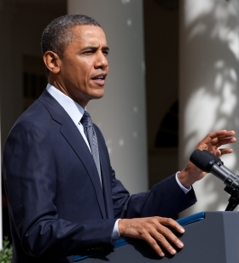
What May Change in U.S. Higher Ed Policy?
Views on policies likeliest to flip:
¾ favored 2013 decision to apply Title IX to gender identity as well as gender.
67% support gainful employment.
63% back use of “preponderance of evidence” in assault cases.
Overwhelming opposition to NLRB ruling on unionization of teaching assistants.
71% oppose College Scorecard.

Slide 8
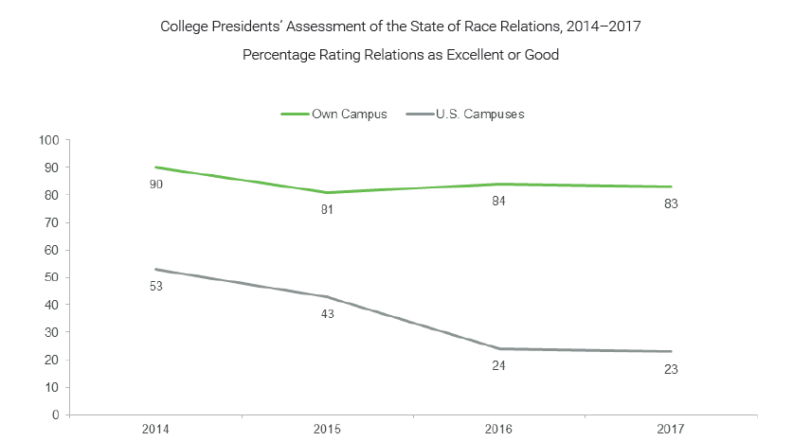
Racial Tensions? Not on My Campus

Slide 9
Financial Confidence Up (for Most)
Institution Type | % Agreeing Institution Will Be Financially Stable Over a Decade, 2015 | % Agreeing Institution Will Be Financially Stable Over a Decade,2016 | % Agreeing Institution Will Be Financially Stable Over a Decade, 2017
Public Doctoral | 42% | 54% | 69%
Public Master's/Bacc. | 32% | 37% | 54%
Public Associate | 36% | 39% | 43%
Private Doctoral/ Master's | 42% | 54% | 61%
Private Baccalaureate | 41% | 54% | 46%

Slide 10
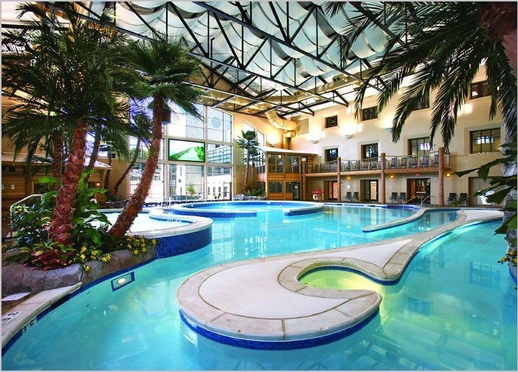
Don’t Let Me Be Misunderstood…
84% of presidents say “attention to student debt” leads many prospective students and parents to believe college is less affordable than it is.
80% say focus on small number of institutions with large endowments has “created a perception that most colleges are wealthier than they are.”
76% say campus competition to provide student amenities has “contributed to the perception that these institutions have misplaced priorities.”

Slide 11
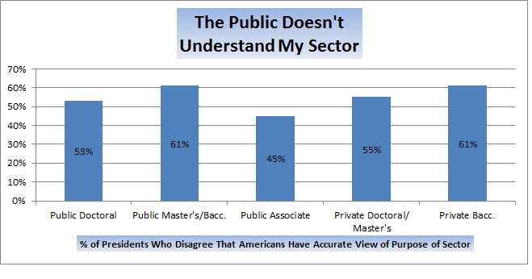
Accurate Views of Purpose of Higher Ed?

Slide 12
Speaking Out Beyond Campus
 | All | Public | Private Nonprofit
Did you, personally, speak out more on political issues during 2016 campaign than you typically do? | 31% | 34% | 27%
Have you spoken out more on political issues post-election than normal? | 33% | 37% | 29%
Do you wish you had spoken out more during the presidential campaign? | 16% | 20% | 12%
Do you intend to speak out more now about issues beyond those that directly affect your college? | 45% | 45% | 45%

Slide 13
More Information
Inside Higher Ed article:
https://www.insidehighered.com/news/survey/college-presidents-see-disconnect-public-worry-about-washington
Download the survey report:
https://www.insidehighered.com/booklet/2017-inside-higher-ed-survey-college-and-university-presidents

Slide 14
Thanks …

