Slide 1



Making Sense of the Noise:
Data Analytics to Inform Learning
Tom Fikes, EdPlus Action Lab, Arizona State University
Sanam Raza, Pearson Online Learning Services
June 28, 2017
1
Presentation Title Arial Bold 7 pt

Slide 2


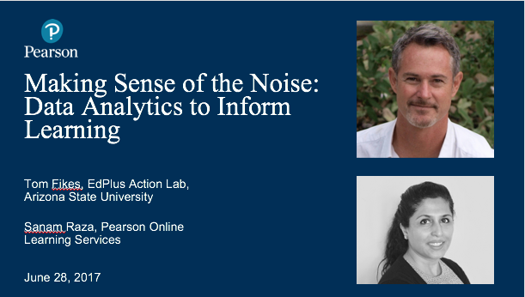

BEFORE WE BEGIN
We are using On24 for today’s webinar. Please enter questions in the text field at the bottom of the Q&A Window. We are monitoring the discussion and will try to bring the Q&A comments into the conversation.
We will not use the “raise your hand” feature.
We are recording the webinar; the webinar archive and slides will be available later today.

Slide 3

Today’s Speakers
Tom Fikes, Ph.D.
EdPlus Action Lab, Arizona State University
(tgfikes@asu.edu)
Sanam Raza
Pearson Online
Learning Services
(sanam.raza@pearson.com)
June 28, 2017
3
Presentation Title Arial Bold 7 pt

Slide 4


Slide 5





Action Lab Charter
Action Lab is Higher Education’s
First Dedicated Research Lab Designed
for Longitudinal Digital Learning Innovation Research
INSIGHT
ACTION
IMPACT
Multi dimensional in research design and focus
Cognition, behavioral, and digital learning design focus
Practical application of research in continuous course design improvement
Private/Public sector co-creation of EdTech innovation
Sustainable increases in continued student success
Increased success rates in innovative digital learning market solutions

Slide 6
Action Lab Research Tracks
1
2
3
  ASU Online
  Alt Design & Delivery
  Emerging Tech
Research on learning efficacy and learning analytics in fully online accredited programs in across subject areas. Research topics focus on learning effectiveness, course design, and student engagement measures.
Examining learning effectiveness in non- traditional eLearning design and accredited courses using GFA’s unique business and instructional design model
Research and discovery process of existing adaptive learning platforms, defining an industry accepted taxonomy and MVP requirements for effective adaptive platforms.

Slide 7


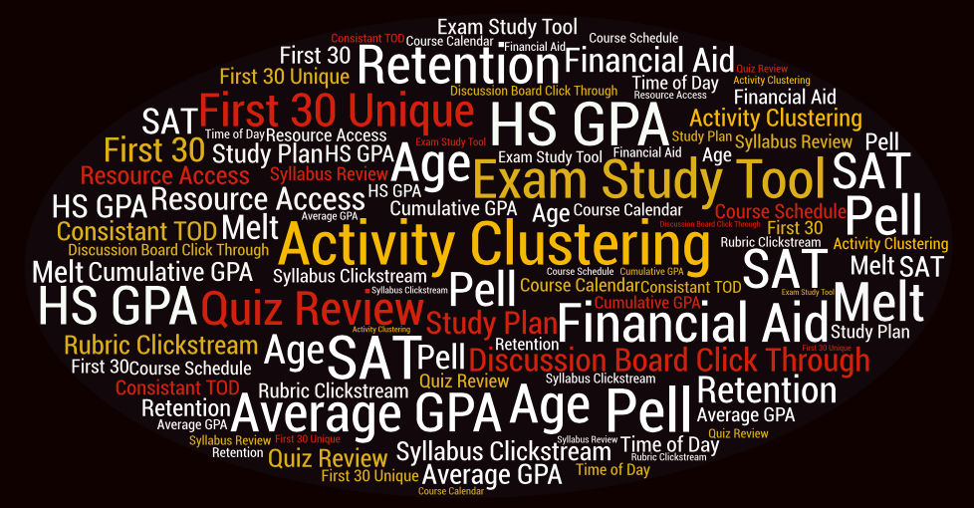
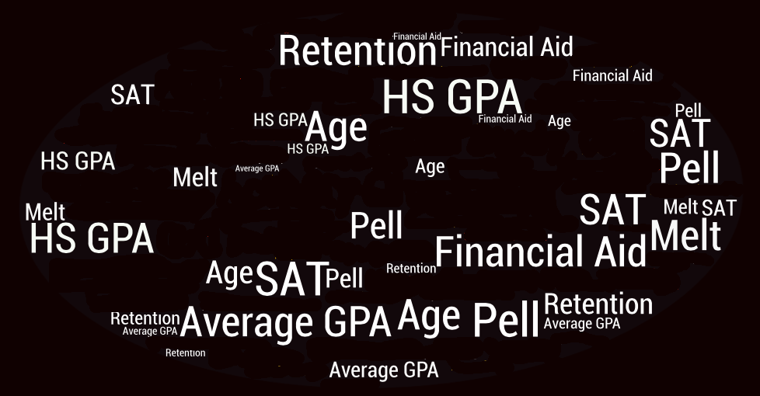
Data Differentiation
Operational Analysis
Business Analysis
Demographic variaBLES
Regression Analysis
Predictive Values
Learning Analytics Variables

Slide 8
Building a Continuous Improvement Ecosystem
for Digital Teaching and Learning
Strategy: How do we ask the “Does it work?” question in a way that is actionable? That appreciates the nuances and complexities, but captures the basic trends? → Efficacy Results
Function: How do we embed the results and ongoing research process into the design-teach-analyze cycle to create an ecosystem for continuous improvement? → Learning Analytics Results
Infrastructure: How do our processes for data storage and extraction, communication of results, and design/intervention need to be structured to facilitate this strategy and function? ? → Next Steps: Learning Analytics Hub

Slide 9
[Poll] Data Driven Decisions
Does your institution use data to inform decisions for online student success?
Response options
Yes, we use technology and data to make informed decisions
We have the technology to capture data but we don’t use it well
We do not have the technology / means needed to capture data to make data driven decisions
We do not offer online programs

Slide 10





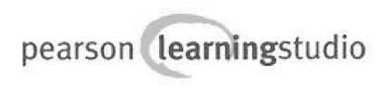




Data Sources
LT I
Course-Specific
Non-Cognitive
Student Success CTR
Library Sciences

Slide 11


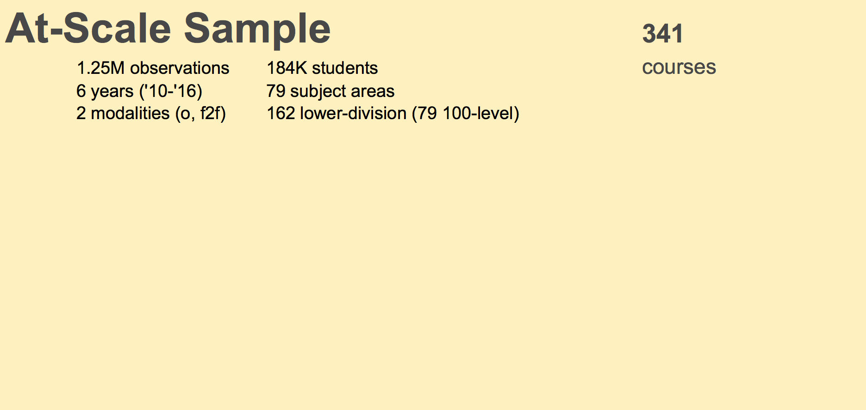

Notes:
The next few slides will give you a sense of the size and scope of the data we harvested…unprecedented at ASU.
• Main data pulls were from Peoplesoft, Blackboard & Pearson Learning Studio (Pearson help kudos)
• We extracted enough learning analytics from Bb but were hoping for more (we’ll acquire more)
• (click) The next round of research we’ll attempt to pull data from other student behavior data such as
o library sciences
o student success center
o Non-cognitive assessment
o social behavior sources Indigo
o mag card

Slide 12
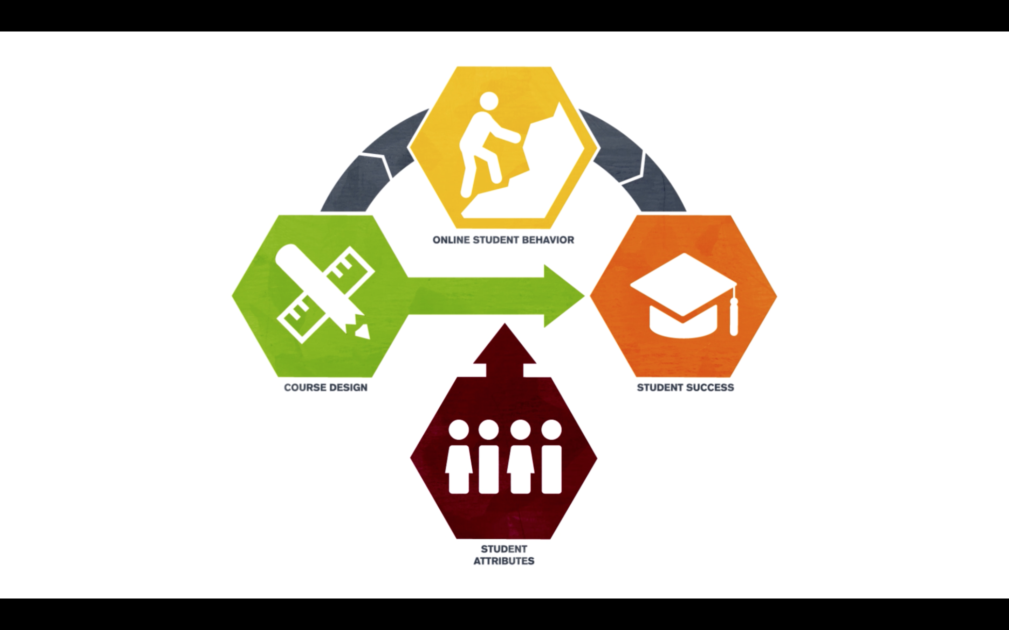

Slide 13
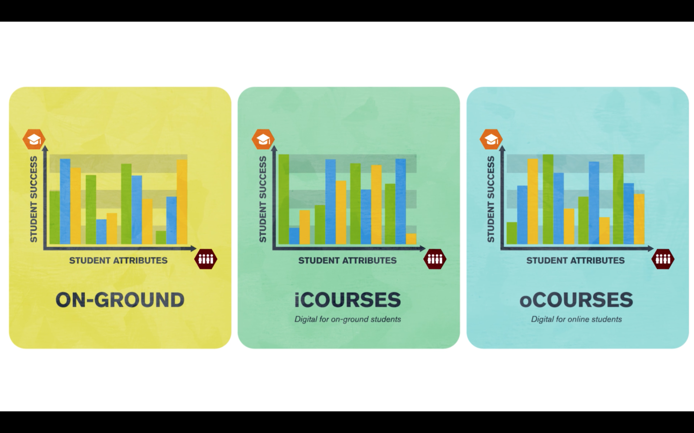
ON-CAMPUS

Slide 14


Slide 15
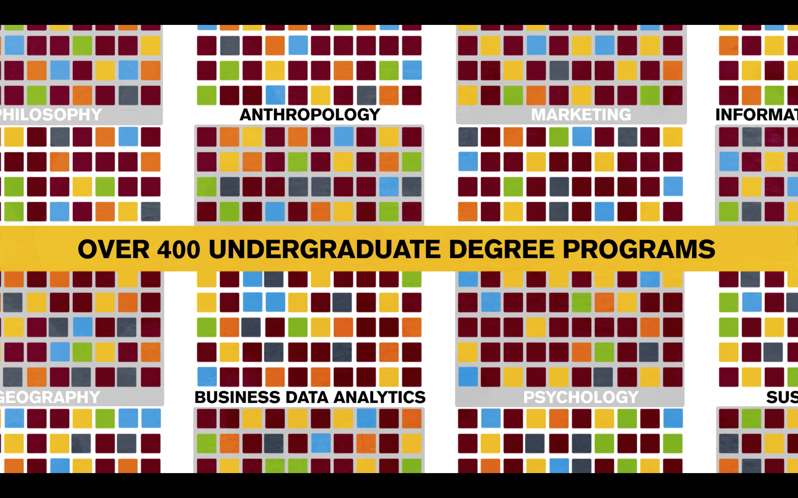

Slide 16
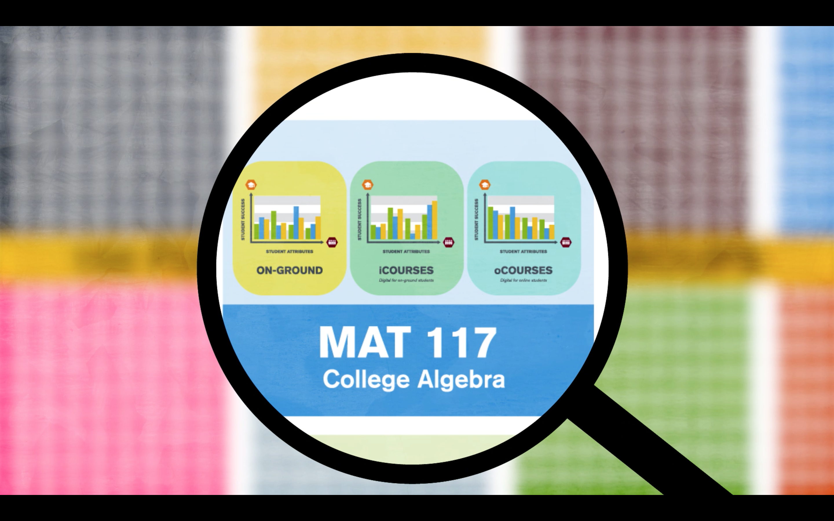

Slide 17
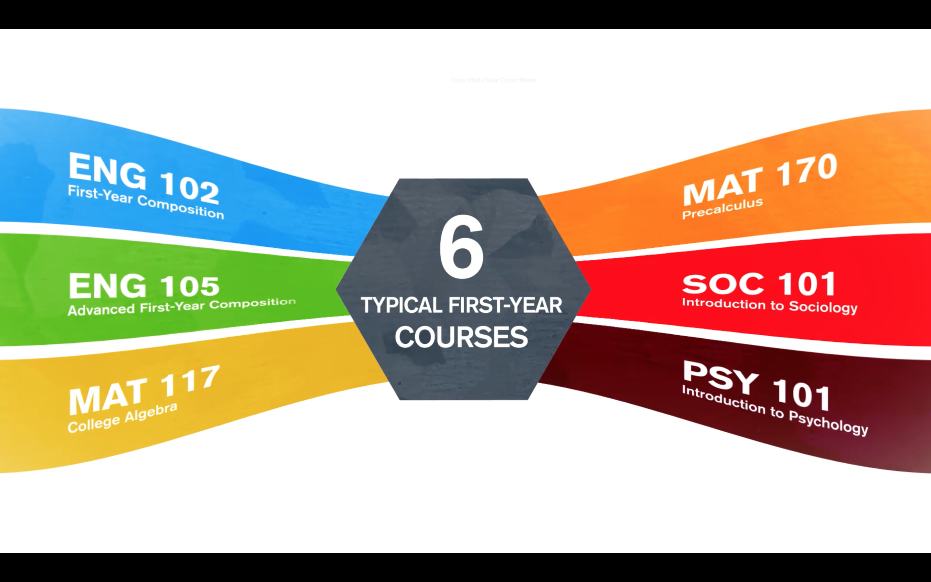

Slide 18

ASU-Online Study: Research Questions
I. Efficacy
Does student success differ in face-to-face and ASU Online modalities?
II. Learning Analytics
Do clickstream LMS data on student behavior and course design elements predict student success?

Slide 19
[Poll] Online vs. Face to Face?
How do you view online and face to face modalities?
Response options
Believe online and face to face provide the same quality education
Believe face to face is superior to online
Believe online is superior to face to face
My institution/school doesn’t offer online programs or it’s too early to tell.
Other

Slide 20
Q&A
Context, Research Questions, Strategy and Methods

Slide 21
Efficacy
Research Question
How does student success differ in face-to-face and ASU Online, and how does a course’s modality interact with students’ attributes to affect their success?

Slide 22


Efficacy
Methods
Modality
Student Success
ASU Online vs.
Face-To_Face
Completion
Passing
Mastery
Student Attributes
Logistic Regression
Controlling for age, academic prowess

Slide 23
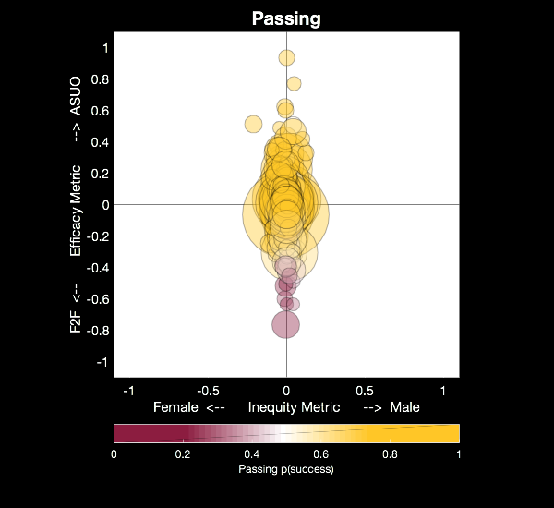


Efficacy:
How well does an ASU-O course do, overall, relative to it’s course-matched Face-to-Face counterpart?
Efficacy & Equity Metrics
F2F Efficacy ASU-O
Inequity:
How much does the ASU-O - F2F gap differ in that course for students who differ on an attribute?
ASU-O Performance:
Model predictions for
ASU-O Sections
Female Inequity Male

Slide 24
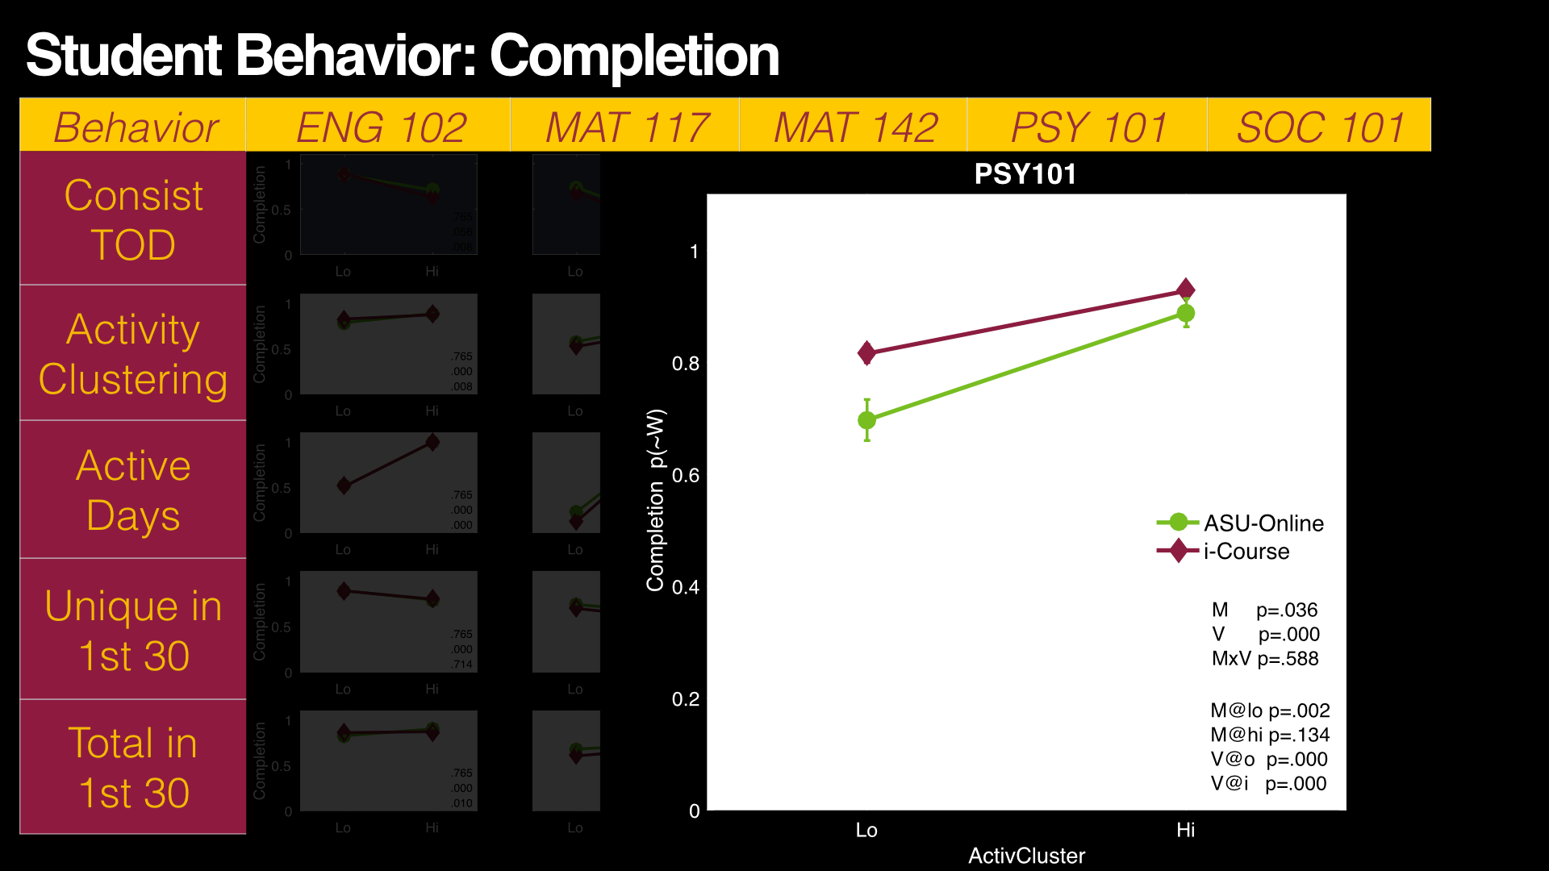
Learning Analytics

Slide 25
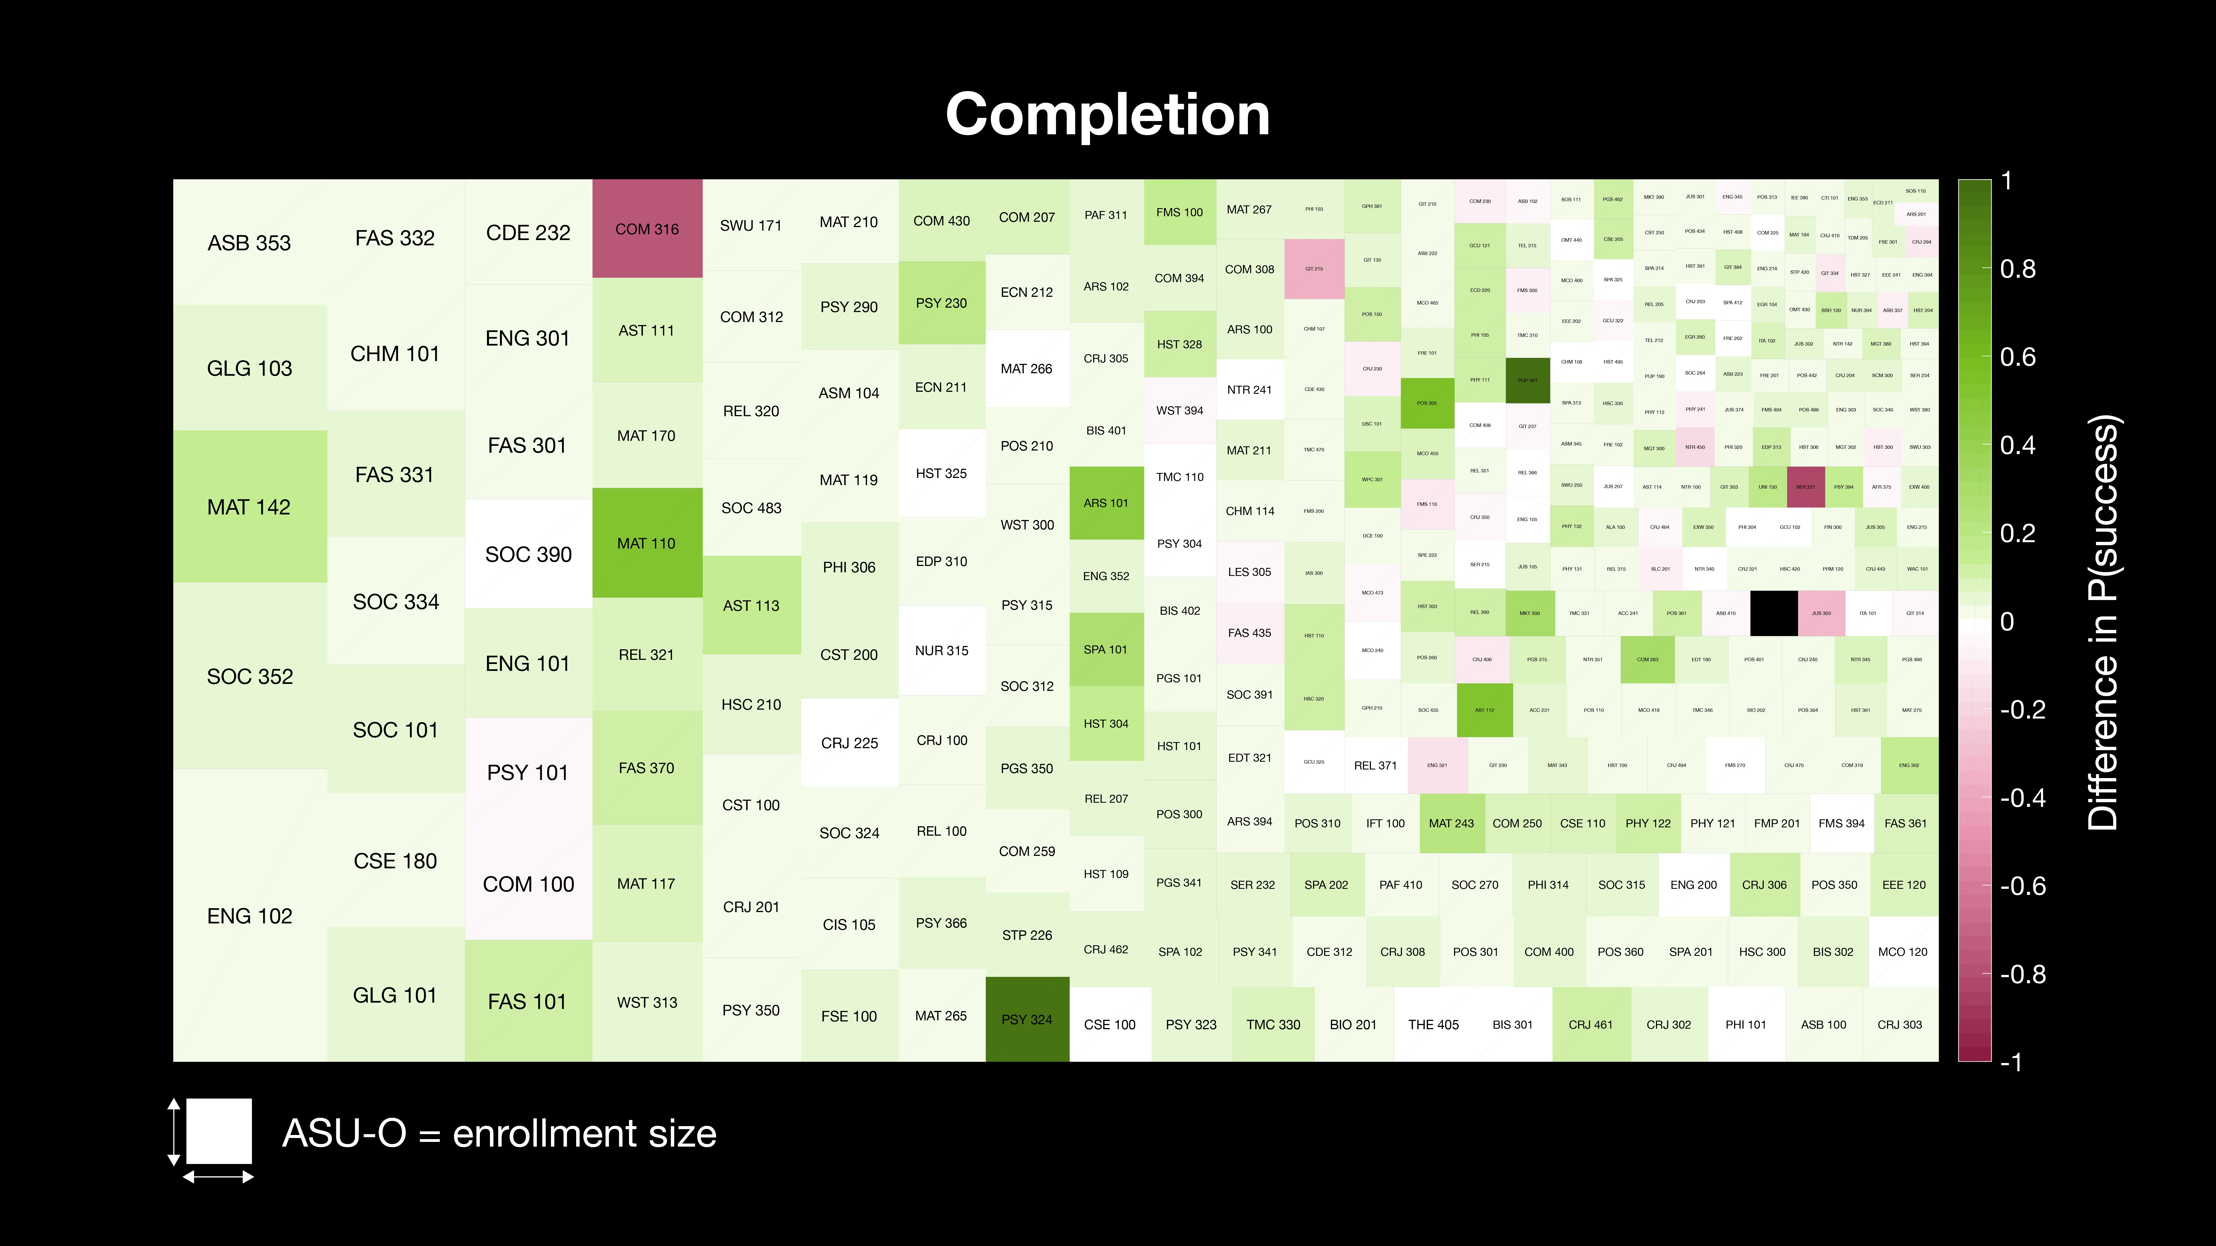

Slide 26
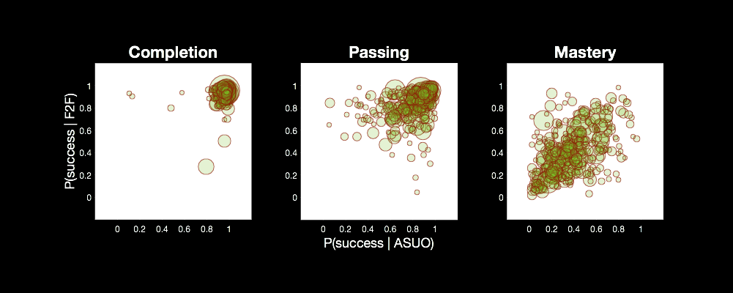
ASU Online Efficacy
Summary

Slide 27
Difference in Conditional Probability of Success

Slide 28
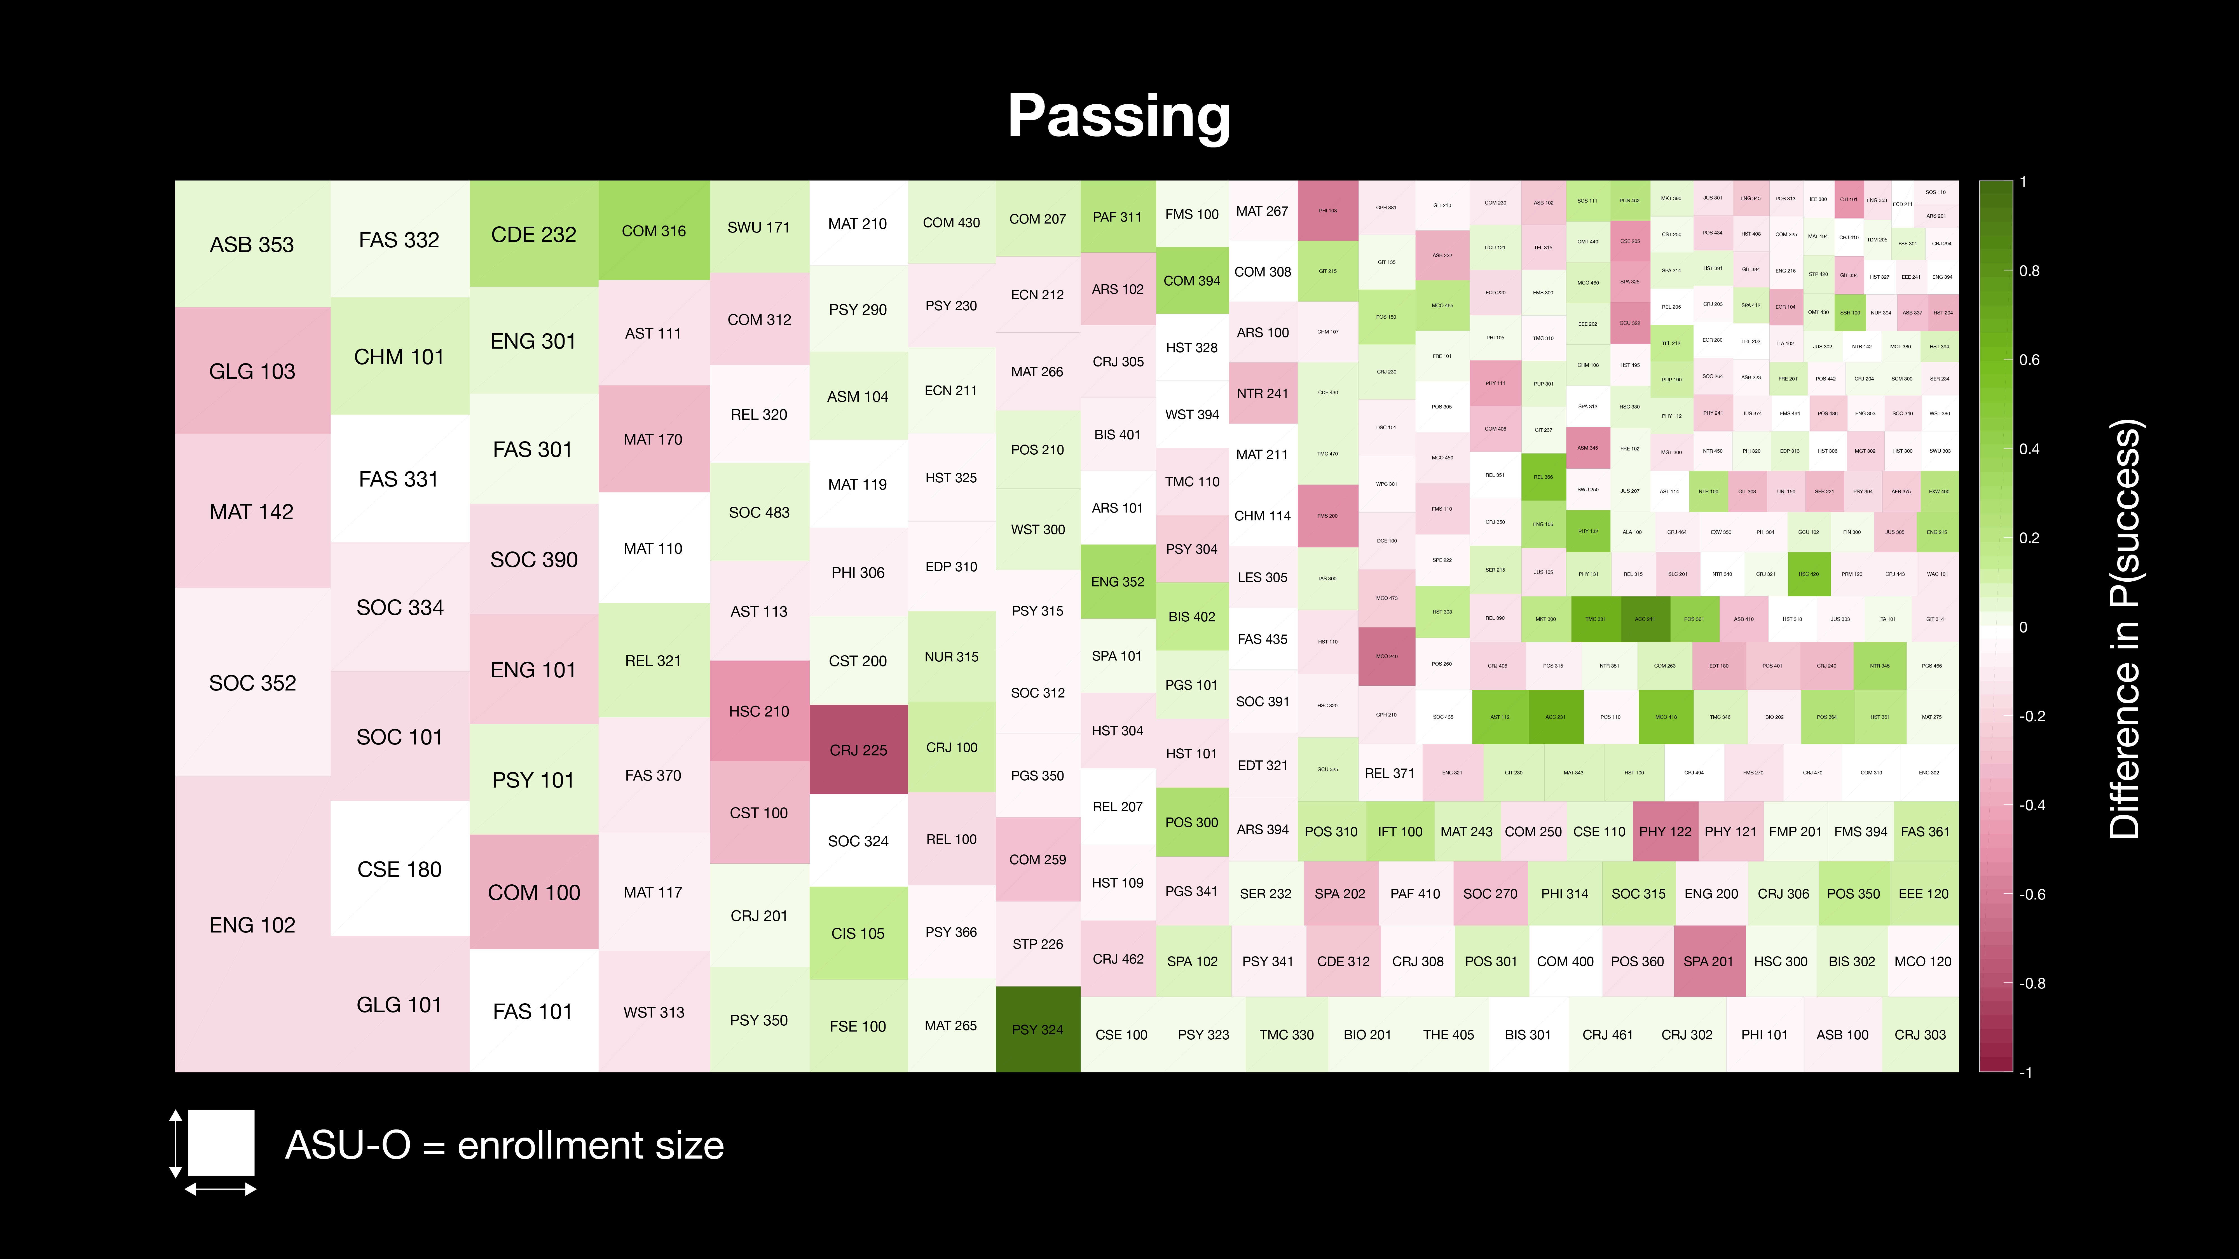

Slide 29
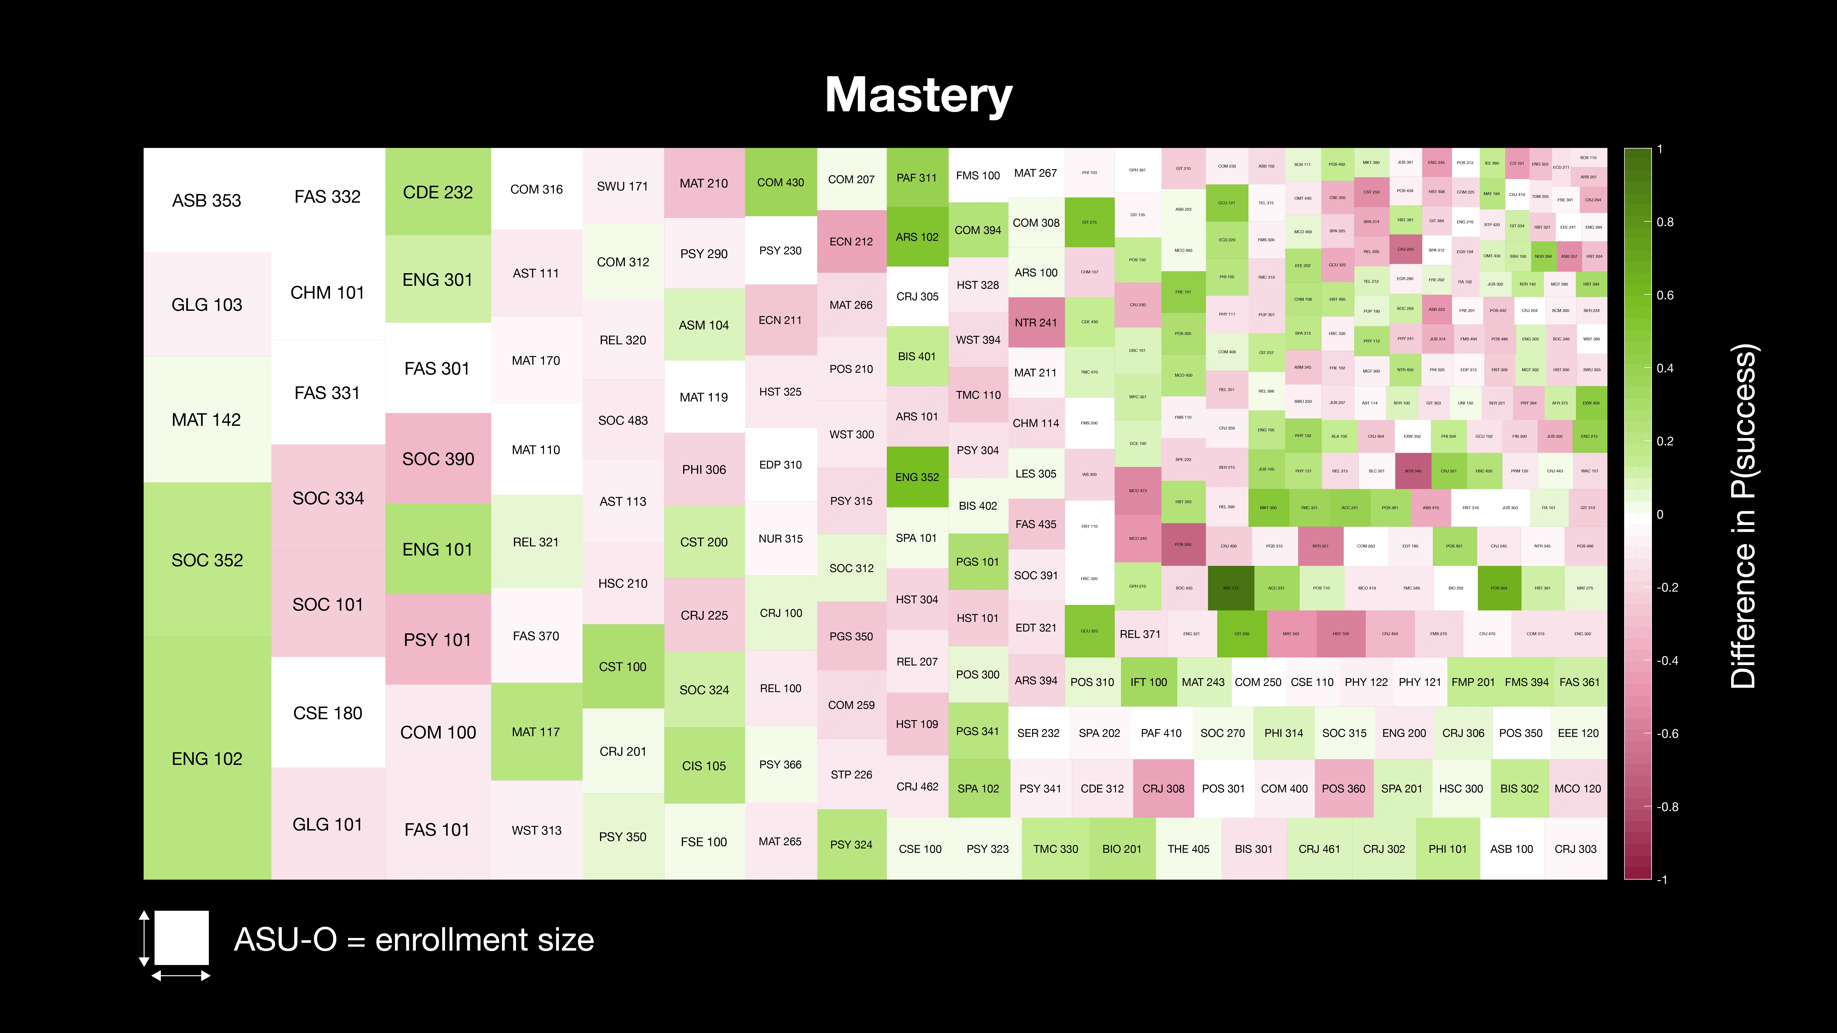

Slide 30
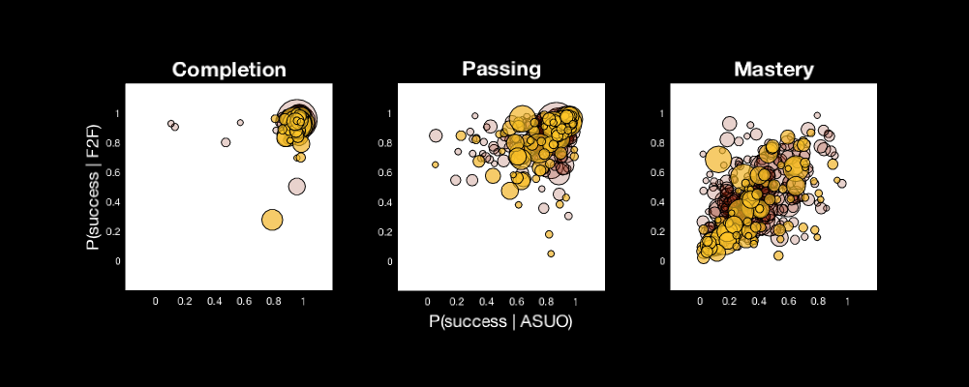
ASU Online Efficacy
STEM (n=93) vs. non-Stem (n=238)

Slide 31
Efficacy & Equity Metrics
PASSING
Efficacy:
How well does an ASU-O course do, overall, relative to it’s course-matched Face-to-Face counterpart?
F2F Efficacy ASU-O
Inequity:
How much does the ASU-O - F2F gap differ in that course for students who differ on an attribute?
Performance:
How well does an ASU-O course do in absolute terms?
Female Inequity Male
ASU-O Enrollment

Slide 32
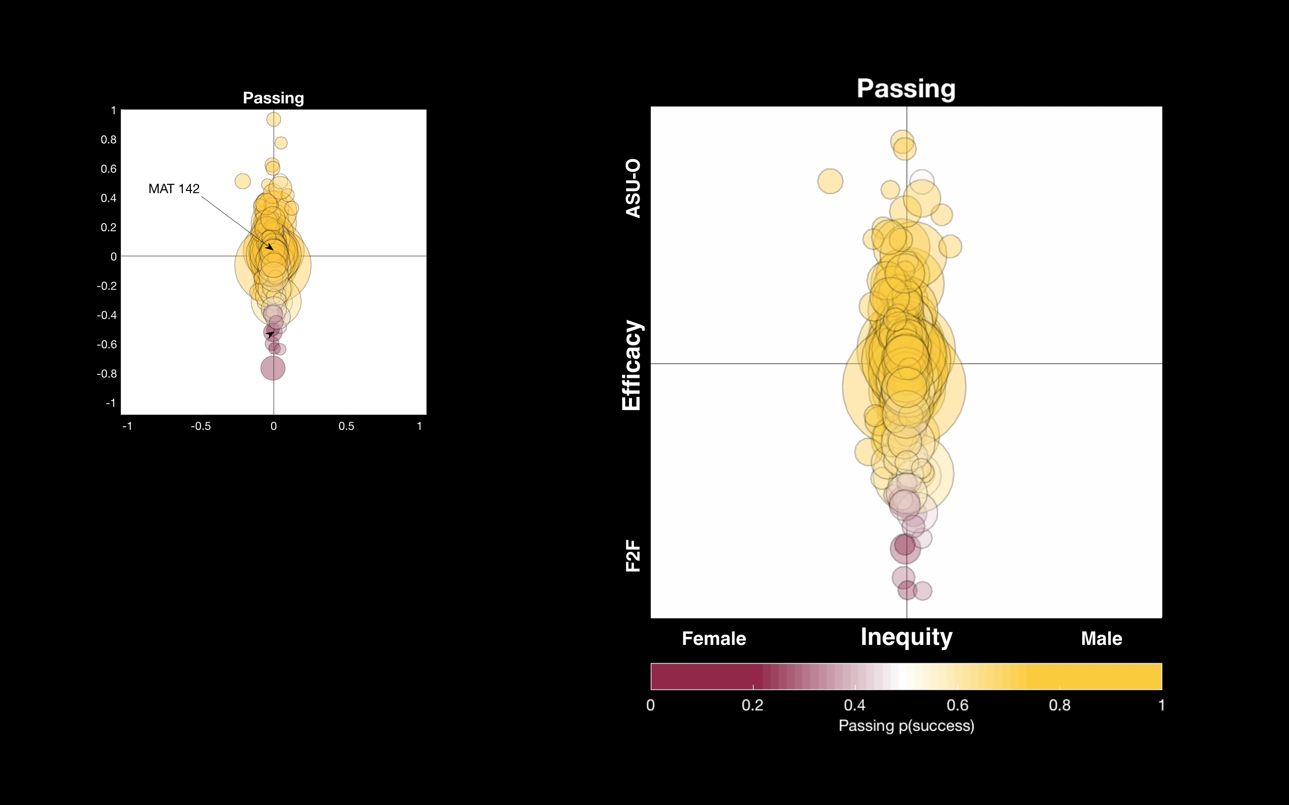

Slide 33
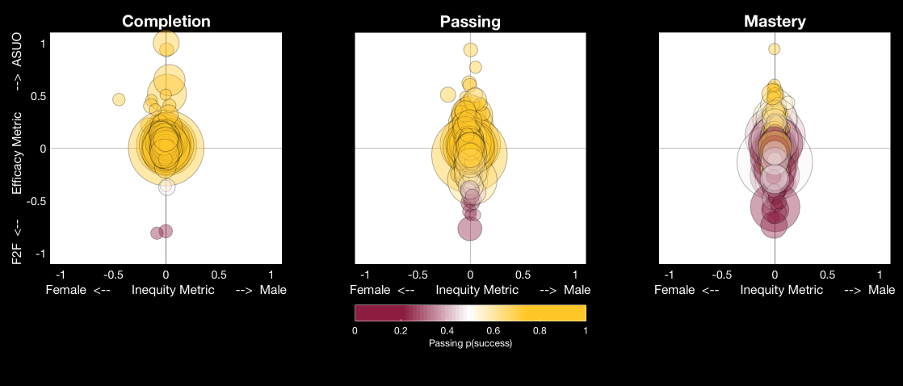
Relative ASU Online Efficacy
Gender
F2F Efficacy ASU-O
Female Inequity Male
ASU-O p(success)

Slide 34
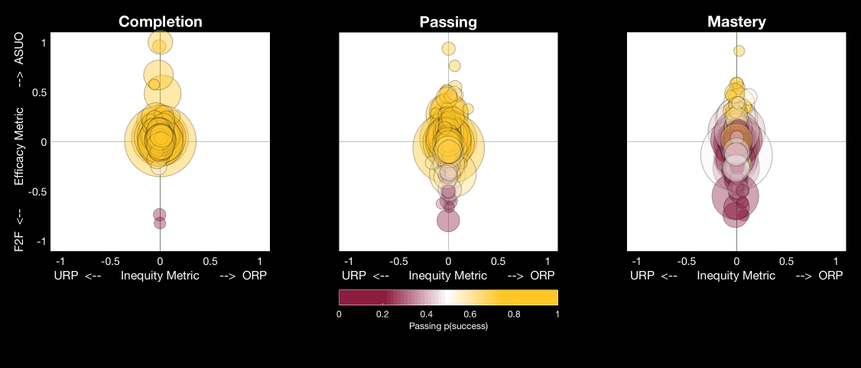
Relative ASU Online Efficacy
Ethnicity
F2F Efficacy ASU-O
URP Inequity ORP
ORP: Over-Represented Populations (white, Asian)
URP: Under-Represented Populations (all others)
ASU-O p(success)

Slide 35
ASU Online Performance
Gender
F2F Efficacy ASU-O
Female Inequity Male

Slide 36
ASU Online Performance
Ethnicity
F2F Efficacy ASU-O
URP Inequity ORP
ORP: Over-Represented Populations (white, Asian)
URP: Under-Represented Populations (all others)

Slide 37
Q&A
Efficacy Methods & Results

Slide 38
Learning Analytics
How well do clickstream LMS data on student behavior and course design elements allow us to predict student success?

Slide 39
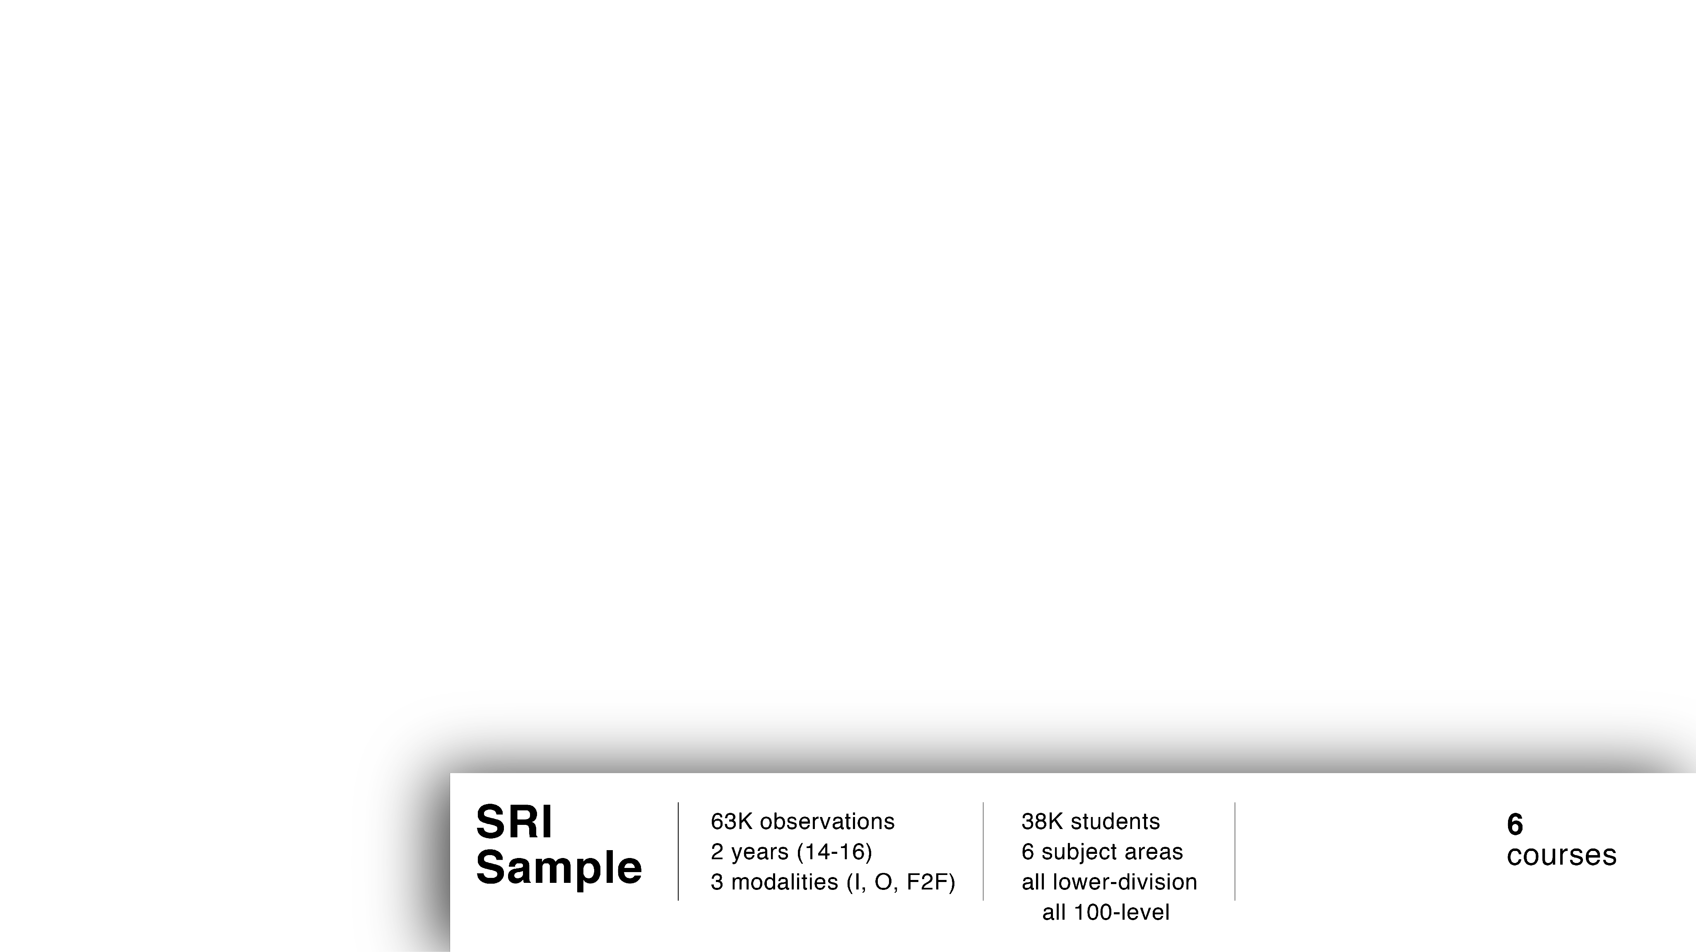
Consistent Time of Day
Activity Clustering
Number of Active Days
Unique Items in First 30 Days
Total Activity in First 30 Days
Learning Analytics
Results
Student Behavior
Course Design:
ASU Online vs iCourse
Syllabus
Discussion Board
Resource
Rubric
Exam Study Tool
Review Quiz
Study Plan
Student Success
Completion
Passing
Mastery
Student Attributes

Slide 40
Student behavior: Completion
Behavior | ENG 102 | MAT 117 | MAT 142 | PSY 101 | SOC 101
Consist TOD
Activity Clustering
Active Days
Unique in 1st 30
Total in 1st 30

Slide 41
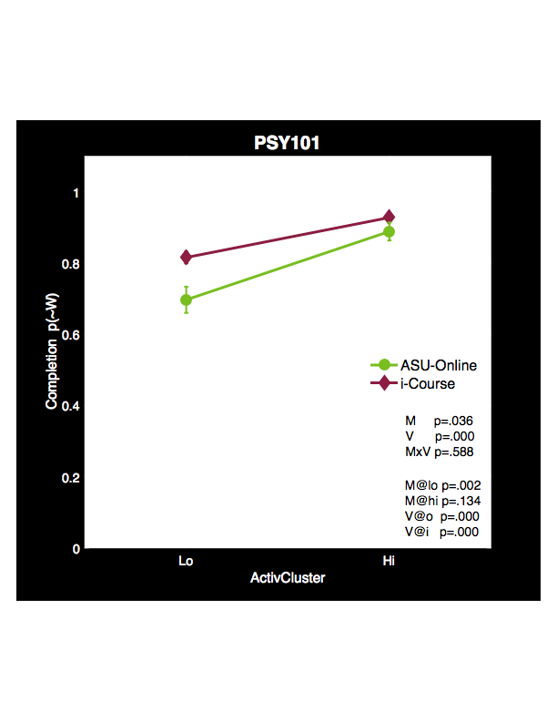
Student behavior: Completion
Behavior | ENG 102 | MAT 117 | MAT 142 | PSY 101 | SOC 101
Consist TOD
Activity Clustering
Active Days
Unique in 1st 30
Total in 1st 30

Slide 42
Course Design Features: MATH Courses
Outcome | MAT 117 | MAT 117 | MAT 117 | MAT 142
Completion
Passing
Mastery
Feature: | Syllabus | Study Plan | Review Quiz | Syllabus

Slide 43
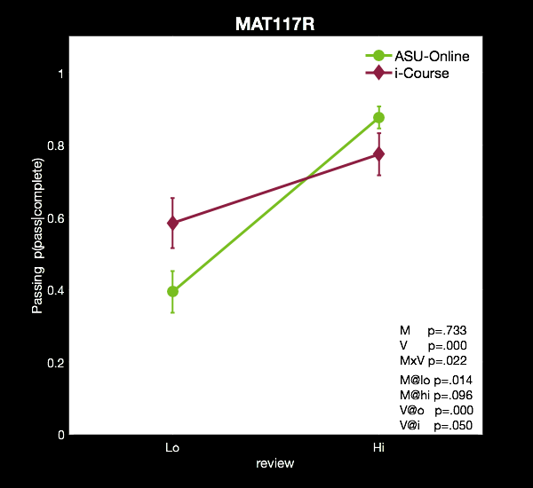
Course Design Features: MATH Courses
Outcome | MAT 117 | MAT 117 | MAT 117 | MAT 142
Completion
Passing
Mastery
Feature: | Syllabus | Study Plan | Review Quiz | Syllabus

Slide 44
Q&A
Learning Analytics Methods & Results

Slide 45
Primary Conclusions
Overall Performance | Gender & Ethnicity | STEM | Learning Analytics
What is the overall effectiveness of ASU’s digital teaching and learning program? | Does digital teaching and learning selectively disadvantage based on gender or ethnicity? What other student characteristics might be important to analyze here? | STEM courses are particularly important for 21st century workforce… Do online programs selectively disadvantage students in these programs? What other course groupings might be important to focus on? | Do deeper analysis of student behavior and course features give us deeper understanding of student success? Are there learning analytics data that give us ability to advance the quality of teaching? (Continuous Improvement Environment)?

Slide 46

Capacity Building
Expanding Learning Analytics at ASU

Slide 47
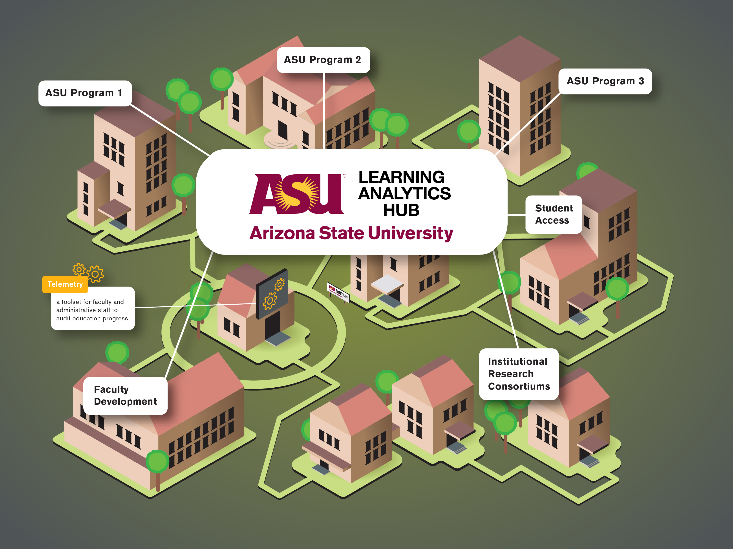

Slide 48


Slide 49


Slide 50
Resources and Additional Information:
  Five Keys to Building a Competitive Online Program White Paper
  Videos around Online Learning
  Pearson, ASU and Starbucks Case Study
  Save the Date
    Executive Leadership Forum – The Networked University: Building Partnerships for Innovation in Higher Education
    September 27-28, 2017 Google Headquarters, NY.

Slide 51
Q&A
?

Slide 52
Today’s Speakers
Tom Fikes, Ph.D.
EdPlus Action Lab, Arizona State University
(tgfikes@asu.edu)
Sanam Raza
Pearson Online
Learning Services
(sanam.raza@pearson.com)
June 28, 2017
52
Presentation Title Arial Bold 7 pt

Slide 53
[Poll] Online Learning Strategy
Would your colleagues / leadership team be open to establishing resources
to collect & analyze student data?
Response options
Would welcome the opportunity to invest in people or technology resources to collect and analyze student data
Would be skeptical of investing resources in people and technology tools to collect this data
Would be open to the idea but would try to make it work with the tools and people resources they have now first.
Other.

