Slide 1
SA&FS Badges

Slide 2
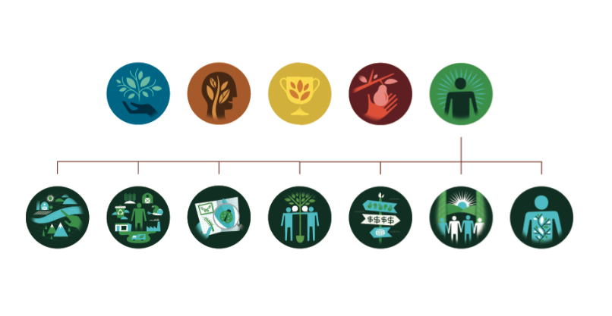
SYSTEM OF BADGES FOR
SUSTAINABLE AGRICULTURE & FOOD SYSTEMS MAJOR
AT UC DAVIS
SKILL
KNOWLEDGE
HONOR
EXPERIENCE
COMPETENCE
Category-level
Badges
Strategic
Management
Systems
Thinking
Experimentation
& Inquiry
Interpersonal
Communication
Understanding
Values
Civic
Engagement
Personal
Development
Badges for the SA&FS Competencies

Slide 3
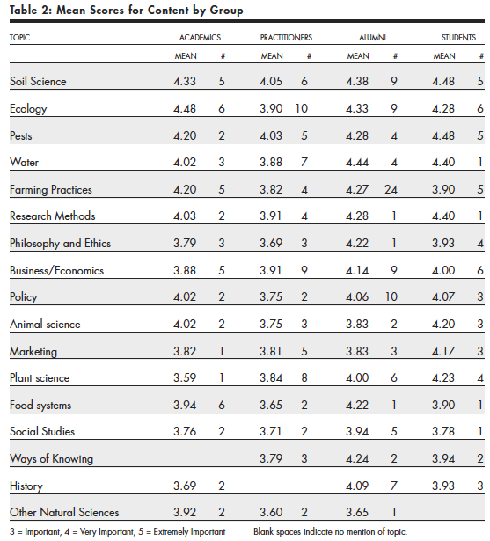
Knowledge
(Content)

Slide 4
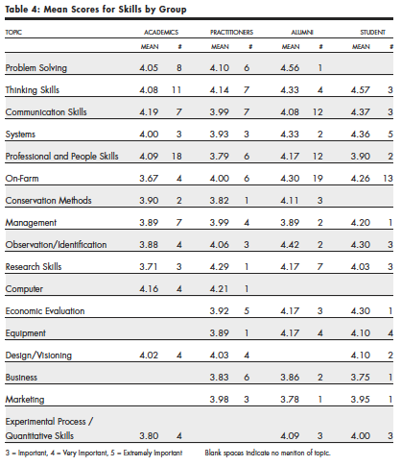
Skill

Slide 5
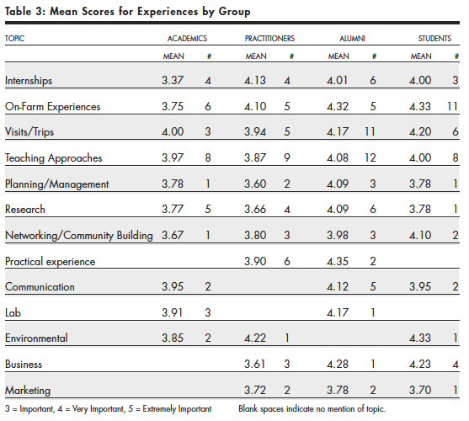
Experience

Slide 6
Competence
A competency is “a combination of skills, abilities, and knowledge needed to perform a specific task” (U.S. Department of Education 2001)

Slide 7
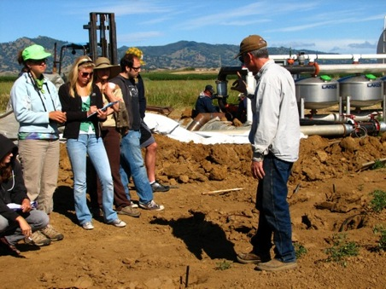
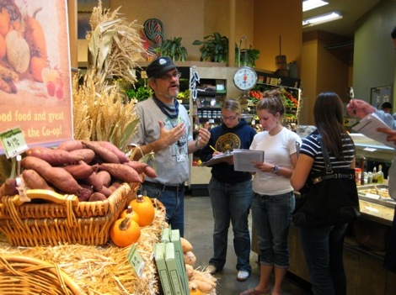
Systems Thinking
Students are competent in the analysis of complex systems, integrating societal, environmental and economic perspectives. Students reflect systems thinking in a deepening understanding of complexity, holistic approaches, and how the parts relate to the whole.¹
Notes:
In Sustainable Agriculture 15, Students create a tool called the Sustainability Scorecard, where they develop criteria for assessing the sustainability of a farm or ranch,
and then apply those criteria during a site visit to a local farm.
In Food Systems 20, students conduct social science research at multiple locations representing different aspects of the food system and in a final evaluation, are asked to tie together their findings from across a wide range of experiences that represent the food system holistically.

Slide 8
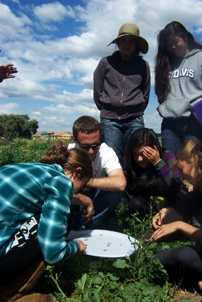
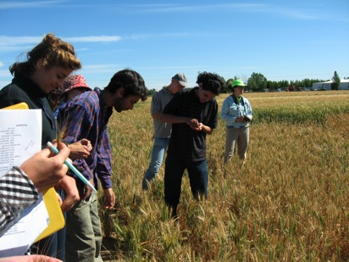
Experimentation and Inquiry
Students formulate questions, investigate current knowledge gaps, develop sound research design, learn current research methods and perspectives, experiment with new approaches to scientific inquiry, and integrate scientific and practical knowledge.²

Slide 9
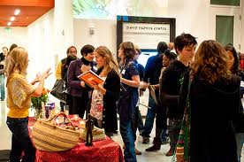
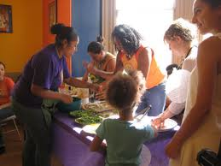
Understanding Values
Students reflect critically on their own values and examine different paradigms and perspectives, seeing beyond objective data to understand how values shape commerce, research, policy and action in sustainable agriculture and food systems.

Slide 10
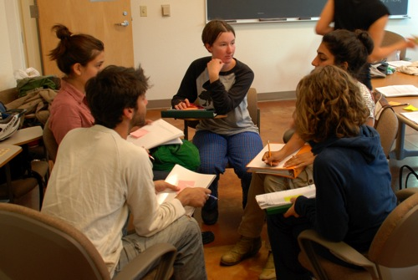
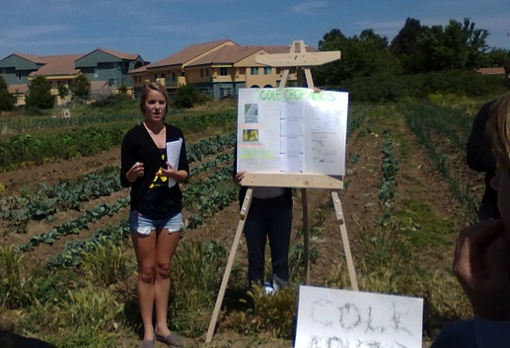
Interpersonal Communication
Students work in collaborative teams, present information for varied contexts and audiences, negotiate approaches and viewpoints and take leadership roles on important issues.

Slide 11
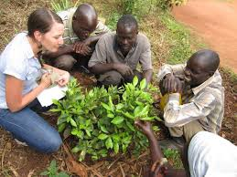
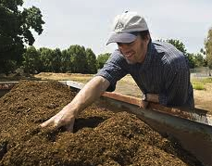
Strategic Management
Students work to collectively design and implement interventions, anticipating future scenarios and adaptively managing information, human and natural resources for maximum impact.³

Slide 12
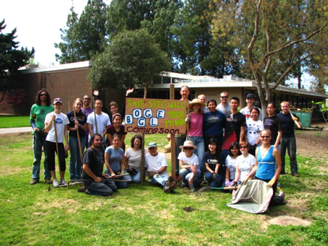
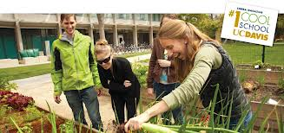
Civic Engagement
Students work to make a difference in the civic life of their communities, through both political and non-political processes. As part of a larger social fabric, students consider social problems to be at least partly their own; make and justify informed judgments; and take action when appropriate.³

Slide 13
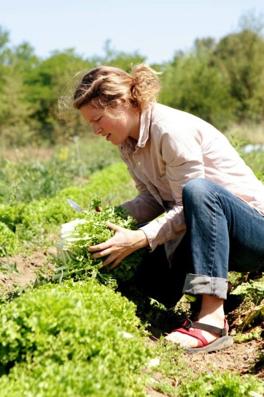
Personal Development
Students seek deeper understanding of their own and thinking and learning processes. They can tolerate ambiguity, respecting those with differing opinions and beliefs, while setting firm standards for behavior and holding themselves and others accountable⁴. Students work to promote open
expression of individuality and diversity
within the bounds of courtesy,
sensitivity and respect⁵.

Slide 14
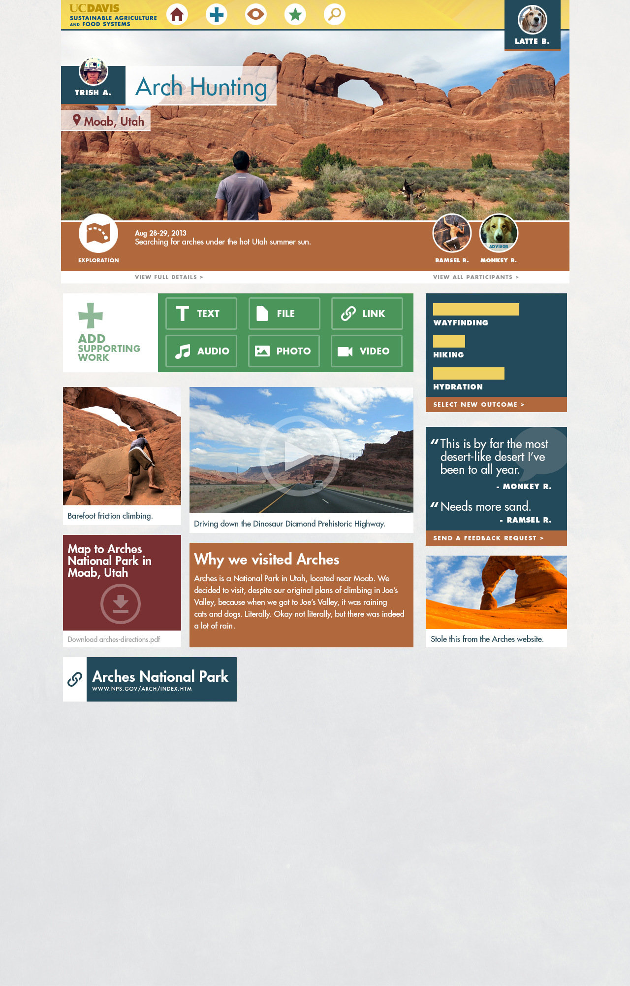

Slide 15
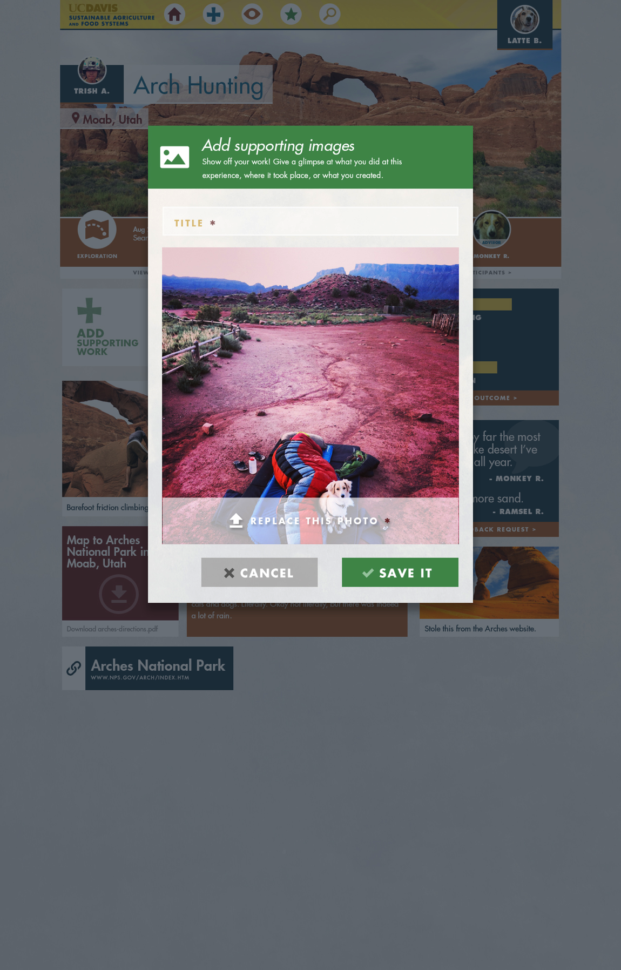

Slide 16
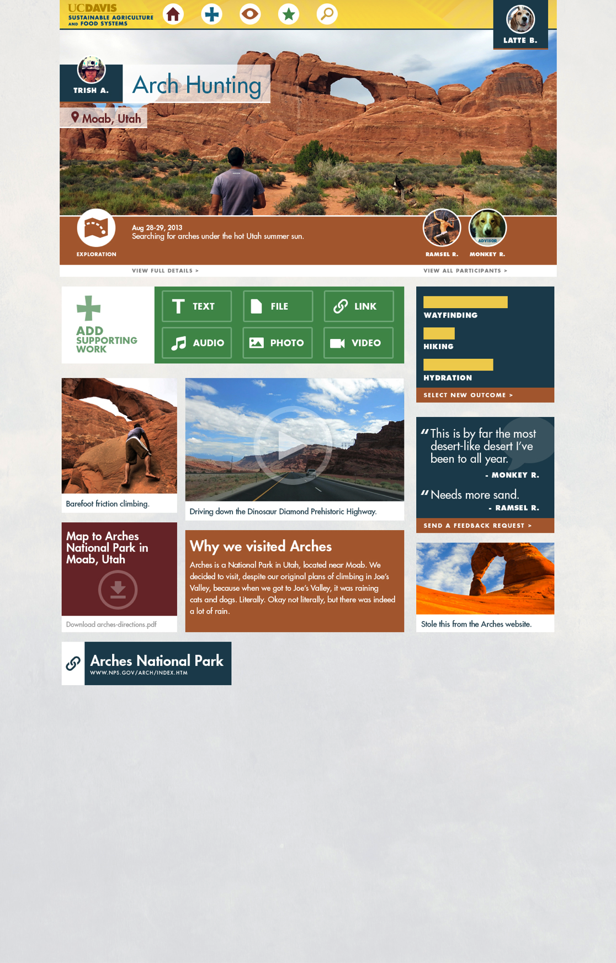

Slide 17
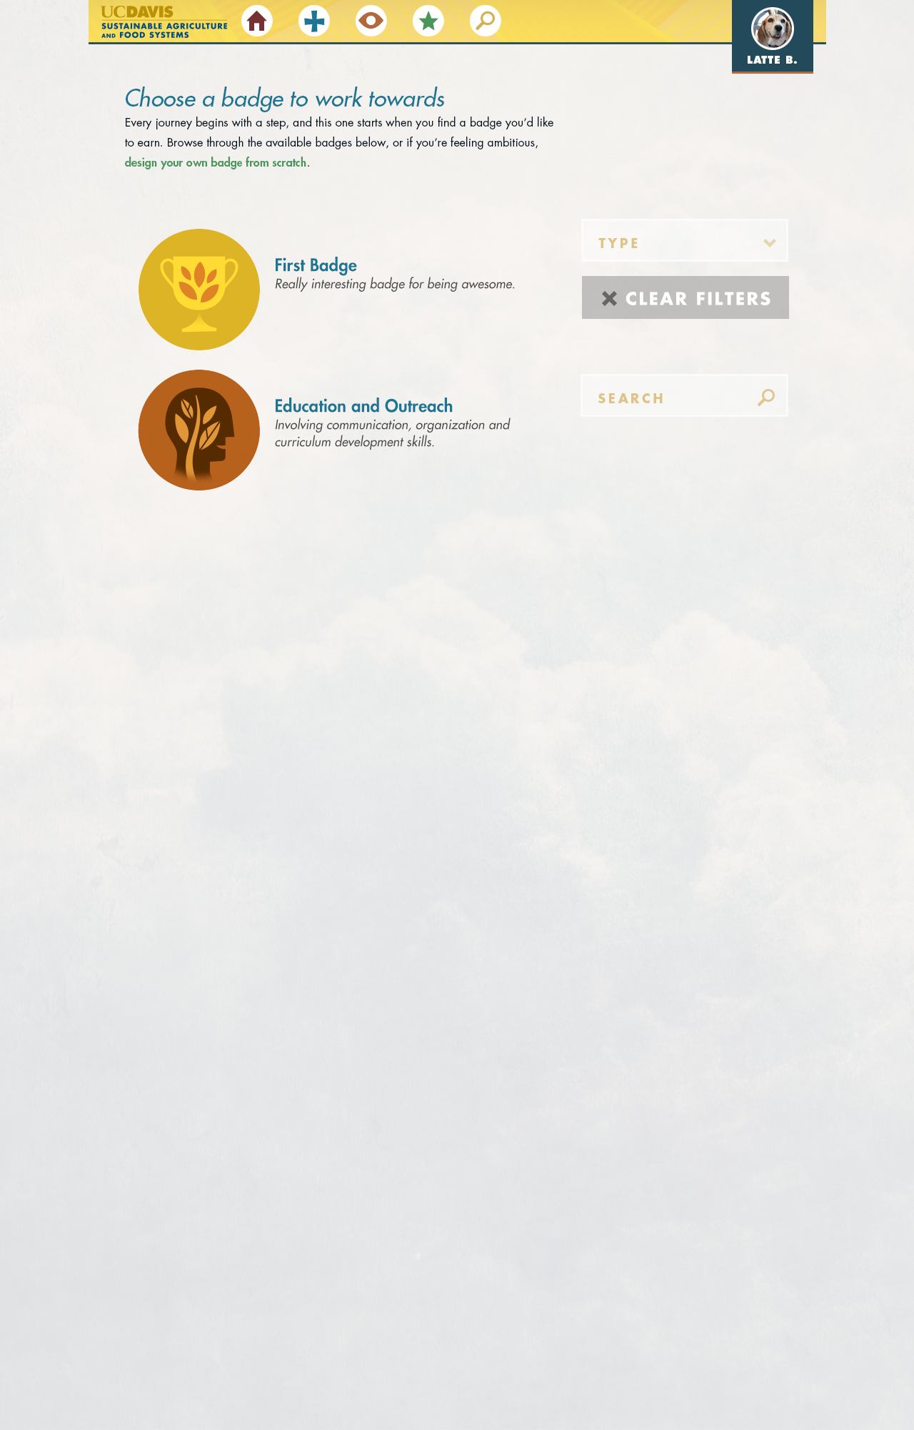

Slide 18
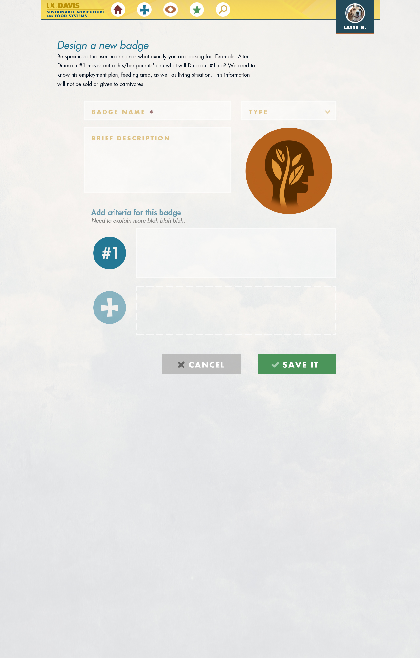
Notes:
Each of the criteria can be satisfied with one or more pieces of evidence. Evidence can be documentation from a portfolio item, the portfolio item itself, or some action from another user within the system, such as moderator approval.
Unique Features:
Students can design new badges, determining their own criteria
These student-defined badges can be made available to all badge earners in the system
Only the SA&FS competency badges have program-defined criteria, all others are faculty and student-created.
In this first version of the system, only faculty and program staff can comment on student work (in addition to the students themselves).
In the future, students will be able to interact with each others profiles and provide peer assessment functions.

Slide 19
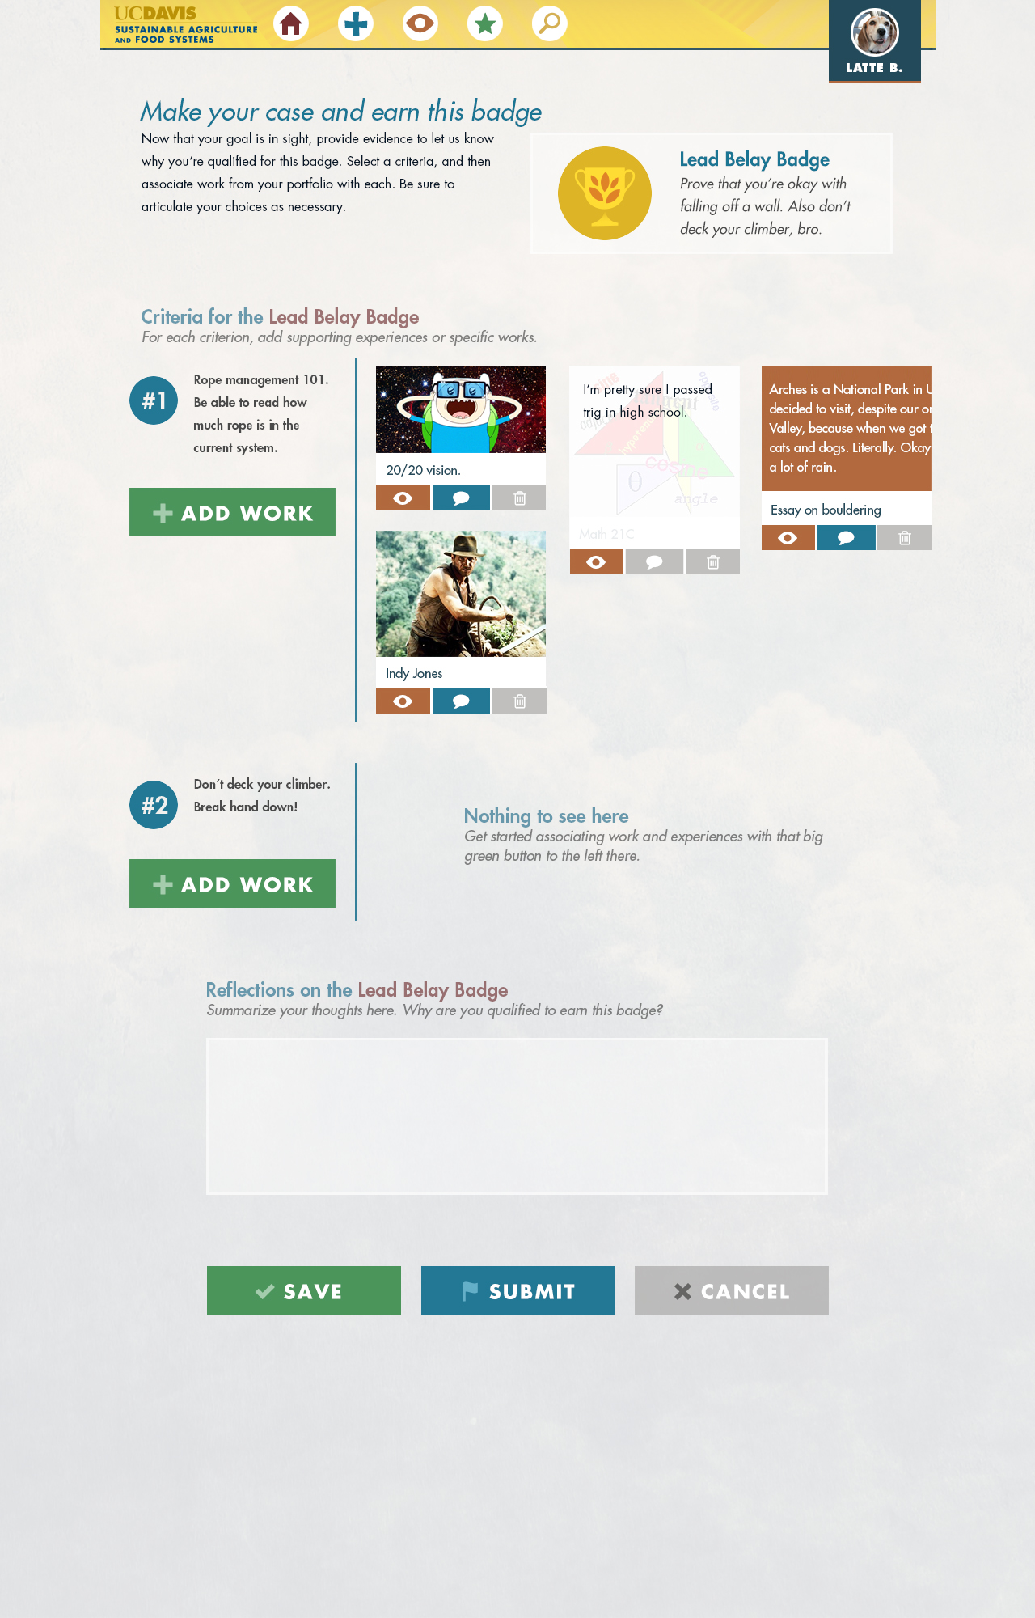

Slide 21
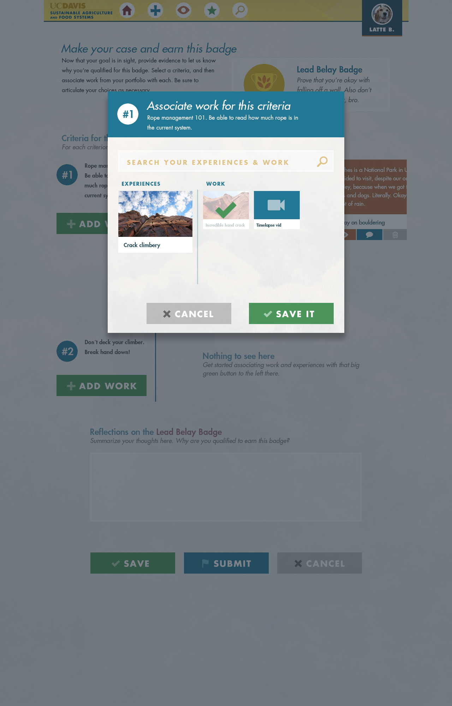
Notes:
Each of the criteria can be satisfied with one or more pieces of evidence. Evidence can be documentation from a portfolio item, the portfolio item itself, or some action from another user within the system, such as moderator approval.

