Slide 1
The 2017 Survey of Community College Presidents
An Inside Higher Ed webinar
Wednesday, May 10, at 2 p.m. Eastern

Slide 2
Presenters
Scott Jaschik, editor, Inside Higher Ed
scott.jaschik@insidehighered.com
Paul Fain, news editor, Inside Higher Ed
paul.fain@insidehighered.com

Slide 3
Methodology
Questions drafted by Inside Higher Ed editors in collaboration with Gallup researchers.
Gallup conducted the polling.
Responses included from 236 presidents or chancellors of community colleges.
Complete anonymity for those responding.

Slide 4
Enrollment Compared to Three Years Ago

Slide 5
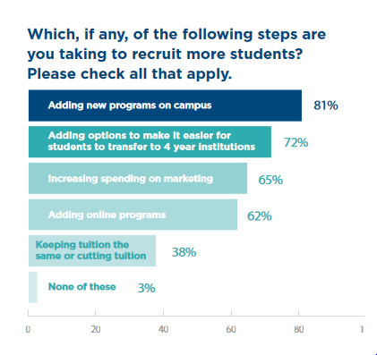
Strategies to Attract Students

Slide 6
Strategies, by Enrollment Trends

Slide 7
The Unemployed Worker in the Midwest

Slide 8
The Top Challenges

Slide 9
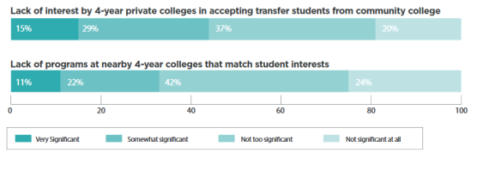
Barriers to Transfer

Slide 10
The Future of Free

Slide 11
But Might There Be a New York Impact?

Slide 12
Future of the Community College Presidency

Slide 13
Your Questions
Q&A.
Suggestions for future coverage.

Slide 14
With Thanks

