Slide 1
Higher Ed Economics: Beyond Tuition
An Inside Higher Ed webinar
Thursday, March 16 at 2 p.m. Eastern

Slide 2
Presenters
Scott Jaschik, editor, Inside Higher Ed, scott.jaschik@insidehighered.com
Doug Lederman, editor, Inside Higher Ed, doug.lederman@insidehighered.com

Slide 3
Beyond the Obvious Drivers of Higher Ed Economics
Tuition
State appropriations
Endowment income
Gifts

Slide 4
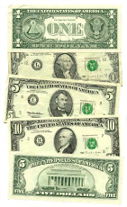
Every Dollar Counts
Wealthy private colleges and flagship publics are not the institutions that enroll most students.
Most private colleges are tuition-dependent, and need cost savings to minimize tuition increases.
Many public colleges don’t receive the funds they need to pay for enrollment levels.

Slide 5
How to Count/How to Measure

Slide 6
Credit Cards – Campus Agreements

Slide 7
Using Credit Cards to Pay for College
CreditCards.com survey:
--85% of largest public and private colleges accept payments with credit cards.
--Average “convenience fee” is 2.62%.
--Substantial majorities of four-year colleges charge convenience fees, but only 8% of community colleges do so.

Slide 8
Growing Facilities Backlogs

Slide 9
Paying for Carbon Neutrality

Slide 10
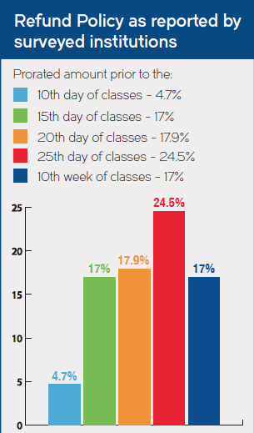
Tuition Insurance
Many institutions aren’t sure if students know refund policies.
45% of institutions are seeing growing number of medical withdrawals.

Slide 11
Intellectual Property

Slide 12
Taxes and Town/Gown

Slide 13
Retention and Completion

Slide 14
Your Questions
Q&A
Ideas for coverage

Slide 15
With Thanks

