Slide 1
Challenges in Enrollment
An Inside Higher Ed webinar
Thursday, June 8
2 p.m. Eastern

Slide 2
Presenters
Scott Jaschik, editor, Inside Higher Ed, scott.jaschik@insidehighered.com
Doug Lederman, editor, Inside Higher Ed, doug.lederman@insidehighered.com

Slide 3
Agenda
Overview
Issues that cross sectors
Public higher education
Private higher education
Q&A

Slide 4
Falling Numbers of Students

Slide 5
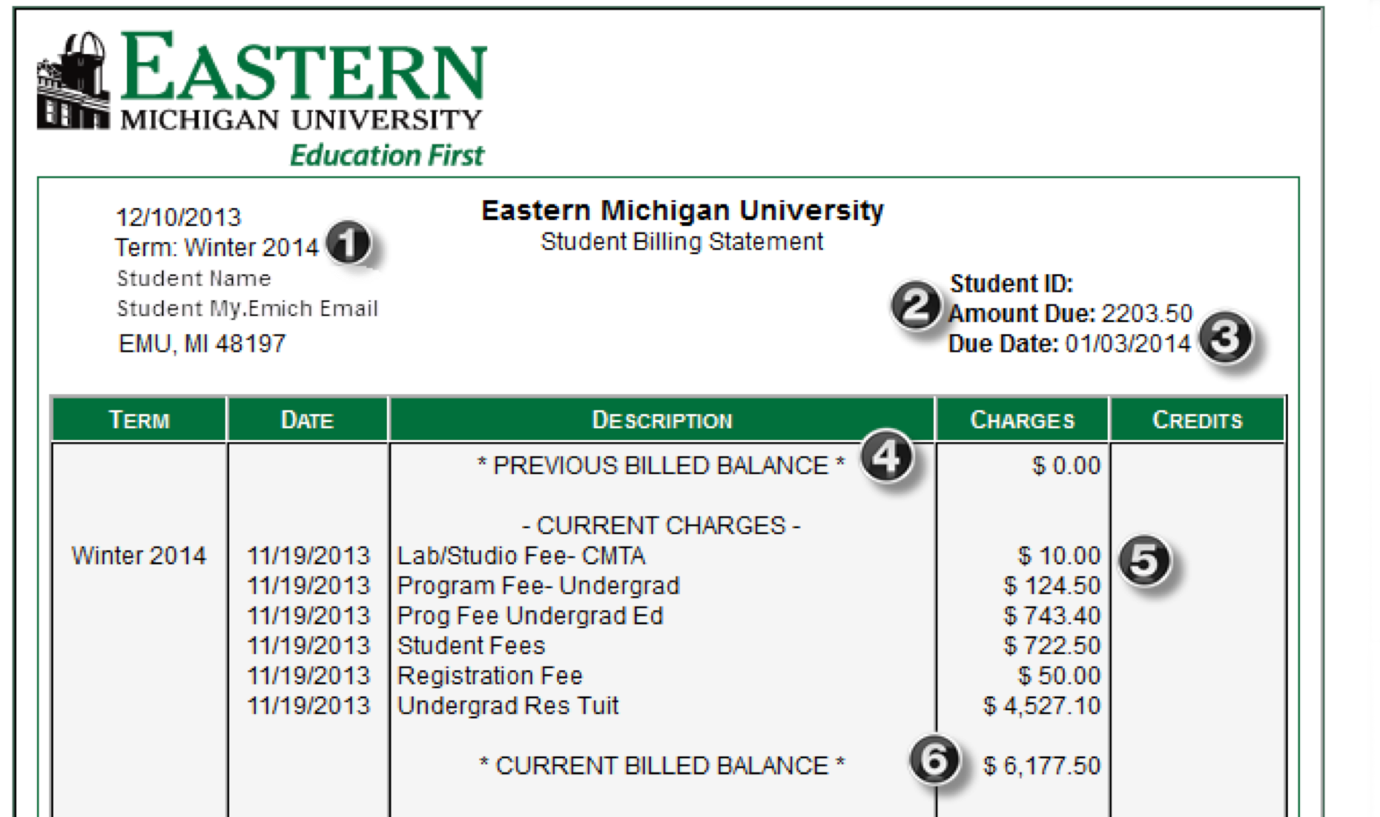
Everyone Is Tuition Dependent
The 1 percenters – public and private
The vast majority of publics
The vast majority of privates

Slide 6
Debt Perceptions and Realities
Fear of debt has impact on where students apply and where students enroll.
Many students and families lack basic understanding of debt.
A disconnect is growing between college officials and the public on how much debt is reasonable.

Slide 7
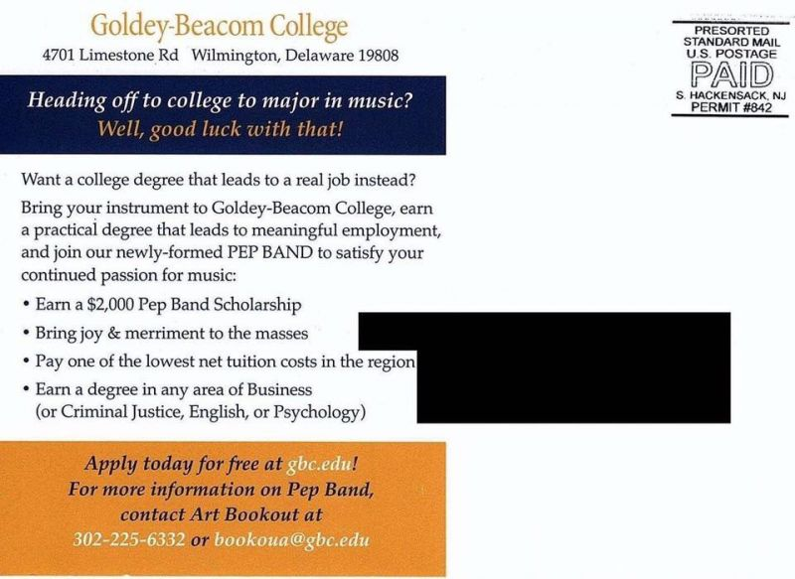
ROI Perceptions and Realities

Slide 8
Online Growth May Be Ending

Slide 9
International

Slide 10
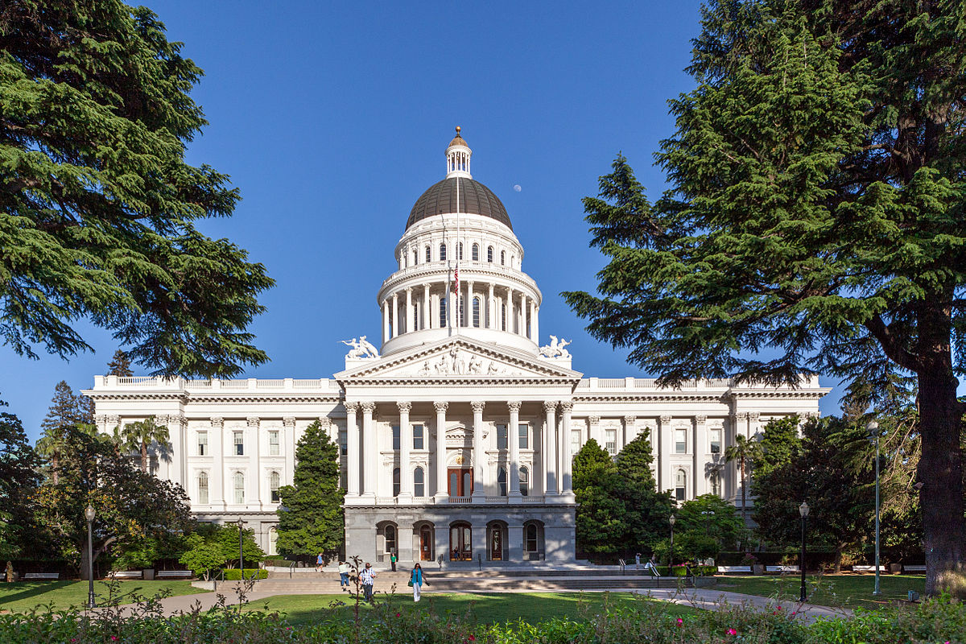
Public I: Statehouse Uncertainties

Slide 11
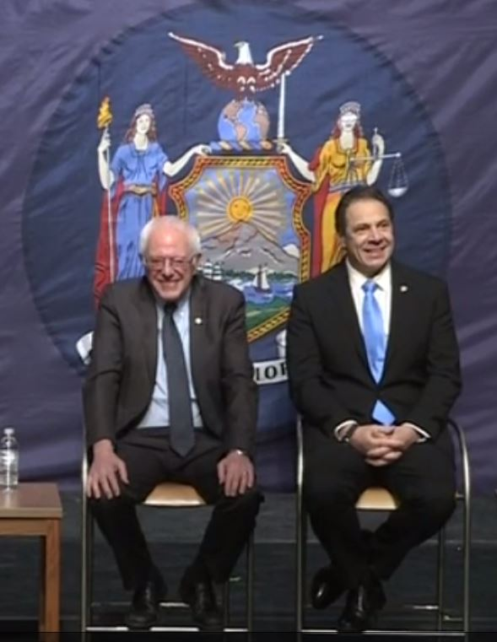
Public II: Free Tuition
Note: Another slide will address issue from private college perspective.

Slide 12
Public III: Out-of-State Creativity

Slide 13
Public IV: Out-of-State Questions
Political backlash
Too many institutions with same policy?
Mission of public higher education

Slide 14
Public V: Which Students?
Flagships vs. non-flagships
Geography within a state
Diversity within a state

Slide 15
Public VI: The Kentucky Strategy

Slide 16
Private I: Discount Rates

Slide 17
Private II: Free Tuition
Why many are concerned
The impact beyond New York State
Shifts in tenor of public policy

Slide 18
Private III: Liberal Arts Angst

Slide 19
Private IV: The Drew Example

Slide 20
Private V: The Mills Example

Slide 21
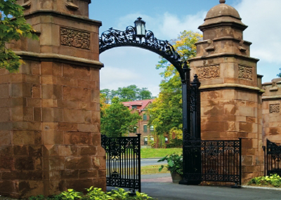
Private VI: Transfers
Why private colleges are paying attention
Success stories
What’s needed to make it work

Slide 22
Private VII: Diversity

Slide 23
New From Inside Higher Ed: Admissions Insider

Slide 24
Questions and Discussion

Slide 25
With Thanks…

