Slide 1

Making the Cut:
Getting Hired for Academic Positions
An Inside Higher Ed webinar
Thursday, March 30 at 2 p.m. Eastern

Slide 2

Presenters
Scott Jaschik, editor, Inside Higher Ed, scott.jaschik@insidehighered.com
Doug Lederman, editor, Inside Higher Ed, doug.lederman@insidehighered.com

Slide 3

Skill, Luck and Perspective

Slide 4
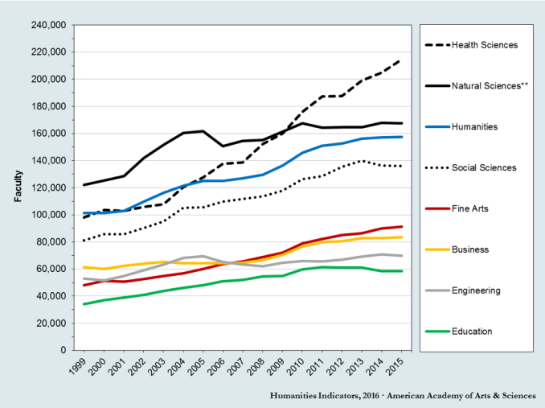
Current Trends

Slide 5
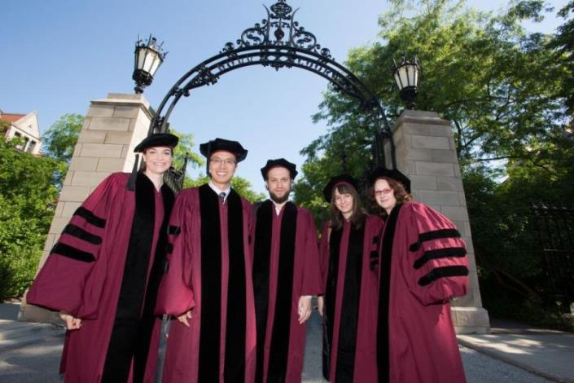
Shifting Out of Ph.D. Student Perspective

Slide 6
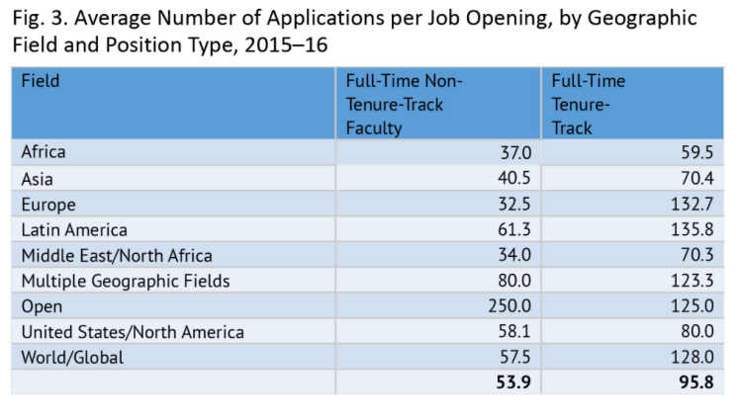
Specializations Matter:
History as an Example

Slide 7
Thinking About Search Committee Members
Panels have multiple people with multiple priorities.
You can’t know too much about their backgrounds.
May or may not be agreement on the position.
Many departments fight the last battle again.
The compromise candidate may make the cut.
Listen to the gossip, but don’t trust it.

Slide 8
Diversity
The desire of many colleges and departments to diversify is real.
The meaning of diversity varies by sector, location, discipline and more.
When search committee members talk about diversity, it may be race and ethnicity, or many other factors as well.
Minority candidates still face stereotypical and other unfair expectations.
White men are still being hired for many positions.

Slide 9

Dual Career
When should you flag the issue?
What should your expectations be?
What are common errors?

Slide 10
Community College Jobs
The opportunity
The career path
Why search committees may be skeptical
Approaches that may work

Slide 11
Teaching Online
Institutions that are largely or entirely online
Traditional institutions looking to do more online

Slide 12

Liberal Arts Colleges and Other Teaching-Oriented Institutions

Slide 13
Being a Rain-Maker
Landing grants
Managing grants
Managing budgets
Challenges outside the sciences

Slide 14
Plan Bs and Not Plan B
Adjunct jobs
Postdocs
Alt-ac jobs
Non-academic jobs

Slide 15
Resources
Job alerts by discipline and geography: https://careers.insidehighered.com/newalert/
Diversity Matters news and job listings: https://www.insidehighered.com/content/subscribe-diversity-matters
Job listings in higher education: https://careers.insidehighered.com/
Advice on academic careers: https://www.insidehighered.com/advice?utm_source=ihe&utm_medium=careers-site&utm_content=header-link

Slide 16
Your Questions
Q&A

