Slide 1
The OER Moment
An Inside Higher Ed webcast
Tuesday, July 18
2 p.m. Eastern

Slide 2
Presenters
Scott Jaschik, editor, Inside Higher Ed, scott.jaschik@insidehighered.com
Doug Lederman, editor, Inside Higher Ed, doug.lederman@insidehighered.com

Slide 3

What Is OER?
Basic definitions
Add-on definitions

Slide 4
Why Now? Philosophy
The philosophical case
The pragmatic case

Slide 5
Why Now? Textbook Issues
Cost
Faculty choices
Customization

Slide 6
Why Now? Resources
Vetting
Permissions
Curriculum
Plus you can still be a solo operator.

Slide 7
Why Now? State Initiatives

Slide 8
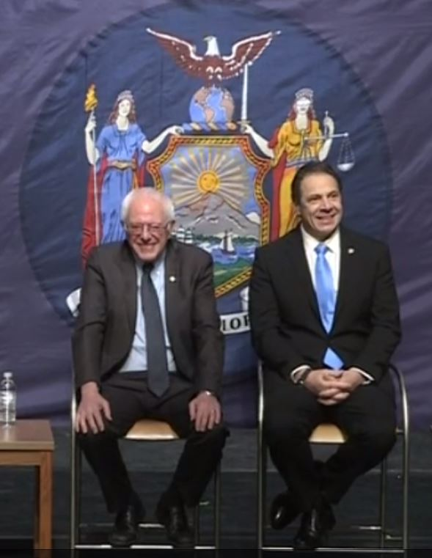
Link to Free Tuition Movement

Slide 9
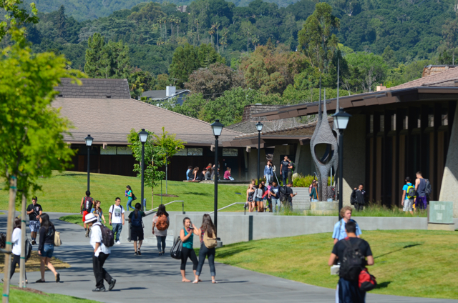
Community Colleges
Student body
Proportional costs
Importance of key fields

Slide 10

Case Study: Lynn University

Slide 11
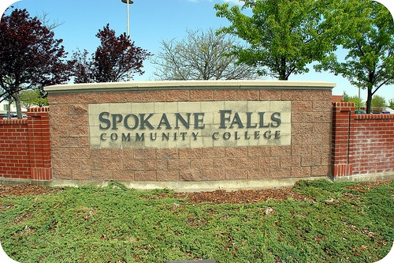
Case Study:
Community Colleges of Spokane

Slide 12
The Fight at Fullerton
Who makes choices?
Conflicts of interest
Single choice for multi-section courses

Slide 13
Faculty Attitudes / Actions
From “Going Digital,” Independent College Bookstore Association, 2015

Slide 14
Faculty Attitudes / Actions
From Babson Survey Research Group

Slide 15
Q&A
Your questions
Suggestions for future coverage

Slide 16

With Thanks …

