Slide 1
New Directions in Online Education
An Inside Higher Ed webcast
Thursday, September 7, 2 p.m. Eastern

Slide 2
Presenters
Scott Jaschik, editor, Inside Higher Ed, scott.jaschik@insidehighered.com
Doug Lederman, editor, Inside Higher Ed, doug.lederman@insidehighered.com

Slide 3
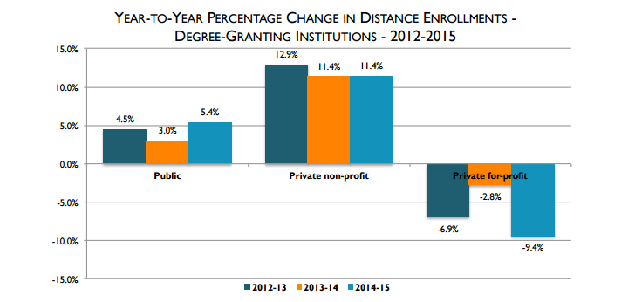
Enrollment Trends - I
--From Digital Learning Compass

Slide 4
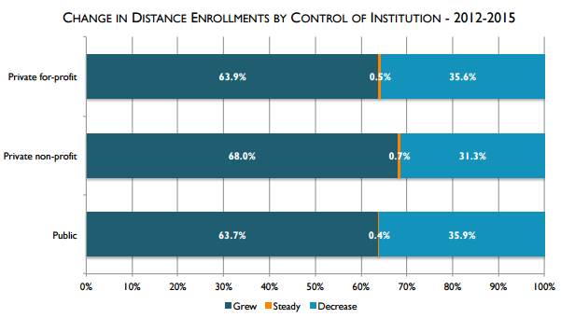
Enrollment Trends - II
--From Digital Learning Compass

Slide 5
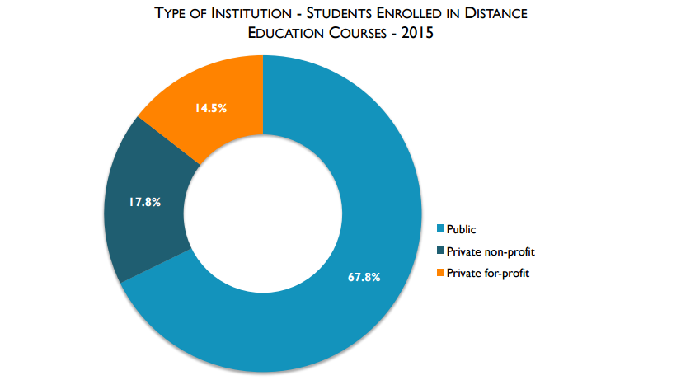
Enrollment Trends - III
--From Digital Learning Compass

Slide 6
Enrollment This Year (Early)
Many institutions report flat enrollments or modest increases.
Professional and specialized programs appear to be gaining more than are other programs.
Trends have significance for other colleges.

Slide 7
The Post-MOOC Era

Slide 8
Potential to Help Liberal Arts Colleges

Slide 9
Personalized Learning
Advances in technology
Moving online learning from mass education to individualized education (in some cases keeping the mass)
Specialized programs and small parts of traditional online

Slide 10
Test Before You Buy
Impact of criticism of for-profits and borrowing
Appeal to those who are experimenting with online
Help for those without experience learning online

Slide 11
Disability

Slide 12
At-Risk Students
Studies that point to challenges
Tools and programs that can help at-risk students
The role of support services

Slide 13
Effective Teaching Online
What the research says
Teaching instructors how to teach online

Slide 14
Rewards and Incentives
For creating courses
For learning how to teach
For those on tenure track

Slide 15
Inside Digital Learning

Slide 16
Q&A
Your questions
Suggestions for future coverage

Slide 17
With Thanks …

