Slide 1
Teaching Today’s Students
An Inside Higher Ed webcast
August 29 at 2 p.m. Eastern

Slide 2
Presenters
Scott Jaschik, editor, Inside Higher Ed, scott.jaschik@insidehighered.com
Doug Lederman, editor, Inside Higher Ed, doug.lederman@insidehighered.com

Slide 3
Why Teaching Matters
A central purpose of higher education
The greater importance of retention – from educational and financial perspectives

Slide 4
Challenges/Opportunities Today
Wide variation on college preparedness
Shifting generational expectations
Digital tools encouraged by educators
Digital tools discouraged by educators

Slide 5
The Flipped Classroom
--From University of Washington

Slide 6
The Laptop-in-Class Debate
--Getty Images

Slide 7
Smartphones and Other Devices
--Getty Images

Slide 8
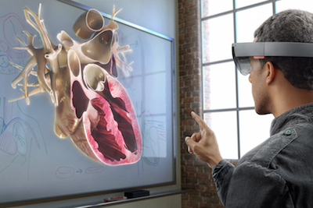
Virtual Reality

Slide 9
Active Learning (Beyond Tech)

Slide 10
The Syllabus
More than a list of assignments
Setting expectations
Too legalistic or not legalistic enough?

Slide 11
Academic Integrity

Slide 12
Evolving Ideas on Remediation
Traditional model
Why it wasn’t working
Approaches gaining ground

Slide 13
Students With Disabilities

Slide 14
Promoting a Love of Learning
--Getty Images

Slide 15
Grading

Slide 16
Difficult Discussions
--Getty Images

Slide 17
Training and Support (or Lack of)
In doctoral programs
For new faculty members
In tenure and promotion process

Slide 18
With Thanks …

Slide 19
Q&A
Your questions
Suggestions for future coverage

