Slide 1
New Student Demographics: Recruiting, Retaining and Graduating a Diverse Student Body
An Inside Higher Ed webcast
Tuesday, June 27
2 p.m. Eastern

Slide 2
Presenters
Scott Jaschik, editor, Inside Higher Ed scott.jaschik@insidehighered.com
Doug Lederman, editor, Inside Higher Ed doug.lederman@insidehighered.com

Slide 3
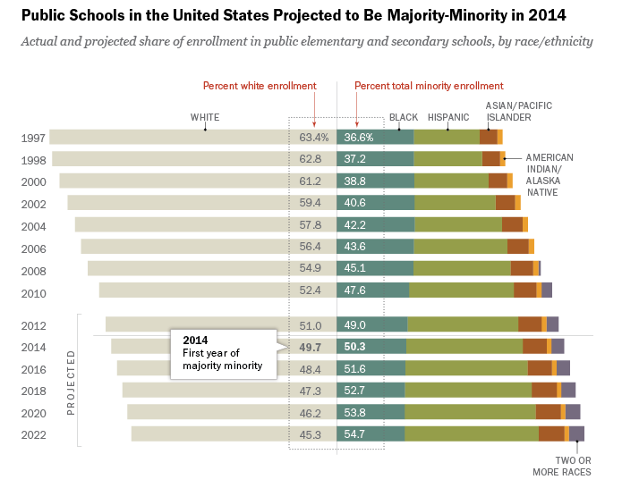
High School Demographics
--Pew Research Center

Slide 4
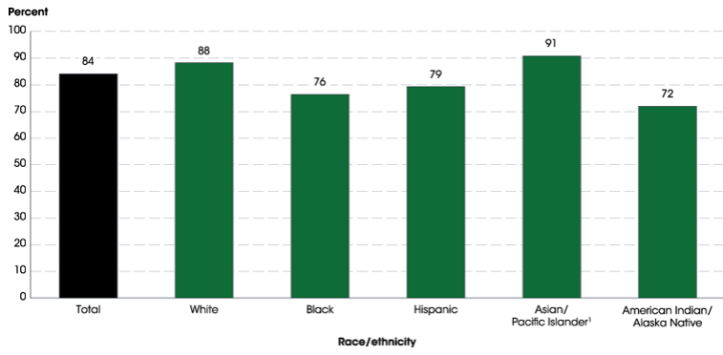
High School Graduation Rates
--National Center for Education Statistics

Slide 5
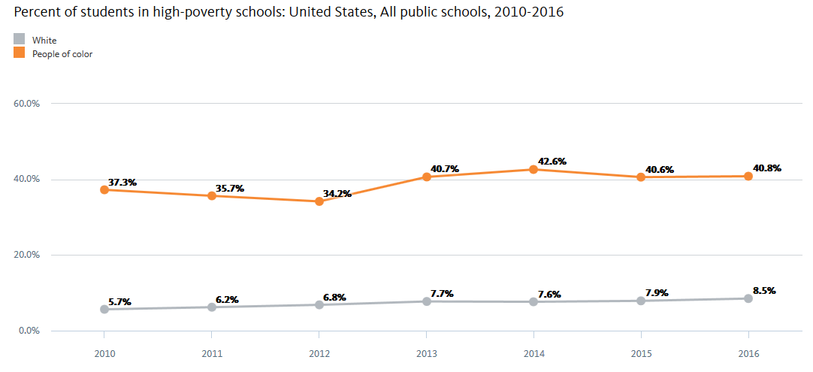
Public Schools, Race and Poverty
--National Equity Atlas, University of Southern California

Slide 6
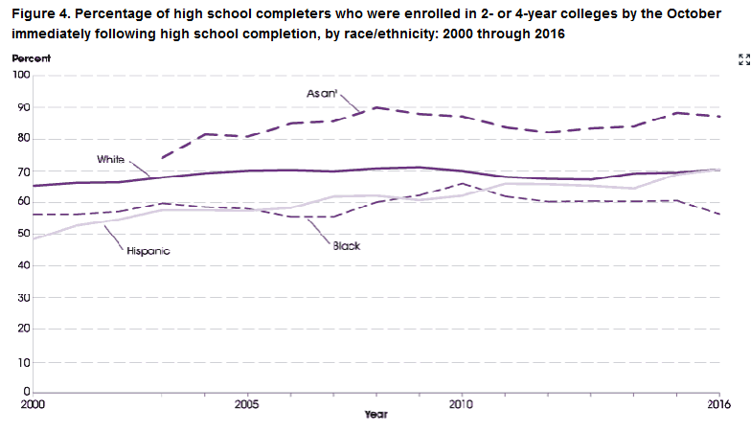
From High School to College
--National Center for Education Statistics

Slide 7
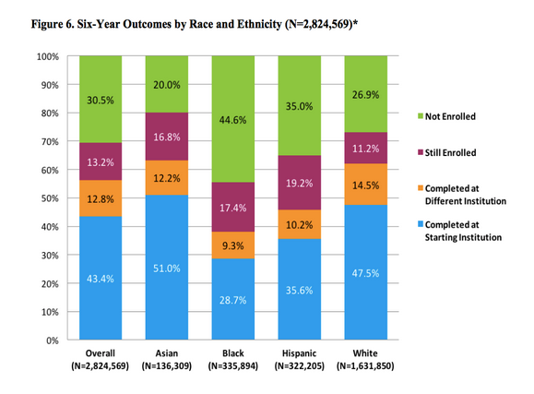
College Outcomes
--National Student Clearinghouse

Slide 8
Different Groups, Different Issues
--Excelencia in Education!

Slide 9
And Don’t Forget …
Adult students
Immigrant students
International students
Online students
Veterans

Slide 10
Myths About Affirmative Action in Admissions
Everyone does it.
Because relatively few colleges practice it, it doesn’t matter.
Eliminating affirmative action in some states hasn’t had a major impact.
Asian-Americans are all wealthy.
Preferences in admissions in the U.S. never benefit white people.

Slide 11
The Harvard Case

Slide 12
Where Colleges Recruit

Slide 13
Test-Optional Admissions

Slide 14
Ending Application Fees

Slide 15
Outreach for First Gen Students

Slide 16
Academic Advising

Slide 17
Free Tuition

Slide 18
Benefits of Full-Time Enrollment
What the research says
Successes of many colleges
Why it may not help everyone

Slide 19
Financial Aid
Why loans aren’t all bad
Why some loans are bad
Defaults

Slide 20
Moving to Meet Full Need

Slide 21
The Community College Role
Promoting transfer
Creating pathways
Transfer credit
Support services

Slide 22
Academic Support
Placement
Remediation
Tutoring services
Support for online learning

Slide 23
Campus Climate

Slide 24
The Full Experience
Internships
Student abroad
Student life

Slide 25
Emphasis on Graduation
Talking about getting done in four
The role of cohorts
Seeking family support
Policies to encourage that

Slide 26
Q&A
Your questions
Ideas for coverage

Slide 27
With Thanks …

