Slide 1
Making Higher Education More Efficient and Effective
An Inside Higher Ed webcast
Thursday, March 22
2 p.m. Eastern

Slide 2
Presenters
Scott Jaschik, editor, Inside Higher Ed, scott.jaschik@insidehighered.com
Doug Lederman, editor, Inside Higher Ed, doug.lederman@insidehighered.com

Slide 3
Introduction
What is efficient?
What is effective?
What about mission?
What about resources?
Who decides?
--Getty Images

Slide 4
The Centrality of Data
--Getty Images

Slide 5
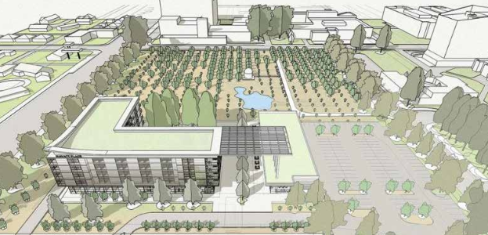
Partnerships

Slide 6
Vendor Relationships

Slide 7
Mergers
--iStock

Slide 8
Finding the Right Size (Growth or Shrinkage)
--iStock

Slide 9
Creating the Right Physical Spaces

Slide 10
Processes

Slide 11
Student Success: Entry

Slide 12
Student Success: Instruction

Slide 13
Student Success: Completion

Slide 14
Q&A
Your questions
Suggestions for future coverage

Slide 15
With Thanks …

