Slide 1
Flipping the Classroom and Other Techniques to Improve Teaching
An Inside Higher Ed webcast
Thursday, December 7
2 p.m. Eastern

Slide 2
Presenters
Scott Jaschik, editor, Inside Higher Ed, scott.jaschik@insidehighered.com
Doug Lederman, editor, Inside Higher Ed, doug.lederman@insidehighered.com

Slide 3
The Big Picture
It’s ultimately about teaching and learning.
“Flipping” gets all the attention, but doesn’t always mean the same thing.
Student success – particularly with students who might not be likely to succeed – is key.
Measuring performance matters.

Slide 4
Flipping the Classroom
The basic definitions
Ideas more than a checklist
--Illustration from University of Washington

Slide 5
An Experiment at CUNY
The challenge of low passing rates in chemistry course
A course redesign
Impressive results

Slide 6
A Professor Finds Mixed Results

Slide 7
Has the Idea Lost Meaning?

Slide 8
The Debate Over Harvard’s CS50

Slide 9
Michigan State Robot Experiment

Slide 10
The Great (and Not So Great) Debate on Laptops in Class

Slide 11
Keeping Student Attention

Slide 12
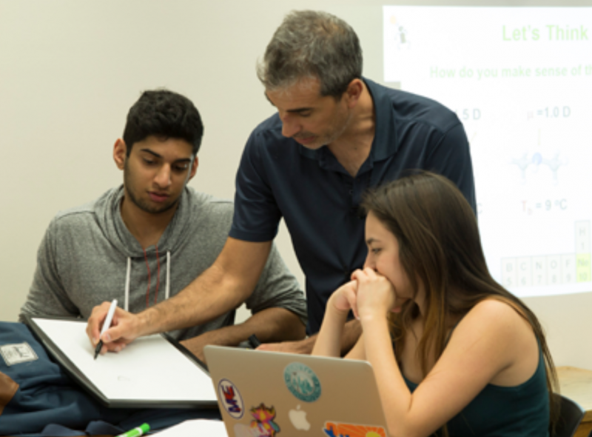
‘New Normal’ for STEM Teaching
--University of Arizona

Slide 13
Breaking Out of M-W-F Routine
--Coker College

Slide 14
Class Size Matters

Slide 15
Obstacles to Teaching Innovation
Reward structures
Disinclination to change
Lack of training
Fear of looking stupid

Slide 16
Q&A
Your questions
Ideas for future coverage

Slide 17
With Thanks …

