Slide 1
Promoting Student Success
An Inside Higher Ed webcast
Tuesday, June 5
2 p.m. Eastern

Slide 2
Presenter
Scott Jaschik, editor, Inside Higher Ed scott.jaschik@insidehighered.com

Slide 3
The Easy Way (to Not Make a Difference)
Recruit only top students.
Assume all students are alike.
Use simplistic measures.

Slide 4
Interconnectedness
--Dan Leap / iStock

Slide 5
Undermatching: Still a Problem
--iStock

Slide 6
Where Colleges Recruit
Colleges prioritize high schools where average family income in the neighborhood served is in excess of $100,000.
Visits to out-of-state high schools by public universities are to those that serve neighborhoods wealthy families.
The high schools visited almost always have a majority of white students.
--The Off-Campus Recruiting Research Project

Slide 7
The Appeal (and Limits) of Free

Slide 8
Texts to Prevent Summer Melt

Slide 9
Multiple Measures for Placement

Slide 10
Rethinking Remediation
Simultaneous with college-level courses
Short modules
Reaching students in high school
Using technology (adaptive and other approaches)

Slide 11
Closing Gaps in San Francisco

Slide 12
Pushing for Graduation in Four

Slide 13
Focus on Academic Advising
Why it matters
Why it matters most to disadvantaged students
Why many colleges ignore the need
Choices for colleges

Slide 14
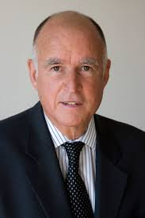
Chipotle as a Model?

Slide 15
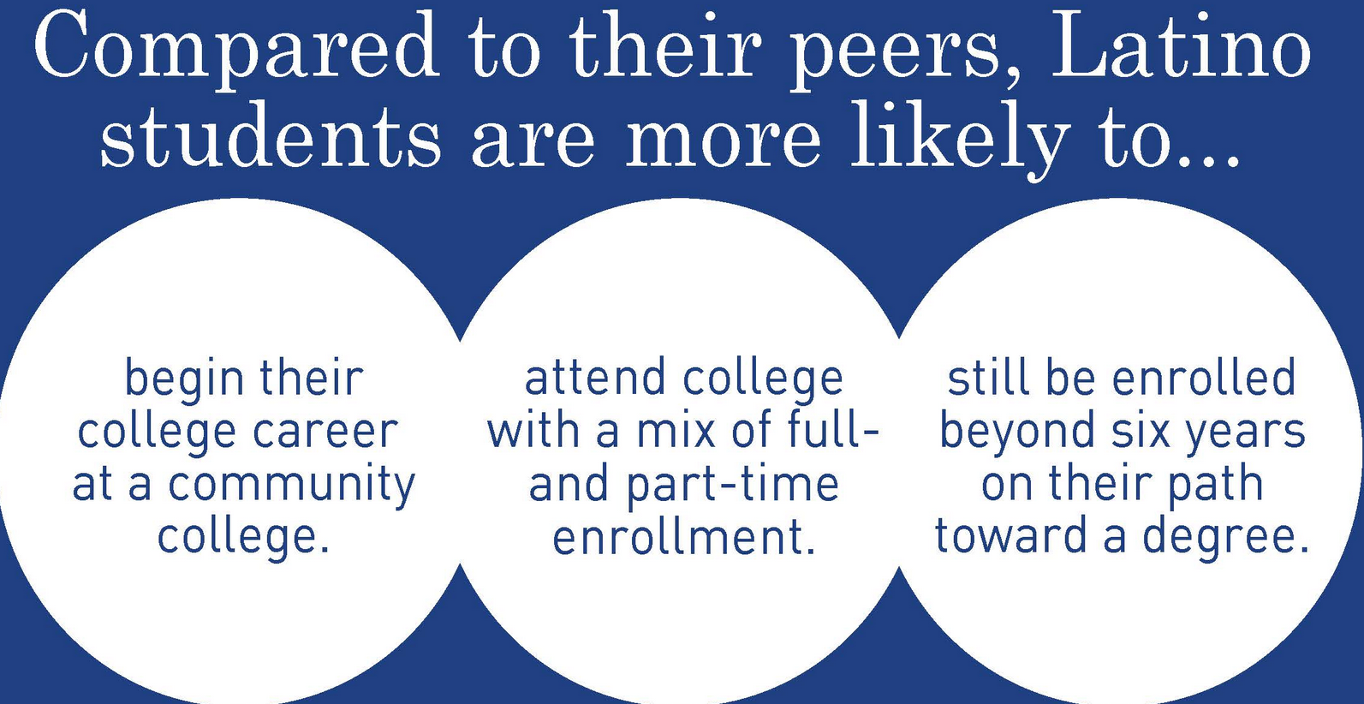
Different Groups, Different Patterns
--Excelencia in Education

Slide 16
Role Models and Success

Slide 17
Collaboration and Goals

Slide 18
Post-College Success
Per Gallup/Strada research, only a third of students believe they will graduate with the skills and knowledge to be successful in the job market (34%) and in the workplace (36%).

Slide 19
Q&A
Your questions
Ideas for coverage

Slide 20
With Thanks …

