Slide 1

Building system-wide
Data and analytics capacity
Dan Cohen-Vogel, Ph.D.
Vice President, Data and Analytics
University of North Carolina System Office
Sponsored by
Notes:
Good afternoon.
My name is Dan Cohen-Vogel, and I’m the Vice President for Data & Analytics at the University of North Carolina System office.
Before I get started, let me say thanks to Inside Higher Ed for providing this space and to HelioCampus for inviting us to share our experience.
I’m going to share our experience pursuing a long-term vision for data and analytics in the UNC System.

Slide 2


Today’s Speaker
Join the conversation today
on Twitter:
#AskUNCSystem
Daniel Cohen-Vogel, Ph.D.
Vice President, Data and Analytics,
University of North Carolina System Office
drcohenvogel@northcarolina.edu
Notes:
That’s me and how to get in touch with me if you wish. Thank you to the airbrush crew.
And there’s also a note about how you can tweet your thoughts and feedback during today’s webinar.

Slide 3
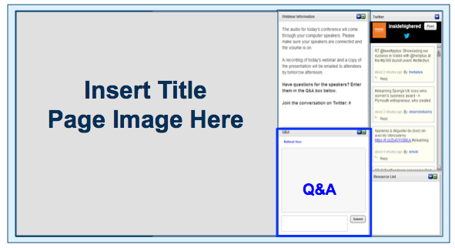
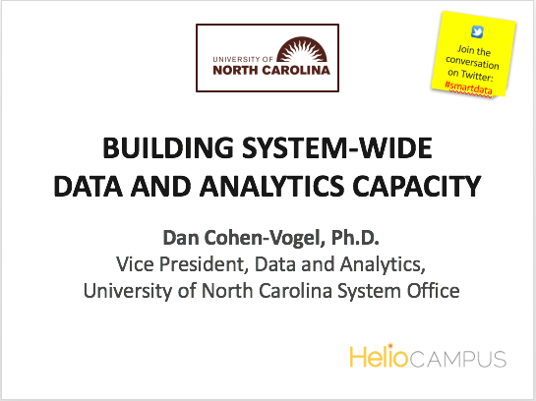
BEFORE WE BEGIN
We are using On 24. Please enter questions in the text field at the bottom of the Q&A Window. We are monitoring the discussion and will try to bring the Q&A comments into the conversation.
We are recording the webinar; the webinar archive and slides will be available later today.
Notes:
[Casey will say a few words…]

Slide 4
Agenda
About UNC
Vision: System Analytical Capacity
First Step: The Data Foundation
Analytics: Needs, Partnering, Development
  Data Visualization Examples
Lessons Learned and Next Steps
Notes:
I’ll start with some brief notes about UNC, and then
I’m going to share our vision for UNC System data and analytics that we have been pursuing over the last 5 years.
I’ll start with an overview of our creation of a system-wide data warehouse – probably take about 10 minutes to set the stage and share what was a very exciting project and I feel a real success story –
And then I’ll discuss our development of an analytics environment that draws on that warehouse – how we identified needs, developed the right partnership, and now are in the midst of implementation. You’ll see some examples of what we’re doing in that space right now, and I’ll touch on some other complementary efforts and what’s coming down the pike.

Slide 5




About UNC
16 Universities
1 High School
Many Affiliates
233,000 students
55,000 degrees
63,000 faculty and staff
$1.4 billion R&D awards
Notes:
The University of North Carolina is statutorily a single, multi-campus University, consisting of the seventeen constituent institutions and other affiliated organizations. I sit in the System/central office, and we have a System President, my boss, who reports to a 28-member Board of Governors that has broad statutory responsibility for the oversight and management of the System.
Those summary statistics give a sense of the size and complexity of the System, which includes all public four-year institutions in the state, two residential high school programs (one stand-alone shown here), 6 of 16 that are historically minority institutions, and a range of sizes and academic missions, from large, research-intensive to small liberal arts and a school of the arts.

Slide 6

CORE PRIORITIES
Access
Affordability and Efficiency
$
Student Success
Economic Impact
Excellent and Diverse Institutions
Notes:
Since I came on board here a little over 5 years ago, I’d summarize leadership demands (in pursuit of System and campus goals) as follows – “better data faster.” They don’t always know exactly what they want; but they know they want the information necessary to make decisions when those decisions have to be made. More timely. Better quality. More flexible. More detailed. More accessible. And more effectively packaged.
They want to be able to provide a window into the University to external stakeholders and provide tools to decision makers at all levels within the University. (Decision makers responsible for pursuing strategic goals, such as those articulated within the five broad Board of Governors strategic priorities shown here.)
And that goes to the crux of what “analytics” means, right? – drawing meaningful information from the data and providing it to folks in an accessible, useful manner.
For me, leading a strategic support unit responsible for managing UNC data and providing insights from the data, it was and still is critically important to articulate a vision for building UNC System analytics capacity.

Slide 7
Building a data foundation
Notes:
And the starting point of that vision is good data.

Slide 8
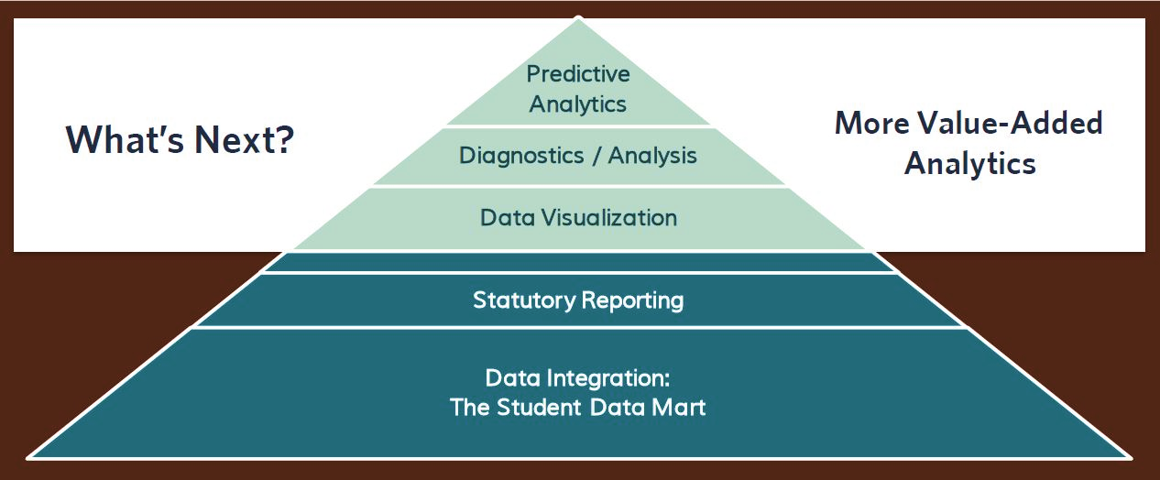
A Robust Data Foundation
Notes:
In order to expand analytical capacity and deliver value-added insights, it’s essential we have a strong data foundation. That’s the big lift required to get to the good stuff, the real value-added analytics.
This was our vision, and still is. Once we have the data systems in place, we can continue to support the stuff we have to do (regulatory reporting, etc.) – and hopefully do so more efficiently. And, most importantly, we can enable the stuff we want to do more of (program evaluation, policy analysis) – i.e., decision support for the system and its constituent institutions at multiple levels.
And as many of you no doubt already understand, the technology here is the easy part. To build this strong foundation across 17 diverse institutions, we have to change cultures and business practices and communications. And that doesn’t happen with the flip of a switch.
I’ll share a summary of our data system development, and then I’ll go on to show how we’ve tackled the analytics.

Slide 9
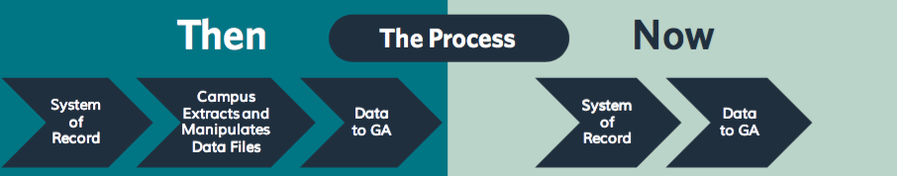
Student Data Mart: Process Innovation
Notes:
Within this simple diagram of how we changed our data collection process is a pretty significant set of technological, organizational, and cultural transformations.
Technology-wise, we previously had a system of flat file collections that put our IR offices in the role of mediating what came out of various campus systems. We changed to a new data system that pulls dozens of tables out of campus ERP systems (14 different Banner systems and two with PeopleSoft) into a central warehouse – our Student Data Mart.
In short, we took out that time-consuming middle step and put the bulk of quality control processes on the front end – accelerating the submission process and requiring that anything loaded into the warehouse would come directly out of the institutions’ ERP systems. The only way to get it right in the Data Mart is to get it right in Banner or PeopleSoft.
Organizationally, or culturally, this has meant that under the Data Mart regime, the campus IR offices are no longer extractors of data files for the central data system but instead have become the arbiters of data quality and the communication point on each campus with registrars, admissions, financial aid, facilities, deans, of course IT, and more. And the implementation of the system and ongoing maintenance have involved all of those players as well. This has created new dynamics among campus business units and among the System office IR and IT functions and our institutions.

Slide 10
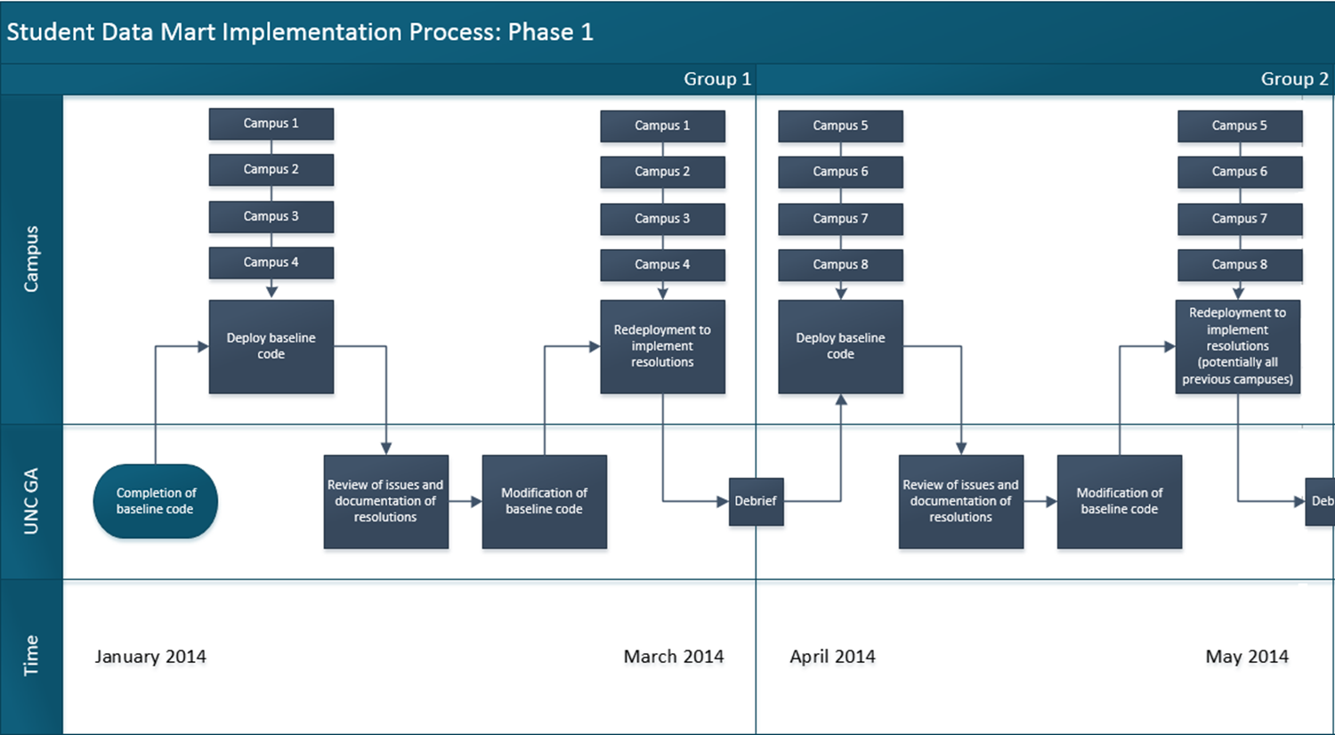
Plan for Change; Phased Implementation
Notes:
The implementation of the new Student Data Mart, after 6+ months of planning, occurred over about 2 ½ years with four groups of four universities, each implementing on a staggered, phased schedule, with intensive data integration and standardization work conducted. This picture is a slice of our map of that implementation process.
To the credit of all 16 institutions – for whom this has been a big lift on top of their other duties – and to the credit of great System IT and Data & Analytics staff and System leadership sustained support, we successfully implemented the plan on schedule and within the planned budget, and we realized some significant unanticipated benefits from building up and maintaining the System office ERP team as well.

Slide 11
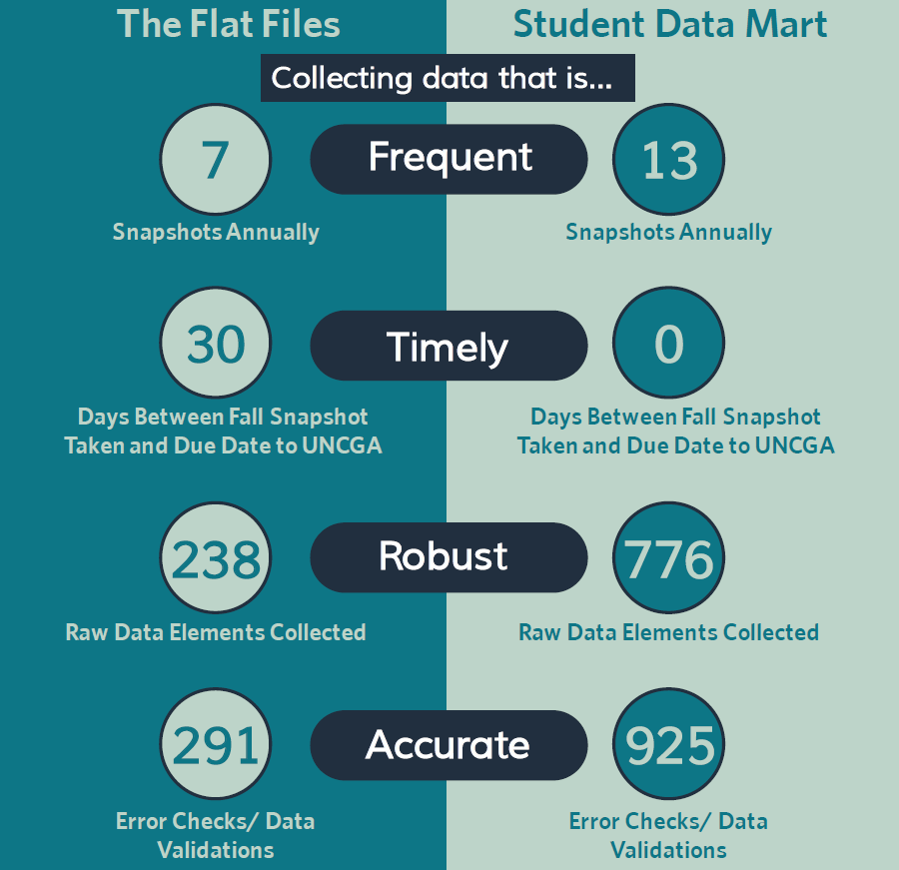
Student Data Mart: Results
“Better data faster!”
Expanded capacity, quality, timeliness, responsiveness.
Benefits extend beyond building the data foundation.
Notes:
And in addition to getting it done on time and on budget, it’s a better data system… and continuously improving.
We collect a lot more data, more consistently across institutions and across time, with more than triple the error checks and validations provided through the previous system.
We collect more frequently and, very importantly, on time and unit record scales that are more closely aligned with the underlying processes the data are intended to represent. Snapshots are not just census-period, but also first-day-of-term, end-of-term, and post-grades snapshots, as well as retrospective data pulls for the full fiscal year when dealing with financial aid and facilities.
And the data are more timely. Instead of working for months after an event (like fall census) to get the files in shape, we take a census snapshot on census day. We still have a built-in process for post-snapshot corrections. Those should continue to be less numerous and less significant as the process is normalized and the validation and edit checks continue to improve.

Slide 12
Demo:
Student data mart Interface
Notes:
I’ll give you a quick flavor of what this all looks like, and then we’ll get on to the analytics.

Slide 13
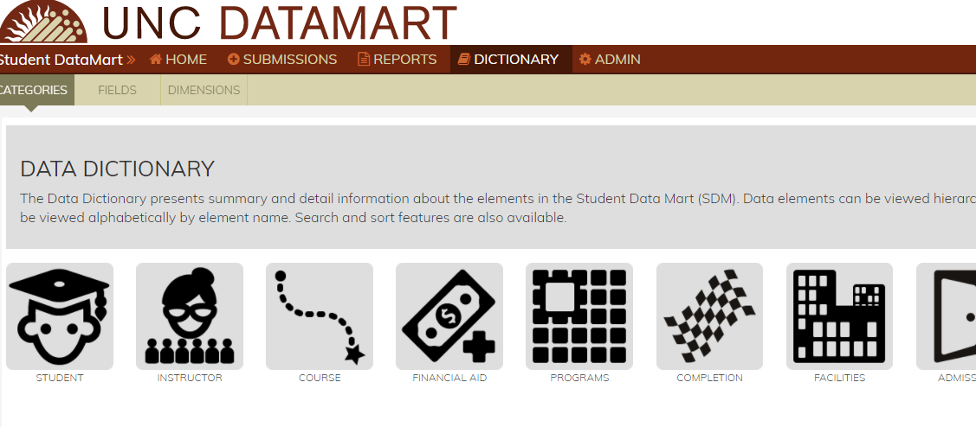
Student Data Mart
Dictionary
Notes:
This is our data dictionary. The page shows some of the other features of our user interface for the Data Mart, including the ability to assign access and different roles through the Admin tab, the ability to track submissions and the running totals and details of errors (or lack thereof) leading up to final snapshots, and this Dictionary site. Users can search our dictionary and get information thematically, as shown here, as well as look by dataset, data element (“fields”), and the numerous dimension (or “value”) tables associated with the data. A great resource.
And although I’m not going to show you the hundreds of elements, note that we didn’t build this as a System office foundation, but as a System foundation. For example, we expanded the data in the warehouse from the old regulatory reporting-driven set to a much broader set that includes dozens and dozens of campus-specific fields, stuff that’s useful for institutions, like departments and majors as opposed to just federal CIP codes. That way, campuses would have less reason to view this as “the System office’s data,” as distinct from what they at the campus level need for institutional reporting and analysis.

Slide 14
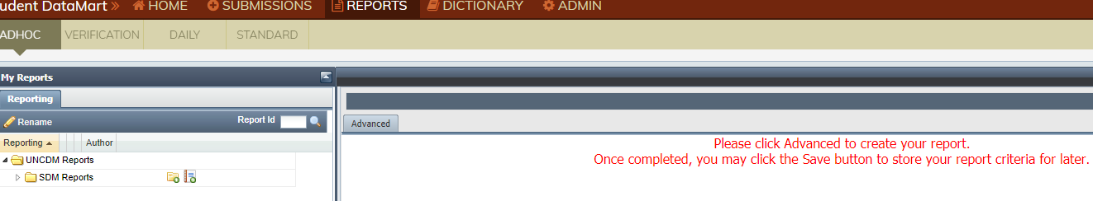
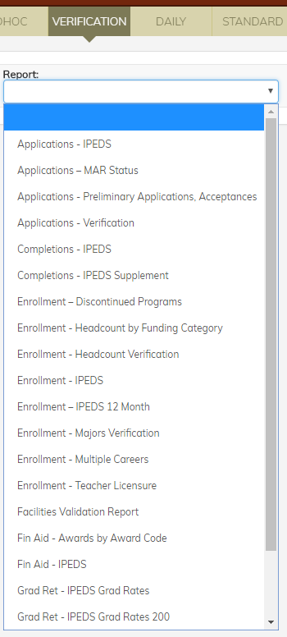
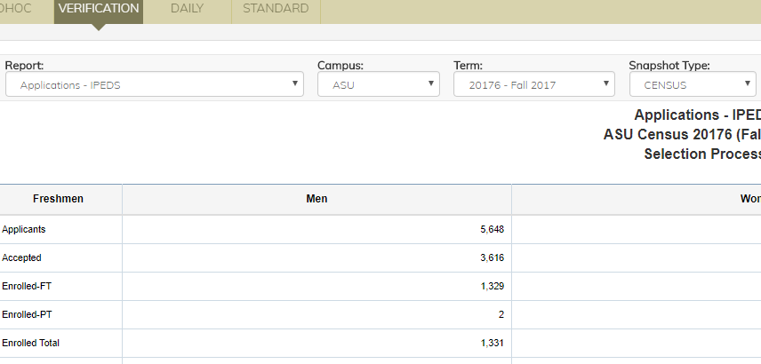
Student Data Mart
Reporting “Widget” – Verification
Notes:
We also built some reporting capability. Here’s one of dozens of verification reports. This one showing IPEDS-related Applications data for Appalachian State University.

Slide 15
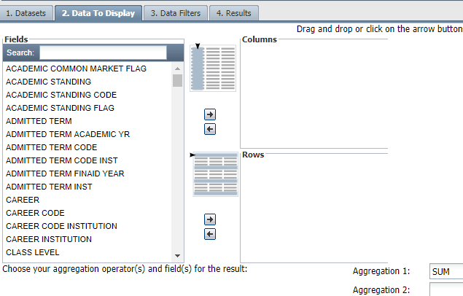
Student Data Mart
Reporting “Widget” – Ad Hoc
Notes:
And this is an example of the Ad Hoc capability of our own reporting tool.
It’s a cool and useful home-grown BI tool, but it’s pretty limited. I can only work with one dataset at a time, and I can’t join datasets or do visualizations, for example. It’s just a tool for extracting from individual datasets or building crosstabs and pivot tables. Obviously, we knew this was an interim measure until the data system was built.
And then the work of establishing a much more robust analytics environment would begin, which is where I’ll shift gears now…

Slide 16
Questions at this point?
Notes:
Let me take a breath and pause here. Anything I should address further, clear up, etc. before going on?

Slide 17
Developing an Analytics Environment
Creating the space, tools, flexibility, and accessibility to meet different stakeholder needs.
Notes:
Going back to that pyramid I put up earlier, now we’re focused on the top. The question we wanted to address was, what value-added analytics could this new data system support.

Slide 18
Define Needs, Find Partner
  RFP reflected UNC System needs
  Built on data system work already done
Notes:
I’ll talk about our process – defining our needs, the RFP process, managing the contract. And talk later about our analytics platform being developed with HelioCampus and what it is doing for us.
We started with the end goals in mind – what uses, which audiences, etc. Our “better data faster” directive was from folks who think of their needs as the ability to dig deep, analyze on the fly, etc. Essentially, when they talk about “the data,” they’re asking for analytics – which broadly means they want data translated into answers to their questions, whatever those questions are.
Let me summarize some salient features of our analytics RFP in which we articulated our conceptualization of the UNC System’s analytics needs:
We wanted a product (and I use that term broadly, as it could be a suite products, an environment, etc. – components of our analytics ecosystem) – so, a product that would provide for data visualizations, analytics, and predictive modeling that would leverage the existing data warehouse as a baseline source of data.
The architecture of the selected product must be (…and I’ll repeat some of the specific words we used…) high performing, secure, portable, flexible, modular, non-proprietary, sustainable, and scalable. (That’s a mouthful, but it was very deliberately articulated that way.)
The product should be extendable to constituent UNC institutions for their own data analytics purposes beyond the data currently residing in System’s data warehouse, with appropriate levels of access control and security among institutions.
And the product should have a baseline set of services available to all UNC constituent institutions, with additional services and options available on a institution-by-institution basis.
Our RFP process involved different players from within the system office and different business units/constituencies from some of our institutions.
We got a dozen or so serious proposals. It was a significant investment of time and energy, but worth it.
And we awarded the contract to HelioCampus, a company that was spun out of the University of Maryland University College, and we began working with them last April to spec out and build our analytics environment.

Slide 19
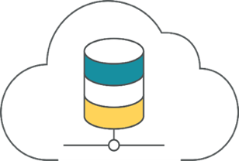
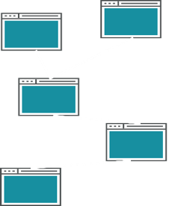
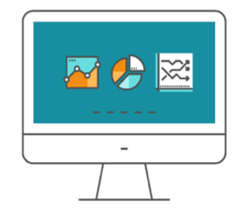
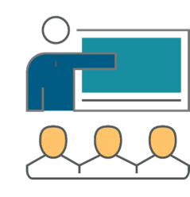
Technology Enabled Service Model
CLOUD TECHNOLOGY Virtual Private Cloud, High Performance Computing, Analytics Toolsets, Network and Security | DATA INFRASTRUCTURE Data Lake, Data Warehouse, Reporting Models | DATA VISUALIZATION Dashboards and Key Performance Indicators | ONGOING SERVICES Data Analysis, Data Storytelling and Data Science
Notes:
And this illustrates the technology-enabled service model HelioCampus is providing.
An instance of our data warehouse (Student and HR Data Marts) in the cloud – in Amazon Redshift. Ability to connect other data sources there as well. Shared dashboards, developed in Tableau by HelioCampus – structured to align with our existing data model (i.e., not requiring us to map to yet a new data model). Tableau licenses to develop additional UNC System tools. ODBC connection to the warehouse in the cloud, so that those in System office or at campuses who are using SAS and numerous other tools can still use those and point to the Data Marts rather than download and store them locally. And there are opportunities to expand system-wide resources as well as individual campus self-service and vendor-service options.

Slide 20
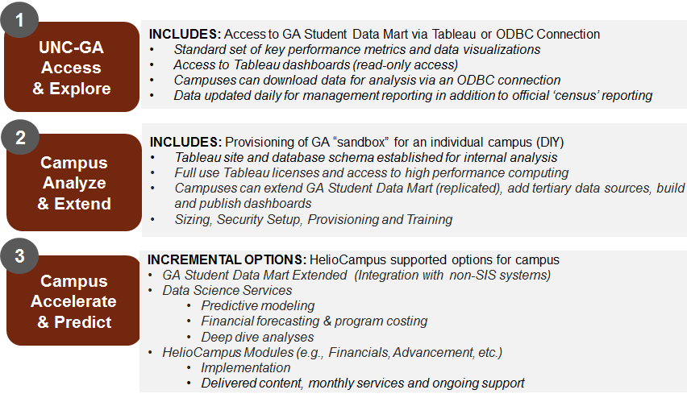
Partnership Levels
Notes:
This slide represents essentially how the proposal and subsequent contract outlined this partnership.
Partnership Level 1 is the baseline set of services – UNC-GA Access and Explore – which is the Data Mart-in-the-cloud with ODBC connections for system office and campuses, with a shared suite of Tableau dashboards, system office Tableau user licenses, and some ongoing data science services. The System office pays for this.
Level 2 – Campus Analyze and Extend – is optional, allowing individual institutions to buy Tableau licenses for their own development needs and additional space in the cloud to move other data. HelioCampus provides the set-up services and support.
Level 3 – Campus Accelerate and Predict – gives a range of other optional services that individual institutions can purchase, on top of Level 2.

Slide 21
Communicate, Be Responsive
  Governance, and communication
  Road map: Routes, detours, and stops
Notes:
Like the planning, implementation, and ongoing maintenance of our Data Mart, the planning, implementation, and maintenance of this analytics platform relies on strong communication and governance. What we have learned about governance is that it is much more easily developed and sustained when built around tangible processes – organically. We saw that with our Student Data Mart in the last few years. We’ve seen that with the Banner hosted environment our IT area manages for about half of our institutions. And we followed that model in developing content and a pricing model for the different levels of service HelioCampus offers us.
We try to be inclusive and transparent – institutions need to be involved in the conversation throughout, be able to weigh options and implications, and make informed decisions – and we try to communicate a lot and with multiple stakeholders at every institution.
And we try to be nimble. We have a road map, a prioritized list of what we think should be part of the baseline System analytics environment. And as institutional needs are expressed and change, as strategic plans and policies and priorities evolve, so too our road map evolves. We map out priority routes, and we’re willing to make detours and stops along the way if necessary.

Slide 22
Demo:
Analytics Environment Examples

Slide 23
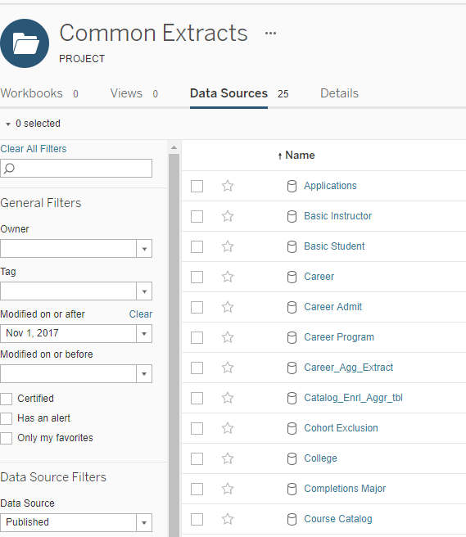
Data Mart Cloud Access
Notes:
Folks with access can extract data from the various datasets in our warehouse. Shown here are some of those datasets. There are about 5 dozen student-related datasets available to users currently, when we include all the additional aggregated datasets that have been created as well as a handful downloaded from IPEDS.

Slide 24
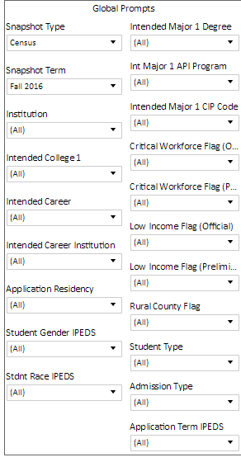
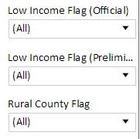
Data Modeling
Goals
Enable aggregate-level data analysis
Campus- and unit-level exploration
Preserve Data Mart structure and logic
Notes:
Built on our Data Mart data model, here’s an example of the list of filters that sits next to our admissions dashboards. The enlarged box there is also an example of the flexibility of the Data Mart, to which we added these derived low-income and rural fields following their development in support of the Board’s strategic plan goals.
Filters like these as well as campus drill-down capabilities allow users to customize output to their particular level of operations – and those include the ability for institutions to organize and filter the data according to each institution’s organizational structure and specific programs, in addition to the federal CIP codes that tend to be our System office unit of analysis.

Slide 25
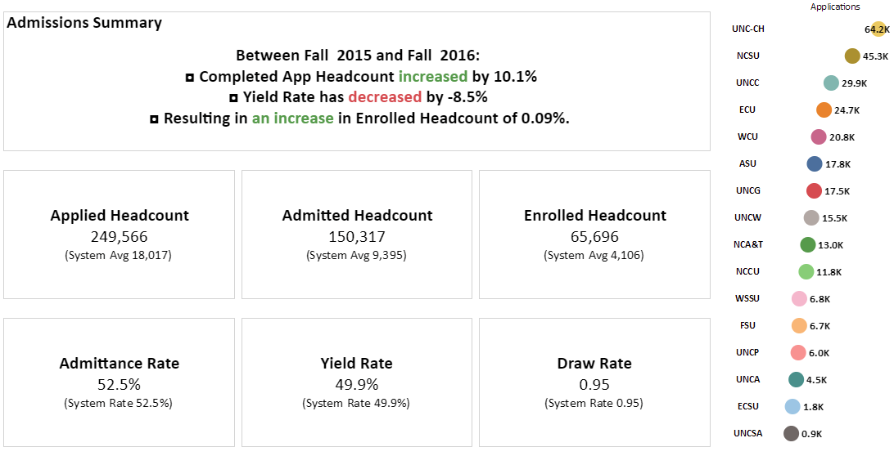
Admissions Summary Dashboard
Notes:
Here’s the “landing” page for the Admissions/Enrollment Management area of dashboards, the first set that HelioCampus developed with us. This Admissions Summary Dashboard shows how some simple, key metrics can be laid out, allowing them to be viewed at individual campus level as well, and of course those filters I just showed would be sitting to the left of this page for the user to further disaggregate. I like the use of the dynamic text in these summary dashboards, giving some insights about the data in addition to some summary statistics. In fact, we have dubbed the entire suite of dashboards and data extracts our UNC Insights.

Slide 26
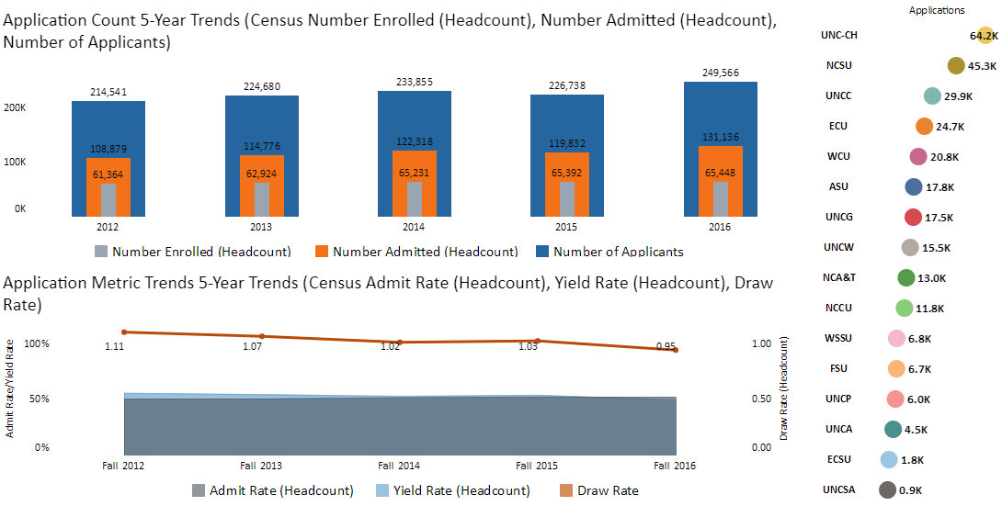
Admission Rate and Funnel Metrics
Notes:
And this starts to set up the foundation for predictive modeling around the admissions/enrollment pipeline. In this case, looking at trends in acceptance and yield rates – and of course being able to drill down to particular populations at particular institutions – begs questions about which groups, programs, etc. that make up the characteristics of the applicant pool will give greater bang for the buck vis-à-vis the admissions process. With limited recruitment dollars, I can start to conceive of optimization models that inform enrollment management investment of resources. That’s where we’re headed.

Slide 27
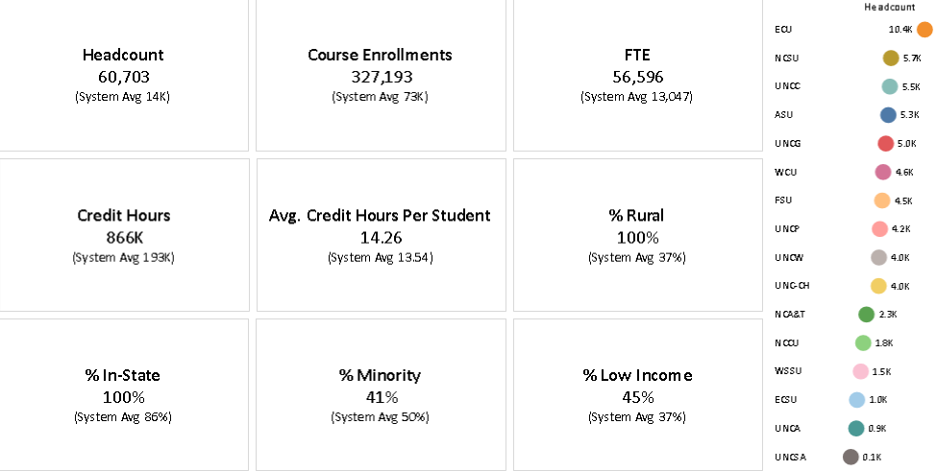
Enrollment Report Card
Notes:
Moving from Admissions to Enrollment, here I’ve pulled a snapshot of our Enrollment Report Card, an overview over some basic metrics associated with enrolled students, in this case filtered to show just undergraduates from distressed, rural counties that are a focal point of our Board’s strategic plan.

Slide 28
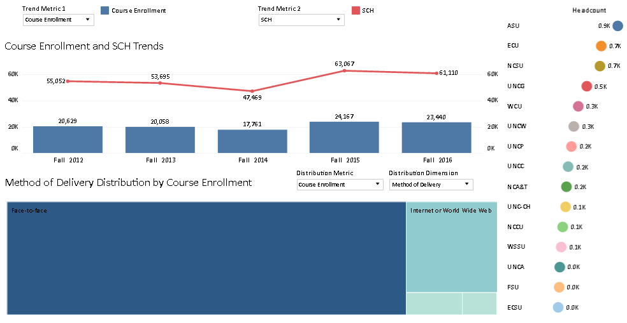
Course Enrollment Trends
Notes:
And within the Enrollment suite of visualizations, in this example I looked at courses in the Critical Workforce Areas (STEM, Health, Education) identified also in our Board’s strategic plan, and this shows trends in those course enrollments as well as a division of those courses by method of delivery.

Slide 29
Next Steps
Roadmap of shared dashboards
How does this fit with other analytics efforts?
  Continuing to develop public-facing resources, at
  https://www.northcarolina.edu/infocenter
  Other System-level partnerships and collaborations
Building organization and culture
  Skills, staffing, orientation
Notes:
Those are a few examples of some of the more developed dashboards available at System and Campus drill-down levels, among the baseline dashboards provided.
On the roadmap are numerous other products.
Strategic plan accountability metrics
Presentations of course enrollments/class sizes along various dimensions (sessions, programs, methods of delivery, instructional format, etc.)
Diagnostic course information, such as DWF rates
Various ways to slice and visualize IPEDS data for higher education institutions in the state and nationally
And it’s important to note that these Tableau dashboards are not the only visualization, diagnostic, or predictive tools that the System office and institutions are taking advantage of. At the System level, we have a set of existing, public-facing dashboards built in SAS Visual Analytics and hosted by SAS, and those are continuing to evolve as well, presenting that public face, or “window” into the University that speaks to various external stakeholders’ perceptions of our transparency and accountability. We at the System office and many of our institutions have also engaged in various partnerships related to student success analytics tools and services, such as those with Hobsons (PAR Framework), EAB, SAS, Rapid Insight, and others. As I noted earlier, in building the Student Data Mart, we intended for it to support multiple tools and processes, and in building out this analytics environment, our intent was to make it as open and connectable to the numerous tools on the market as possible.
And in addition to building warehouses, tools, and environment, we are ever cognizant of the criticality of strong staff and continuous skills development among them.
And this development is facilitated by a cultural orientation toward that analytics vision I shared initially. How can we add value? How can we invest more time in improving the quality of our systems and the meaningfulness and actionability of our products? How best to continue to communicate effectively with our many, diverse stakeholders and to respond to their needs?
And we have to keep in mind throughout that, “Cultural maturation is a process.” There’s not a magic wand, and developing the organizational and cultural infrastructure takes constant attention on multiple fronts and a long view of what success looks like.

Slide 30
Resources and References
UNC InfoCenter
https://www.northcarolina.edu/infocenter
UNC Student Data Mart dictionary
https://uncdm.northcarolina.edu/sdm/dictionary.php
HelioCampus white paper, “Data in Focus”
https://cdn2.hubspot.net/hubfs/2492978/HelioCampus_2017/Docs/HelioCampus_WhitePaper_HigherEdAnalytics_Final.pdf?t=1512394945559
Notes:
I’m going to stop there. Before I respond to any additional questions, I’ll point you to the Resources and References page of the presentation, which provides some links to topics mentioned today. And of course, you are welcome to reach out to us.

Slide 32
Today’s Speaker
Daniel Cohen-Vogel, Ph.D.
Vice President, Data and Analytics,
University of North Carolina System Office
drcohenvogel@northcarolina.edu

Slide 33

THANK YOU!

