Slide 1
Financial Viability, academic programs, & the faculty role: a Survey of CBO’s
Webinar on Inside Higher Ed/Gallup 2016 Survey of College and University Business Officers
Thursday, August 18, 2016 2 p.m.

Slide 2
Presenters
Doug Lederman, editor, Inside Higher Ed
doug.lederman@insidehighered.com
Scott Jaschik, editor, Inside Higher Ed
scott.jaschik@insidehighered.com

Slide 3
Methodology
Survey conducted by Gallup in April-May 2016
Responses from 386 chief business officers
Responses coded to allow for analysis by sector
Complete anonymity for individuals and institutions

Slide 4
Key Findings
Almost 2/3 of CBOs believe that media reports of a financial crisis for higher education are accurate.
Only 54% of business officers are optimistic that their institution is financially sustainable over a decade. But that’s 12% higher than last year.
CBOs overwhelmingly say colleges are too hesitant to close academic programs. Fewer (but still 68%) say their own campuses are too reluctant.
Only 43% of CBOs say faculty members participate meaningfully in campus budget decisions. Those who do are more open to faculty input in such discussions.

Slide 5
Higher Ed Finances in Crisis
63% of campus business officers say media reports suggesting a crisis in higher ed finance accurately reflect the landscape.
Was 56% in 2015.

Slide 6
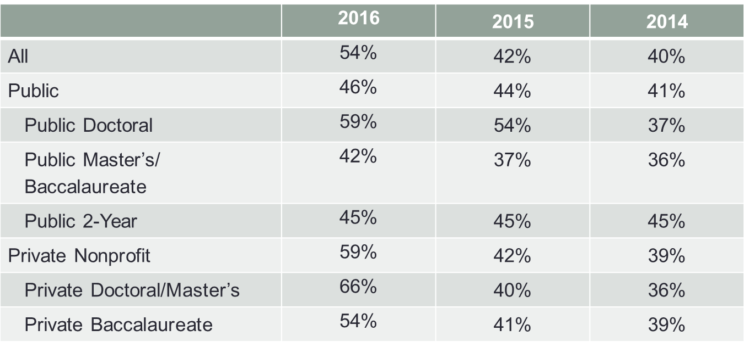
My Campus Is Financially Viable Over Next Decade…

Slide 7
Making the Hard Choices?
9 in 10 business officers agree that colleges are too hesitant to shut down academic programs, and that colleges need to be more willing to experiment with new kinds of academic and nonacademic offerings…
but only 68% say their own institution is too hesitant to close academic programs.

Slide 8
What Matters Most in Academic Program Decisions?
Factors CBOs say colleges should value most in deciding which programs to strengthen/eliminate:
Importance to mission (91%)
Academic quality (89%)
Enrollment levels (84%)
Number of majors (77%)
Contribution to gen ed (71%)
Program is self-sustaining (64%)
Record of winning grants/support (35%)

Slide 9
Strategies to Get Financially Healthier
CBOs focusing on strategies to raise revenue rather than cut costs: increasing enrollment (89%), creating new academic programs (71%), collaborating with other colleges on academic programs (65%).
43% said they would eliminate underperforming academic programs, lowering discount rate (36%), reducing administrative positions (35%), increasing teaching loads for full-time faculty (32%).
Cutting athletic programs? 11%

Slide 10
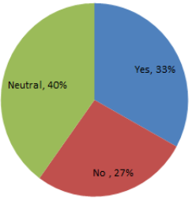
The Faculty Role – Helpful or Not?
CBOs split on whether professors have been supportive of efforts to address budget problems on their campuses….
But views appear linked to whether or not the faculty is perceived to be meaningfully involved in campus discussions about finances.

Slide 11
When Faculty Are Involved vs. Not

Slide 12
Too Much Debt, Not Enough, or Just Right?

Slide 13
Other Findings
Nearly half of CBOs (49%) say their institutions cannot make additional and significant spending cuts without hurting quality.
4 in 10 business officers say their institution’s tuition discount rate is unsustainable. 50% at private colleges, 28% at publics; 60% at private baccalaureate colleges.
CBOs overwhelmingly agree that financial issues, not ethical or political ones, should drive decisions on investing endowment funds.

Slide 14
More Information
Inside Higher Ed article:
https://www.insidehighered.com/news/survey/foundering-finances-faculty-role-survey-business-officers
Download the survey report:
https://www.insidehighered.com/booklet/2016-survey-college-and-university-business-officers

Slide 15
With Thanks to Supporters

