Slide 1
What Presidents Think
Webinar on the 2016 Inside Higher Ed/Gallup Survey of College and University Presidents
Thursday, April 7, 2016
2 p.m. Eastern

Slide 2
Presenters
Doug Lederman, editor, Inside Higher Ed
doug.lederman@insidehighered.com
Scott Jaschik, editor, Inside Higher Ed
scott.jaschik@insidehighered.com

Slide 3
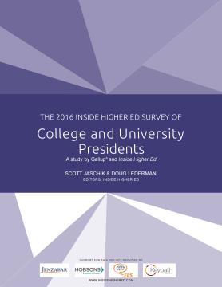
Methodology
Questions prepared by Inside Higher Ed
and Gallup
Survey conducted by Gallup in January- February 2016
Responses from 727 presidents and chancellors (24% response)
Responses coded by institution to allow for sorting by sector and segment
Complete confidentiality for individuals and institutions

Slide 4
A Semester of Rising Tensions

Slide 5
Race Relations on Own Campuses
Generally speaking, would you say the state of race relations on your campus is excellent, good, fair or poor?
 | 2015 | 2016
Excellent | 18% | 20%
Good | 63% | 64%
Fair | 18% | 16%
Poor | 1% | 1%

Slide 6
Race Relations Generally in Higher Ed
Generally speaking, would you say the state of race relations on college and university campuses in the U.S. is excellent, good, fair or poor?
 | 2015 | 2016
Excellent | 1% | 0%
Good | 42% | 24%
Fair | 51% | 65%
Poor | 5% | 10%

Slide 7
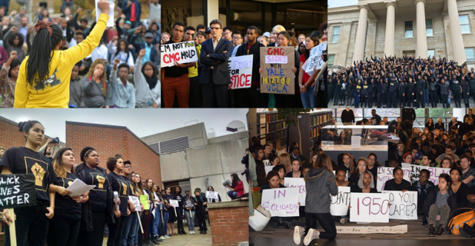
Are Colleges Effectively Serving Minority Students?
28% strongly agree they are.
46% agree that they are.
4% disagree.
1% strongly disagree.

Slide 8
Evaluating the Demands
22% of presidents agreed or strongly agreed that the demands of student protests were reasonable; 38% disagreed or strongly disagreed.
More than half of presidents agreed or strongly agreed that some demands raise free speech or academic freedom issues.

Slide 9
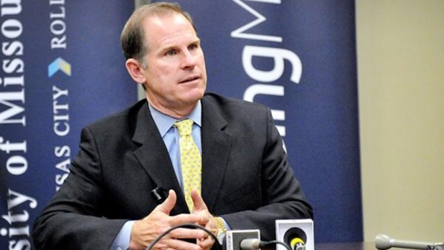
The Nontraditional President

Slide 10
Traditional or Nontraditional?
54% say traditional emphasis on hiring presidents with extensive academic experience is appropriate (76% public doctoral, 44% private baccalaureate)
Boards should not hire presidents strongly opposed by faculty leaders: 58%
College presidents should have a Ph.D.: 48%

Slide 11
Grading Obama Over All

Slide 12
Grading Obama on the Issues

Slide 13
Financial Confidence By Sector
Institution Type | % Agreeing Model Is Sustainable Over a Decade, 2014 | % Agreeing Model Is Sustainable Over a Decade, 2015 | % Agreeing Model is Sustainable Over a Decade, 2016
Public Doctoral | 53% | 42% | 54%
Public Master's | 56 | 31 | 37
Public Baccalaureate | 50 | 34 | 37
Public Associate | 44 | 36 | 39
Private Doctoral/Master's | 48 | 42 | 54
Private Baccalaureate | 45 | 41 | 54

Slide 14
Against Campus Carry
Presidents strongly opposed campus carry legislation: 69% strongly agree and 18% agree that allowing students to carry concealed weapons will endanger students and faculty members.
72% strongly disagree and 16% disagree that allowing students to carry concealed weapons will protect students from potential harm.
85% agree or strongly agree that elected officials who support campus carry legislation do not understand the culture of higher education.

Slide 15
More information
Doug Lederman
doug.lederman@insidehighered.com
Scott Jaschik
scott.jaschik@insidehighered.com
Link to survey:
https://www.insidehighered.com/news/survey/race-campus-nontraditional-leaders-rising-confidence-survey-presidents

Slide 16
Questions/Thank You

