Slide 1
The Public View Of Affirmative Action
Webinar on poll results by Gallup/Inside Higher Ed
Thursday, August 4, at 2 p.m. Eastern

Slide 2
Presenters
Scott Jaschik, editor, Inside Higher Ed, scott.jaschik@insidehighered.com
Doug Lederman, editor, Inside Higher Ed, doug.lederman@insidehighered.com

Slide 3
Methodology
Questions prepared by Inside Higher Ed and Gallup.
Polling conducted June 29-July 1 as part of Gallup’s nightly polls of the public.
Responses from a nationally representative sample of 3,270 adults (aged 18 or older).
95% confidence level that margin of error is plus/minus 3 percentage points.

Slide 4
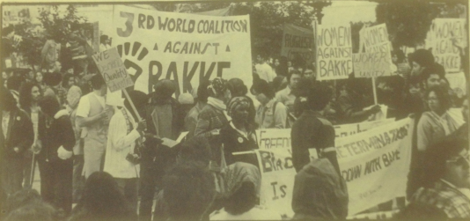
The Supreme Court and Affirmative Action
1978: Regents of the University of California v. Bakke
2003: Gratz v. Bollinger
2003: Grutter v. Bollinger
2013: Fisher v. University of Texas at Austin
2016: Fisher v. University of Texas at Austin

Slide 5
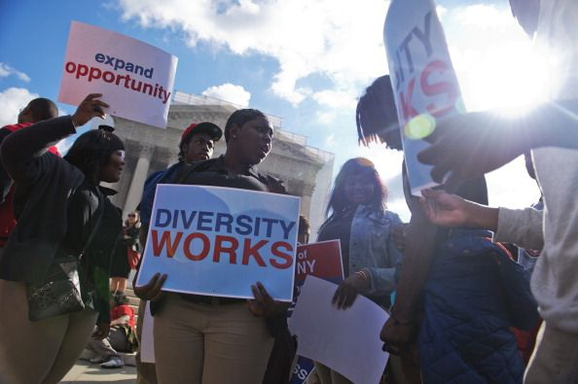
The Second Fisher Ruling
The majority decision
The dissent

Slide 6
Challenges in Polling on Affirmative Action
Definitions
Wording
General trends
Our approach

Slide 7
Context
Major higher education associations and presidents who spoke out on Fisher case overwhelmingly backed U of Texas (the position in favor of considering race and ethnicity).
Voters in six states have barred public colleges from considering race in admissions. The states: Arizona, California, Michigan, Nebraska, Oklahoma and Washington State.
Only one state referendum to bar the consideration of race in admissions – in Colorado -- has been defeated.

Slide 8
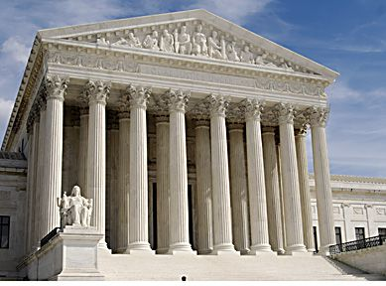
Poll: Do You Agree With Decision?
Yes: 31%
No: 65%
No opinion: 4%

Slide 9
Poll: Support for Ruling, by Educational Attainment
Some graduate education: 46%
Undergraduate degree: 35%
Without college degree: 27%

Slide 10
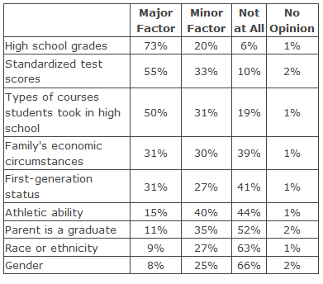
Poll: What Should Colleges Consider

Slide 11
Poll: Should Race Be Factor, by Race

Slide 12
Issues Ahead
Will colleges be vulnerable to continued challenges?
Will campus protests resume in the fall, and what impact might they have?
How will changing demographics in American society change the debate over affirmative action?
Will more focus on Asian-American applicants undercut support for affirmative action?
Do American colleges need to increase efforts to enroll and graduate low-income students?
Does it hurt higher education that academic leaders have one view of affirmative action and the public another?

Slide 13
Inside Higher Ed/Gallup Conference
For more information: http://ihenow.com/2b0LJhN

Slide 14
Your Questions
--Questions
--Suggestions for future coverage

