Slide 1
What Admissions Deans Think
Results of a survey by Inside Higher Ed and Gallup
Thursday, September 28, 2017
2 p.m. Eastern

Slide 2
Presenters
Scott Jaschik, editor, Inside Higher Ed, scott.jaschik@insidehighered.com
Doug Lederman, editor, Inside Higher Ed, doug.lederman@insidehighered.com

Slide 3
Methodology
Survey conducted by Gallup on behalf of Inside Higher Ed.
Responses from 453 admissions directors (or senior person in admissions).
Survey in field July 20-August 16.
Complete anonymity for those responding, but responses coded to allow for analysis by sector.

Slide 4
The Pressure Grows and Grows
Colleges Reporting They Met Target by May 1
2015 | 2016 | 2017
42% | 37% | 34%

Slide 5
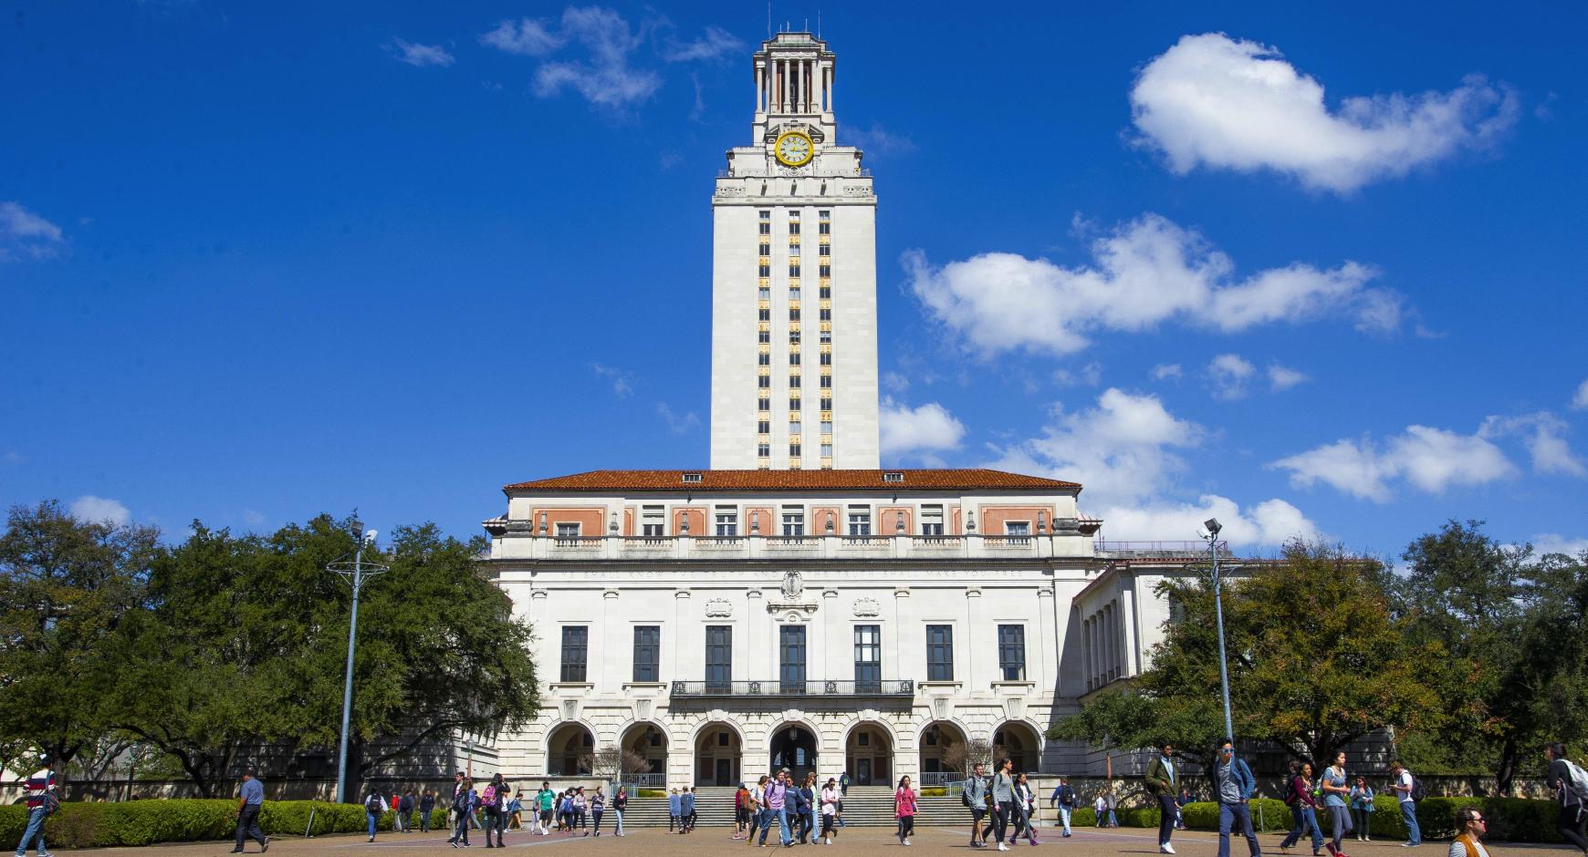
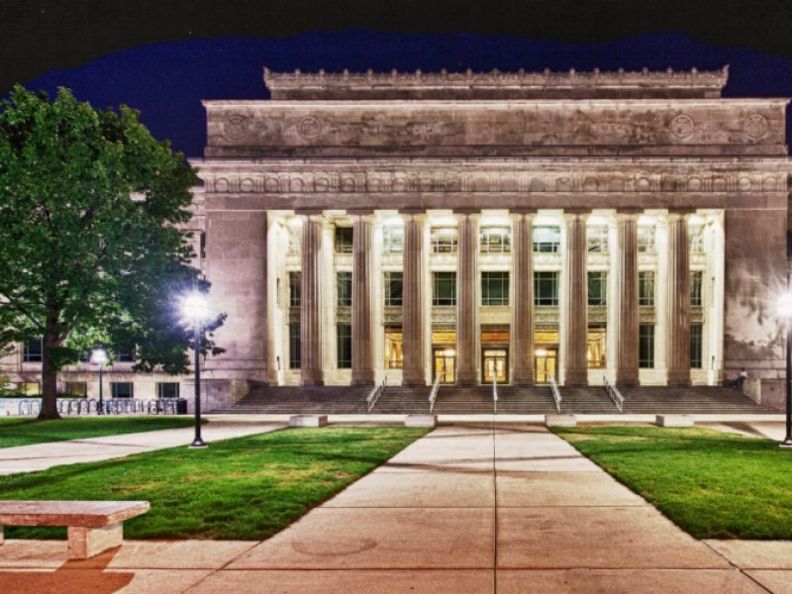
The Exception: Doctoral Publics

Slide 6
Colleges’ Targets
Groups That Will Be Target of Increased Recruiting
Group | Public | Private
Transfer students | 63% | 85%
Minority students | 74% | 66%
Recruited with merit scholarships | 46% | 70%
First generation | 69% | 49%
Out-of-state students | 39% | 66%
Veterans or active duty military | 55% | 45%
Online students | 53% | 42%
Full pay students | 42% | 52%
International students | 33% | 59%

Slide 7
International Students: Looking Ahead (and Discounting)
46% of admissions leaders at public institutions expect a decline in the number of international students in the years ahead. At private nonprofit colleges, the figure is 20%.
Asked about providing non-need-based aid to international aid or adding such aid, only 21% of public admissions leaders expect to do so. At private colleges, the figure is 53%.

Slide 8
Are Colleges Too Dependent on a Few Countries?

Slide 9
Social Media: Harvard Isn’t The Only One
Number revoked/rejected in last two years:
Number of Times | Public | Private Nonprofit
Once | 1% | 7%
Two or three | 2% | 3%
Four or more | 1% | 4%

Slide 10
Do They Check? Will They Check?

Slide 11
Impact of the Election - I
Percent of admissions leaders agreeing:
Statement | Public | Private
Higher education needs to redouble efforts to recruit and retain minority groups. | 86% | 66%
Americans are less committed than in the past to increasing the number of racial and ethnic minority students in college. | 44% | 35%

Slide 12
Impact of the Election - II
Percent of admissions leaders agreeing:
Statement | Public | Private
Colleges -- especially elite colleges -- should recruit more students from rural areas. | 42% | 32%
Colleges -- especially elite colleges -- should recruit more low-income white students. | 32% | 24%
Colleges with overwhelmingly liberal student bodies should increase recruiting efforts, including affirmative action, for conservative students. | 16% | 12%

Slide 13
Impact of the Election -- III
Colleges that are stepping up recruitment of:
Group | Public | Private
Rural students | 52% | 28%
Low-income white students | 41% | 22%
Conservative students | 9% | 8%

Slide 14
Image Problem: Public Perceptions of Higher Ed
Statement | Public | Private Nonprofit
Higher education needs to do a better job of explaining the value of earning college degrees. | 94% | 95%
Media reports of college graduates who are unemployed or underemployed have discouraged students from considering higher education. | 63% | 69%
Public discussion of student debt has discouraged students from considering higher education generally. | 61% | 66%
Public discussion of student debt has discouraged students from considering my college. | 36% | 78%

Slide 15
Extra Challenge for Liberal Arts

Slide 16
Tolerance of Debt: What Admissions Leaders Call ‘Reasonable’
 | Public | Private Nonprofit
No debt at all | 6% | 0%
< $5,000 | 7% | 1%
$5,000 to < $10,000 | 17% | 2%
$10,000 to < $20,000 | 31% | 19%
$20,000 to < $30,000 | 28% | 42%
$30,000 to < $40,000 | 9% | 23%
$40,000 to < $50,000 | 1% | 8%
$50,000 and up | 0% | 5%

Slide 17
Free Tuition for Public Higher Ed
Admissions directors who agree:
 | Public | Private
Free public higher education remains a good idea to pursue. | 50% | 26%
Proponents of free tuition programs are not paying sufficient attention to long-term financing issues. | 64% | 86%
The idea of free public higher education poses threat to private higher education. | 38% | 83%
Free public tuition, if adopted in my state, would pose threat to my institution. | n/a | 85%

Slide 18
Issues on the Horizon
Affirmative action
DACA
Scrutiny of advantages of the wealthy
Challenges for liberal arts colleges, regional publics, minority-serving institutions
Too many conflicting demands on admissions
Haves and have-nots

Slide 19
Q&A
Your questions
Ideas for future surveys

Slide 20
With thanks…

