Slide 1

What Community College
Leaders think
A webinar on the Inside Higher Ed/Gallup survey
of community college presidents
Wednesday, May 4 at 2 p.m. Eastern

Slide 2
Presenters
Scott Jaschik, editor, Inside Higher Ed, scott.jaschik@insidehighered.com
Doug Lederman, editor, Inside Higher Ed, doug.lederman@insidehighered.com

Slide 3
Methodology
Gallup surveys presidents of all colleges for an Inside Higher Ed survey. Questions focused on community college issues are asked only of leaders of those institutions.
220 community college presidents answered the questions about their sector.
Presidents receive complete anonymity to encourage frank answers.

Slide 4

Crucial Time for Community Colleges
Obama administration, which has focused unprecedented attention, is coming to a close.
The “completion agenda,” which has received significant government and foundation support, has yielded more small-scale successes than systemic change.
After years of enrollment increases, set off by economic downturn of 2008, many community colleges are seeing enrollment declines.

Slide 5
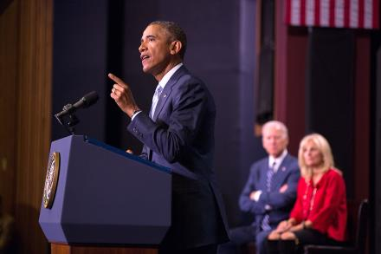
Thumbs Up for Free Community College
62% of presidents support or strongly support the idea of free community college, while only 24% disagree.
82% agree or strongly agree that the debate over free community college has focused welcome attention on the financial needs of community colleges and their students.

Slide 6
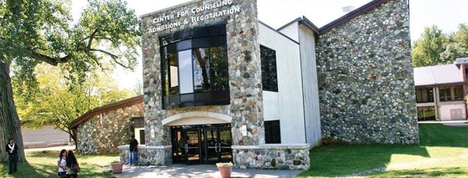
Doubts on Whether Idea Will Spread
35% of presidents agree that, within 5 years, free community college programs will be adopted in at least one-third of states.
37% of presidents disagree.

Slide 7
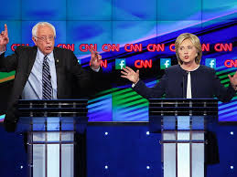
The Democratic Candidates’ Plans
61% of presidents agree or strongly agree that they support the plans of the Democratic presidential candidates to make public college tuition free or debt-free.
53% agree or strongly agree that the plans may shift emphasis away from the idea of free community college.

Slide 8

Grading Obama
Community college presidents, compared to their colleagues in other sectors, are more generous to the president, giving him a grade of 2.6 (compared to 2.1 across sectors).
The president earned the highest grade from community college leaders on focusing attention on low-income students. 88% gave him an A or B.
Community college leaders share the skepticism of their colleagues in other sectors on the administration’s College Scorecard, and on regulation generally.

Slide 9
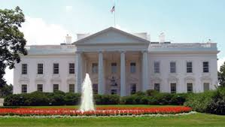
End of an Era
38% of presidents believe the next president of the U.S. will continue President Obama’s emphasis on community colleges.
43% of presidents doubt they will see another president in their lifetimes focus as much on community colleges.

Slide 10
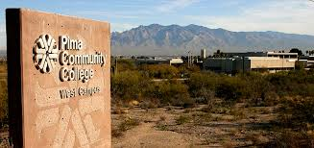
Declining Enrollment
21% of presidents report that enrollments in 2015-16 are higher than those of the prior year.
20% report flat enrollments.
58% report declining enrollments.

Slide 11
Why Is Enrollment Down?
Reason | % Very Important | % Important
More people finding jobs | 79% | 19%
A natural decline after years of increases | 45% | 48%
Competition from new higher ed models | 14% | 44%
Reports that question value of higher ed | 11% | 42%
Competition from for-profit higher ed | 13% | 37%
Academic programs not aligned with student needs | 12% | 24%

Slide 12
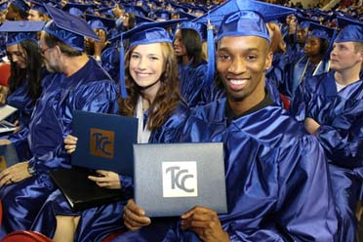
Graduation Rate Goals: Your College
Goal | Percentage
0-24% | 12%
25-49% | 40%
50-74% | 35%
75-100% | 14%

Slide 13
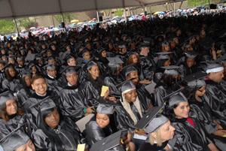
Graduation Rate Goals:
Community Colleges Nationally
Goal | Percentage
0-24% | 14%
25-49% | 44%
50-74% | 37%
75-100% | 5%

Slide 14
Q&A
Your questions.
Your ideas for future coverage.

Slide 15



With Thanks

