Slide 1
What About Certificates? Evidence on the Labor Market Returns to Non-Degree Community College Awards in Two States
Di Xu & Madeline Trimble
Community College Research Center
Teachers College, Columbia University
September 18, 2014 | CAPSEE Conference

Slide 2
Certificates: why do we care?
In general, we think of certificates as non-degree awards
“Short-term certificates” : < 1 year of full-time study
“Long-term certificates” : >= 1 year of full-time study
A substantial proportion of awards from community colleges are certificates as of 2011:
38% nationally
46% in North Carolina
29% in Virginia
Notes:
We think it’s important to differentiate between short-term and long-term certificates
Preliminary evidence has suggested they may lead to different labor market outcomes
Theoretically, one could imagine that a short-term certificate might not involve enough coursework to get over a threshold that makes its earner a substantially more valuable worker than an employee an employer has to train themselves
1 year is just a convenient cut-off (it’s what IPEDS uses)
In NC:
All “certificates” are considered short-term certificates
All “diplomas” are considered long-term certificates
In VA:
All “career studies certificates” are considered short-term
All “certificates” and “diplomas” are considered long-term
Breakdown of credentials: 21% short and 17% long nationally; 32% short and 14% long in NC; 18% short and 12% long in VA

Slide 3
Certificates: why do we care?
Relatively little rigorous research on returns to certificates so far
especially differentiating short-term and long-term certs (Jepsen, Troske, & Coomes; Complete College America; Dadgar & Weiss)
Certificates are often cited as a solution for worker retraining: do they work?
Are certificate earners likelier to gain employment?
Once employed, do they earn more than they would otherwise?
Notes:
This is especially important given the current recession. With so many unemployed workers, they want to know: if they go back to school, are they going to be able to get a job and support a family?

Slide 4
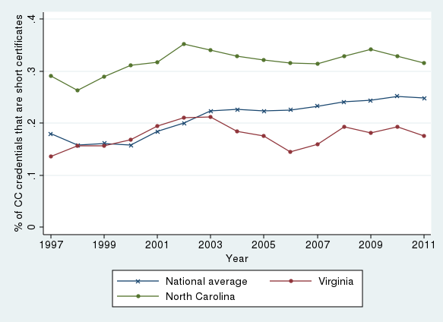
Trends in short-term certificates
Notes:
Large increase nationally in the early 2000s and a more gradual increase since
Plenty of local variation:
NC starts high but doesn’t increase all that much over the last decade and a half
WA sees a huge increase, with a big jump around 1999-2001 and another around 2008-2010
VA follows the national trend for the most part, except actually saw a dip since 2003

Slide 5
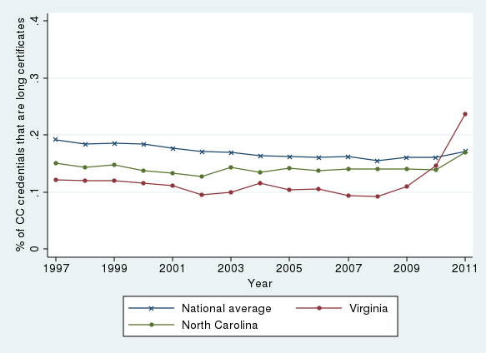
Trends in long-term certificates

Slide 6
Research Questions
What are the economic returns to long-term and short-term certificates?
How do the returns to certificates vary by field of study?
Do the returns to certificates also substantially vary by program within a particular field?

Slide 7
Data
Similar data from both states:
Transcript data
Credential data
Demographic data
Unemployment Insurance data
UI data from VA has VA, MD, NJ, OH, PA, WC, DC
UI data from NC is North Carolina only
Notes:
UI data has some significant limitations, e.g. does not include federal workers (problem for VA) and often self-employed workers or off-the-books workers

Slide 8
Sample
North Carolina: 2006-07 and 2007-08 first-time cohorts
Tracked 2005Q1 through 2012Q1 (~1-2 years prior, ~4-5 years follow-up)
155k students
Virginia: 2006-07, 2007-08, and 2008-09 first-time cohorts
Tracked 2005Q1 through 2012Q4 (~1-3 years prior, ~4-6 years follow-up)
28k students

Slide 9
What do students get certificates in?
Long-term
Short-term
NC VA US
NC VA US
NC VA US
NC VA US
NC VA US
NC VA US
NC VA US
NC VA US

Slide 10
What are the most common programs?
 | North Carolina |  |  | Virginia
Rank | Program Name | N | % | Program Name | N
Long-term certificates
1 | Practical Nursing | 430 | 12% | General Education | 3206 | 61%
2 | Diploma In Arts | 314 | 9% | Practical Nursing | 352 | 7%
3 | Dental Assisting | 295 | 8% | Medical Assisting | 106 | 2%
4 | Cosmetology | 256 | 7% | Medical Office Administration | 92 | 2%
5 | Air Condit., Heat., & Refrig. Tech | 232 | 6% | Law Enforcement | 80 | 2%
Short-term Certificates
1 | Basic Law Enforcement Training | 508 | 7% | Management | 149 | 5%
2 | Cosmetology | 447 | 7% | Nursing | 119 | 4%
3 | Early Childhood Associate | 351 | 5% | Early Childhood Development | 98 | 3%
4 | Air Condit., Heat., & Refrig. Tech | 346 | 5% | Practical Nursing | 97 | 3%
5 | Medical Office Administration | 308 | 5% | Truck Driving | 75 | 2%

Slide 11
Methodological Approach
Method: Individual Fixed Effects
What does it mean?
A
Certificate earner
y
impact
B
Control
Pre-
Post-
Time
Notes:
To estimate the economic returns to certificate, we used an individual fixed effect approach.

Slide 12
Outcome Measures
Quarterly earnings, unconditional on employment
Includes $0 earnings when unemployed
Adjusted to 2010$
Probability of employment
Quarterly earnings, conditional on employment
Includes only quarters when employed

Slide 13
Overall Returns to Certificates

Slide 14
Heterogeneity by Field of Study

Slide 15
Industry Breakdown: Nursing & Allied Health Certificates
North Carolina
Virginia

Slide 16
Industry Breakdown: Education & Childcare Certificates
North Carolina
Virginia

Slide 17
Probability of Employment by Field
 | North Carolina |  | Virginia
 | Long-term | Short-term | Long-term | Short-term
Allied Health | 0.201** | 0.144** | 0.077*** | 0.071***
Business and marketing | 0.103** | 0.026 | 0.007 | -0.004
Construction | 0.127** | 0.055** | -0.064** | 0.107***
Cosmetology, culinary, and admin services | 0.019 | -0.031 | 0.095*** | 0.063**
Education and Childcare | 0.028 | 0.041 | 0.06** | 0.048**
Engineering sciences | 0.023 | 0.049** | -0.012 | -0.009
Humanities and Social Sciences | -0.011 | 0.144 | 0.000 | 0.079**
Information science, communication & design | -0.054 | 0.063** | 0.014 | 0.005
Mechanics, repair and welding | 0.094** | 0.049** | 0.144*** | 0.009
Missing/Other | 0.135 | 0.123** | -0.307* | 0.05***
Nursing | 0.232** | 0.150** | 0.178*** | -0.039**
Protective Services | -0.035 | 0.208** | 0.169*** | -0.068**
Transportation | 0.012 | -0.061* |  | 0.018

Slide 18
Returns by Program (allied health)

Slide 19
Returns by Program (protective services)
“Basic law enforcement training” (BLET) short term certificates lead to $2,647 returns in NC
In VA, long-term law enforcement (but not short-term) certificates yield positive returns
 | North Carolina |  |  | Virginia
Field | Program | Long-term | Short-term | Program | Long-term | Short-term
Protective Services | Basic law enforcement training |  | 2,647** | Law enforcement | 1,199*** | -647**

Slide 20
Conclusions & Policy Implications
Key Findings | Policy Implications
Significant positive returns to certificates | Increase the visibility of certificates, especially for adult learners
Substantial variations not only in field of study but also in specific programs even within a field | Provide detailed program-level information to students and college administrators
Suggestive evidence that returns to certificates are closely related to their labor market alignment | Encourage certificate programs to build direct links to local employers and career pathway opportunities
Certificates may confer benefits other than high wages | Include multiple measures to evaluate the benefits of a certificate program
Noticeable differences in program offerings and economic returns between states | Conduct local-level analysis

Slide 21
Visit us on the web at capseecenter.org
We’re also on Facebook and Twitter.
Center for Analysis of Postsecondary Education and Employment
Teachers College, Columbia University
525 West 120th Street, Box 174, New York, NY 10027
capsee@columbia.edu
212.678.3091
CAPSEE is funded through a grant (R305C110011) from the Institute of Education Sciences, U.S. Department of Education.

Slide 22
Extra slides

Slide 23
What do students get certificates in?
 | North Carolina |  | Virginia |  | National
 | Long-term | Short-term | Long-term | Short-term | Long-term | Short-term
Allied Health | 25% | 10% | 10% | 26% | 18% | 17%
Business and marketing | 4% | 9% | 1% | 8% | 6% | 10%
Construction | 7% | 10% | 2% | 2% | 5% | 4%
Cosmetology, culinary, and admin services | 8% | 11% | 3% | 3% | 11% | 7%
Education and Childcare | 1% | 7% | 2% | 5% | 3% | 5%
Engineering sciences | 3% | 9% | 2% | 8% | 5% | 6%
Humanities and Social Sciences | 11% | 1% | 62% | 3% | 6% | 1%
Information science, communication and design | 2% | 6% | 1% | 4% | 4% | 5%
Mechanics, repair and welding | 20% | 17% | 8% | 11% | 15% | 11%
Missing/Other | 7% | 5% | 0% | 18% | 2% | 1%
Nursing | 12% | 2% | 7% | 8% | 22% | 14%
Protective Services | 0% | 9% | 3% | 3% | 4% | 10%
Transportation | 0% | 4% | 0% | 3% | 1% | 8%
N | 3,622 | 6,799 | 5,276 | 3,180 | 141,250 | 218,171

Slide 24
Industry Breakdown: Nursing & Allied Health Certificates
 | North Carolina |  | Virginia
 | Before College | After College | Before College | After College
Admin & support & waste | 4% | 6% | 4% | 4%
Construction | 1% | 1% | 2% | 1%
Educational services | 3% | 3% | 6% | 5%
Health care & social assistance | 21% | 52% | 14% | 41%
Information & finance | 5% | 6% | 6% | 5%
Manufacturing | 17% | 3% | 3% | 2%
Public administration | 2% | 2% | 3% | 4%
Retail & wholesale trade | 14% | 11% | 20% | 12%
Services | 22% | 9% | 40% | 25%
Others | 11% | 8% | 2% | 1%
N | 1,747 | 1,580 | 1,217 | 1,268

Slide 25
Industry Breakdown: Education & Childcare Certificates
 | North Carolina |  | Virginia
 | Before College | After College | Before College | After College
Admin & support & waste | 3% | 5% | 4% | 3%
Construction | 2% | 0% | 1% | 0%
Educational services | 30% | 43% | 33% | 52%
Health care & social assistance | 8% | 10% | 5% | 9%
Information & finance | 4% | 5% | 6% | 3%
Manufacturing | 17% | 3% | 11% | 1%
Public administration | 2% | 3% | 2% | 1%
Retail & wholesale trade | 9% | 5% | 15% | 2%
Services | 17% | 14% | 24% | 8%
Others | 10% | 14% | 0% | 1%
N | 364 | 242 | 122 | 118

Slide 26
Returns by Program (allied health)
 | North Carolina |  |  | Virginia
Field | Program | Long-term | Short-term | Program | Long-term | Short-term
Allied Health | Medical assisting | 1,407** |  | Medical assisting | 179*
 | Medical office administration | 125 | 275 | Medical office administration | 288**
 | Dental assisting | 2,992** |  | Dental assisting | 693***
 | Surgical technology | 2,620** |  | Health sciences | -243* | -507**
 | Pharmacy technology | 1,506** |  | Respiratory therapy |  | 1,355***
 | Phlebotomy |  | 1,128** | Medical laboratory technology |  | 390**
 | Therapeutic massage | 216 |  | Emergency Medical Services |  | 1,997

Slide 27
Heterogeneity by Field of Study
 | North Carolina |  | Virginia
 | Long-term | Short-term | Long-term | Short-term
Allied Health | 1,818** | 253 | 294*** | 526**
Business and marketing | -276 | -463** | -221 | -469**
Construction | 179 | -8.0 | -740*** | -166**
Cosmetology, culinary, and admin services | -186 | -424** | -64 | 872***
Education and Childcare | -600 | -577** | -358 | 97
Engineering sciences | -13 | 126 | -325 | 302***
Humanities and Social Sciences | -355 | 859 | -256*** | -268
Information science, communication & design | -820** | -144 | -262 | 100
Mechanics, repair and welding | 170 | 40 | 1714*** | -204**
Missing/Other | 461 | 57 | -2153** | 184**
Nursing | 3,451** | 159 | 1767*** | -96
Protective Services | -1,376 | 2,460** | 1182*** | -268
Transportation | 1,084 | -707* |  | 171

