Slide 1

Campus Safety
An Inside Higher Ed webinar
Tuesday, September 13 at 2 p.m. Eastern

Slide 2
Presenters
Scott Jaschik, editor, Inside Higher Ed
scott.jaschik@insidehighered.com
Doug Lederman, editor, Inside Higher Ed
doug.lederman@insidehighered.com

Slide 3
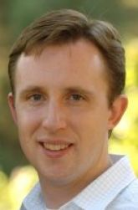
Shootings of Professors

Slide 4
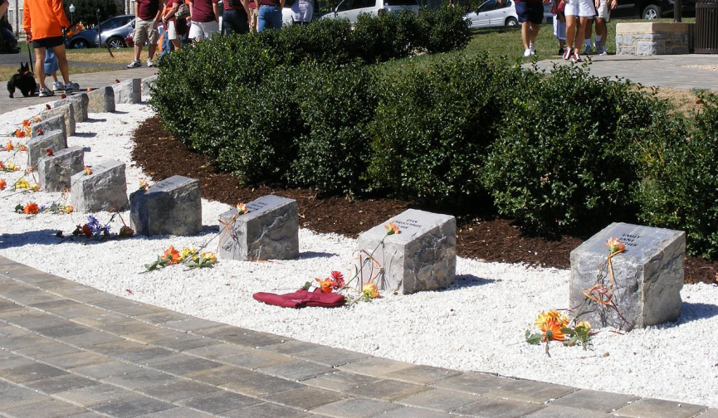
Shootings of Students

Slide 5

Shootings of Students Off Campus

Slide 6
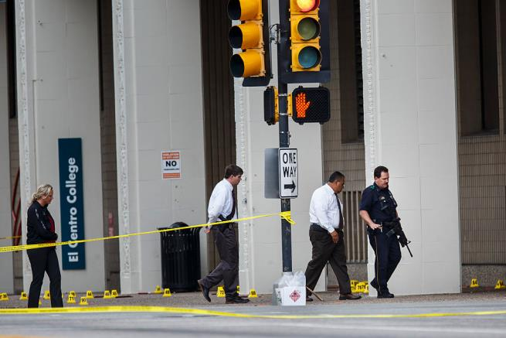
Campuses as Random Site of Violence
Getty Images

Slide 7
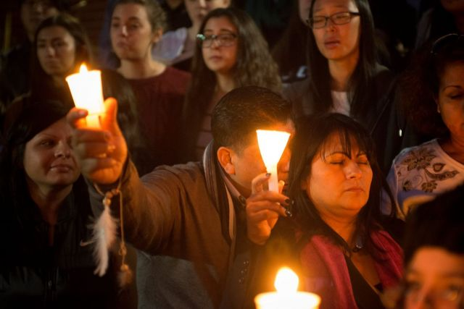

Risks of Study Abroad

Slide 8
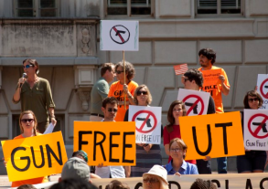

The Battle Over Campus Carry
The evolution of the debate (in Texas and elsewhere)
Some of the key arguments
The impact on teaching

Slide 9

The ‘Ban the Box’ Movement

Slide 10
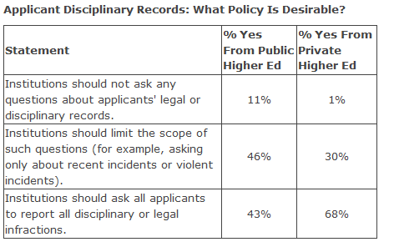
How Admissions Deans View the Box
From 2015 Inside Higher Ed survey of admissions officers:

Slide 11

Cybersecurity

Slide 12

Sexual Assault I: New Attention for an Old Issue

Slide 13

Sexual Assault II: Legal Issues
Title IX obligations
The “Dear Colleague” letter
Burden of proof
Effectiveness of campus disciplinary processes

Slide 14
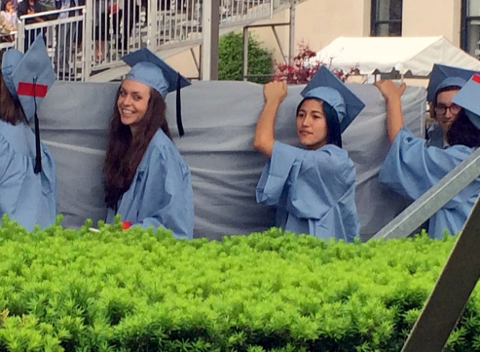

Sexual Assault III: The Public Discussion

Slide 15
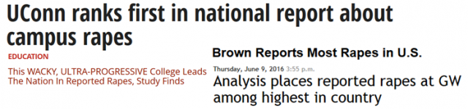
Crime on Campus: The Data Debate

Slide 16


Fallout From Bad Headlines

Slide 17
Your Questions
Q&A.
Suggestions for future coverage.

Slide 18



With Thanks

