Slide 1
New era of digital Accessibility
An Inside Higher Ed webinar
Tuesday, March 21, 2017 at 2 p.m. Eastern

Slide 2
Presenters
Scott Jaschik, editor, Inside Higher Ed, scott.jaschik@insidehighered.com
Doug Lederman, editor, Inside Higher Ed, doug.lederman@insidehighered.com

Slide 3
Key Federal Legislation
Section 504 of the Rehabilitation Act of 1973
Americans With Disabilities Act
The essential language (from 504 but also applies to ADA): "No otherwise qualified individual with a disability in the United States … shall, solely by reason of her or his disability, be excluded from the participation in, be denied the benefits of, or be subjected to discrimination under any program or activity receiving federal financial assistance…."

Slide 4
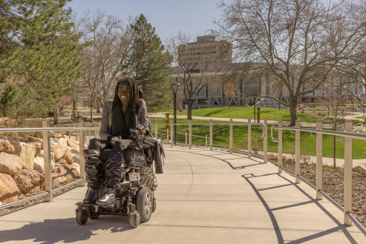
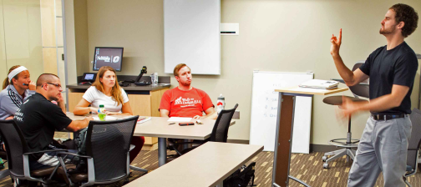
First Generation Accessibility Issues
Mobility issues and other physical disabilities – in traditional campus settings

Slide 5
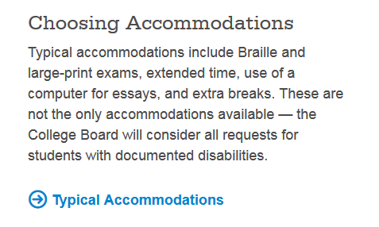
Second Generation Accessibility Issues
People with learning disabilities – again in traditional campus settings

Slide 6
The Digital Era Arrives
Immediate gains evident for people with hearing disabilities.
Key caveat: Many early online educational tools did not rely on audio.

Slide 7
Key Digital Transformations
Digital tools are central to teaching and learning, whether students are enrolled online or in face-to-face instruction.
LMS has become standard tool for record-keeping, professor-student communication and distribution of educational materials.
Digital means communication, not just delivery of information.
Digital means audio, not just visual.
The growth of mobile means that all of the above apply to multiple platforms.

Slide 8
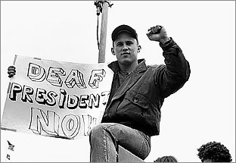
Key Political/Societal Transformations
People with disabilities are receiving more support in K12, enabling more to go on to higher education.
People with disabilities, individually and with support of groups and government officials, increasingly insist on their rights.
During Obama administration, Justice and Education Departments were more active than in the past.

Slide 9
Key Tools to Promote Accessibility
Captions/transcripts
Audio of written materials
Alternate ways to communicate graphics, photos, charts
Website design

Slide 10
Key Issues in Adopting Tools
Consistency (vs. hit and miss)
Faculty role at point of course development
Communicating the tools that are available

Slide 11
The LMS / Evolution of LMS

Slide 12
Library Collections

Slide 13
Ebooks

Slide 14
Free Online Content: MOOCs and More

Slide 15
When an Instructor Plans From the Start

Slide 16
Your Questions
Q&A
Ideas for coverage

Slide 17
With Thanks

