Slide 1
The Future of Educational materials and the Role of the College Bookstore
An Inside Higher Ed webinar
Thursday, October 13, 2 p.m. Eastern

Slide 2
Presenters
Scott Jaschik, editor, Inside Higher Ed
scott.jaschik@insidehighered.com
Doug Lederman, editor, Inside Higher Ed
doug.lederman@insidehighered.com

Slide 3
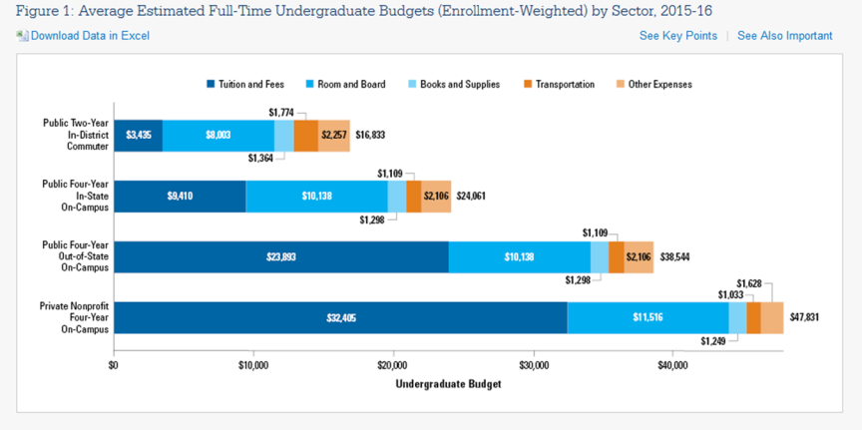
A Sliver, but an Important Sliver
--College Board data

Slide 4
Why Students Read and Don’t Read
It’s not quality writing, as most assume, but these factors (according to research from American Psychological Association):
Gender (female students more likely to read)
Quality of visuals
Quality of photographs
Whether faculty members are explicit about how textbook relates to material discussed in class

Slide 5
The PIRG Report and Its Critics
65% of students reported not buying a book because of cost.
94% of those students reported believing their grades would suffer as a result.
48% said price of textbooks influenced decisions about courses.
82% said that free online textbooks would help them do better academically.
How publishers responded to the data …

Slide 6
The Fullerton Controversy
Debate at one campus illustrated issues of cost, quality, students' needs and faculty rights.

Slide 7
Faculty Members’ Views - I

Slide 8
Faculty Members’ Views -- II

Slide 9
The Shift to Digital
For the first time in 2015, publishers (or companies that previously were called publishers) reported more revenue from digital than print.

Slide 10
The Moment of OER?

Slide 11
Persuading Professors

Slide 12
Bypassing Professors
--Getty Images

Slide 13
The Challenge of the $400 Textbook
Upper-level and specialized vs. introductory and general

Slide 14
Your Questions
Q&A.
Suggestions for future coverage.

Slide 15
With Thanks

