Slide 1
Evolving Economic Models for Higher Education
An Inside Higher Ed webinar
Tuesday, June 11
2 p.m. Eastern

Slide 2
Presenters
Scott Jaschik, editor, Inside Higher Ed, scott.jaschik@insidehighered.com
Doug Lederman, editor, Inside Higher Ed, doug.lederman@insidehighered.com

Slide 3
Agenda
Shifts that cross sector lines
Private
Public
Online

Slide 4

Cross-Sector: Have and Have-Not

Slide 5
Cross-Sector: Traditions No More
State appropriations
Feeder high schools
Assumption that going to college is wise

Slide 6

Cross-Sector: Debt

Slide 7
Cross-Sector: New Competition
Traditional sectors no longer stick to their traditional roles.
Online offerings mean no institution has a place-based monopoly.
Boot camps, badges and other non-degree models proliferate.

Slide 8
Cross-Sector: Underlying Costs
Scholarly publishing and tenure
Open access
Open educational resources

Slide 9

Private: The Limits of Robin Hood

Slide 10
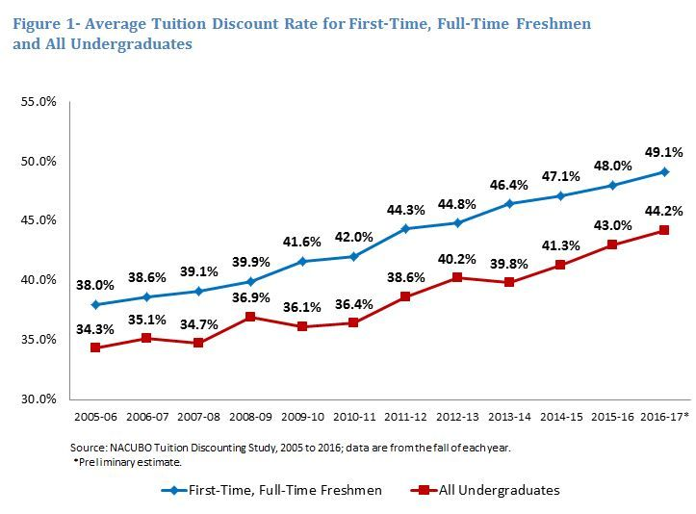
Private: Discount Rates

Slide 11


Private: Experiments With Tuition
Middlebury
Dayton
NYU
Cuomo plan

Slide 12
Private: Shift in Programs
Many colleges are adding programs (on campus and online) in fields they believe will attract tuition-paying students.
Such programs require investments (faculty, facilities, marketing).
Critics raise questions about mission alignment and likely success of strategy.

Slide 13


Private: Perpetual Fund-Raising

Slide 14
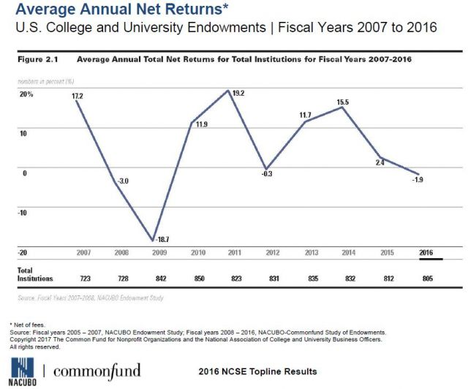
Private: Disappointing Endowments

Slide 15
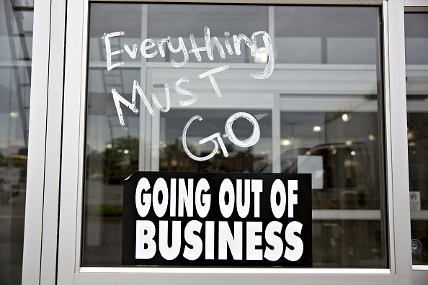
Private: Closures and Mergers

Slide 16
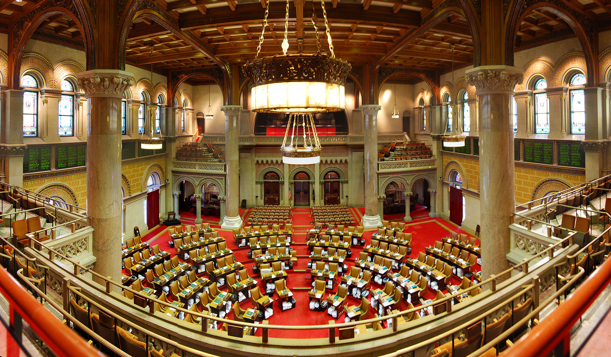
Public: State Appropriations

Slide 17

Public: Dysfunctional States

Slide 18
Public: Embracing Private Model
Out-of-state students
Private dollars
Seeking exemptions from state regulations
Program shifts
Risks of these strategies
Difficulty of these strategies outside flagships

Slide 19
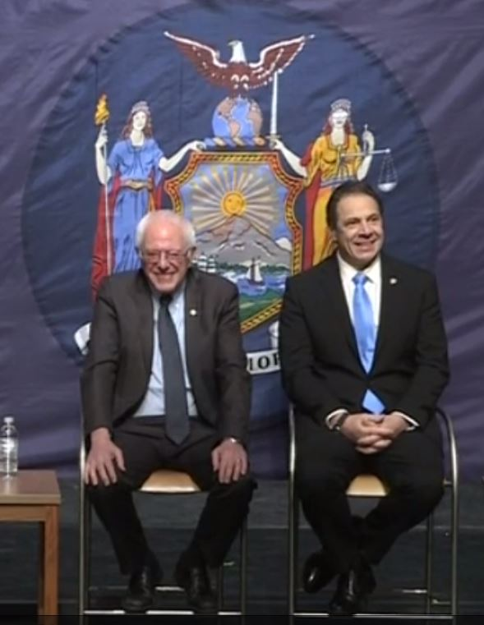
Public: Free Tuition
The promise and popularity of the idea
The fine print
Budget support

Slide 20

Public: Radical New Models

Slide 21
Public: Mergers, Collaboration
The Georgia model
Combining some campus functions

Slide 22
Online: The Great Hope
New programs
New revenue streams
Yes, but …

Slide 23
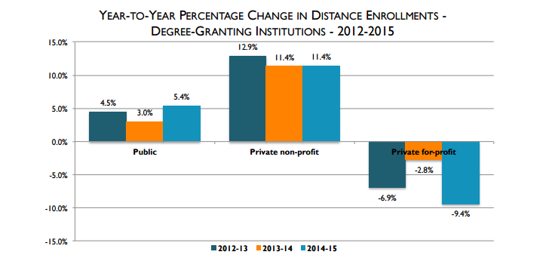
Online: Current (Volatile) Market

Slide 24
Q&A
Your questions
Suggestions for future coverage

Slide 25

With Thanks …

