Slide 1




Multi-State Collaborative To Advance Quality Student Learning
In partnership with:

Slide 2






Today’s Speakers & Moderator
Julie Carnahan
Terrel Rhodes
Catherine Wehlburg
MODERATOR
This webinar is brought to you by

Slide 3
Purpose of Today
Preview “30,000 foot” initial results from the Multi-State Collaborative Demonstration Year using the LEAP Value Rubrics
to inform teaching and learning.
Provide examples of detailed results to be released with full report in January 2017

Slide 4
These slides summarize results from the demonstration study involving 48 institutions in twelve states using common rubrics to assess more than 8,000 student work products. The sample of student work in the pilot represented the near-graduation students across the participating institutions in the twelve states only; therefore, the results are not generalizable for all students in each participating state or nationwide.

Slide 5
VALUE Rubric Approach Assumptions
Learning is a process that occurs over time
Student work is best representation of motivated learning
Focus on what student does in key learning outcomes
Faculty & educator expert judgment
Results are useful & actionable for learning (& accountability)

Slide 6
The Current VALUE Initiative
Purpose
  Sea change in assessment
  Reliability
  Validity
  Local value
  Policy debate = learning

Slide 7
The Multi-State Collaborative
States committed to the importance of learning outcomes and quality of a degree
Mindful of students contribution to the states in which they live
Respectful that teaching & learning is prerogative of faculty
Focus is on improvement of student learning not ranking states or institutions

Slide 8
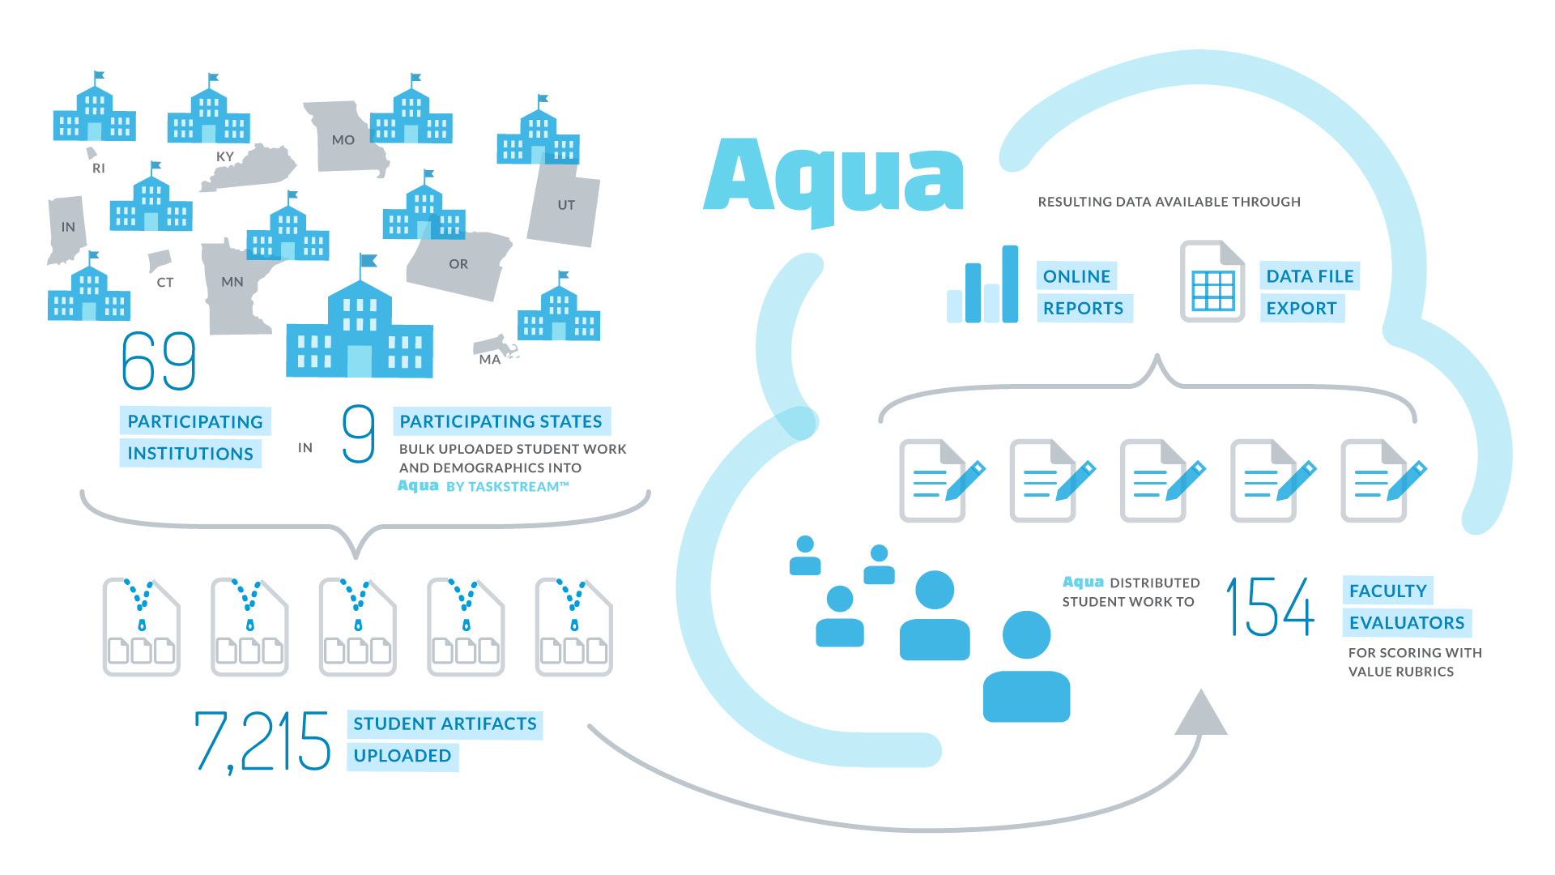
The MSC Challenge: Scaling Direct Assessment
8,308

Slide 9

Demonstration Year: Taking the vision to scale from 9 to 12 states
Steering Committee
Point person from each state and reps from SHEEO & AAC&U
Institution Point Persons
From each campus in each state
p
ME
MN
MA
OR
RI
CT
IN
UT
MO
KY
TX
HI

Slide 10
Demonstration Year: Taking the vision to scale from 9 to 12 states
Goals
  Root assessment of learning in authentic work & the expertise of faculty
  Establish benchmarks for essential learning outcomes
  Develop transparency of shared standards of learning to assist with transfer
ME
MN
MA
OR
RI
CT
IN
UT
MO
KY
TX
HI

Slide 11
Multi-State Collaborative To Advance Learning Outcomes Assessment
Preview of Demonstration Year (2016) Results

Slide 12
MSC Demonstration Year by the Numbers
48 public institutions uploaded artifacts
By sector
  29 four-year, including 8 research institutions
  19 two-year
ME
MN
MN
MA
OR
OR
RI
CT
IN
IN
UT
UT
KY
MO
KY
MO
TX
HI
These results are not generalizable across participating states or the nation in any way. Please use appropriately.

Slide 13
MSC Demonstration Year by the Numbers
8,308
1886
pieces of student work were submitted
assignments were submitted*
These results are not generalizable across participating states or the nation in any way. Please use appropriately.

Slide 14
Artifacts Scored Per Outcome
MSC Demonstration Year Profile of VALUE Scorers
These results are not generalizable across participating states or the nation in any way. Please use appropriately.

Slide 15
Profile of Scorers by Discipline and/or Institutional Role
MSC Demonstration Year Profile of VALUE Scorers
These results are not generalizable across participating states or the nation in any way. Please use appropriately.

Slide 16
Critical Thinking Rubric Dimensions
 | Capstone 4 | Milestones 3 2 |  | Benchmark 1
Explanation of issues | Issue/problem to be considered critically is stated clearly and described comprehensively, delivering all relevant information necessary for full understanding. | Issue/problem to be considered critically is stated, described, and clarified so that understanding is not seriously impeded by omissions. | Issue/problem to be considered critically is stated but description leaves some terms undefined, ambiguities unexplored, boundaries undetermined, and/or backgrounds unknown. | Issue/problem to be considered critically is stated without clarification or description.
Evidence Selecting and using information to investigate a point of view or conclusion | Information is taken from source(s) with enough interpretation/evaluation to develop a comprehensive analysis or synthesis. Viewpoints of experts are questioned thoroughly. | Information is taken from source(s) with enough interpretation/evaluation to develop a coherent analysis or synthesis. Viewpoints of experts are subject to questioning. | Information is taken from source(s) with some interpretation/evaluation, but not enough to develop a coherent analysis or synthesis. Viewpoints of experts are taken as mostly fact, with little questioning. | Information is taken from source(s) without any interpretation/evaluation. Viewpoints of experts are taken as fact, without question.
Influence of context and assumptions | Thoroughly (systematically and methodically) analyzes own and others' assumptions and carefully evaluates the relevance of contexts when presenting a position. | Identifies own and others' assumptions and several relevant contexts when presenting a position. | Questions some assumptions. Identifies several relevant contexts when presenting a position. May be more aware of others' assumptions than one's own (or vice versa). | Shows an emerging awareness of present assumptions (sometimes labels assertions as assumptions). Begins to identify some contexts when presenting a position.
Student's position (perspective, thesis/hypothesis) | Specific position (perspective, thesis/hypothesis) is imaginative, taking into account the complexities of an issue. Limits of position (perspective, thesis/hypothesis) are acknowledged. Others' points of view are synthesized within position (perspective, thesis/hypothesis). | Specific position (perspective, thesis/hypothesis) takes into account the complexities of an issue. Others' points of view are acknowledged within position (perspective, thesis/hypothesis). | Specific position (perspective, thesis/hypothesis) acknowledges different sides of an issue. | Specific position (perspective, thesis/hypothesis) is stated, but is simplistic and obvious.
Conclusions and related outcomes (implications and consequences) | Conclusions and related outcomes (consequences and implications) are logical and reflect student’s informed evaluation and ability to place evidence and perspectives discussed in priority order. | Conclusion is logically tied to a range of information, including opposing viewpoints; related outcomes (consequences and implications) are identified clearly. | Conclusion is logically tied to information (because information is chosen to fit the desired conclusion); some related outcomes (consequences and implications) are identified clearly. | Conclusion is inconsistently tied to some of the information discussed; related outcomes (consequences and implications) are oversimplified.
For full text of AAC&U VALUE Rubric for Critical Thinking, see: https://www.aacu.org/value/rubrics/critical-thinking.

Slide 17
These results are not generalizable across participating states or the nation in any way. Please use appropriately.

Slide 18
Quantitative Literacy Rubric Dimensions
 | Capstone 4 | Milestones 3 2 |  | Benchmark 1
Interpretation Ability to explain information presented in mathematical forms (e.g., equations, graphs, diagrams, tables, words) | Provides accurate explanations of information presented in mathematical forms. Makes appropriate inferences based on that information. For example, accurately explains the trend data shown in a graph and makes reasonable predictions regarding what the data suggest about future events. | Provides accurate explanations of information presented in mathematical forms. For instance, accurately explains the trend data shown in a graph. | Provides somewhat accurate explanations of information presented in mathematical forms, but occasionally makes minor errors related to computations or units. For instance, accurately explains trend data shown in a graph, but may miscalculate the slope of the trend line. | Attempts to explain information presented in mathematical forms, but draws incorrect conclusions about what the information means. For example, attempts to explain the trend data shown in a graph, but will frequently misinterpret the nature of that trend, perhaps by confusing positive and negative trends.
Representation Ability to convert relevant information into various mathematical forms (e.g., equations, graphs, diagrams, tables, words) | Skillfully converts relevant information into an insightful mathematical portrayal in a way that contributes to a further or deeper understanding. | Competently converts relevant information into an appropriate and desired mathematical portrayal. | Completes conversion of information but resulting mathematical portrayal is only partially appropriate or accurate. | Completes conversion of information but resulting mathematical portrayal is inappropriate or inaccurate.
Calculation | Calculations attempted are essentially all successful and sufficiently comprehensive to solve the problem. Calculations are also presented elegantly (clearly, concisely, etc.) | Calculations attempted are essentially all successful and sufficiently comprehensive to solve the problem. | Calculations attempted are either unsuccessful or represent only a portion of the calculations required to comprehensively solve the problem. ﻿ | Calculations are attempted but are both unsuccessful and are not comprehensive.
Application / Analysis Ability to make judgments and draw appropriate conclusions based on the quantitative analysis of data, while recognizing the limits of this analysis | Uses the quantitative analysis of data as the basis for deep and thoughtful judgments, drawing insightful, carefully qualified conclusions from this work. | Uses the quantitative analysis of data as the basis for competent judgments, drawing reasonable and appropriately qualified conclusions from this work. | Uses the quantitative analysis of data as the basis for workmanlike (without inspiration or nuance, ordinary) judgments, drawing plausible conclusions from this work. | Uses the quantitative analysis of data as the basis for tentative, basic judgments, although is hesitant or uncertain about drawing conclusions from this work.
Assumptions Ability to make and evaluate important assumptions in estimation, modeling, and data analysis | Explicitly describes assumptions and provides compelling rationale for why each assumption is appropriate. Shows awareness that confidence in final conclusions is limited by the accuracy of the assumptions. | Explicitly describes assumptions and provides compelling rationale for why assumptions are appropriate. | Explicitly describes assumptions. | Attempts to describe assumptions.
Communication Expressing quantitative evidence in support of the argument or purpose of the work (in terms of what evidence is used and how it is formatted, presented, and contextualized) | Uses quantitative information in connection with the argument or purpose of the work, presents it in an effective format, and explicates it with consistently high quality. | Uses quantitative information in connection with the argument or purpose of the work, though data may be presented in a less than completely effective format or some parts of the explication may be uneven. | Uses quantitative information, but does not effectively connect it to the argument or purpose of the work. | Presents an argument for which quantitative evidence is pertinent, but does not provide adequate explicit numerical support. (May use quasi-quantitative words such as "many," "few," "increasing," "small," and the like in place of actual quantities.)
For full text of AAC&U VALUE Rubric for Quantitative Literacy, see: https://www.aacu.org/value/rubrics/quantitative-literacy

Slide 19
These results are not generalizable across participating states or the nation in any way. Please use appropriately.

Slide 20
Questions?

Slide 21
Potential to Disaggregate by Demographic Characteristics

Slide 22
Critical Thinking Scores by Race
2 year
4 year
Asian Black Hispanic White
These results are not generalizable across participating states or the nation in any way. Please use appropriately.

Slide 23
Critical Thinking Scores by Pell Eligibility
2 year
4 year
Not Eligible Pell Eligible
Not Eligible Pell Eligible
These results are not generalizable across participating states or the nation in any way. Please use appropriately.

Slide 24
State Level Results
Potential to Inform State Level Policy
Transfer & Articulation
Equity
Increase resources to support professional development
Inform policy leaders about the learning outcomes students in state are demonstrating

Slide 25
MSC Criterion State Level Score Distribution

Slide 27
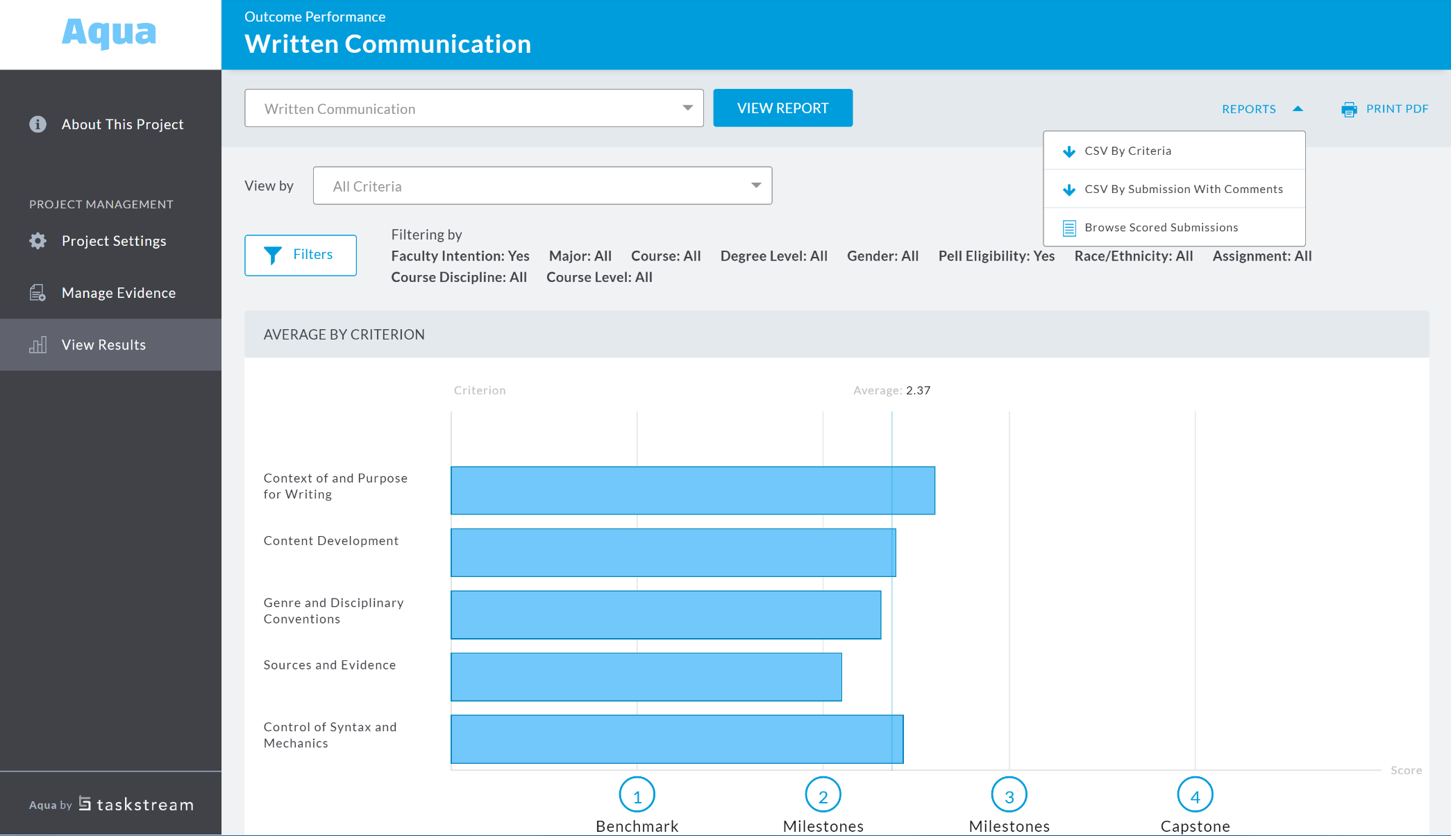
Institution Level Results

Slide 28
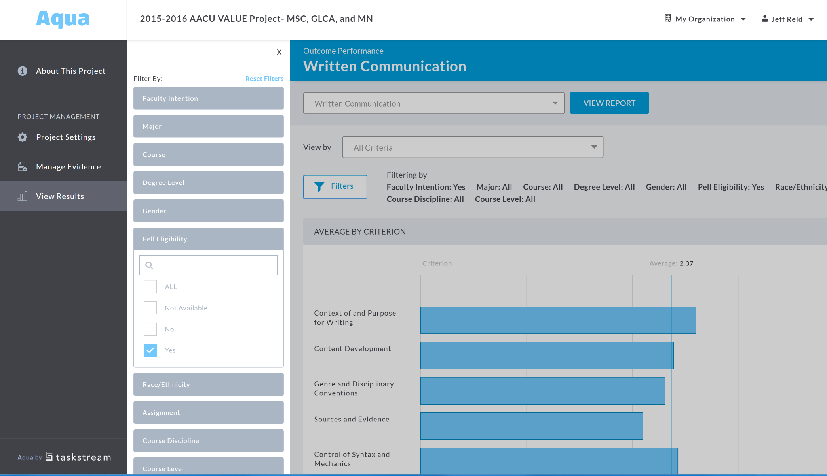
Institution Level Results

Slide 29
Questions?

Slide 30
Inherent Challenge for VALUE
Navigating Methodological Complexity

Slide 31

Nature & Implications of Complexity
Establishing the validity & reliability of VALUE is a key priority

Slide 32
Reality Check
There is no large-scale model for what we are doing.
The very variables other assessment approaches “control” or “eliminate” VALUE embraces.

Slide 33
Purpose = Discuss validity & reliability in relation to inherent complexity of VALUE

Slide 34
A Careful Balancing Act

Slide 35
VALUE & Validity

Slide 36
Faculty & staff saw the VALUE rubrics as valid.
Percent of scorers who reported Strongly Agree or Agree with each aspect of rubric use
These results are not generalizable across participating states or the nation in any way. Please use appropriately.

Slide 37
Lessons Learned
Actionable data about student achievement and improvement of key learning outcomes on specific key dimensions of these important learning outcomes can be generated via a common rubric-based assessment approach.
Faculty can effectively use common rubrics to evaluate student work products—even those produced for courses outside their area of expertise.
Following training, faculty members can produce reliable results using a rubric-based assessment approach.
Faculty report that the VALUE Rubrics used in the study do encompass key elements of each learning outcome studied, and were very useful for assessing student work and for improving assignments.
A web-based platform can create an easily usable framework for uploading student work products and facilitating their assessment.

Slide 38
Next Steps
MSC Refinement Year (year three)
13 states, five with representative samples for the state
20,000 artifacts collected and uploaded
Establishment of inter-state “SWAT” teams
Increased focus on evaluation – panel of data scientists
Increased focus on equity
Explore feasibility of sub-study following students into the workforce

Slide 39
Virginia joins as 13th state.
ME
MN
MA
OR
RI
CT
IN
VA
UT
MO
KY
TX
HI

Slide 40
Questions?

Slide 41



Contact Us!
Julie Carnahan
JCarnahan@sheeo.org
Terrel Rhodes
rhodes@aacu.org
Taskstream.com/Aqua
events@taskstream.com

