Slide 1
Key trends in graduate and professional education: Attracting Students in Changing Times
An Inside Higher Ed webinar
Wednesday, November 2 at 2 p.m. Eastern

Slide 2
Presenters
Scott Jaschik, editor, Inside Higher Ed
scott.jaschik@insidehighered.com
Doug Lederman, editor, Inside Higher Ed
doug.lederman@insidehighered.com

Slide 3
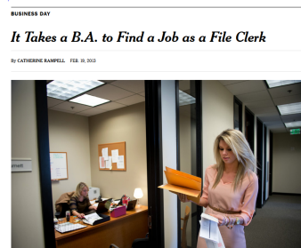
Why Grad School Matters
The hype and the reality
The impact of the recession and the limited recovery
The liberal arts
For higher education, a range of motives

Slide 4
Grad Degrees and Income

Slide 5
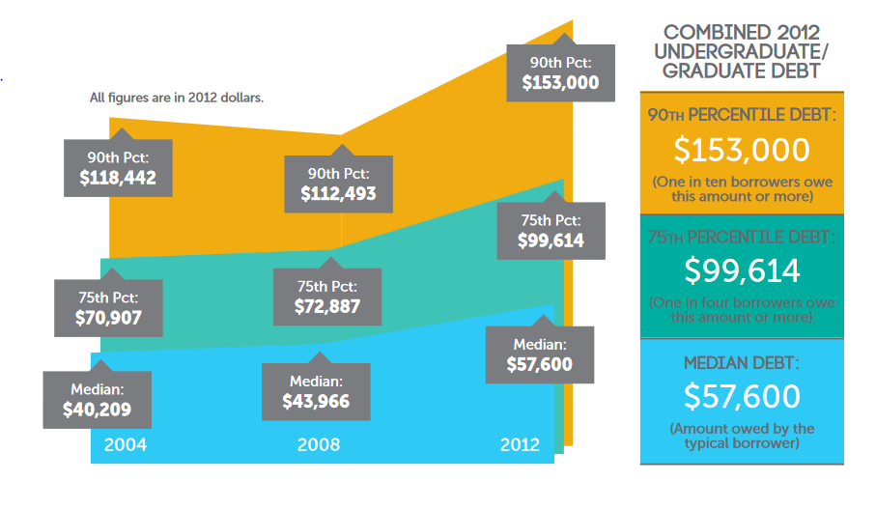
Grad Degrees and Debt
--Graphic from New America

Slide 6
The Risk of Generalization
Graduate and professional education programs vary widely in length of degree, expense, post-graduation pay and many other factors.
Availability of generous financial aid is common in some programs and unheard of in others.
The motives of students for pursuing graduate education also vary widely.

Slide 7
Getting In (Elite Programs)
The revelations and impact of the 2016 book Inside Graduate Admissions: Merit, Diversity and Faculty Gatekeeping

Slide 8
Getting In: The Global (Elite) Competition

Slide 9
Getting In (Everywhere Else)
Many graduate and professional programs are effectively open admissions (if you can pay).
Much of the battle for students is either local or local vs. online.
Impact of willingness of employers to pay.
Law school admissions/enrollment as the model feared by many other grad/professional programs.

Slide 10
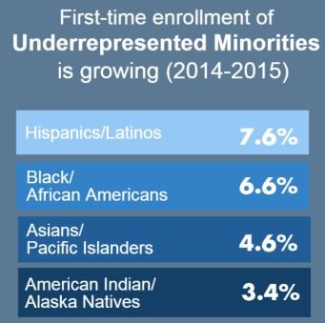
Numbers Going Up
First-time graduate enrollments were up 3.9% in fall 2015, largest one-year gain since 2009.
Minority enrollments increased by larger percentage than total enrollments.

Slide 11
The International Factor: 1-Year Change in First-Time International Graduate Enrollments
 | Fall 2012 | Fall 2013 | Fall 2014
Total | +10% | +8% | +5%
Asia
--China | +5% | -1% | +12%
--India | +40% | +27% | +12%
--South Korea | -12% | -7% | +5%
--Taiwan | -8% | -8% | +2%
Europe | +3% | +3% | -4%

Slide 12
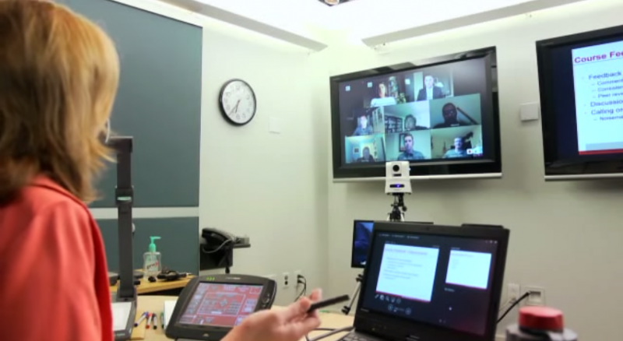
The Online Impact I: The M.B.A. Reboot

Slide 13
The Online Impact II: Georgia Tech Master’s Program

Slide 14
The Online Impact III: MicroMasters

Slide 15
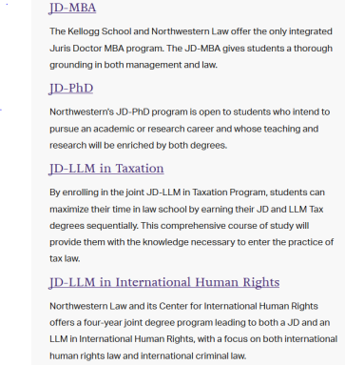
Dual Programs

Slide 16
Tip-Toeing Into Graduate Education

Slide 17
Your Questions
Q&A.
Suggestions for future coverage.

Slide 18
With Thanks

