Slide 1
New Challenges in Graduate and Professional Education
An Inside Higher Ed webcast
Wednesday, November 15 at 2 p.m. EST

Slide 2
Presenter
Scott Jaschik, editor, Inside Higher Ed, scott.jaschik@insidehighered.com

Slide 3
Agenda
Issues that cross various graduate and professional fields
Master’s/Ph.D. programs
Law
Medicine
Business
Common themes across professional education

Slide 4
Issues Across Varying Programs
Doubts about value of bachelor’s degrees
New competition for master’s degrees
Demonstrating value of graduate/professional education
Uncertainty in the economy
Diversity
International enrollments

Slide 5
Enrollment Trends

Slide 6
Degree Trends

Slide 7
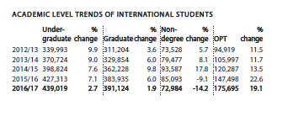
International Students - I
--Institute of International Education

Slide 8
International Students -- II

Slide 9
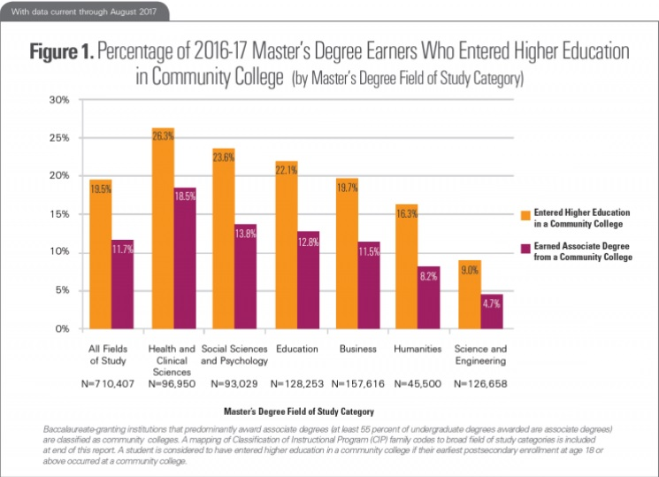
Casting a Wider Net
--From National Student Clearinghouse

Slide 10
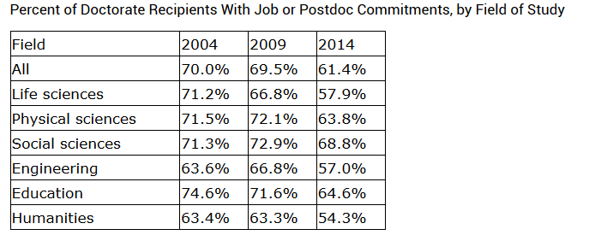
Doctoral Education: Where Are the Jobs?
--From Survey of Earned Doctorates

Slide 11
Debates Over Ph.D. Job Market
Promoting non-academic careers
Focusing on decline in tenure-track positions and treatment of adjuncts
Questioning whether too many doctoral students are admitted in some fields or programs (third rail issue!)

Slide 12
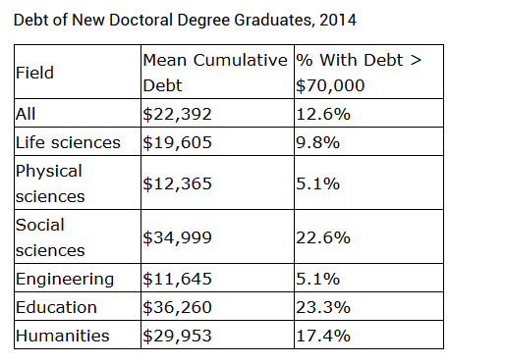
Doctoral Student Debt
--From Survey of Earned Doctorates

Slide 13
Potential Impact of Tax Bill

Slide 14
Does Doctoral Education Discourage Academic STEM Careers?

Slide 15
Law Schools’ Viability
Criticism over job placement rates
Reaction to Whittier closure
Concerns on for-profit law schools

Slide 16
Law School Admissions
Testing options
Reliance on testing
Diversity

Slide 17
Flipped Med School Classrooms

Slide 18
Medical School Growth
New medical schools
Significant growth in medical schools
For-profit medical schools
Concerns about specializations

Slide 19
Decline of E.M.B.A.s
Why they were once seen as cash cow
New competition
Different educational needs

Slide 20
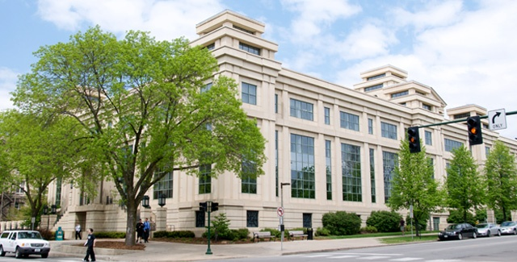
M.B.A. Programs
Decline of full-time programs
Rise of specialized programs, many of which are not degrees

Slide 21
Across Professional Programs: Elites vs. Non-elites

Slide 22
Questions
Your questions
Your ideas for future coverage

Slide 23
With Thanks …

