Slide 1
Coping With Uncertainty:
American Colleges and International Students
An Inside Higher Ed webinar
Tuesday, June 13, 2017
2 p.m. Eastern

Slide 2
Presenters
Scott Jaschik, editor, Inside Higher Ed, scott.jaschik@insidehighered.com
Doug Lederman, editor, Inside Higher Ed, doug.lederman@insidehighered.com

Slide 3
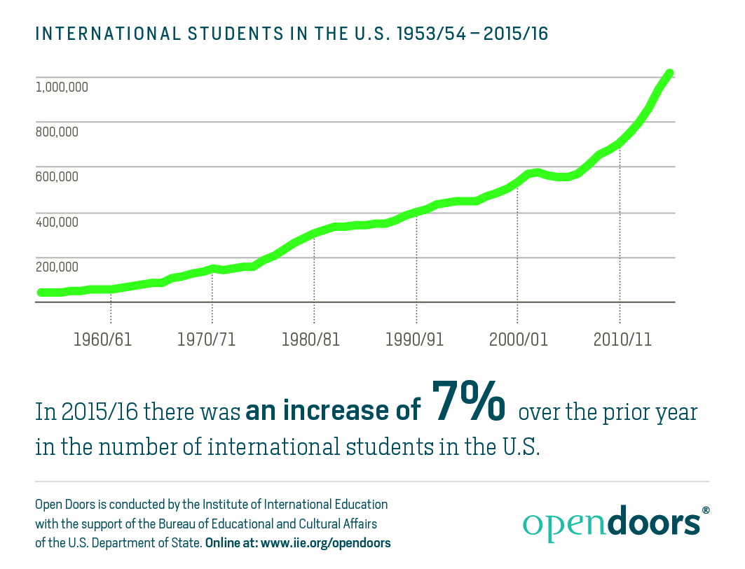
The Longterm Trends

Slide 4
Countries of Origin
Country | # of International Students, 2015-16 | Percent Change From Prior Year
1. China | 328,547 | +8.1%
2. India | 165,918 | +24.9%
3. Saudi Arabia | 61,287 | +2.2%
4. South Korea | 61,007 | -4.2%
5. Canada | 26,973 | -1.0%

Slide 5
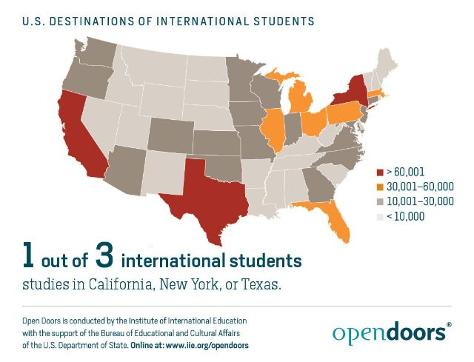
Where They Enroll

Slide 6


The Travel Ban

Slide 7


Countering the Message

Slide 8
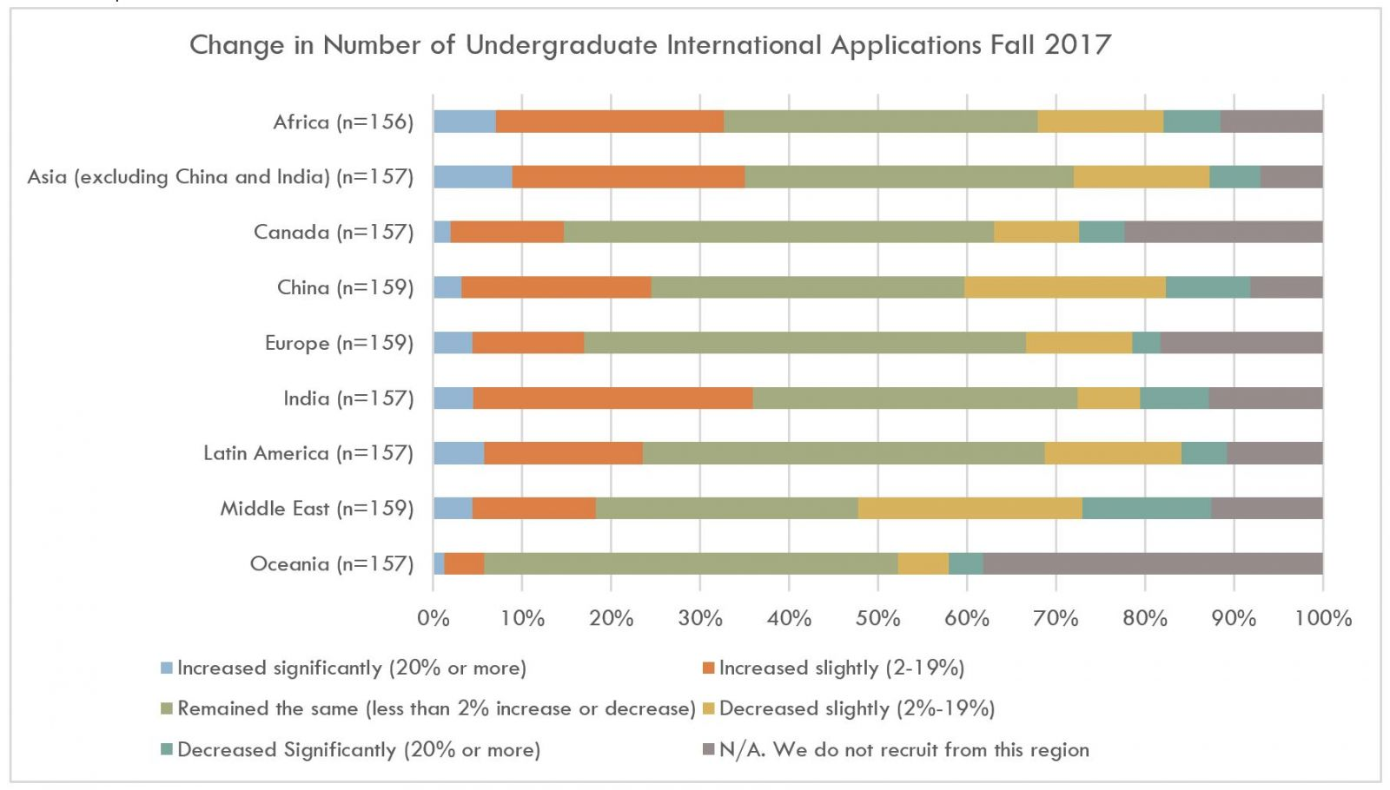
The Trump Impact So Far

Slide 9
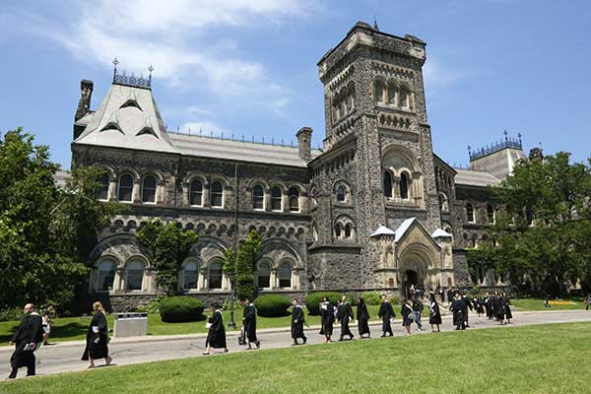
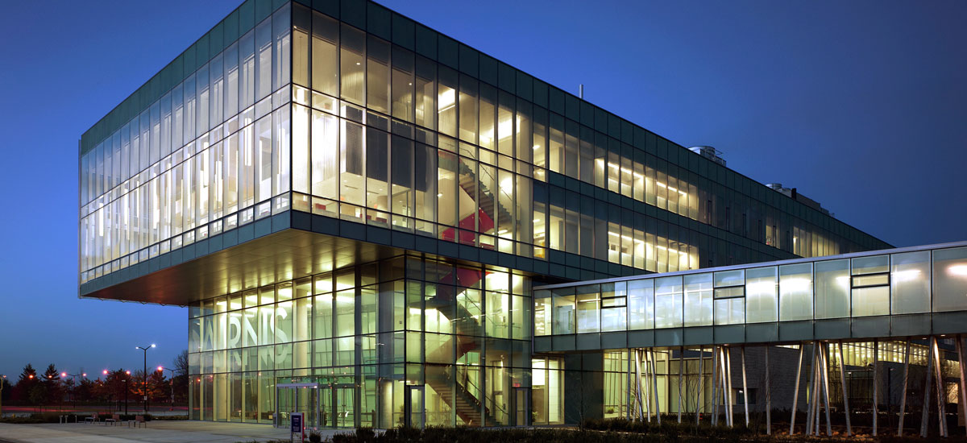

O Canada

Slide 10
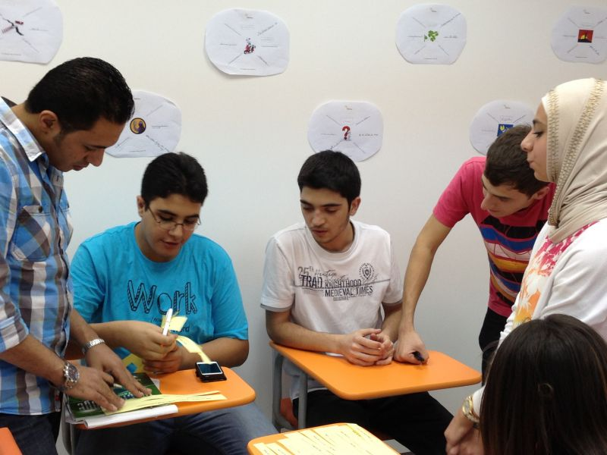
Are Saudis Staying Home?

Slide 11

Countries Rise and Fall

Slide 12

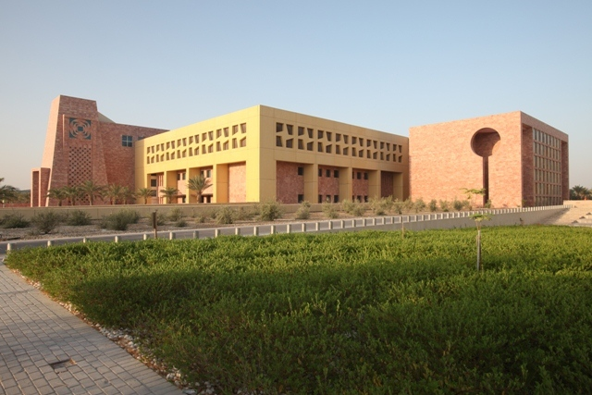
Crisis in Qatar

Slide 13
(Over-?) Reliance on China
Numbers go up year after year.
China’s investments in its own universities go up year after year.
Value of American degrees (at non-elite universities) is questioned by some in China.
Tensions in U.S.-China relations create risks.

Slide 14
The Never-Ending Agents Debate
The history
NACAC’s shift and the response
An accreditation challenge

Slide 15
Strategies
Pathways programs
Diversifying country base
The road less traveled
Offering more aid

Slide 16
Questions

Slide 17

With Thanks

