Slide 1

Lifelong learning
Through Alternative Credentials
An Inside Higher Ed webinar
Tuesday, April 11 at 2 p.m. Eastern

Slide 2

Presenters
Scott Jaschik, editor, Inside Higher Ed, scott.jaschik@insidehighered.com
Doug Lederman, editor, Inside Higher Ed, doug.lederman@insidehighered.com

Slide 3
Master’s Degrees -- I
Institutions awarding most master’s degrees
and 8-year percentage increase, 2012
Sources: Washington Post, Education Department
College | # of Degrees | 8-Year %
U of Phoenix Online | 18,602 | 183%
New York U | 6,876 | 29%
Columbia U | 6,794 | 49%
Grand Canyon U | 6,385 | 421%
U of Southern California | 6,136 | 67%

Slide 4
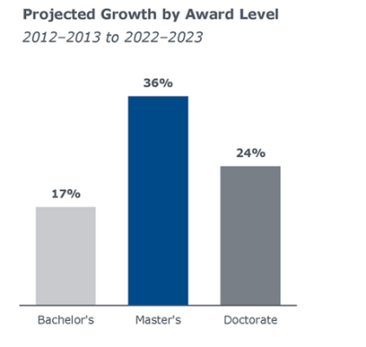
Master’s Degrees -- II
Source: EAB

Slide 5

Master’s Degrees and Alternative Credentials
Both lack initial signal of a bachelor’s degree and the ultimate signal of a doctoral degree.
Strong presumption of career orientation.
Strong presumption that the student (or employer) is paying – either directly or in wages post-degree.
Many formats available, in person and online.

Slide 6

Ryan Craig’s ‘College MVP’ Idea
Traditional College | College MVP
Faculty-centric | Employer-centric
Learning outcomes | Competencies / skills
Curriculum | Assessment
Assignments | Work product
Liberal arts | Critical thinking
Electives | Prescribed pathway

Slide 7

Competency-Based Education
Awarded based on demonstrated skills, not seat time.
Initial growth was from upstart institutions, but now embraced by big names as well.
Significantly alters role of educators (professors), frequently into coach model.
Gaining enrollments.
Support from many political leaders.

Slide 8
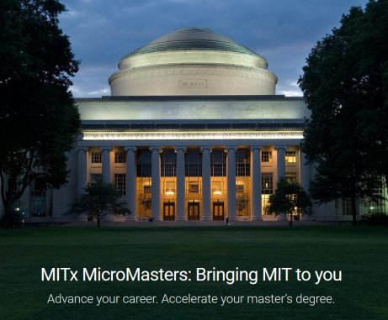
The Evolution of the MOOC Model
Georgia Tech computer science
MIT (and others) MicroMasters

Slide 9
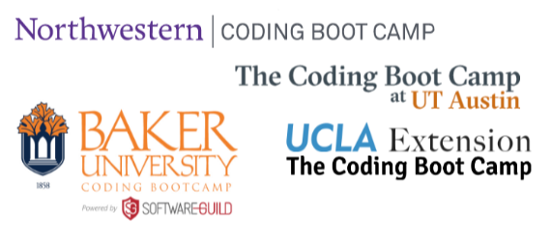
Coding Academies
Freestanding
Linked to universities

Slide 10
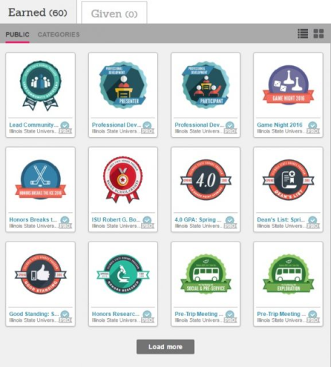
Badges

Slide 11

Key Question for Future: Employers

Slide 12

Key Question for Future: Oversight

Slide 13
Your Questions
Q&A

Slide 14

With Thanks …

