Slide 1
Recruitment, Diversity, Success
An Inside Higher Ed webinar
Wednesday, June 15 at 2 p.m. Eastern

Slide 2
Presenters
Scott Jaschik, editor, Inside Higher Ed
scott.jaschik@insidehighered.com
Doug Lederman, editor, Inside Higher Ed
doug.lederman@insidehighered.com

Slide 3
An Overview: Connected Issues

Slide 4
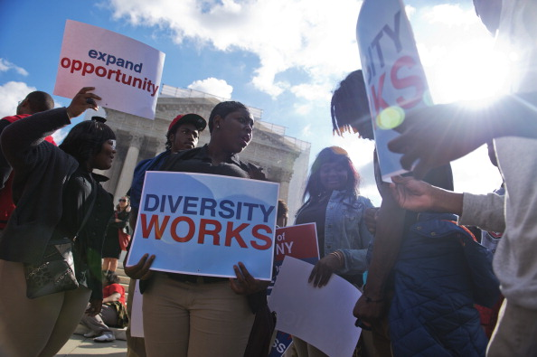
Recruitment I – Waiting for Supreme Court

Slide 5
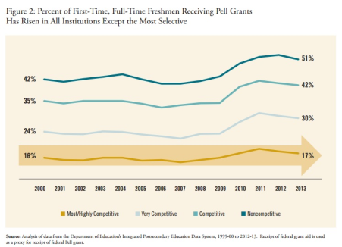
Recruitment II – Disadvantaged Students
Policies that help and policies that discourage.
Class vs. race (or class plus race).
The impact of policies at prestigious institutions and the institutions that enroll many more low-income students.

Slide 6
Recruitment III – The Out-of-State Strategy

Slide 7
Recruitment IV – The Out-of-State Backlash

Slide 8
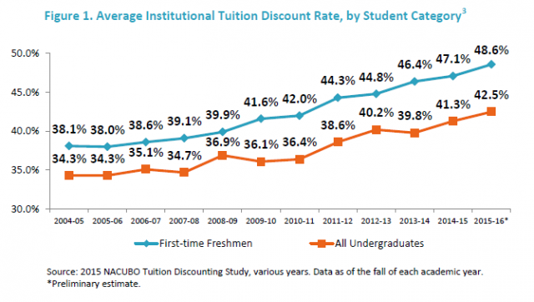
Recruitment V – Luring (Bribing?) Students
Gimmicks.
Admissions requirements.
Discount rates.

Slide 9
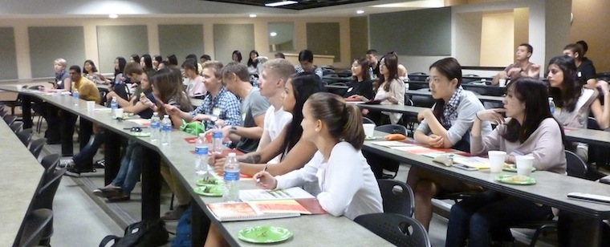
Recruitment VI -- Transfer
The Florida/California model.
Private colleges with strong records.
Private colleges just starting.

Slide 10
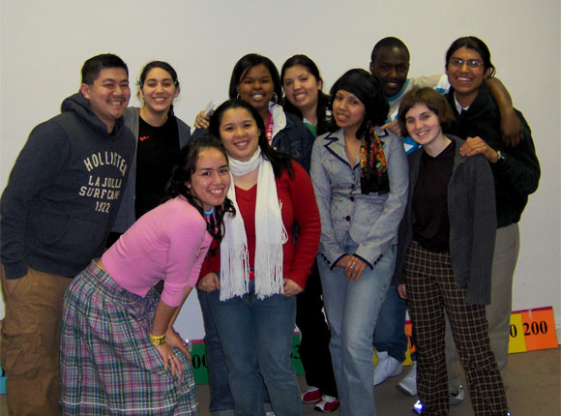
Recruitment VII – Cohort Approach
The Posse approach.
The Grinnell rejection of the approach.

Slide 11
Diversity I – Definitions and Goals
Race, class, gender, disability, sexual orientation, gender identity.
Who is counted and who isn’t?
Combinations that matter.
Faux diversity.
Different goals for different missions.

Slide 12
Diversity II – Programs for Black Males

Slide 13
Diversity III – Can Inclusivity Be Measured?

Slide 14
Diversity IV – What the Protests Mean

Slide 15
Success I – Missing Part of Equation
For students.
For institutions.
For public policy.

Slide 16
Success II – Different Success Levels

Slide 17
Success III – Missing Data
Flaws in federal completion rates.
Lack of uniform student unit records.

Slide 18
Success IV – Try and Try Again

Slide 19
Your Questions
Q&A.
Suggestions for future coverage.

Slide 20
With Thanks

