Slide 1
Student Learning and Course Materials
An Inside Higher Ed webcast
Wednesday, October 25
2 p.m. Eastern

Slide 2
Presenters
Scott Jaschik, editor, Inside Higher Ed, scott.jaschik@insidehighered.com
Doug Lederman, editor, Inside Higher Ed, doug.lederman@insidehighered.com

Slide 3
Our Framework Today

Slide 4
Student Learning: Where’s the Rigor?
Lessons From Academically Adrift:
32% of students do not take any courses in a given semester with more than 40 pages of reading assigned a week.
Half don’t take a single course in which they must write more than 20 pages over the course of a semester.
Students spend, on average, about 12-14 hours a week studying.

Slide 5
Rigor and Learning
Also from Academically Adrift: Students whose classes reflect high expectations (more than 40 pages of reading a week) saw greater increases in skills and knowledge in college than did other students.

Slide 6
Where’s the Challenge?
--From National Survey of Student Engagement

Slide 7
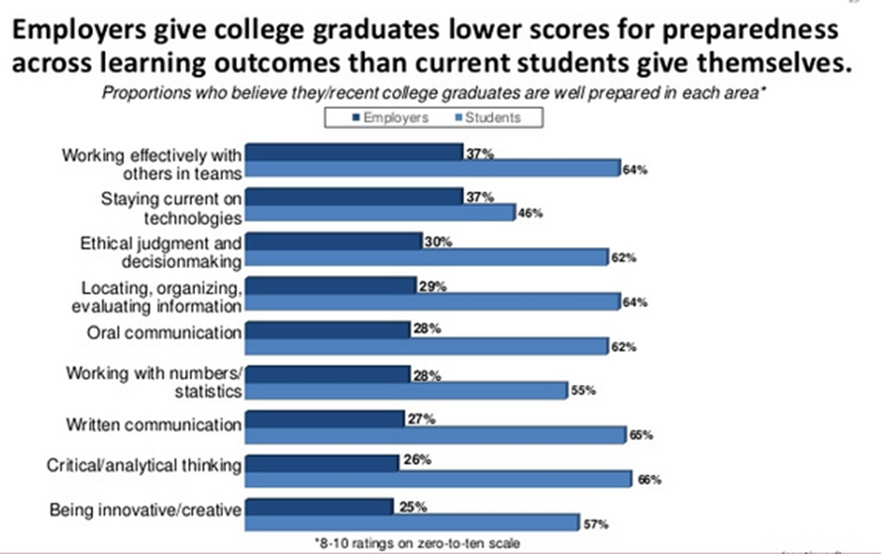
Students’ Inflated Views of Themselves
--From Association of American Colleges and Universities

Slide 8
Who Uses Textbooks: 4 Factors per American Psychological Association
Gender of student
Quality of photographs
Quality of visuals
Links by instructor between in-class lectures/discussions and the readings

Slide 9
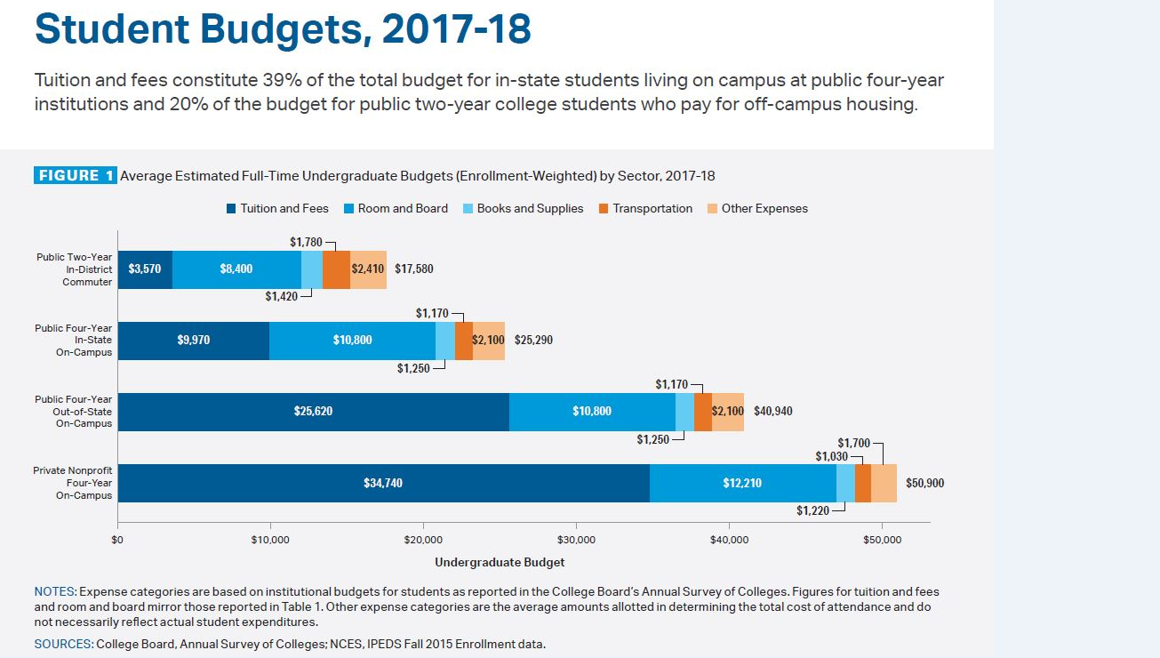
Books and Materials as Share of Student Budgets (With Caveats)
--From the College Board

Slide 10
Prices, Student Choices and Grades
85% of students delay or avoid altogether purchasing textbooks for their courses.
91% of these students say cost is the reason.
Half report that their grades were lower as a result.
--Study of 1,000 undergraduates by Wakefield Research (sponsored by VitalSource)

Slide 11
Changes in Ideas About Teaching
“Active” classrooms
Flipped classrooms
Greater emphasis on student success
Course materials in all of the above

Slide 12
The Arrival/Viability of Etexts
The false predictions (of 5 years ago, 10 years ago, 15 years ago) and why they didn’t come true
What’s changed (technology)
What’s changed (students)
What’s changed (instructors)
What’s changed (worries about money)

Slide 13
The Significance of OER
Concept
Challenges
Pure OER
OER (assisted)
Mix and match

Slide 14
Rethinking How Choices Are Made
Numerous surveys suggest that professors believe cost should be considered in course material selection.
When push comes to shove, it’s unclear that many act on that belief.
Dispute at Cal State Fullerton illustrates tensions.

Slide 15
New Business Models
“Inclusive access”
Other ways to reduce prices

Slide 16
Q&A
Your questions
Ideas for future coverage

Slide 17
With Thanks …

