Slide 1

The Evolving Quest
For Student Success
An Inside Higher Ed webinar
Tuesday, April 18 at 2 p.m. Eastern

Slide 2

Presenters
Scott Jaschik, editor, Inside Higher Ed, scott.jaschik@insidehighered.com
Doug Lederman, editor, Inside Higher Ed, doug.lederman@insidehighered.com

Slide 3

Agenda
Brief history of the movement
Potential philosophical turning points
Hot ideas

Slide 4
Brief Recap of the Movement
From 60s on, educators and politicians pushed to broaden access to American higher education.
From 90s on, concerns started to grow about student success, with concerns about low retention and graduation rates.
From 2000s on, more attention is paid to completion as key metric.
During Obama administration, unusual convergence of interest in student success (among state and federal governments, Republicans and Democrats, foundations and educators).

Slide 5
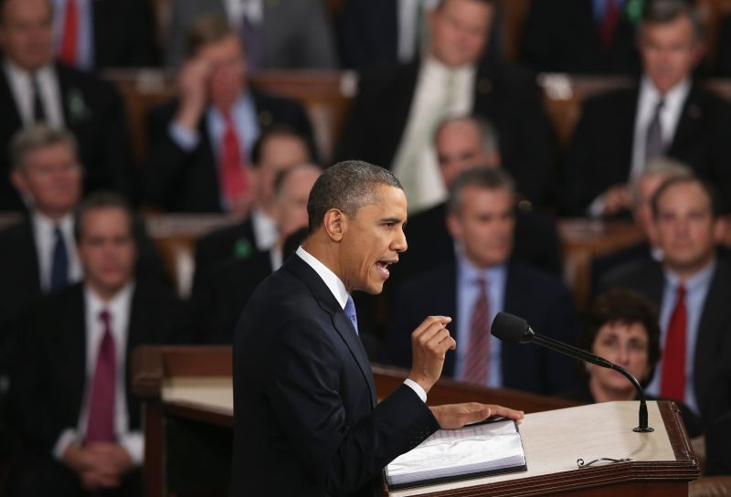
The Obama Impact

Slide 6
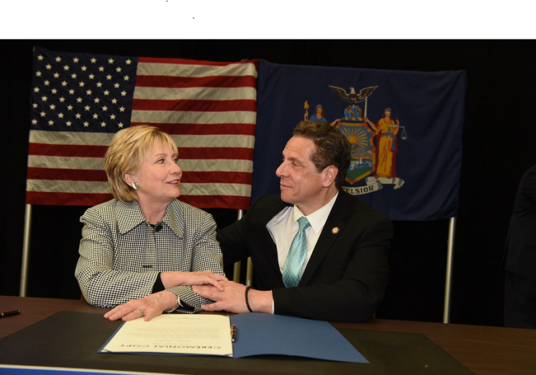
Impact of Free Tuition Movement

Slide 7
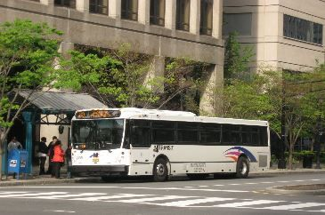

You Can’t Succeed If You Can’t Get There

Slide 8

Online Student Success
Evidence of success and failure online (as in face-to-face instruction)
Evidence on at-risk students and the start of a college program
Evidence on importance of support services (both for academic help and tech support) for at-risk students

Slide 9

The Importance of Summer
Campus policies
Return of summer Pell?

Slide 10

Building Relationships With Latino Students

Slide 11
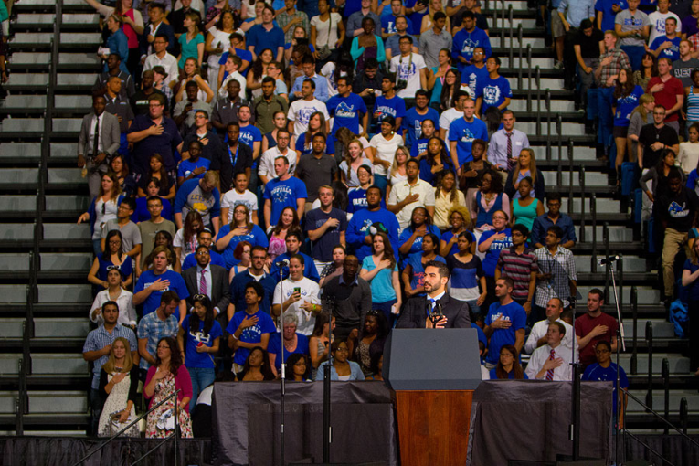
Defining Goals and Pledging to Keep Them

Slide 12

Making Transfer Work
Logistics
Learning

Slide 13

Preparing Students for Careers
Job-specific academic programs
Training across academic fields
Soft skills

Slide 14

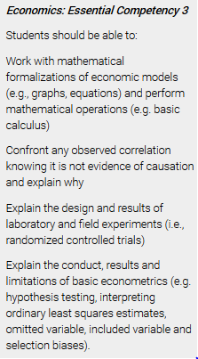
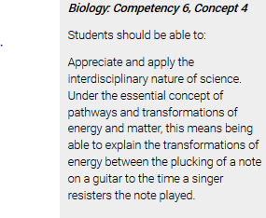
Defining and Measuring Learning Goals

Slide 15
More Important Than Ever
Tools for tracking
Tools to assure the tracking data are used
Advising students

Slide 16
Your Questions
Q&A

Slide 17

With Thanks

