Slide 1

INNOVATION
IN TEACHING
An Inside Higher Ed webinar
Tuesday, May 24 at 2 p.m. Eastern

Slide 2
Presenters
Scott Jaschik, editor, Inside Higher Ed
scott.jaschik@insidehighered.com
Doug Lederman, editor, Inside Higher Ed
doug.lederman@insidehighered.com

Slide 3

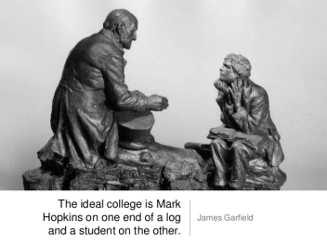

The Traditional Ideal

Slide 4
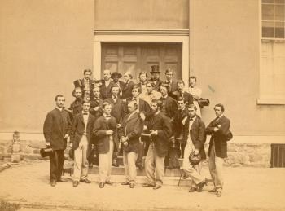


Unfortunate Realities

Slide 5
Why Teaching Matters More Than Ever
Federal and state goals to increase share of adult population with college degrees/certificates.
Differing student populations, not all of whom have historically succeeded in American higher education.
Push by government and accreditors to measure student learning outcomes.
Technology tools have created new teaching techniques (and worries from some about the faculty role).

Slide 6
Innovation in Learning to Teach
Emerging consensus that Ph.D. programs have ignored or belittled this key role of future faculty.
Change in some Ph.D. programs – particularly in recognition of current career patterns.
Arrival of new technologies means that even experienced instructors need to learn how to teach in new ways.
Growth of programs in teaching different groups of students, such as those at community colleges.
Desire to reach all kinds of students.

Slide 7
Innovations in Timing

Slide 8
Innovations in Teaching of Writing

Slide 9
Innovations in STEM Teaching
Howard Hughes efforts
AAU efforts
UNC Chapel Hill
Michigan State
Why research universities matter.

Slide 10
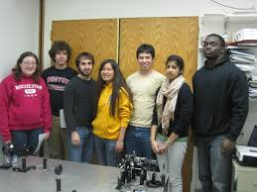
Innovations in Community College Teaching
Changes in placement approach.
Changes in remediation.
Research on why students succeed (or don’t).
Better alignment with high schools, four-year institutions and employers.
Adaptive learning and other tech innovations.

Slide 11

Innovation: Let Faculty
Experiment Without Fear

Slide 12
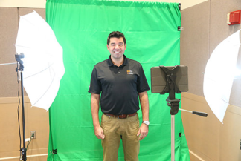
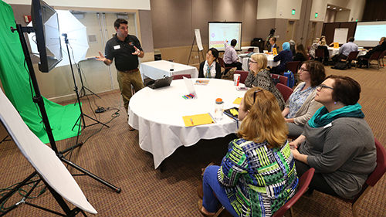
Innovation: the Flipped Classroom

Slide 13
Innovation From MOOCs (Yes, Really)
Ability to use large sample sizes and to refine courses in multiple interactions.
Changing peer-to-peer learning.
Adopting MOOC style to MOOC-like programs that are having success with well prepared students.

Slide 14

Innovation at Moravian:
Old School, New Tech

Slide 15

Innovation: Leave It in the Bag

Slide 16

Innovation: Implications of Great Lakes Study

Slide 17
Obstacles to Innovation
State funding formulas that discourage teaching emphasis.
Traditional prestige focus of academe by sector and job title.
Increased reliance on adjuncts without giving them the support needed.
Consumer mentality about students, taken to an extreme.
Lack of trust between faculty members and administrators.
Politicians who think good teaching doesn’t cost money.
Some faculty members resist new ideas.

Slide 18
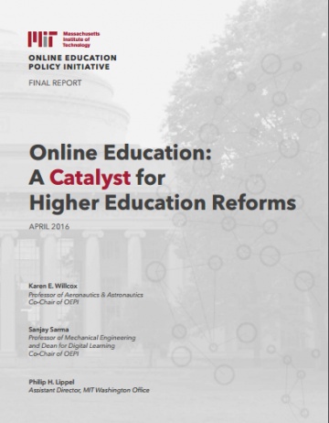
Innovation Reminder From MIT:
Centrality of the Faculty Role

Slide 19
Resources
Innovation in Teaching booklet: https://www.insidehighered.com/content/innovation-teaching
General Education booklet: https://www.insidehighered.com/content/critical-role-general-education
Articles on teaching and learning: https://www.insidehighered.com/news/focus/teaching-and-learning

Slide 20
Your Questions
Q&A.
Suggestions for future coverage.

Slide 21

With Thanks

