Slide 1
Technology and the evolving Business Model in Higher Education
An Inside Higher Ed webinar
Thursday, August 25 at 2 p.m. Eastern

Slide 2
Presenters
Scott Jaschik, editor, Inside Higher Ed
scott.jaschik@insidehighered.com
Doug Lederman, editor, Inside Higher Ed
doug.lederman@insidehighered.com

Slide 3
Agenda
Technology within academic programs
Technology to deliver higher education
Technology to measure success
New styles of leadership

Slide 4
Recruiting Students
Defining (and expanding) the applicant pool
Tracking application and enrollment patterns (and allocating aid accordingly)
Communicating with applicants
Preventing “summer melt”

Slide 5
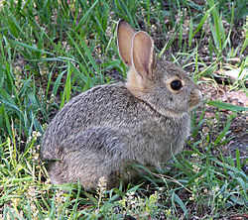
Retention and the Business Model
Why your CFO cares about retention
Shifting demographics
Tuition dollars

Slide 6
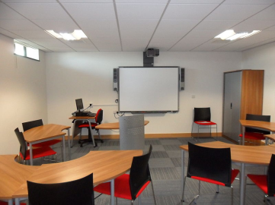
Classroom Tools
The flipped classroom
Early warning systems
Communication with students
Creative approaches to teaching

Slide 7
The MIT Model

Slide 8
Online Education: 2014 Data From Online Learning Consortium
3.9% increase in number of online students
More than 5 million students with at least one online course
More than 2.8 million students enrolled online only
Public higher ed outpaces private higher education – with for-profit falling.

Slide 9
Easy Growth No Longer Assured
Advantages of early players, large players, brand recognition
Confusion about online as synonymous with for-profit
Popularity of hybrid
Importance of niche

Slide 10
The Impact of MOOCs (and the MOOC-like)
The original MOOC model is disappearing.
MOOC-inspired models such as those of Georgia Tech, MIT and others

Slide 11
Online Badging and the Value of Higher Ed

Slide 12
Analytics Broadly Defined

Slide 13
Are Students Logging In?

Slide 14
A New Kind of Higher Ed Leader
Who provides guidance and leadership?
What is the balance of technology, finance and academic issues?
How are these people identified and trained?
Where do they fit into the higher ed infrastructure?
What about the faculty?

Slide 15
Your Questions
Q&A.
Suggestions for future coverage.

Slide 16
With Thanks

