Slide 1
MODERNIZE YOUR BUDGETING PROCESS IN THE CLOUD
Tony Ard
Vice President, Higher Education
Stephanie Bartlett
Solution Engineer, Higher Education

Slide 2


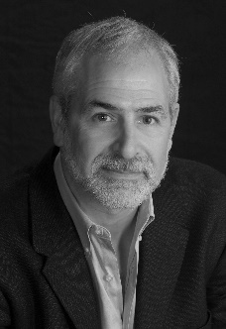
Speakers
Tony Ard
VP, Higher Education
Kaufman Hall | Axiom Software
tonyard@axiomepm.com
Stephanie Bartlett
Solutions Engineer
Kaufman Hall | Axiom Software
sbartlett@axiomepm.com
Casey Green
Webinar Moderator
Director, The Campus
Computing Project
cgreen@campuscomputing.net

Slide 3
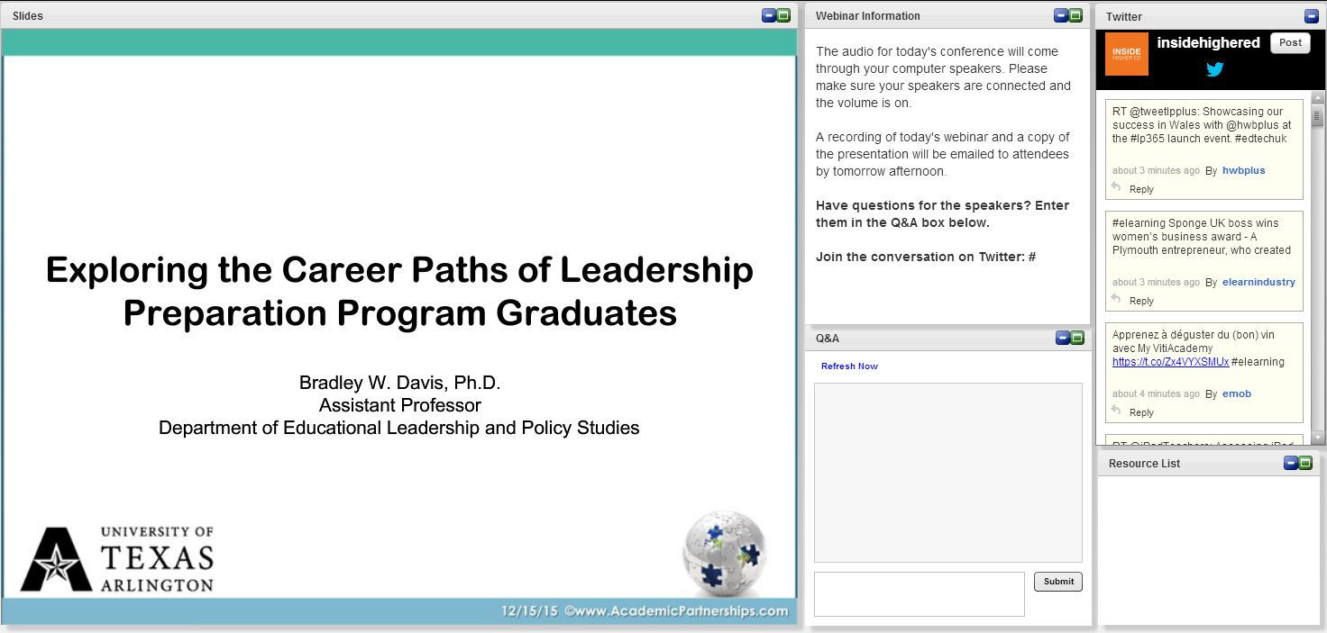
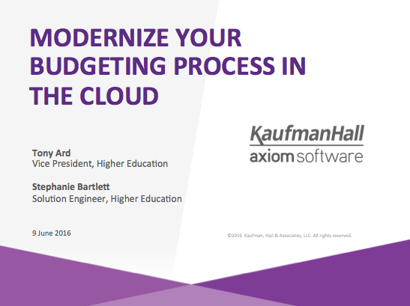
Before We Begin
We are using On24. Please enter questions in the text field at the bottom of the Q&A Window. We are monitoring the discussion and will bring the Q&A comments into the conversation.
We will not use the “raise your hand” feature.
We are recording the webinar; the webinar archive and slides will be available later today.
Q&A

Slide 4
Agenda
Current Environment
Core Capabilities of an EPM Solution
Live Demonstration
  Reporting and Analytics
  Long Range Planning
  Operating Budgeting and Forecasting
About Us

Slide 5
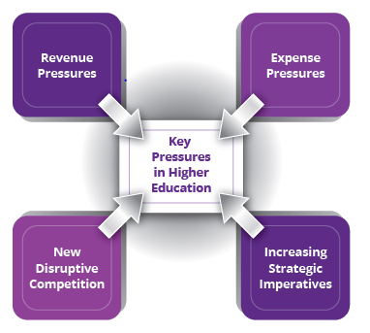
Current Environment
Flat or declining enrollment
Uncertain funding sources
  Shrinking public funding
  Decreasing ability for average family to afford tuition
Competition for top faculty and researchers
Technology revolution
  Alternative delivery options
  Non traditional competitors
  Enterprise systems

Slide 6
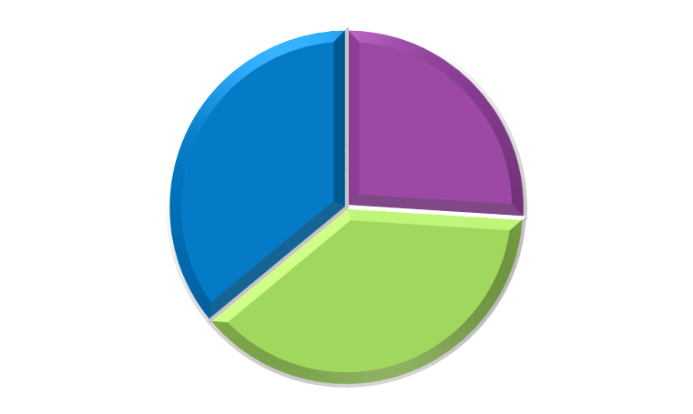
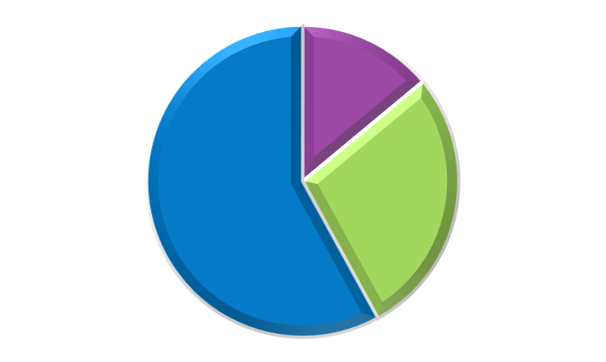
I am confident about the sustainability of my institution's financial model over the next…
5 Years
10 Years
36% Not confident or neutral
14%
Very confident
26%
Very confident
58%
Not confident or neutral
28%
Confident
38%
Confident
Source: 2015 Inside Higher Ed Survey of College & University Business Officers

Slide 7
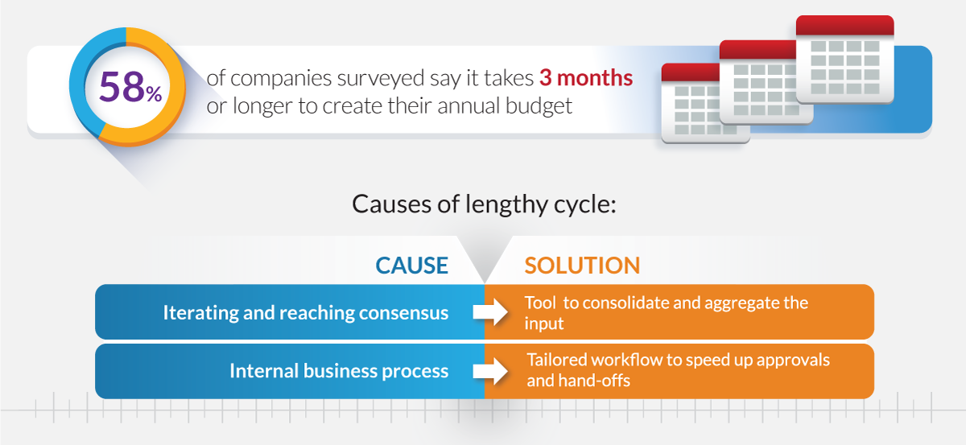
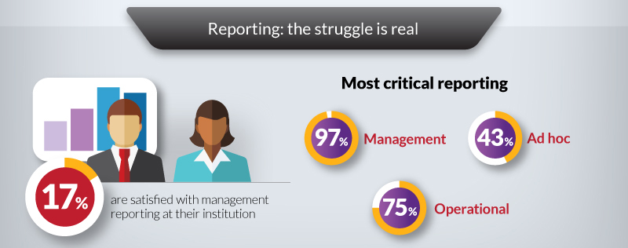
Finance Tools and Processes Need to be Modernized
2015 Axiom Performance Management Survey

Slide 8
CPM Critical Capabilities
Ease of Use
Best Practice Content
MS Excel Integration
Analytics
Cloud Deployment
Source: BPM Partners, Pulse Survey - 2016

Slide 9
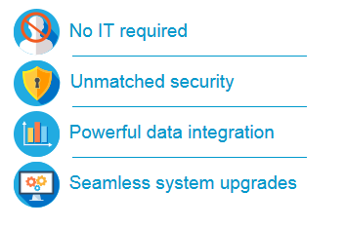
Cloud Deployment
Background
  Software vendor manages platform infrastructure
    Manages maintenance activities
  Users access the software via a secure internet connection
Benefits

Slide 10
Demo Agenda
Reporting and Analytics
Long Range Planning
Operating Budgeting and Forecasting

Slide 11



New Thinking on the Role of Finance
As a Chief Story Teller
  Positioned to be the knowledge center of the organization
  Taking on data stewardship beyond the financials
  With ability to forecast better than anyone
As a Strategic Advisor to the Organization
  Strategic thinker with strong business acumen
  Having a seat at the table
  Well versed in the risk return equation
As a Partner to Operations
  Understanding their goals & objectives
  Establishing a quid pro quo arrangement

Slide 12
What are the most critical performance management initiatives for your organization in the next 1-2 years?
Source: Axiom EPM Survey 2015

Slide 13
Reporting and Analytics Demonstration

Slide 14
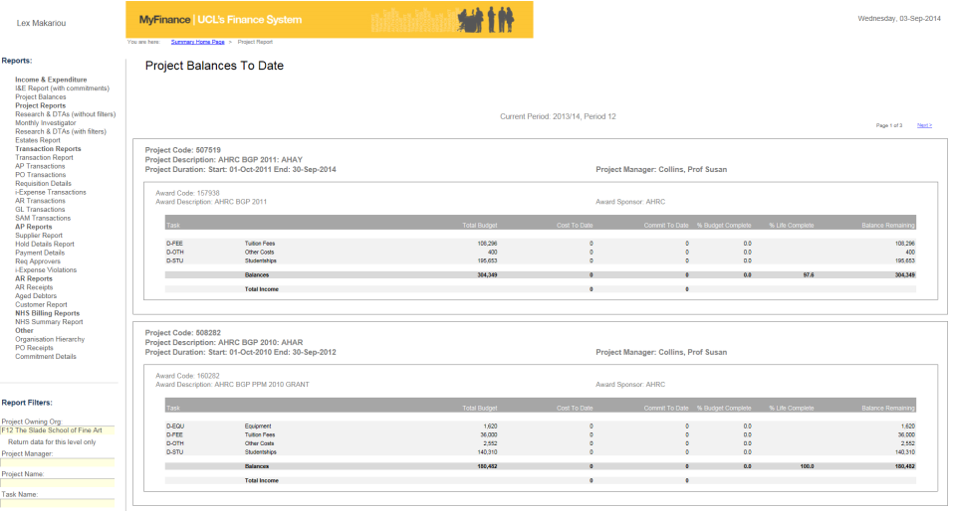

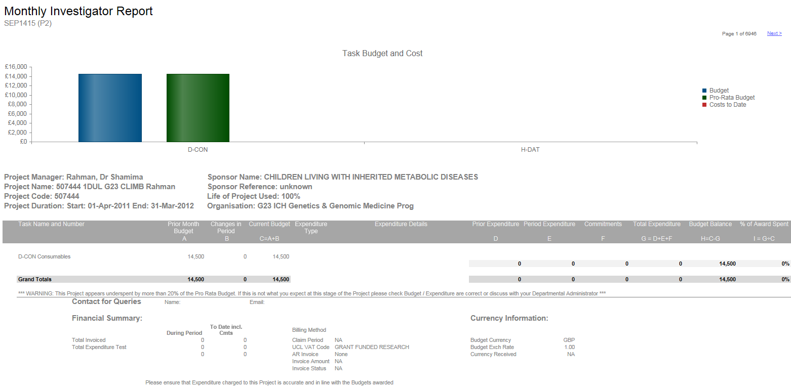
Reporting Case Study: University College London
Quick Facts
  Ranked 4th in the world’s top universities by the QS World Ranking
  Annual Budget ~1Bn GBP
  11,000 staff, 26,500 students
Challenge
  Many disconnected systems
    Many users on different reporting tools
  Data quality problems
Kaufman Hall Axiom Software Solution
  Web based reporting for 3,000 users university wide
    Project managers
    Department administrators
    Finance
  Data integration from GL, payroll, grants systems
  Drill functionality to sub ledgers

Slide 15
The Long Range Plan Sets the Context for the Operating Budget
Long-Range Planning
Baseline projections to assess the impact of market and volume drivers on bottom-line results.
(Outlook - 3-5 years)
NEXT YEAR
YEAR 1
YEAR 2
YEAR 3
YEAR 4
Value of an integrated planning model?
Where are we going?
(Multi-Year Planning)
How do we get there?
(Detailed Budgeting)
Are we on track?
(Rolling Forecasts)
Detailed Budget
Translate defined strategies into operational budgets and plans.
(Outlook – 12 months)
Next Year Budget
Rolling Forecast
Evaluate and trend actual performance against defined plans, project outcomes given current situation.
(Outlook – 18-36 months)
Rolling 24 Month Trends

Slide 16
Long Range Planning Demonstration

Slide 17
Long Range Planning Case Studies
Worked with multiple institutions
  Research institutions
  Liberal arts colleges
  Regional public institutions
Approach
  Corporate finance based approach
  Benchmarks to credit rating median ratios
  Align strategic goals to financial capacity
  Assess debt capacity
Kaufman Hall Axiom Software Solution
  Integrated to core systems
  Baseline projections
  Initiatives
  Scenario management
  Forward looking financial statements

Slide 18

Operating Budget Best Practices
Dimensions
People
Purpose
Timing
Output
Org
Acct
Fund
Project
Budget managers
Assign resources
Accountability
Annually
Forward 18-24 months
Approved budgets
Revenue, expense targets
Strategic Planning
Operating Budget
Long Range Planning
Capital Budgeting
Best Practices:
Driver based where possible
Level of detail appropriate to how you manage
Automated with workflow, notification, data capture
Operating
Budget
Forecasting
Reporting & Analytics

Slide 19
Operating Budget Demonstration

Slide 20
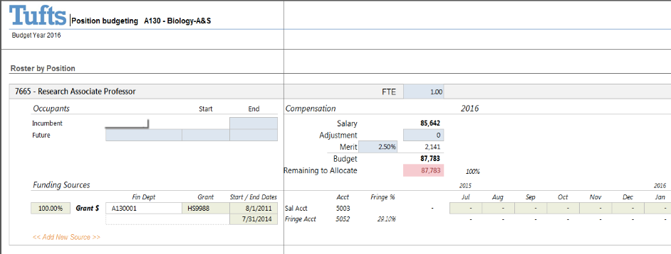
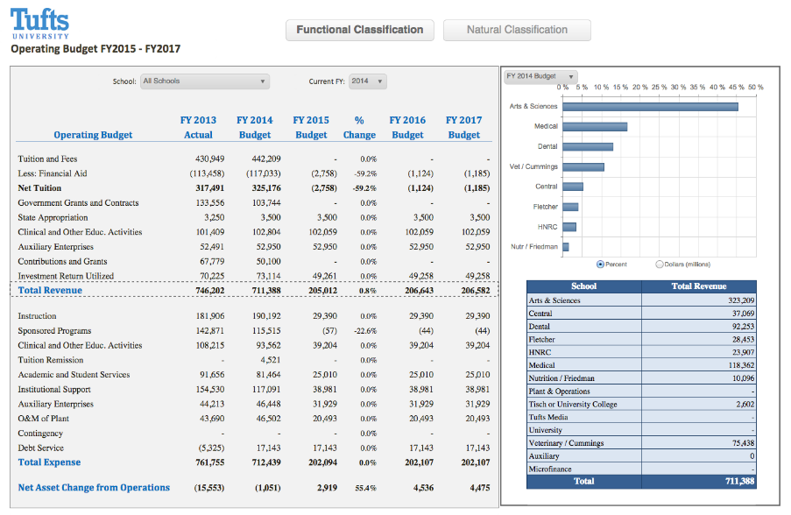

Budgeting and Forecasting Case Study:
Tufts University
Quick Facts
  3 campuses in Boston area
  Annual Budget $800M
  3,000 staff; 10,000 students
Challenge
  De-centralized Excel-based budgeting process
    Manual data integration
    Painful budget consolidation
    Limited scenario capability
Kaufman Hall Axiom Software Solution
  Fully automated operating budget, forecasting including grants
    Detailed labor distributions
  Expanded breadth and depth of analysis for strategic financial planning
  Rich reporting

Slide 21
About Us

Slide 22

Senior Level Consulting and World Class Technology
MANAGEMENT
CONSULTING
Best practices corporate finance grounded in the capital markets
PROCESS
DESIGN
Design internal processes to better respond to industry changes
FINANCIAL
STRATEGIES
Assist institutions make informed financial decisions based on rigorous analysis
Unmatched Consulting Expertise.
Enabling Colleges and Universities to thrive
in the New Era.
Industry Leading Software & Tools.
IMPLEMENTATION
SERVICES
Former practitioners with a proven track record of implementation successes.
SOFTWARE
APPLICATIONS
Embody best practice approaches in an integrated EPM Suite
PLATFORM CAPABILITIES
Industry leading EPM functionality, agile tools to support changing needs.

Slide 23
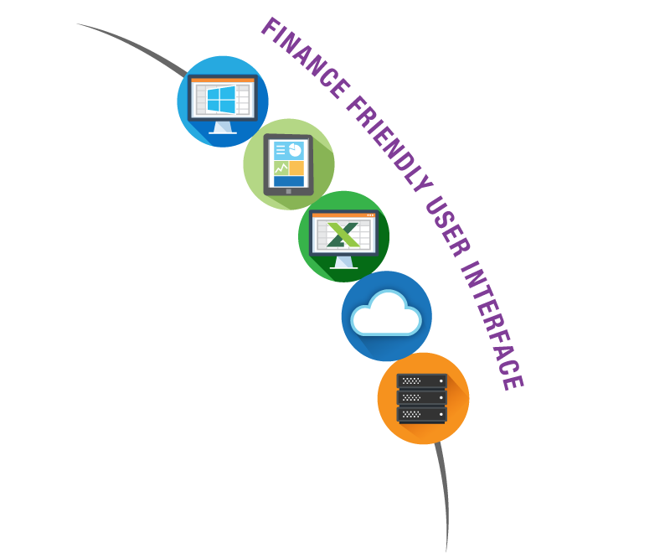

TAILORED
INDUSTRY SOLUTIONS:
Higher
Education
BUDGETING & FORECASTING
LONG-RANGE PLANNING
REPORTING
GRANTS PLANNING
CAPITAL PLANNING
ENROLLMENT PLANNING
BENEFITS
SOPHISTICATED
FLEXIBLE
INTUITIVE

Slide 24

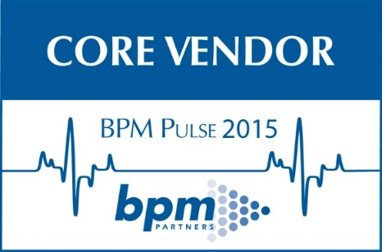
3rd Party Validation
Industry’s Leading Software
1
#
2014 & 2015 Customer
Satisfaction Surveys
Highest Ranking EPM Vendor –
Overall, Vendor Experience, Implementation
1
#
Highest Rated EPM Vendor 4 Years Running
Ranked first in every EPM category

Slide 25











Representative Clients

Slide 26

Upcoming Events
  NACUBO National Meeting
    Montreal, July 2016
    Attend our session:
      An Integrated Financial Model to Support Long-Range Planning and Funding with Northwestern University
  NACUBO Planning & Budgeting Forum
    Philadelphia, September 2016
  CACUBO Regional Meeting
    San Francisco, October 2016
  EACUBO Regional Meeting
    Washington DC, October 2016

Slide 27
Additional Resources
Guides:
  Best Practices in Financial Planning
  Best Practices in Reporting
  Best Practices in Performance Management
  Best Practices in Labor Planning
  Buyer’s Guide: Performance Management
Infographics:
  Performance Management Trends in Higher Education
Blog Posts:
  Continued Economic Pressure in Higher Education
  Reaction to Moody’s Higher Education Sector Survey
  Thriving in a Postmodern ERP World

Slide 28
Final Questions?
Tony Ard
VP, Higher Education
Kaufman Hall | Axiom Software
tonyard@axiomepm.com
Stephanie Bartlett
Solutions Engineer
Kaufman Hall | Axiom Software
sbartlett@axiomepm.com

Slide 29
THANK YOU!

