Slide 1
The 2018 Survey of College and University Business Officers
An Inside Higher Ed Webcast August 9, 2018 2 p.m. EDT
Follow us on:

Slide 2
Presenters
Scott Jaschik, editor and co-founder, Inside Higher Ed
scott.jaschik@insidehighered.com
Doug Lederman, editor and co-founder, Inside Higher Ed
doug.lederman@insidehighered.com
Follow us on:

Slide 3
Methodology
Questions prepared by Inside Higher Ed, in collaboration with Gallup.
Polling conducted by Gallup in May/June.
Results from 413 chief business officers.
Complete anonymity for respondents, but answers coded to allow for breakdown by sector, etc.

Slide 4
Key Findings
CBOs of private four-year colleges have declining confidence in longterm stability of their institutions; most other sectors steady, community colleges up.
More business officers say merger being discussed by senior leaders; sharp rise for private baccalaureate colleges (from 5% to 24%); CBOs likelier to think their institutions should merge than that they will.
Growing concern about tuition discount rates at public and private four-year colleges.
CBOs’ strategies focus on expanding enrollment, not cutting programs or making other hard decisions.

Slide 5
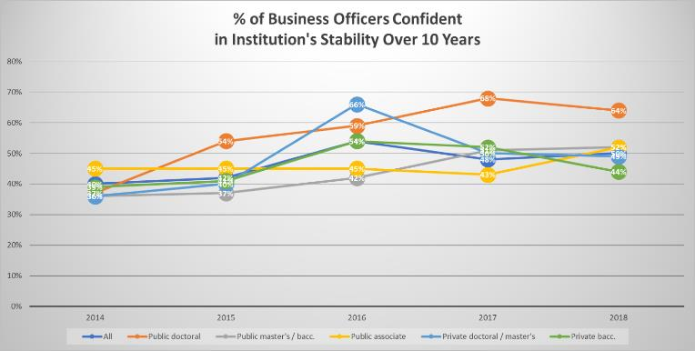
How Confident Are You?

Slide 6
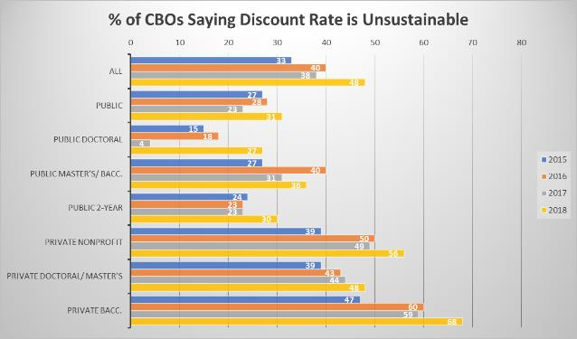
Discount Rate Dangers

Slide 7
Mergers and Consolidation
 | All |  | Public |  | Private Nonprofit
 | 2017 | 2018 | 2017 | 2018 | 2017 | 2018
“Serious internal discussions” about merger? (% Yes) | 12% | 17% | 9% | 9% | 15% | 23%
How likely to merge? (% Very or Somewhat) | 9% | 11% | 11% | 8% | 6% | 12%
Should your institution merge? (% Yes) | 16% | 18% | 13% | 14% | 17% | 21%
Notes:
Seen increase in merger activity – mention special report?
Private bacc.: 26% “should merge”, up from 12% in 2017 …
Larger numbers say institution should consolidate administrative services or academic programs with another college…

Slide 8
How CBOs Are Responding
Strategy to Undertake in 2018-19 | 2016 | 2017 | 2018
Increase enrollment | 87% | 71% | 72%
Launch new academic programs | 71% | 68% | 63%
Collaborate on academic programs | 65% | 63% | 43%
Collaborate on administrative services | 39% | 46% | 33%
Eliminate underperforming academic programs | 43% | 50% | 35%
Lower discount rate | 36% | 23% | 28%

Slide 9
Reporting and Transparency
Two-thirds (64%) say they run monthly reports to year end; 27% run quarterly.
7 in 10 say they distribute to cabinet and trustees; 12% with faculty leaders.
¾ of CBOs say students, faculty/staff and alumni "very" (15%) or "somewhat" (61%) aware of campus financial health; 86% say senior leaders give “accurate and sufficient” information to other constituents.
BUT: CBOs who are NOT confident in institutions’ financial future are LESS likely to say that campus constituents are aware of financial health and that administrators give those groups good information.

Slide 10
Judging Financial Health
% Very Important | All | Public | Private Nonprofit
Net Operating Revenues Ratio | 55% | 42% | 67%
Unrestricted Net Assets (increase or decrease) | 53% | 41% | 65%
Rate of Net Tuition Growth | 52% | 31% | 71%
Primary Reserve Ratio | 44% | 38% | 50%
Cash on Hand | 43% | 39% | 47%
Viability Ratio | 36% | 27% | 45%

Slide 11
As Pressure Builds, Views Change
CBOs lacking confidence in financial future 2X likelier than peers (23% to 11%) to say they’d discussed merger. Also likelier to believe institution would merge (13% to 8%) and should merge (26% to 10%).
Almost twice as likely (32% to 17%) to strongly agree that tuition discount rate is unsustainable, but only modestly more likely to say they would cut discount rate in 2018-19 (29% to 26%).
Less likely to believe presidents and trustees were realistic. Roughly 15 percentage points lower in saying trustees and senior administrators "are aware of and understand" financial challenges facing the institution.

Slide 12
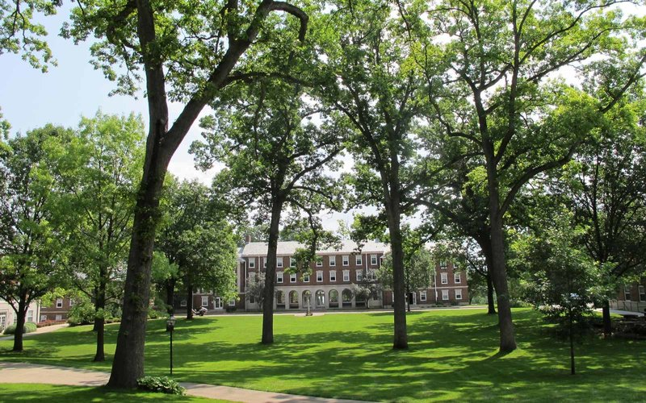
Focus on Small Private Colleges
Most dramatic change in views.
8 percentage point drop in confidence (52% to 44%)
9 percentage point increase in concern about discount rate (to 68%, 20 points higher than any other sector)
24% said senior leaders had discussed merger, up from 5% in 2017.
42% said they would lower discount rate in 2018-19, up from 29% in 2017.

Slide 13
Public College Perspective
More confident, generally, than private college peers.
New questions about public institutions:
¼ of CBOs (24%) say institution froze tuition in 2017-18, 23% plan to do so in 2018-19.
Public doctoral CBOs say 25% of budgets coming from state, average dropping to 20% in 2019.
Interest in more support on compliance from state systems.

Slide 14
Debt and Debt Service
Proportion of CBOs saying their college had too much debt up at public doctoral universities (to 18% from 4% last year) and private baccalaureate colleges (to 22% from 9%).
Public/private difference in share of operating budget going to debt service – 6% at private, 3% at public. But 4.9% at public doctorals.
One third of all CBOs said viability ratio was at or below 1.0, potentially cause for concern.

Slide 15
Other Findings
1/3 of business officers at private baccalaureate colleges said at least 10% of annual budget supported by endowment revenue; 1 in 6 put figure at 15% or more. 1/3 said they would lower payout rate next year.
Majority of CBOs say they lack data to make “informed decisions” in wide range of important areas, including program efficacy, performance of technology, units, programs.

Slide 16
More Information
Article link:
https://www.insidehighered.com/news/survey/peril-private-colleges-survey-business-officers
Report download:
https://www.insidehighered.com/booklet/2018-survey-college-and-university-business-officers

Slide 17
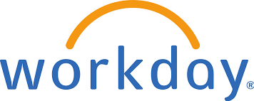
Thank You

