Slide 1
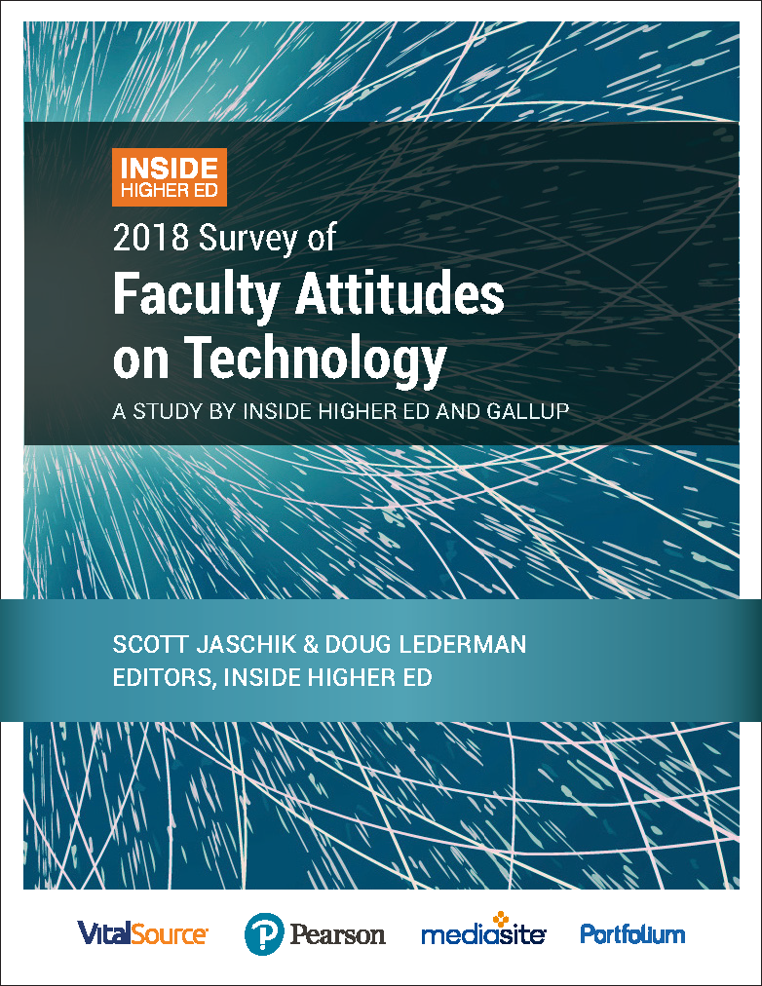
Professors’ Changing Views of Digital Learning
Results from 2018 Survey of Faculty Attitudes on Technology An Inside Higher Ed webcast Nov. 27, 2018, 2 p.m. EST

Slide 2
Presenters
Doug Lederman, editor and co-founder, Inside Higher Ed
doug.lederman@insidehighered.com
Scott Jaschik, editor and co-founder, Inside Higher Ed
scott.jaschik@insidehighered.com

Slide 3
Methodology
Gallup surveyed 2,129 professors and 206 digital learning leaders, Aug.-Sept. 2018
60% of faculty respondents tenured/tenure track, 40% not
Complete anonymity for respondents
Responses coded to enable analysis by faculty status, sector, etc.

Slide 4
Key Findings
Proportion of instructors teaching online and blended courses is growing. So is their support for using technology to deliver instruction.
But their belief in the quality and effectiveness of online courses and digital technology isn’t keeping pace.
Surprisingly modest use of instructional designers

Slide 5
Support for Use of Technology (Philosophically)
1/3 of instructors describe themselves as "early adopter of new educational technologies;" 55% say they “adopt new technologies after seeing peers use them effectively”; 12% "disinclined iStock to use educational technologies.”
75% support increased use of educational technologies (32% fully, 43% “somewhat”); 11% answer to the contrary.
Notes:
Reasons why: When those who describe themselves as technology supporters are asked why that's the case, the three top answers were that they like experimenting with new instructional methods and tools (60 percent), they believe their students learn better when engaged with effective tech tools (58 percent) and they have had success with ed tech in the past (57 percent).
When the much smaller number of professors who said they don't support increased use of technology were asked why that's so, their top answer (67 percent) suggests a strong philosophical opposition: "I am confident that instruction delivered without using technology most effectively serves my students." Smaller numbers cited too much corporate influence (44 percent) and loss of faculty control (40 percent).

Slide 6
More Professors Have Taught Online...
Notes:
The number of instructors who have taught a blended or hybrid course -- one that mixes in-person and online components -- is growing slowly but steadily, too, edging up from 36 percent last year to 38 percent this year. About three-quarters of those who have taught a blended course said they were involved in designing the course.

Slide 7
Differences as You Dig Deeper

Slide 8
...But Their Belief in Its Effectiveness Isn’t Growing
“For-credit online courses can achieve student learning outcomes at least equivalent to those of in-person courses at any institution.”
30% agreed, 36% disagreed, 34% neutral iStock
33% agreed with that statement in 2017
Slightly more (38%) agree when question is about courses “at my institution,” 35% “in the classes I teach.”
Positive answers likelier among those who have taught online (39% vs. 24% of those who have not), at community colleges and professional schools, women.

Slide 9
Doubts About Online Effectiveness
Particular skepticism about ability to reach "at-risk" students (80% say less effective), "rigorously engag[ing] students in course material" (65%), ability to maintain academic integrity (60%).
Professors who’ve taught online view more favorably, but not enthusiastically.
Notes:
Instructors who've taught online had more favorable opinions about the effectiveness of online learning than did their peers, but they still rated face-to-face courses higher in most cases. The question on rigorously engaging students in course materials is a good example: while 77 percent of those who had never taught online said online courses were less effective than in-person courses and 21 percent said they were as effective, 51 percent of online instructors said the courses were less effective on engaging students in the material, while 44 percent said they were as effective

Slide 10
More Teaching Experimentation
Three-quarters of instructors who’ve taught online said doing so helped "develop pedagogical skills and practices that have improved" their teaching:
Think more critically about ways to engage students with content (68%)
Make better use of multimedia content such as video and audio (65%)
Use LMS better (61%)
Experiment more and make changes to try to improve their students' learning experiences (60%)
Notes:
Professors may question whether online learning is improving their students' educational experience, but those who have taught online express confidence that doing so has made them better instructors.
About two-thirds of instructors who had converted a face-to-face course to a blended or hybrid format said they lectured less in the converted course, and a majority (54 percent) said they had incorporated more active learning techniques in the new iteration of the class.

Slide 11
Want to Turn Off Your Faculty? Overpromise
Half of instructors (51%) disagree that digital tools can bring down instructional costs without impairing quality; 24% agree. (Half of digital learning leaders agree with that statement.)
And strong majorities agree "administrators and vendors who promote the use of technology in delivering instruction":
"exaggerate the potential financial benefits" (65% agree or strongly agree)
"play down the risks to quality" (70%)
"do not fully appreciate the upfront costs required to develop high-quality online or blended offerings" (70%)

Slide 12
Institutional Support (or Lack Thereof)
Notes:
Forty-five percent of those who have taught online agreed or strongly agreed that the online courses at any institution could achieve student learning outcomes at least as good as in-person courses; the figure for those who had not taught online was 24 percent. The split was even larger for courses at the professors’ own institution (61 percent of those who had taught online versus 28 percent of the rest), and larger still for the instructors’ own courses (65 percent versus 15 percent).

Slide 13
Textbook Prices, Beliefs and Practice
Professors overwhelmingly think course materials cost too much.
More than two-thirds (70%) support increased use of open educational resources (OER).
BUT:
Fewer than a third (32%) say professors should adopt less-expensive textbook alternatives if they are of lower quality.
1 in 5 say lowering costs justifies some loss of faculty control.

Slide 14
Is Inclusive Access Working?
Roughly half of faculty members and digital learning leaders believe programs aimed at making digital course materials available at start of semester at lower fees are both lowering students’ spending and improving educational outcomes.
A quarter say the programs are accomplishing neither goal.

Slide 15
Assessing Assessment
Majority of professors (59%) convinced that assessment is mainly aimed at satisfying outside forces (accreditors and politicians).
More inclined to disagree (38%) than agree (25%) that assessment efforts have “improved quality of teaching and learning” or bolstered degree completion (36% disagree, 27% agree).
About a quarter (26%) say they regularly get data from assessments that help them improve their teaching. Down from 30% in 2017.

Slide 16
Other Findings
Online program managers. 40% of instructors say their colleges shouldn’t work with outside providers to offer online programs. But majority (58%) say their institutions should seek help in areas they lack expertise.
Accessibility. 2 of 3 professors say their institution offers training in making course materials compliant with ADA.

Slide 17
More About the Survey
Inside Higher Ed article on the results:
https://www.insidehighered.com/news/survey/survey-faculty-views-technology-explores-online-teaching-oer-assessment
Download the survey results:
https://www.insidehighered.com/booklet/2018-survey-faculty-attitudes-technology

Slide 18
Thanks to Our Sponsors

