Slide 1
What Keeps You Up at Night: A Survey of Presidents
An Inside Higher Ed webcast
Tuesday, April 2, 2019
2 p.m. EDT

Slide 2
Presenters
Doug Lederman, editor, Inside Higher Ed
doug.lederman@insidehighered.com
Scott Jaschik, editor, Inside Higher Ed
scott.jaschik@insidehighered.com

Slide 3
Methodology
Questions prepared by Inside Higher Ed, in collaboration with Gallup. Polling conducted by Gallup in January-February 2019.
Results from 784 presidents or chancellors.
Complete anonymity for respondents, but answers coded to allow for breakdown by sector. Some data also available by region, age, etc.

Slide 4
Finances, First of All
Notes:
“Consumer confidence survey”
Private college presidents are more upbeat than their peers at public institutions are, with 60 percent of private college leaders confident in their institution's financial stability versus 52 percent of public institutions' chiefs. The same eight-percentage-point difference was evident in 2018, when the margin was 55 percent to 47 percent.

Slide 5
Mergers and Closures
Predicted Number of College Closures
 | 0 | 1-5 | 6-10 | 11-20 | >20
2018 | <1% | 30% | 40% | 19% | 10%
2019 | 3% | 30% | 34% | 22% | 10%
Private College Mergers |  |  | Public College Mergers
 | 2018 | 2019 |  | 2018 | 2019
0 | 3% | 3% | 0 | 12% | 16%
1-5 | 56% | 53% | 1-5 | 55% | 60%
6-10 | 29% | 28% | 6-10 | 23% | 17%
>10 | 13% | 16% | >10 | 9% | 7%
Notes:
My college close or merge? 14% yes, up from 13% in 2018

Slide 6
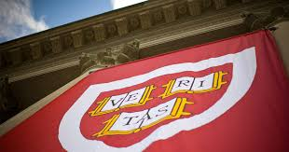
Affirmative Action and the Harvard Case
Almost 2/3 of presidents support use of race in admissions; 79% say public doesn’t understand holistic admissions.
Only 37% “feel confident in Harvard’s defense”; 27% disagree.
Few (13%) “planning for the possibility” of a Harvard loss; 25% at public doctoral universities.
Plurality (42%) worry that Asian Americans face admissions bias at selective colleges.
Notes:
About half of college presidents (52 percent) said they believe it is appropriate for private colleges to consider legacy status in admissions, although private college leaders (60 percent) and those at public doctoral universities (65 percent) were much likelier than those at community colleges (38 percent) and public four-year colleges (44 percent) to agree.
Only a quarter of campus chief executives, 24 percent, agreed that it was appropriate for public colleges to consider legacy status in admissions.

Slide 7
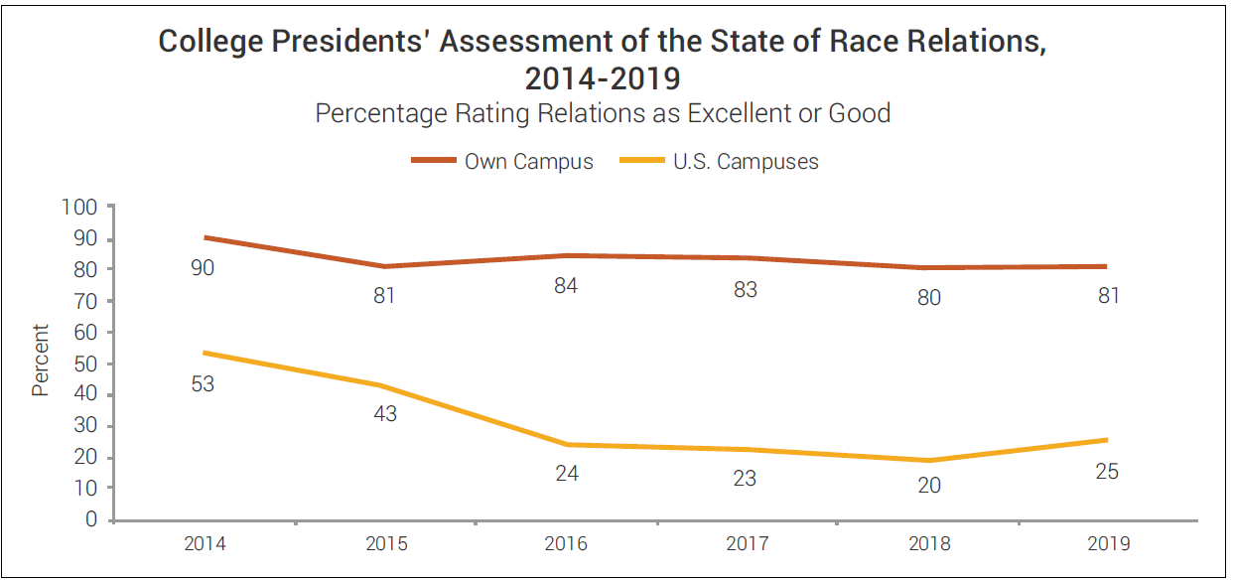
Race and Religion
.
Notes:
% excellent: 22 (cc’s), 8% public master’s/back/doctoral;
Women and younger presidents portrayed the situations on their campuses less positively. While 84 percent of male presidents described race relations on their campus as being good (66 percent) or excellent (18 percent), only 72 percent of women did (16 percent excellent, 56 percent good).
Same dynamic (“human nature”) on anti-Semitism: Roughly two-thirds of college and university leaders told Inside Higher Ed that they viewed anti-Semitism increasing "a lot" (12 percent) or "a little" (53 percent) on campuses nationally in the last few years, with the figure at about 80 percent for leaders of public doctoral and master's/baccalaureate colleges.
But asked about anti-Semitism on their own campuses, barely one in 10 presidents (12 percent) perceived an increase, though the figure was roughly double at public doctoral (24 percent) and public master's/baccalaureate (22 percent) institutions.

Slide 8
Title IX and the Government
Half of presidents (49%) disagree that DeVos rules would move U.S. policy in “right direction;” more than half (62% public, 49% private) say proposals would result in fewer complaints from students who say they've been assaulted or harassed.
But ½ of presidents (42% public, 60% private) agree that Obama approach “did not place enough emphasis on due process for those accused of sexual assault or harassment."

Slide 9
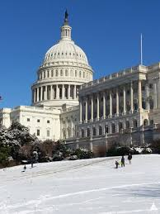
Expectations for Congress
LOW.
25% think Congress will pass budgets generally favorable to institutions like theirs (community colleges most optimistic at 34%).
37% believe Congress will pass legislation to renew the Higher Education Act.
24% believe lawmakers will approve legislation that “will generally help my institution" (14% for public master's/baccalaureate institutions).
Notes:
Add data here on views of Republican perceptions … That divide clearly troubles presidents. More than three-quarters say they worry about Republicans’ increasing skepticism, even as 71 percent disagreed that "Republican doubts about higher education are justified."

Slide 10
Improving Image
Notes:
Still feel misunderstood: Just 16% agree with statement that "most Americans have an accurate view of the purpose of higher education," and 50% disagree.
Fewer than one in five presidents (18%) say Americans understand the purpose of their sector of higher education, with the proportions ranging from 8% for private four-year colleges to 26% for community colleges.
The proportion of campus leaders who say that higher education is perceived as intolerant of conservative views actually increased, to 37 percent from 32 percent in 2018. Presidents of private nonprofit colleges and universities (40 percent) are likelier than their public college peers (33 percent) to answer this way. Male presidents were significantly likelier to strongly agree than were female presidents, by a margin of 15 to 3 percent.

Slide 11
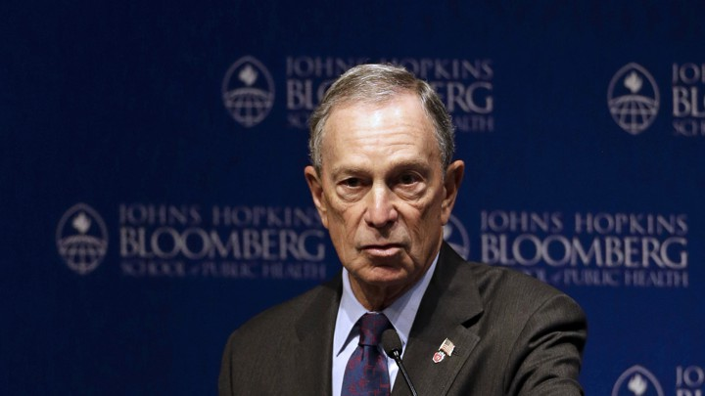
Targeting of Philanthropy
“The largest gifts to higher education would do more good if they went to nonelite institutions." --Public college leaders: 82% --Private college leaders: 74%
“The wealthiest institutions in higher education receive too large a share of philanthropic dollars.” --Public doctoral presidents: 67% --Public master's/baccalaureate colleges: 82%

Slide 12
More Strings Attached?
40% of presidents agree that donors of large gifts are making more demands on use of funds than in the past (27% disagreed); private college presidents less likely to agree (34%) than public campus leaders (46%).
1/3 of presidents (34%) said they had personally rejected financial gifts because of strings that would have been attached about how the funds could be used.

Slide 13
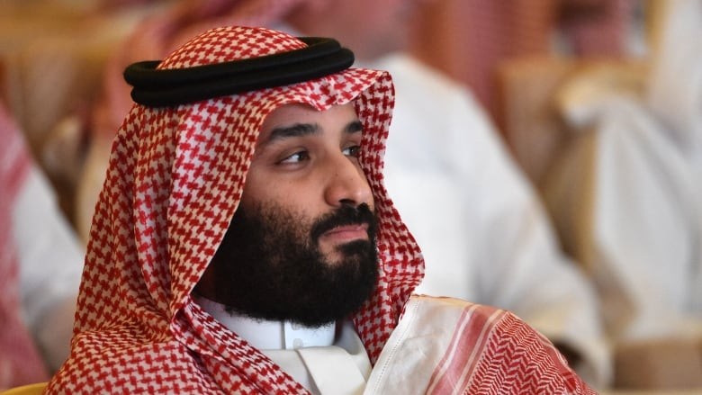
Foreign Ties
2/3 of presidents agree that colleges should "reconsider their involvement with countries that do not respect basic human rights."
Support weaker for the notion that colleges should not set up branch campuses in such countries, with 55% agreeing.

Slide 14
Textbook Affordability
Presidents agree that course materials cost too much and support use of open educational - iStock resources.
But fewer agree that saving students money justifies “some loss of faculty control” and that professors should consider shift even if lower-cost options are of lesser quality.

Slide 15
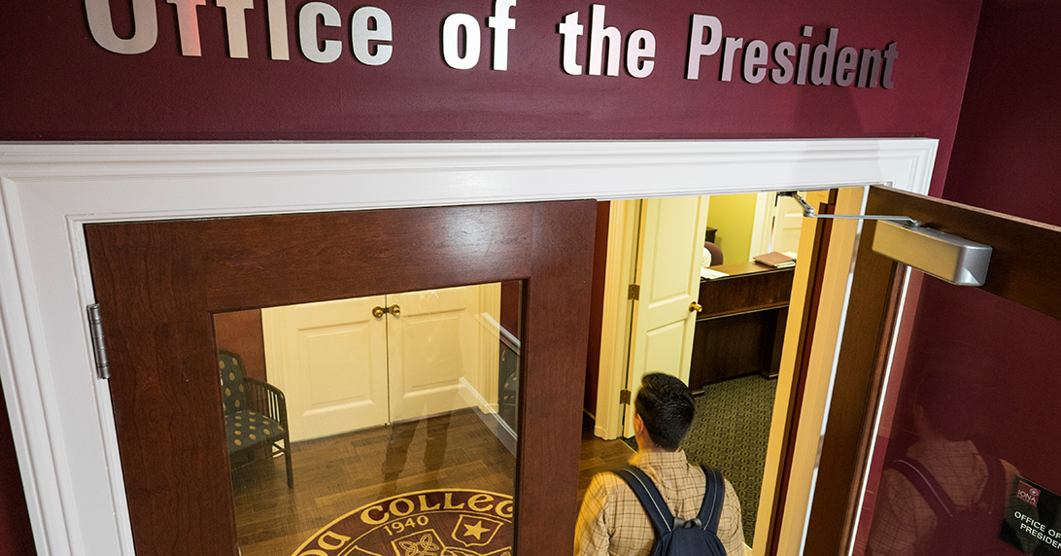
Preparation for the Presidency
Leaders feel most prepared for:
Dealing with the faculty (84%)
Academic affairs (83%)
Financial management & admissions/enrollment (68%)
Least prepared for:
Fund raising (48%)
Digital learning (49%)
Government relations (50%)
Hot-button student affairs issues (51%)
Notes:
Some of the areas public college presidents believe they were better prepared for than private college presidents
include working with faculty members (89 percent to 79 percent), government relations (57 percent to 44 percent)
and digital learning (52 percent to 45 percent). In contrast, more private college presidents thought they were
prepared for fundraising (54 percent to 44 percent) and athletics (57 percent to 46 percent).
Just 34 percent of public associate college presidents say they were well-prepared to handle fund raising, much
lower than for presidents at other types of institutions. Also, public doctoral institution presidents are significantly
more likely than their peers to think they were prepared for government relations (80 percent), financial management
(80 percent) and fundraising (77 percent), but significantly less likely to be prepared for athletics (35 percent).

Slide 16
More Information/Contact
Survey article: https://www.insidehighered.com/surveys
Survey report:
https://www.insidehighered.com/booklet/2019-survey-college-and-university-presidents

Slide 17
With Thanks

