Slide 1
Combining the Digital with the Physical to Create Tomorrow’s Campus
Brad Grimes
Sr. Director of Communications
AVIXA

Slide 2
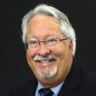
Combining the Digital with the Physical to Create Tomorrow’s Campus
Craig Park Principal, The Sextant Group
Emmett Frank Academic Technologist, Dartmouth College
Aiden Sizemore Dir. of Academic Technology & Systems, Florida State University, College of Business

Slide 3
The Audiovisual and Integrated Experience Association

Slide 4
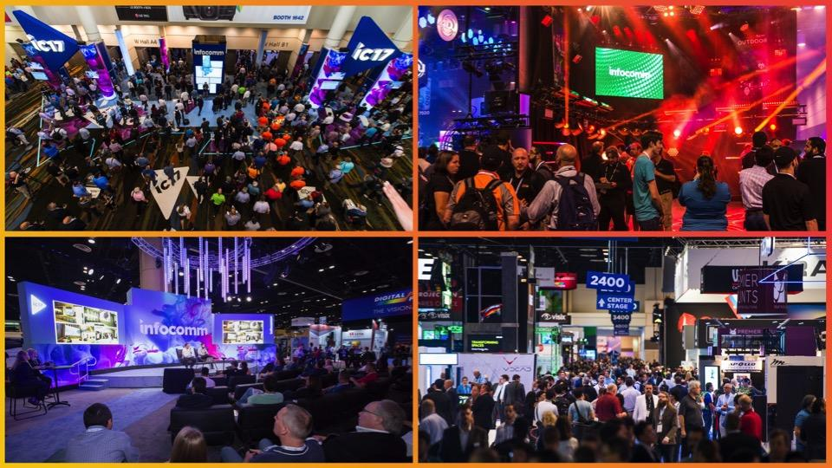

Slide 5
Industry Certification

Slide 6
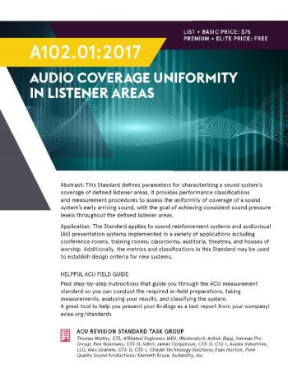
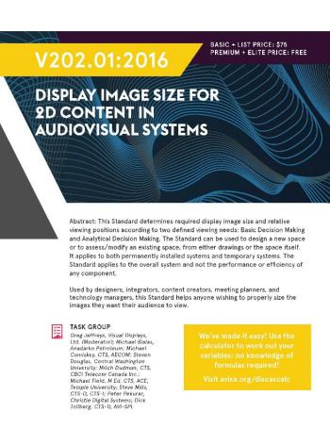
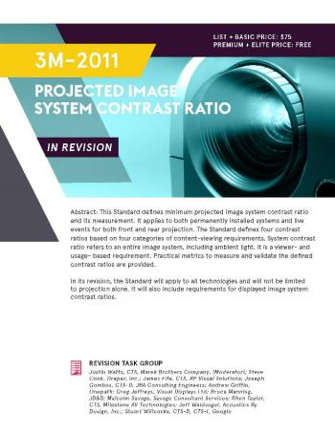
Industry Standards
Notes:
This is a sampling of standards. Let’s touch on a few that may be particularly pertinent to your roles.

Slide 7
We promote integrated audiovisual experiences that lead to better business outcomes in many vertical markets.

Slide 8
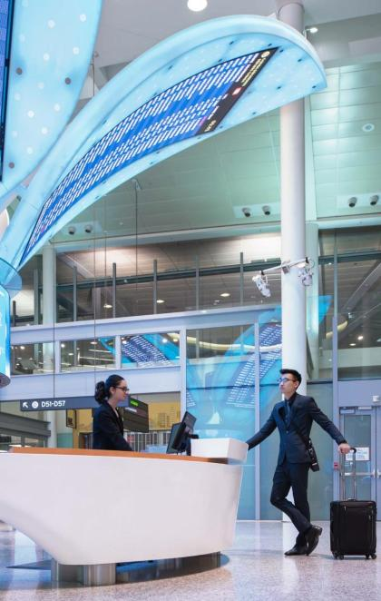
Banking
Retail
Transportation

Slide 9
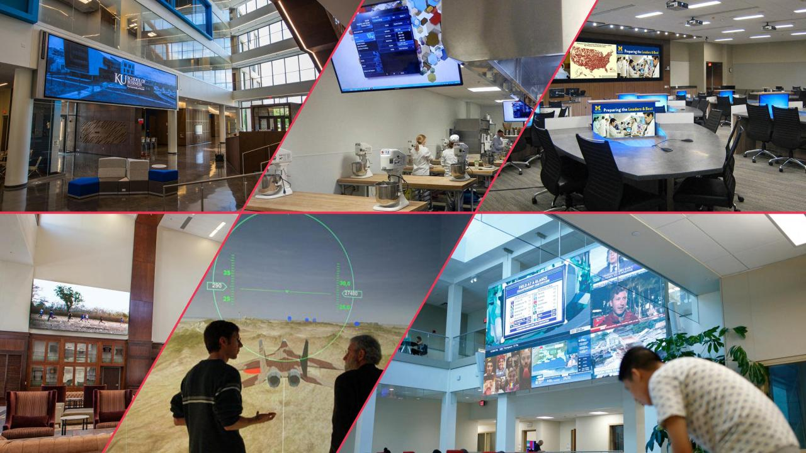
Higher Ed AV

Slide 10
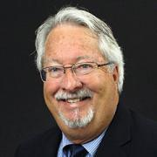
Technology Trends in Higher Education
Craig Park Principal, The Sextant Group

Slide 11
TECHNOLOGY TRENDS in Higher Education
• Designs are Flexible, Team-based, Technology Rich, Supporting Rich Media and BYOD
• Focused on Improved Learning Outcomes through Student-Centered Interdisciplinary, Interprofessional Collaboration
• Leveraging Robust Building IT Infrastructure and AV-over-IP Technology
© 2019 AVIXA

Slide 12
Case studies
1. University of Missouri Kansas City Bloch School of Management
Henry W. Bloch Executive Hall for Entrepreneurship & Innovation
2. University of Texas Southwestern Medical School
South Campus Library Team-Based Learning Center
© 2019 AVIXA

Slide 13
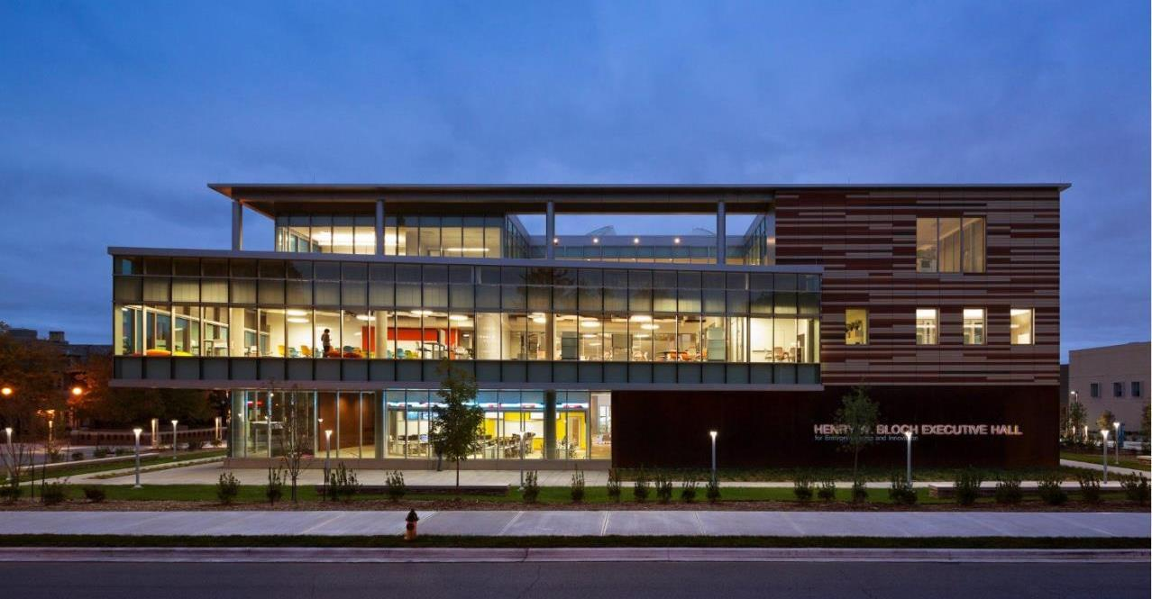
UMKC Henry W. Bloch Executive Hall
Is the “D-School” the new B-School?
© 2019 AVIXA
Notes:
University of Missouri Kansas City Henry W. Bloch Executive Hall for Entrepreneurship & Innovation
Architects: BNIM (KC, MO) w/ MRY (Santa Monica, CA)
GC: JE Dunn
AV/IT/Acoustic Design: The Sextant Group
AV Contractor: SKC

Slide 14
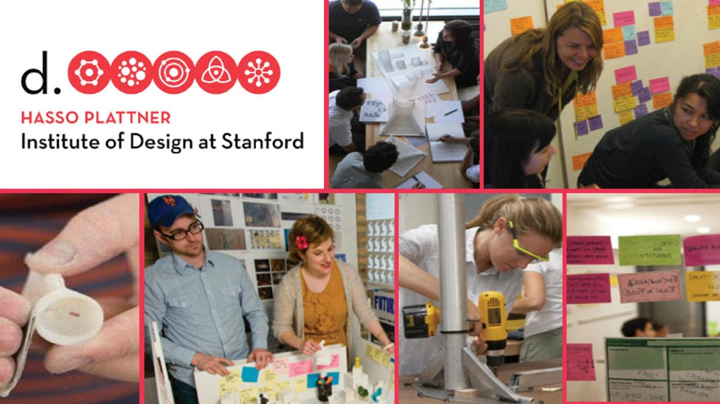
© 2019 AVIXA
Notes:
Project precedent: Developed by Michael and David Kelly from IDEO, Stanford U’s “D-School” focuses on developing ideas through Inter-Disciplinary Teams, “Deep Dive” Analysis, Rapid Prototyping, using Flex Space and collaborative technologies

Slide 15
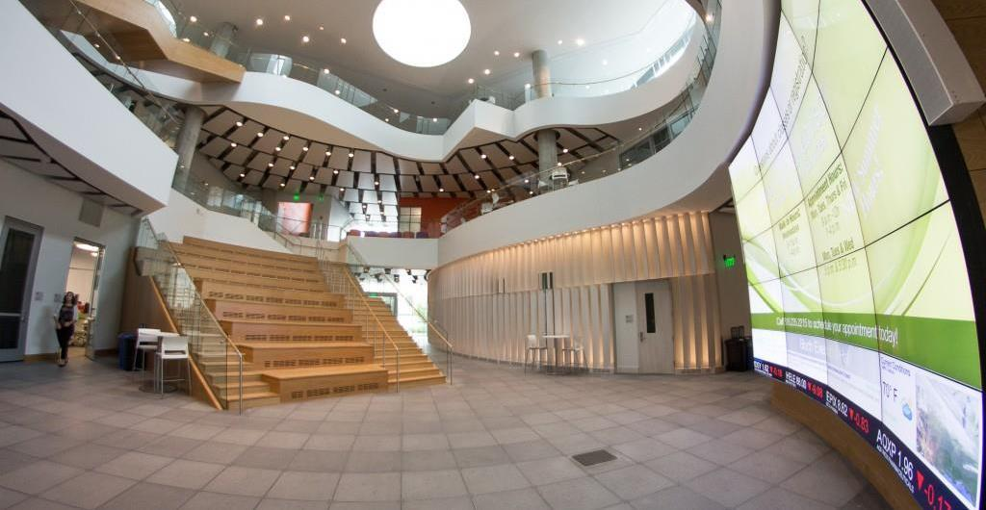
UMKC Henry W. Bloch Executive Hall – Lobby Stair
© 2019 AVIXA
Notes:
UMKC Henry W. Bloch Executive Hall – Lobby Stair

Slide 16
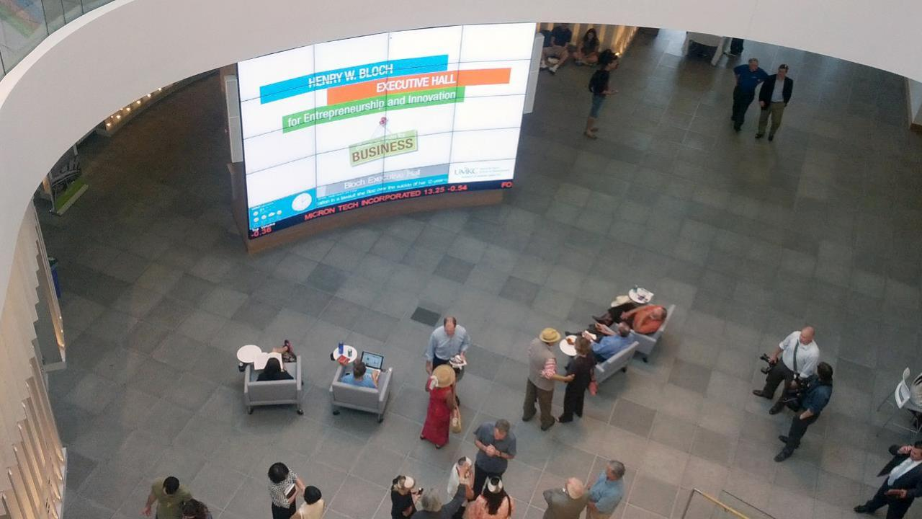
UMKC Henry W. Bloch Executive Hall – Lobby Display/Teaching Wall
© 2019 AVIXA
Notes:
UMKC Henry W. Bloch Executive Hall – Lobby Display/Teaching Wall

Slide 17
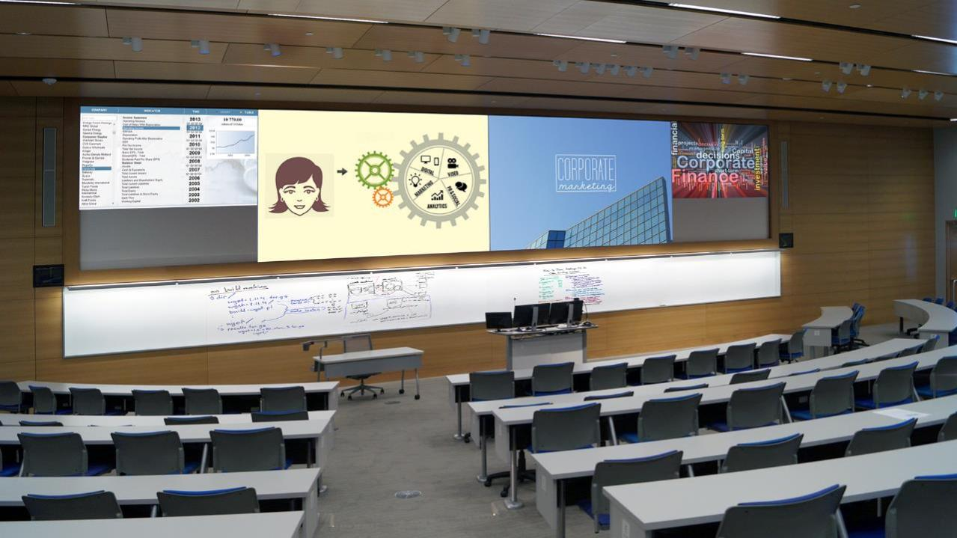
UMKC Henry W. Bloch Executive Hall – 180-Seat Auditorium
© 2019 AVIXA
Notes:
UMKC Henry W. Bloch Executive Hall – 180-Seat Auditorium

Slide 18
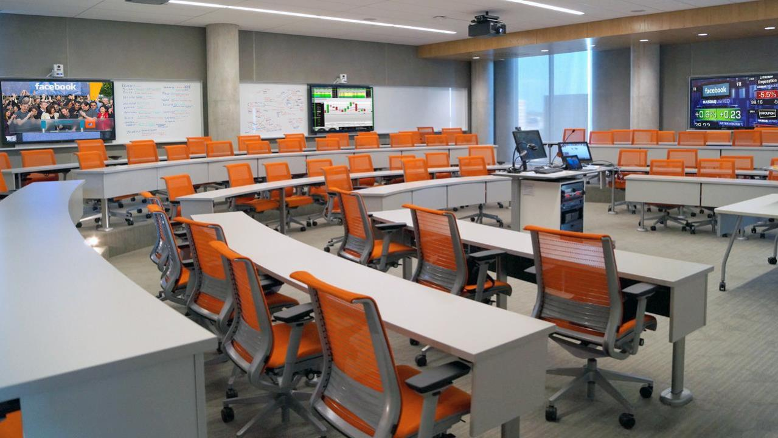
UMKC Henry W. Bloch Executive Hall – Case Method Classroom
© 2019 AVIXA
Notes:
UMKC Henry W. Bloch Executive Hall – Case Method Classroom

Slide 19
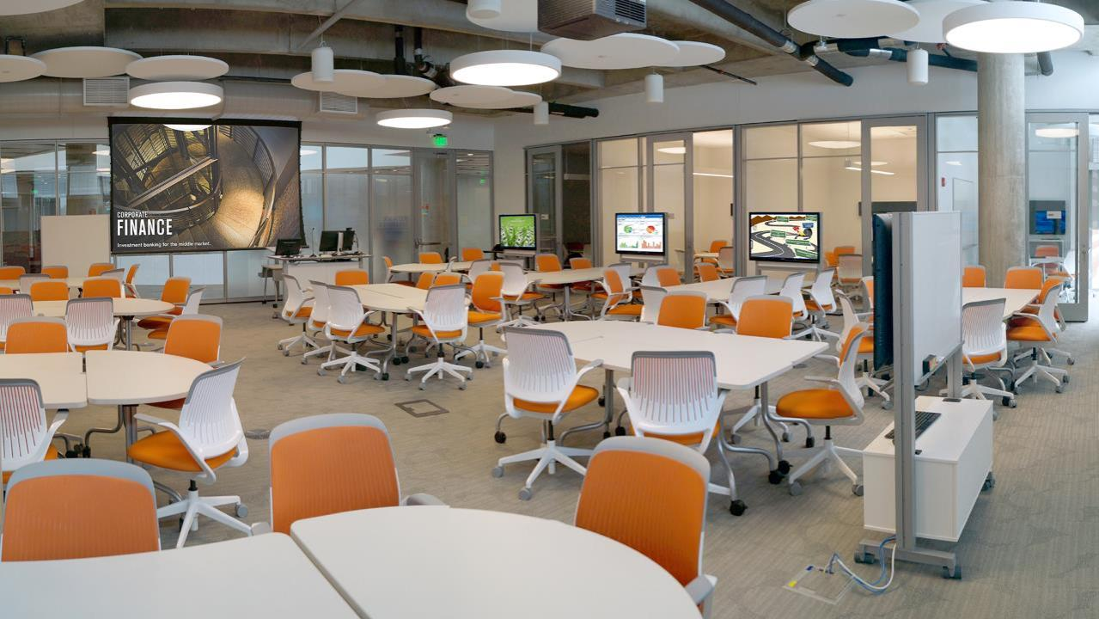
UMKC Henry W. Bloch Executive Hall – Team-Based Classroom
© 2019 AVIXA
Notes:
UMKC Henry W. Bloch Executive Hall – Team-Based Classroom

Slide 20
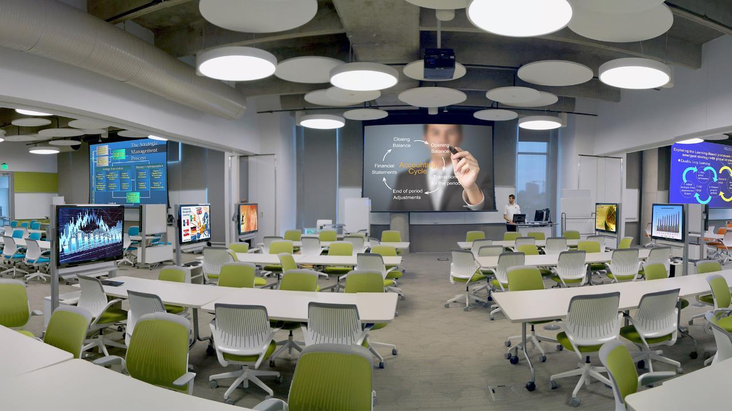
UMKC Henry W. Bloch Executive Hall – Divisible Team-Based Classroom
© 2019 AVIXA
Notes:
UMKC Henry W. Bloch Executive Hall – Divisible Team-Based Classroom

Slide 21
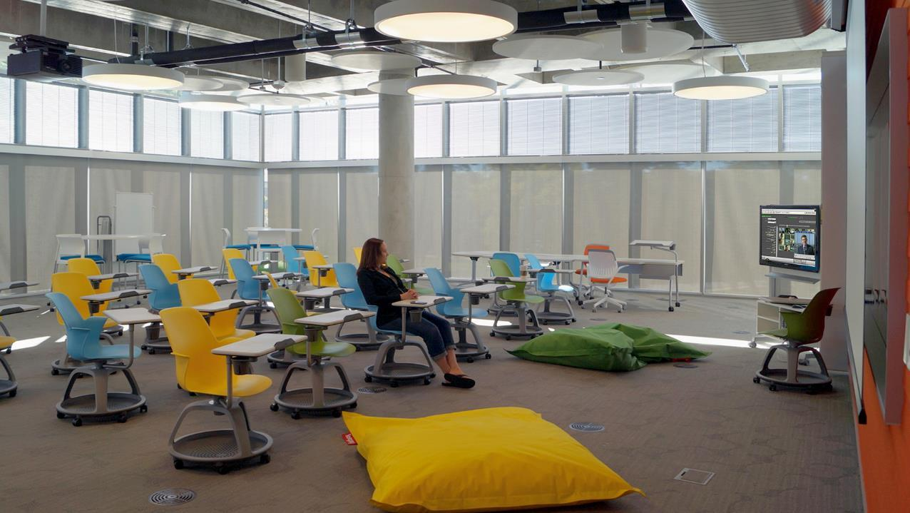
UMKC Henry W. Bloch Executive Hall – Innovation Lab
© 2019 AVIXA
Notes:
UMKC Henry W. Bloch Executive Hall – Innovation Lab

Slide 22
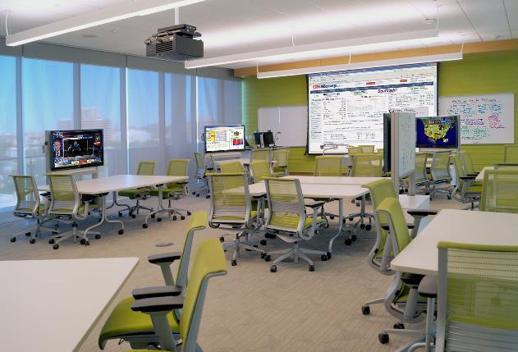
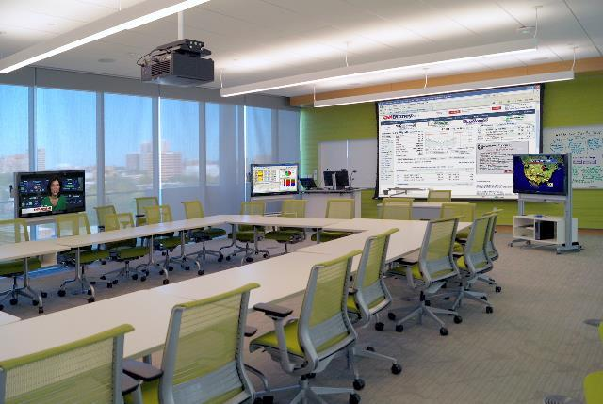
UMKC Henry W. Bloch Executive Hall – Seminar Room
© 2019 AVIXA
Notes:
UMKC Henry W. Bloch Executive Hall – Seminar Room

Slide 23
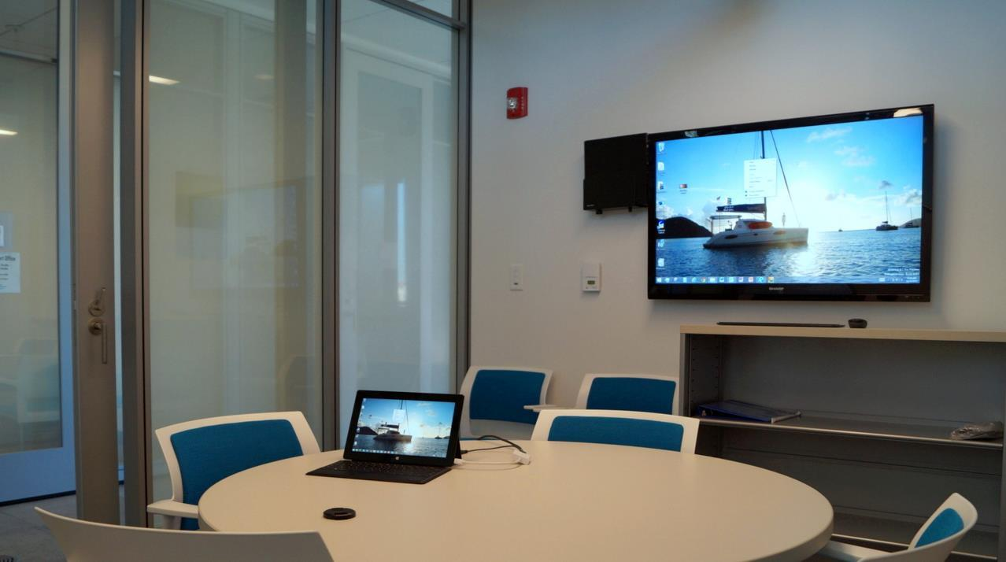
UMKC Henry W. Bloch Executive Hall – “Venture Accelerator” Team/Huddle Room
© 2019 AVIXA
Notes:
UMKC Henry W. Bloch Executive Hall – “Venture Accelerator” Team/Huddle Room

Slide 24
What the client says…
“We love the building. I love teaching in the Seminar spaces. They are so flexible and the technology is terrific.
Other faculty on campus are jealous of those of us who get to teach here. It’s a great building.”
― Mike Allison
Adjunct Faculty, EMBA Program
Bloch School of Management
University of Missouri Kansas City
© 2019 AVIXA

Slide 25
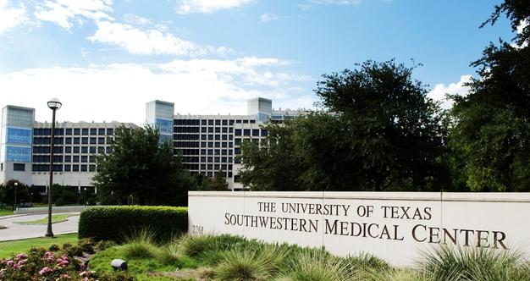
UTSW Medical Center – Team-Based Learning Center
From Passive to Active, No Ifs, Ands, or Buts!
© 2019 AVIXA
Notes:
University of Texas Southwestern Medical Center, Dallas, TX
South Library Team-Based Learning Center
Architect: HDR Architecture
GC: Lemco Construction Services
AV/IT/Acoustic Design: The Sextant Group
AV/IT Contractor: Lantek Communications

Slide 26
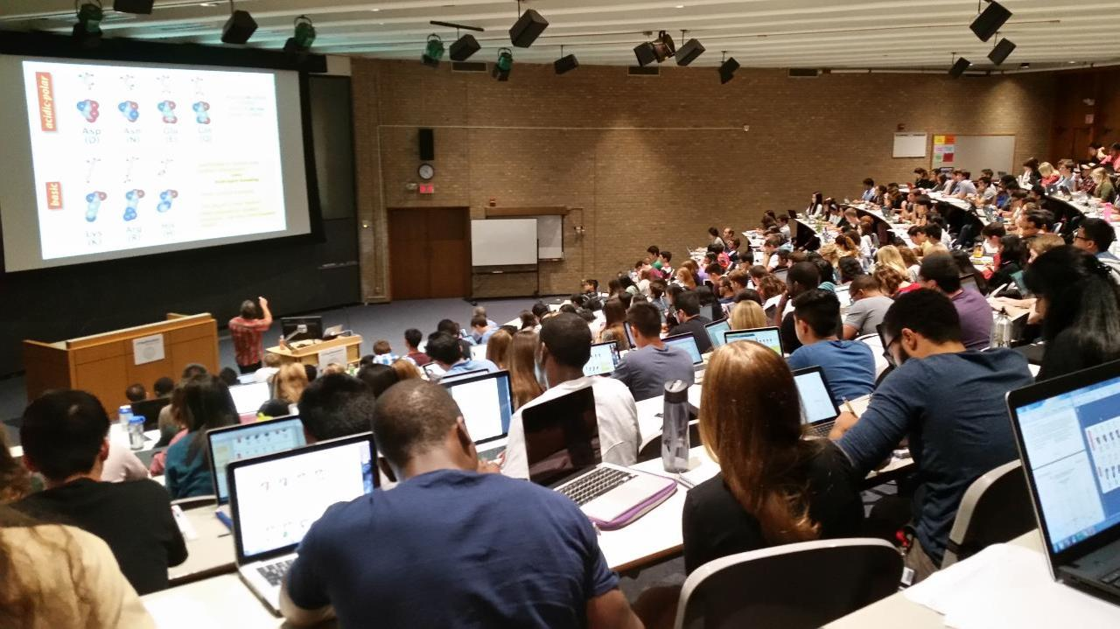
UTSW Medical Center – Lecture Hall
How these classes were taught “BEFORE”
© 2019 AVIXA
Notes:
UTSW Medical Center – Lecture Hall (How these classes were taught “before”)

Slide 27
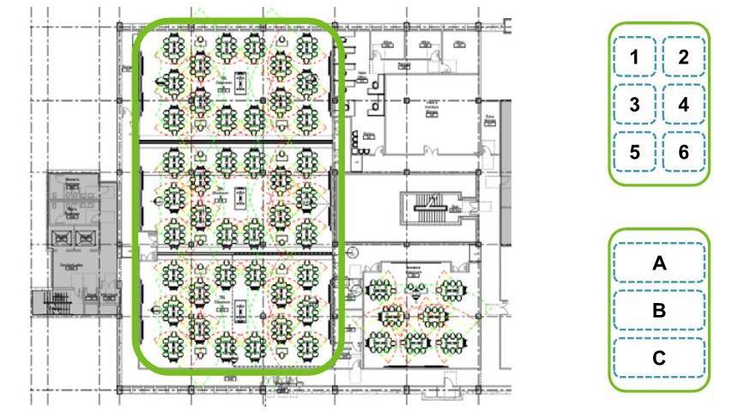
© 2019 AVIXA
Notes:
Floor plan view; space organized into 3 rooms each with two teams of (7) 6-person teams (242 students)

Slide 28
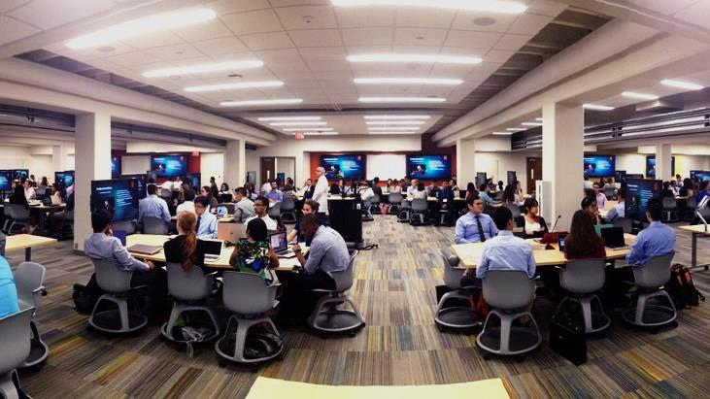
UTSW Medical Center – Team-Based Learning Center
How these classes are taught “TODAY”
© 2019 AVIXA
Notes:
UTSW Med Center Team-Based Learning Center
This is how classes are taught now

Slide 29
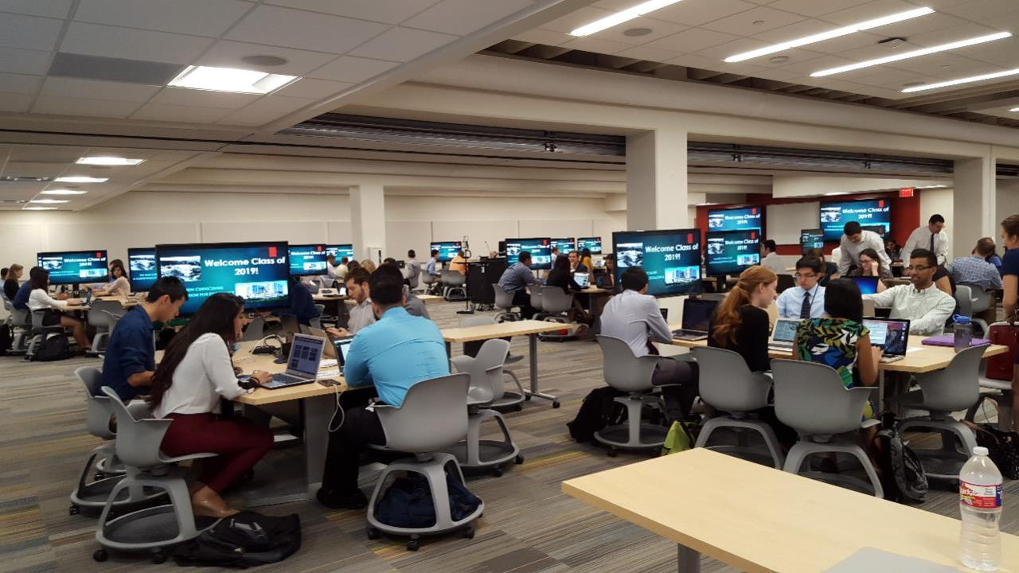
UTSW Medical Center– Team-Based Learning Center
© 2019 AVIXA
Notes:
UTSW Med Center Team-Based Learning Center

Slide 30
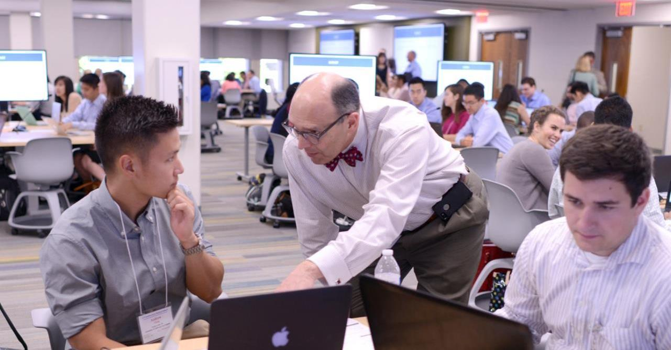
© 2019 AVIXA
Notes:
UTSW Med Center Team-Based Learning Center

Slide 31
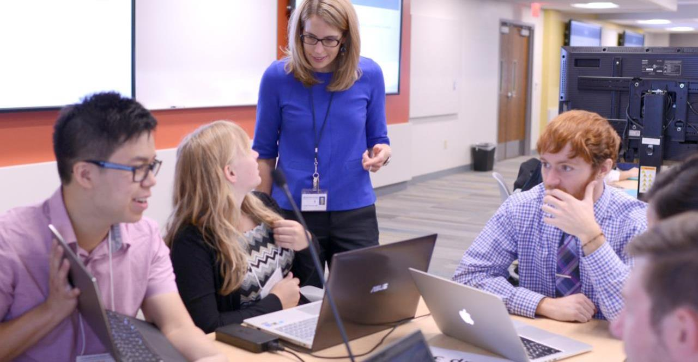
© 2019 AVIXA
Notes:
UTSW Med Center Team-Based Learning Center

Slide 32
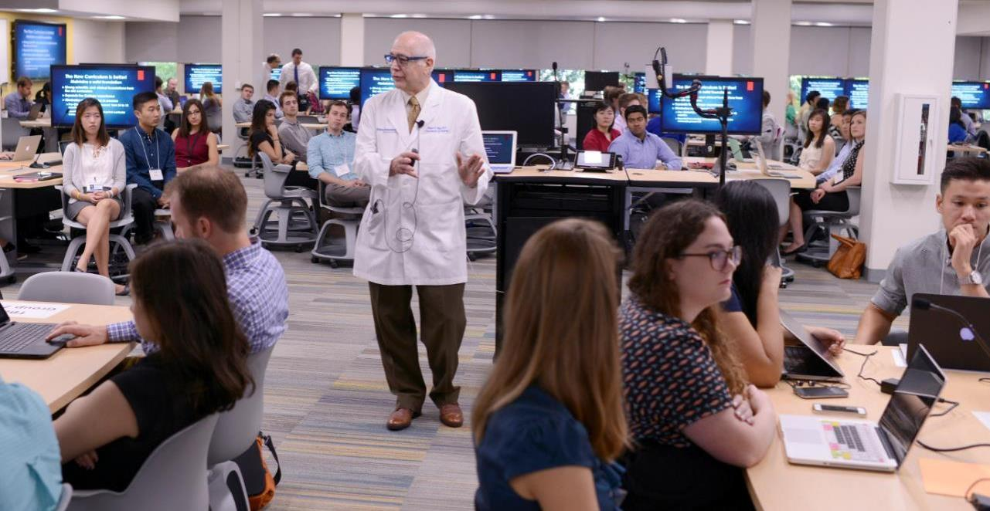
© 2019 AVIXA
Notes:
UTSW Med Center Team-Based Learning Center

Slide 33
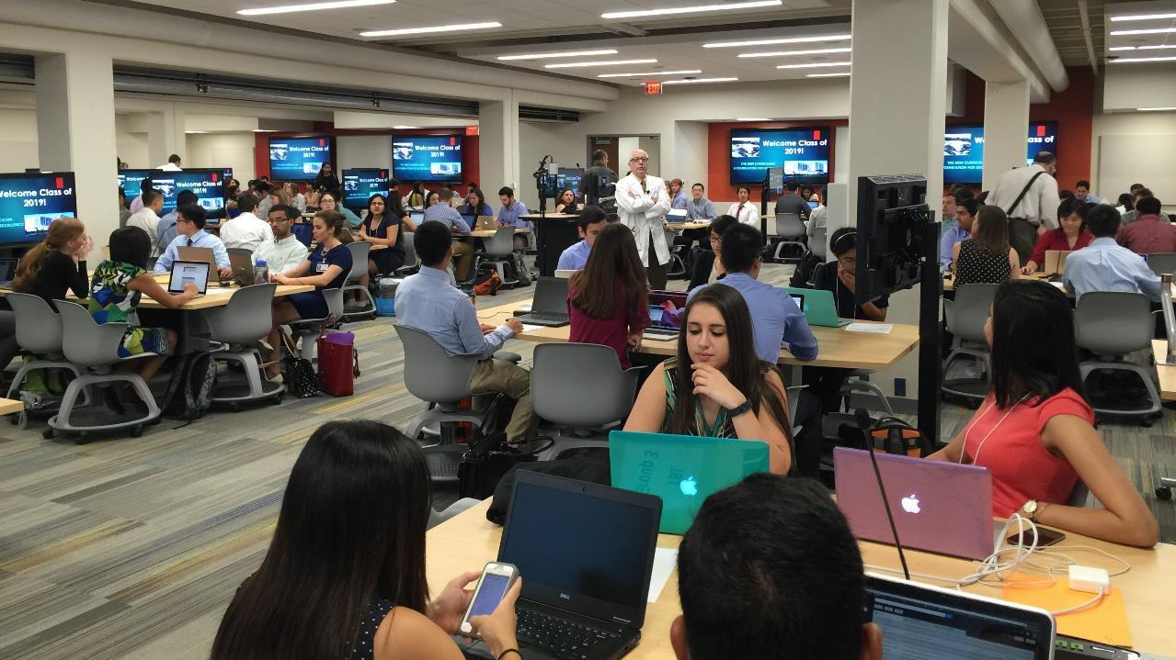
© 2019 AVIXA
Notes:
UTSW Med Center Team-Based Learning Center

Slide 34
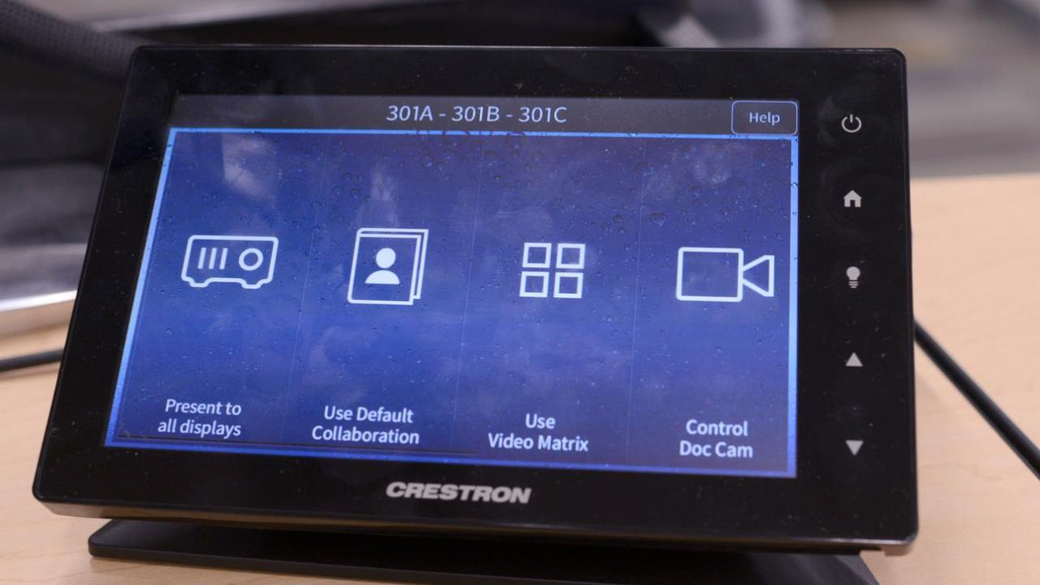
© 2019 AVIXA
Notes:
UTSW Med Center Team-Based Learning Center

Slide 35
What the client says…
“The Team-Based Learning Center fosters the type of organic conversation you can’t create in a lecture environment, helping our students to learn to communicate more effectively – cross-discipline – as they will in the real world.
The AV-over-IP/wireless collaboration technology has been a game-changer, helping our faculty and students to work more effectively to build and improve those interprofessional relationships.”
― Christopher Faulkner, Ph.D. Assistant Professor, Health Care Sciences/Research Director of Educational Technology UT Southwestern Medical Center
© 2019 AVIXA

Slide 36
Technology Trends in Higher Education
Emmett Frank Academic Technologist, Dartmouth College

Slide 37
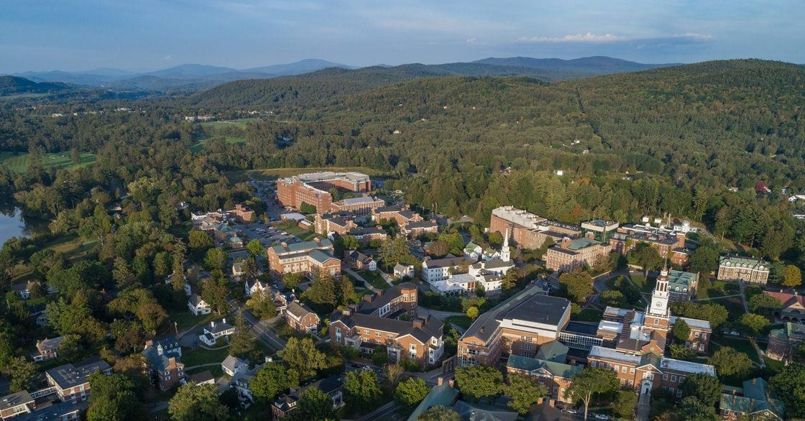
Dartmouth at a glance
© 2019 AVIXA
Notes:
Founded in 1769
Four year private Ivy League liberal arts college
Student population of approximately 4400 undergraduates, 2,100 graduate
50 academic departments; graduate schools of Arts and Sciences, Medicine, Engineering, and business
More information can be found at dartmouth.edu/dartmouth-glance
Support the key learning principles through technology in the classroom
Provide consistent experience and performance across campus through the use of standards
Identify novel technology to introduce to the Dartmouth community

Slide 38
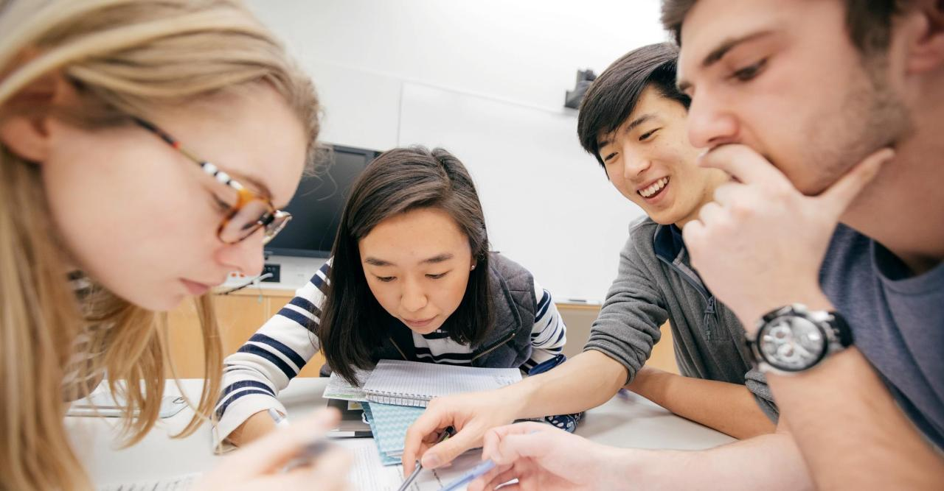
Learning Space Principles for Design
© 2019 AVIXA
Notes:
Academic Challenges: Learning spaces should allow students to actively engage with content and include range of technologies that support multiple modes of teaching and learning
Learning with Peers: learning spaces should provide features that permit students to work both individually and in collaboration with one another.
Promote active engagement with one another
Shared workspaces (e.g., writable walls, projection capability)
Interactions with Instructors: Learning spaces should facilitate communication and interaction between students and faculty
Promote interaction and communication
Allow students to share content to projection (facilitated by instructor)
Ability to present content anywhere in the room (e.g. wireless projection)

Slide 39
classrooms
© 2019 AVIXA

Slide 40
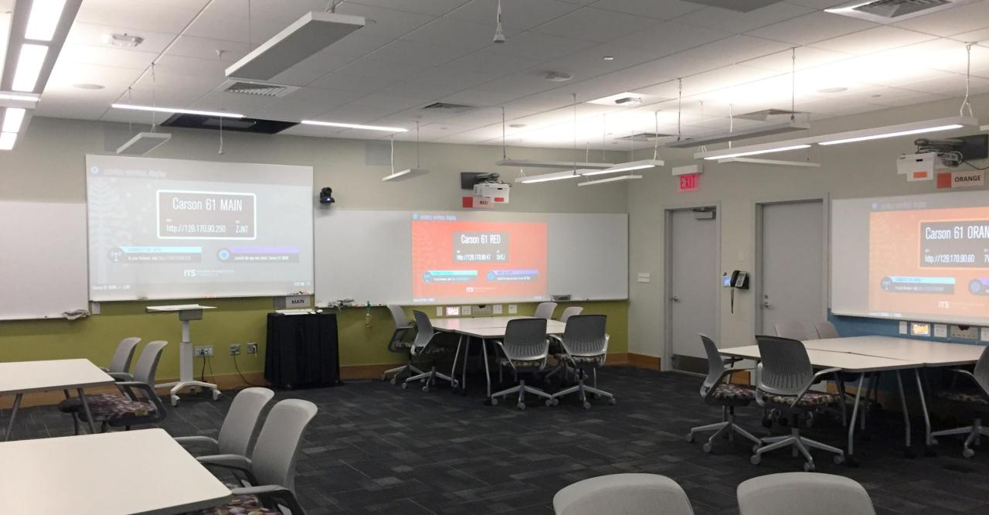
Carson 61
© 2019 AVIXA
Notes:
Seven team stations with
Discrete controls
Wired connection
Wireless gateways
Station routing from local touch panel

Slide 41
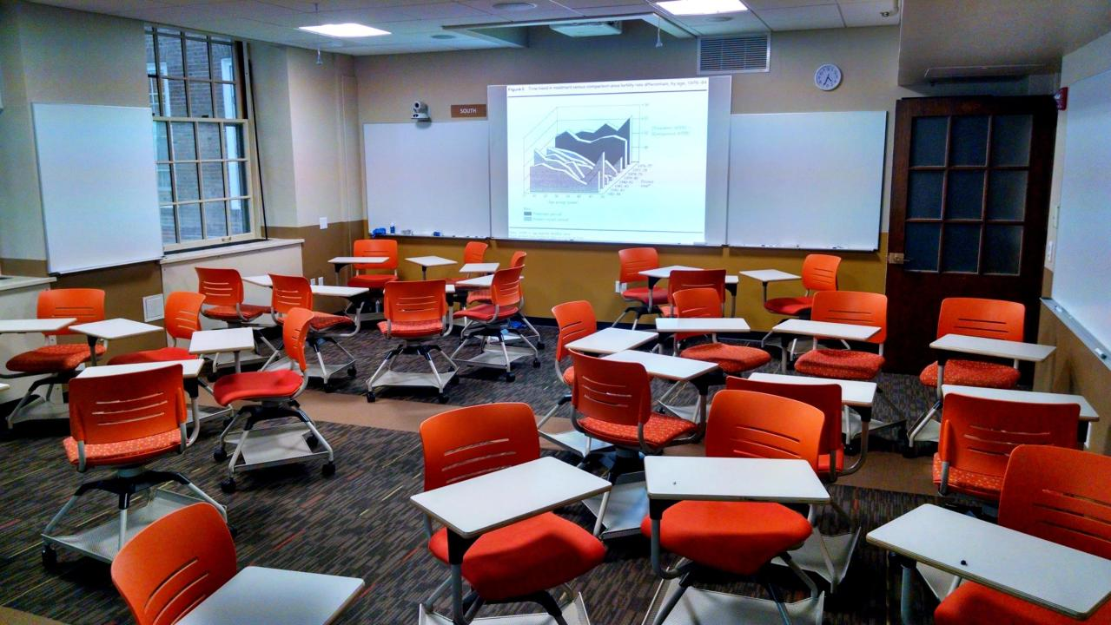
Silsby 213
© 2019 AVIXA
Notes:
Two ultra short-throw projectors on opposing walls
Audio zoning to split room into two groups
Discrete controls for each projector or combined
Wireless gateways

Slide 42
Fairchild 101
© 2019 AVIXA
Notes:
Two projectors to provide comparative display
Tablet for digital annotation or digital whiteboard
Camera at the front of the room for audience capture
Camera at the back of the room for presenter/content capture
Lecture capture appliance in rack
Pendant mics for audience capture
Wireless gateway

Slide 43
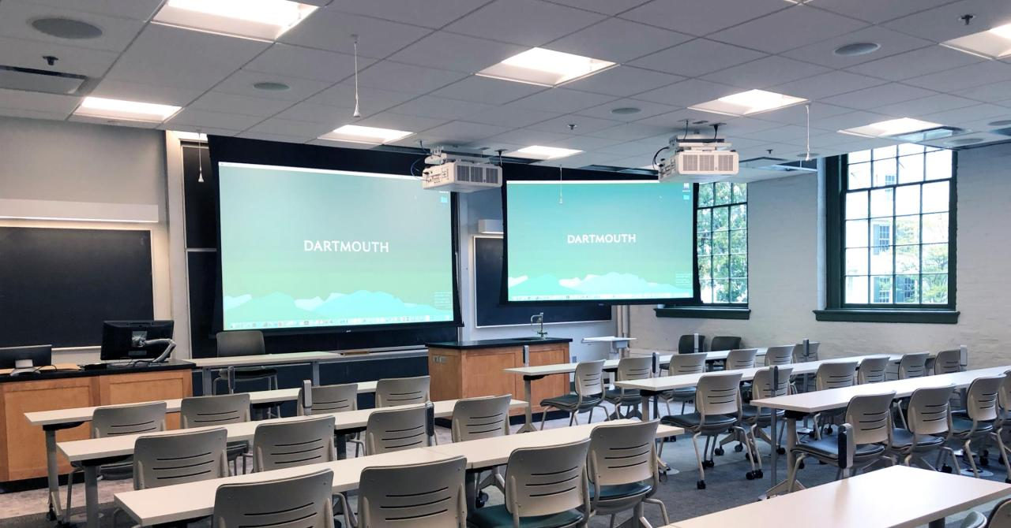
Steele 007
© 2019 AVIXA
Notes:
Two projectors to provide comparative display
Tablet for digital annotation or digital whiteboard
Camera at the front of the room for audience capture
Camera at the back of the room for presenter/content capture
Lecture capture appliance in rack
Pendant mics for audience capture
Wireless gateway

Slide 44
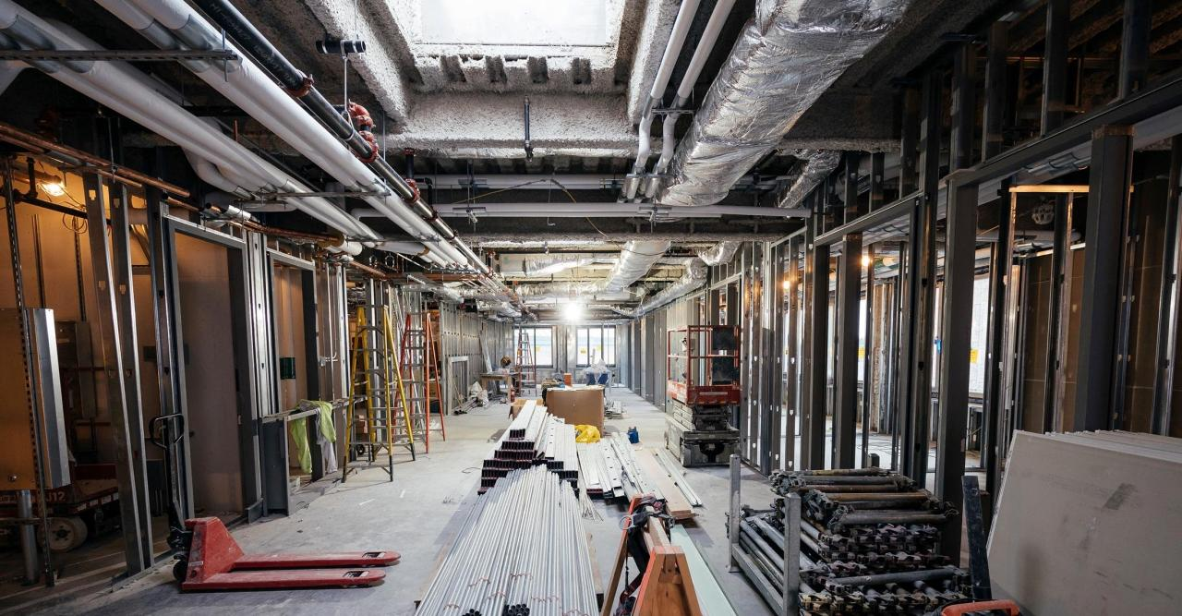
Future opportunities
© 2019 AVIXA
Notes:
Silsby 28 Renovation
Reed Hall Renovation
Dartmouth Hall Renovation
Thornton Hall Renovation

Slide 45
Applying Design Principals To Digital Standards
Aiden Sizemore Dir. of Academic Technology & Systems
Florida State University, College of Business

Slide 46
focusing our efforts
Provide thoughtful spaces with appropriate technology to better assist faculty, staff, and students’ academic pursuits
Maintain consistent technology across all spaces for ease of use and quality of content produced – Lecture Capture, Event Capture, & Digital Content Creation
© 2019 AVIXA
Notes:
Provide thoughtful spaces with appropriate technology to better assist faculty, staff, and students’ academic pursuits
Several Key Spaces
Classrooms
Conference Spaces
Collaboration Labs
Discipline Specific Spaces (i.e. Real Estate War Room or Trading Room)
Resource Spaces (i.e. One Button Studio and Traditional Studio)
Maintain consistent technology across all spaces for ease of use and quality of content produced
Lecture Capture
Event Capture
Digital Content Creation

Slide 47
Updating Traditional Learning Spaces
© 2019 AVIXA

Slide 48
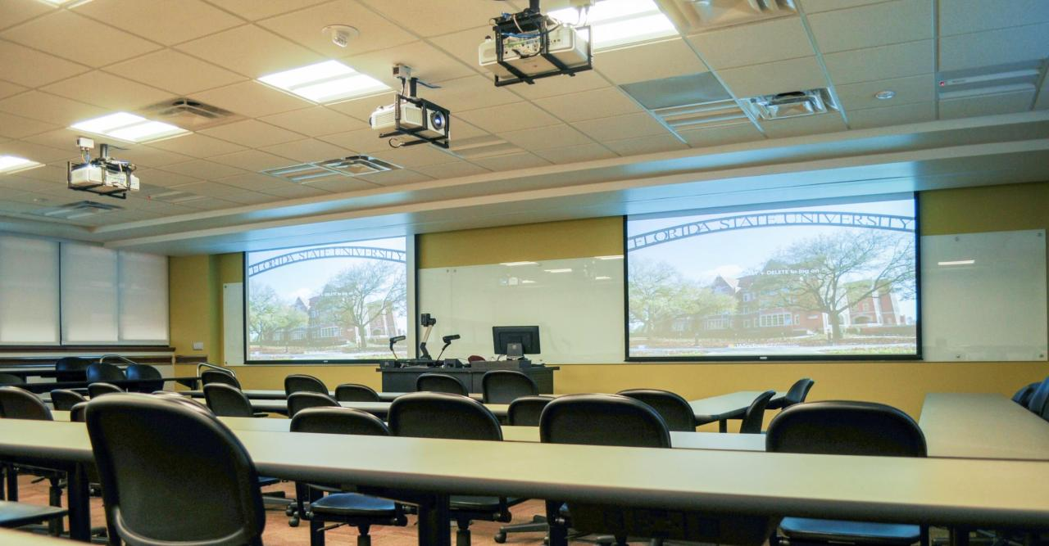
Updated Classroom
© 2019 AVIXA
Notes:
Classrooms
Initially retrofitted for lecture capture ~ 5 years ago
Single mounted camera
One lapel mic for instructor use
Podium system with dedicated computer, projector, and document camera
Lecture capture software solution was Tegrity Lecture Capture

Slide 49
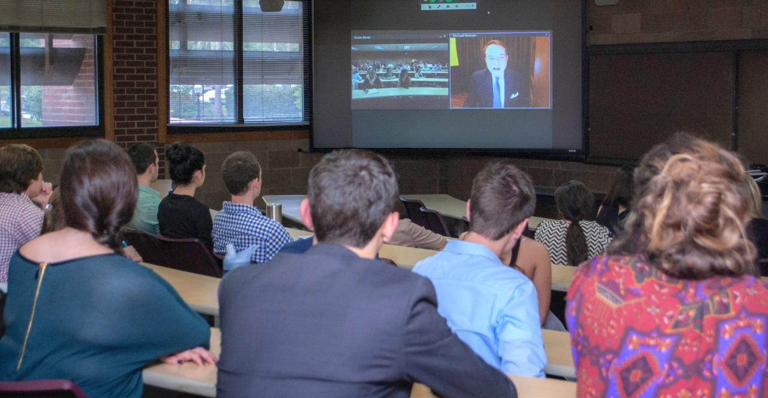
Classroom Webinars
© 2019 AVIXA
Notes:
Recent updates to our spaces
Added additional cameras for both audience and instructor view
Increased usage of the space for webinars and guest speakers using web-based chatting
Added microphones for multiple speakers
Helpful for student group presentations, multiple guest speakers, or panel sessions
Investing in beam forming microphones to increase audience participation and clarity
Switched to Kaltura Classroom for lecture capture software solution

Slide 50
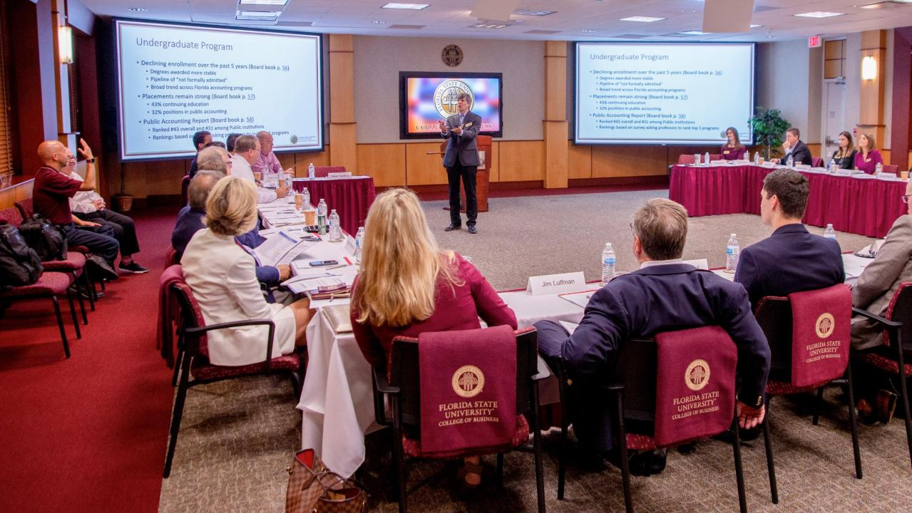
Starry Conference Room - Board Meeting
© 2019 AVIXA
Notes:
Starry Conference Room
Primarily used to host events such as guest speakers, industry panels, and large seminars
Originally outfitted with a single camera and in-room audio system with 3 microphone max

Slide 51
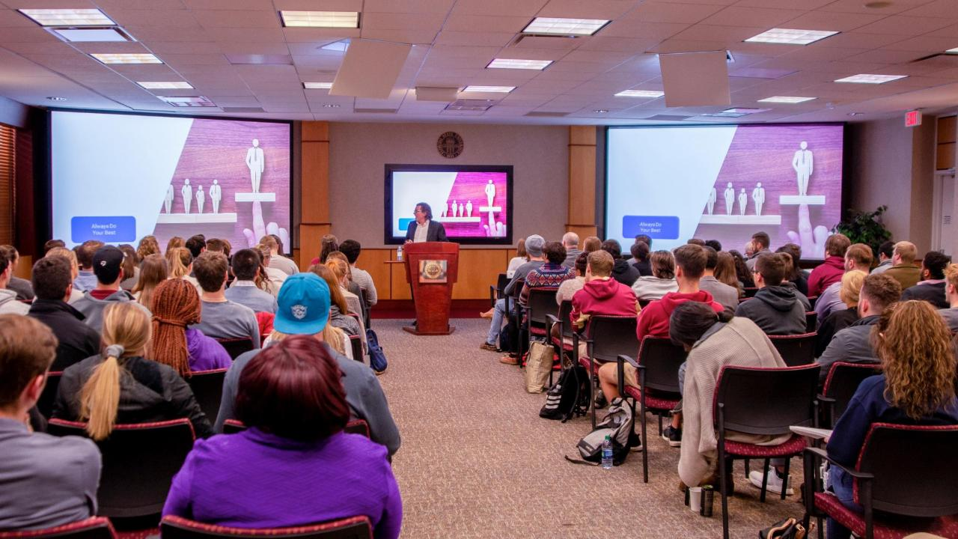
Starry Conference Room – Guest Speaker
© 2019 AVIXA
Notes:
Currently updating to expand room’s capabilities
Multi-camera system
Increased audio capabilities with a dedicated 32 channel mixer and upgraded in-room audio system
Multiple audio and video access points to provide flexibility for additional cameras and microphone layout
Updated laser projectors
Podium integrated confidence monitor

Slide 52
Creating New Learning Spaces
© 2019 AVIXA

Slide 53
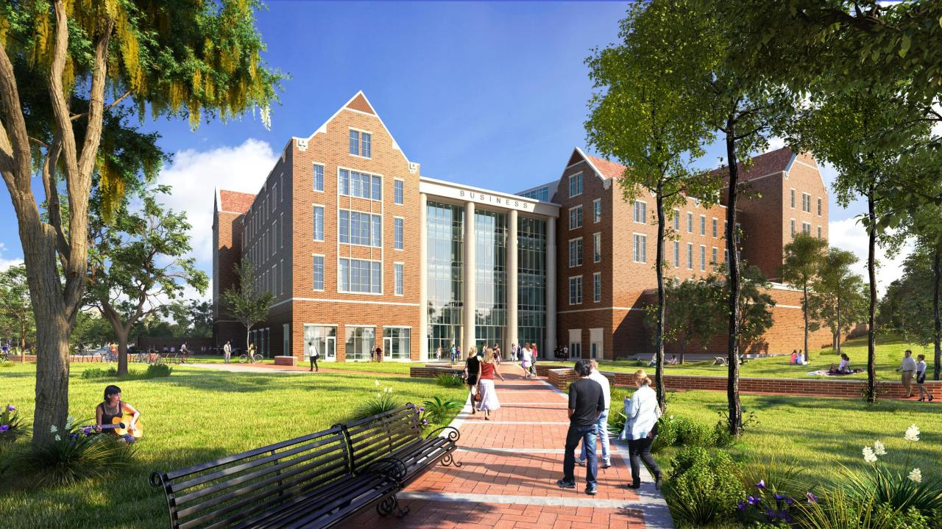
Legacy Hall
© 2019 AVIXA
Notes:
Currently planning and designing a new College of Business building – Legacy Hall
Implementing current updates and looking at additional technologies including:
Implementing multi-camera systems based on the size of the classroom environment – providing multiple views for lecture and event capture
Reviewing microphone use and placement
Redesigning our podium to give our instructors and students flexibility to utilize active learning techniques with the latest technology
Reducing wires and investing in updated casting technology
Providing additional monitors to act as confidence and group work monitors
Controllable lighting and room systems to promote the optimal environment for sound and video capture

Slide 54
Student Collaboration Lab
Created for student groups to utilize to work together and practice using technology for case competitions, presentations, etc.
© 2019 AVIXA
Notes:
Created for student groups to utilize to work together and practice using technology for case competitions, presentations, etc.

Slide 55
Presentation Practice
© 2019 AVIXA
Notes:
Student Collaboration Lab
Created for student groups to utilize to work together and practice using technology for case competitions, presentations, etc.
70-inch presentation screen to practice presentations with faculty advisors and other student groups

Slide 56
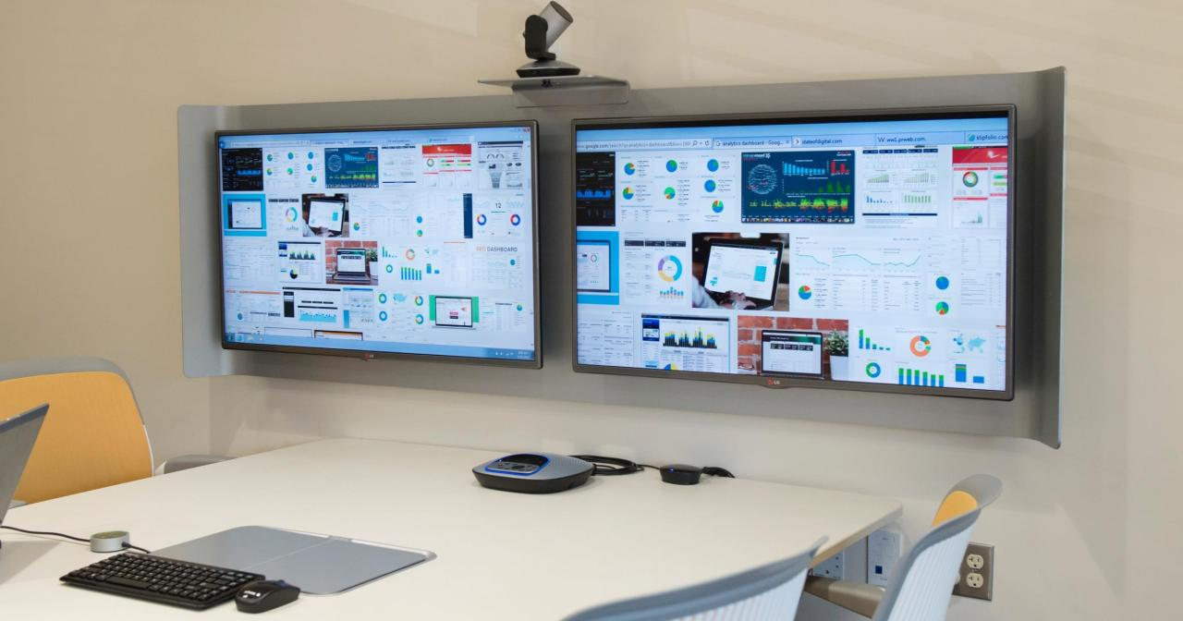
Collaboration Screens
© 2019 AVIXA
Notes:
Utilizes Steelcase VGA Pucks and a 4-screen array allow students to collaborate on multiple machines in one space

Slide 57
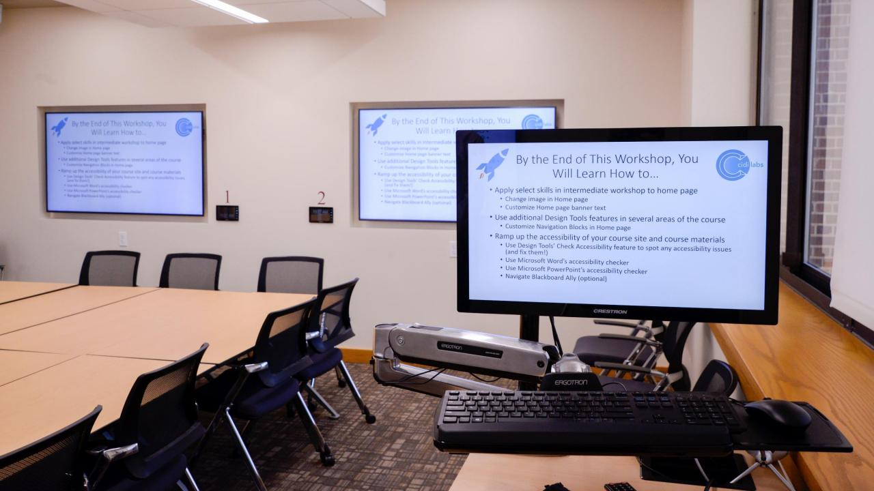
Doctoral Seminar Room
© 2019 AVIXA
Notes:
Doctoral Seminar Room
Created for doctoral students to have a space to host specialty seminars and faculty to present seminars to doctoral students
Mobile podium with Crestron interface & built in computer
4 confidence monitors that double as group breakout screens
Wireless casting via closed network for each screen independently or grouped together, based on preference

Slide 58
Future Collaboration Rooms and Breakout Rooms
Expanded amount of spaces for students and faculty to utilize
Using a consistent design to provide students and faculty collaborative technology across all spaces
© 2019 AVIXA
Notes:
Future Collaboration Rooms and Breakout Rooms
Expanded amount of spaces for students and faculty to utilize
Increasing available options by over 500%
Using a consistent design to provide students and faculty collaborative technology across all spaces
All rooms will include cameras and microphones for webinar sessions and interview support
All rooms will include screens for collaboration and presentation practice
All rooms will be on an integrated scheduling system that is available for on demand booking availability

Slide 59
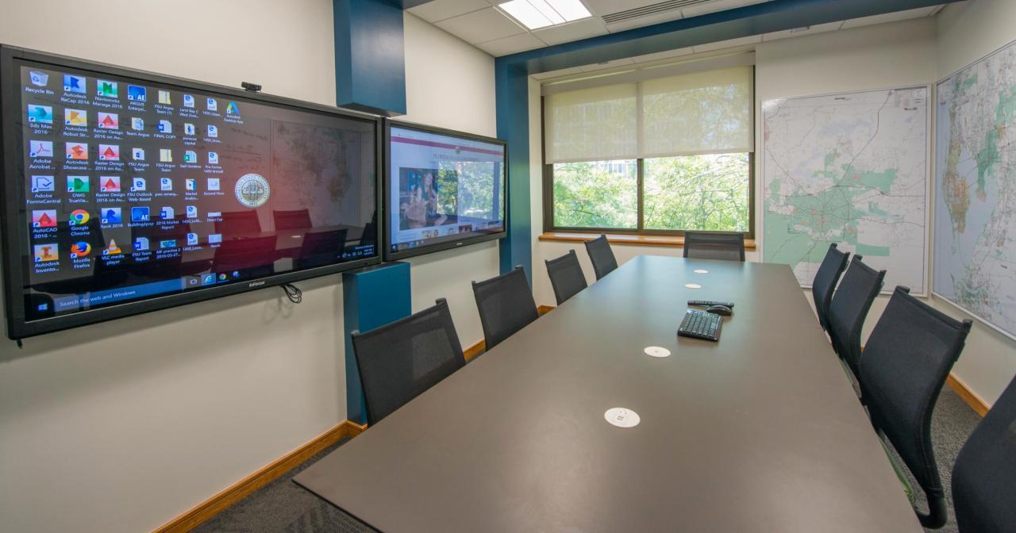
Specialized Spaces – War Room
© 2019 AVIXA
Notes:
Real Estate Research Lab aka “The War Room”
A collaborative space for students and faculty in the real estate department to meet and collaborate; d
Doubles as a small classroom space for seminars
Equipped with two 70-inch screens to deliver presentations or host webinars

Slide 60
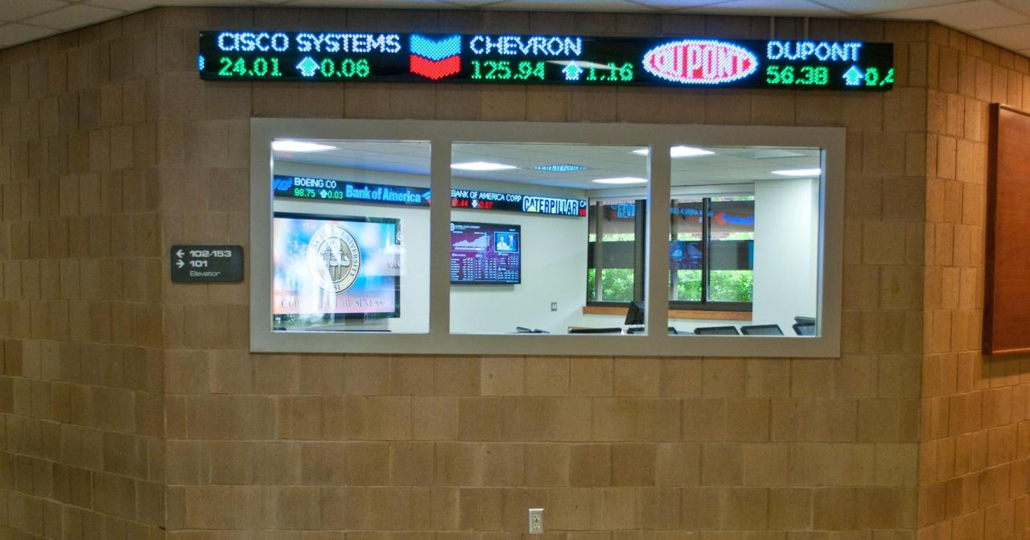
Specialized Spaces – Trading Room
© 2019 AVIXA
Notes:
The home of our student investment fund team and classroom for our investment finance classes
Equipped with:
10 dedicated Bloomberg terminals for students to train and use for education and certification
Scrolling ticker with live market information
70-inch screens to deliver presentations

Slide 61
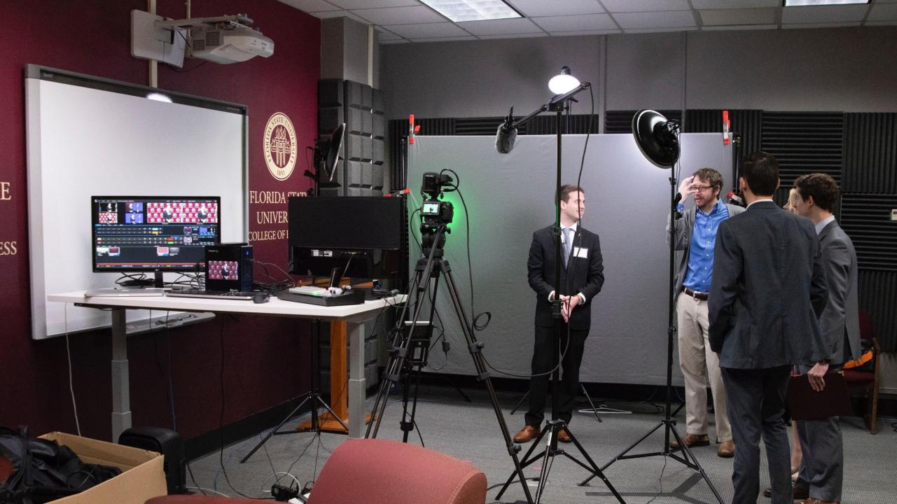
Traditional Studio
© 2019 AVIXA
Notes:
Traditional Studio
Created this space to give faculty and students a resource to create quality digital content and move away from recording in their offices or at home
Originally outfitted with studio grade box lighting, a camera, and smartboard
Recent updates to expand capabilities:
Hired dedicated production team to plan, create, and edit content
Invested in updated camera with 4K capabilities, LED lighting arrays, updated Sennheiser microphones, and LiteRing with Chromatte backdrop to replace the Smartboard setup to present content
Added in TriCaster Mini and confidence monitors to give faculty and students the ability to see finished look of content using live keying and virtual sets
Also expanded our broadcasting abilities to host live events

Slide 62
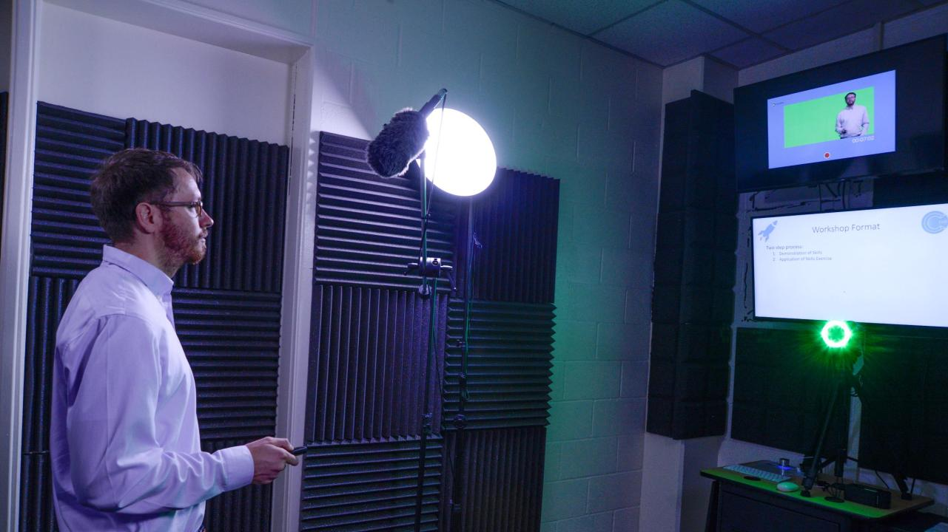
One Button Studio
© 2019 AVIXA
Notes:
One Button Studio
Created this space to give faculty a resource to create quality digital content and be as independent as possible using PSU’s One Button Studio app
Mirrored the same equipment as our traditional studio to maintain consistency in content created
Faculty and students can still utilize editing team to create finished product or can utilize Adobe Creative Cloud to edit their own content

Slide 63
impacts of our focus
Increased demand and usage of collaboration tools and spaces with additional spaces being retrofitted for our students and faculty to use
Increased engagement with digital content from students and faculty
© 2019 AVIXA
Notes:
Increased demand and usage of collaboration tools and spaces with additional spaces being retrofitted for our students and faculty to use
Provides a great testing ground for new and future technologies with ability to get real feedback from users and analysis of usage patterns
Assisted in evaluation of future space needs in Legacy Hall
Increased engagement with digital content from students and faculty
Average student viewing time of content 10-12 minutes (typically presented in 15-18 minute segments) with over 40% of content created being reviewed to completion
Significantly higher than industry standard of ~6 minutes
Over 65% of faculty are utilizing technology resources throughout the spaces provided to assist in teaching and/or mentoring students
Evaluation scores in all courses have risen with the adoption of new technologies regardless of method of delivery, with students providing increased feedback on technology resources they are using

Slide 64
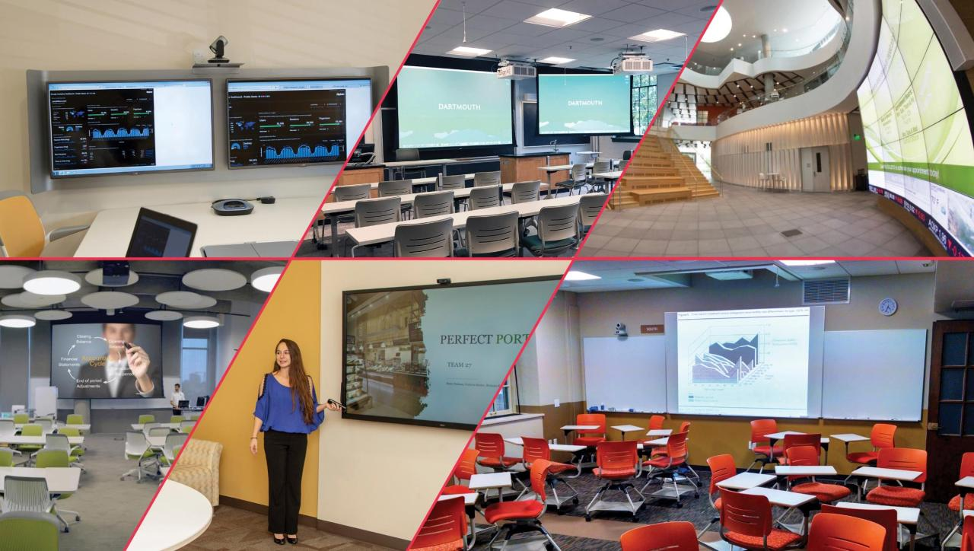
Higher Ed AV

Slide 65
THANK YOU
Get more information and examples at:
avixa.org/higheredAV
Brad Grimes: bgrimes@avixa.org
FOLLOW US

