Slide 1
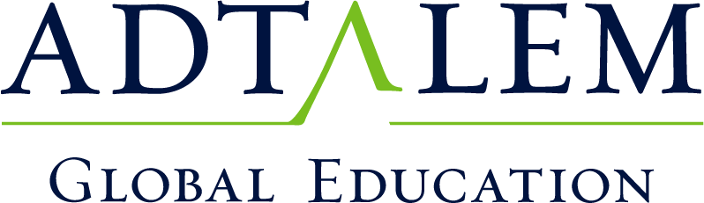
Going All-In: Adtalem’s Cloud Migration Strategy
March 21st, 2019

Slide 2
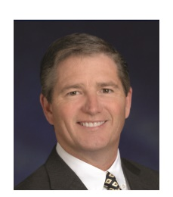
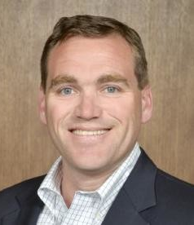
Presenters
Chris Nash
Senior Vice President & Chief Information Officer for Adtalem Global Education
Board of Trustees for Chamberlain University
Dennis Harding
Vice President of IT Infrastructure & Security Operations

Slide 3
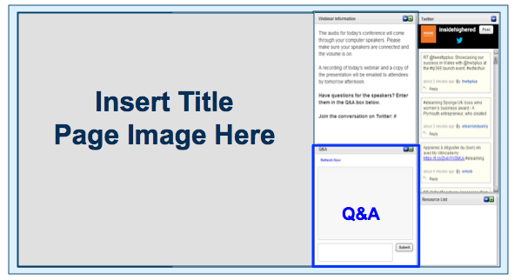
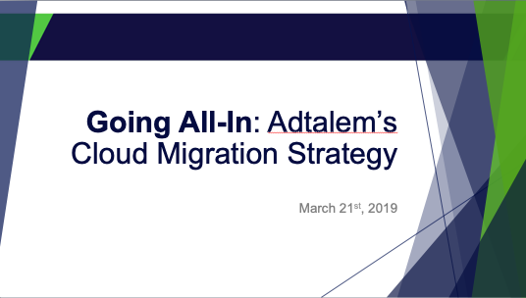
BEFORE WE BEGIN
We are using On24 for today’s webinar. Please enter questions in the text field at the bottom of the Q&A Window. We are monitoring the discussion and will try to bring the Q&A comments into the conversation.
We are recording the webinar; the webinar archive and slides will be available later today.

Slide 4
Agenda
Adtalem Profile
Business Context
Cloud Migration Challenges
Our Four Keys to Success
Results & Lessons Learned

Slide 5








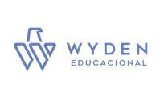




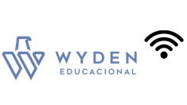
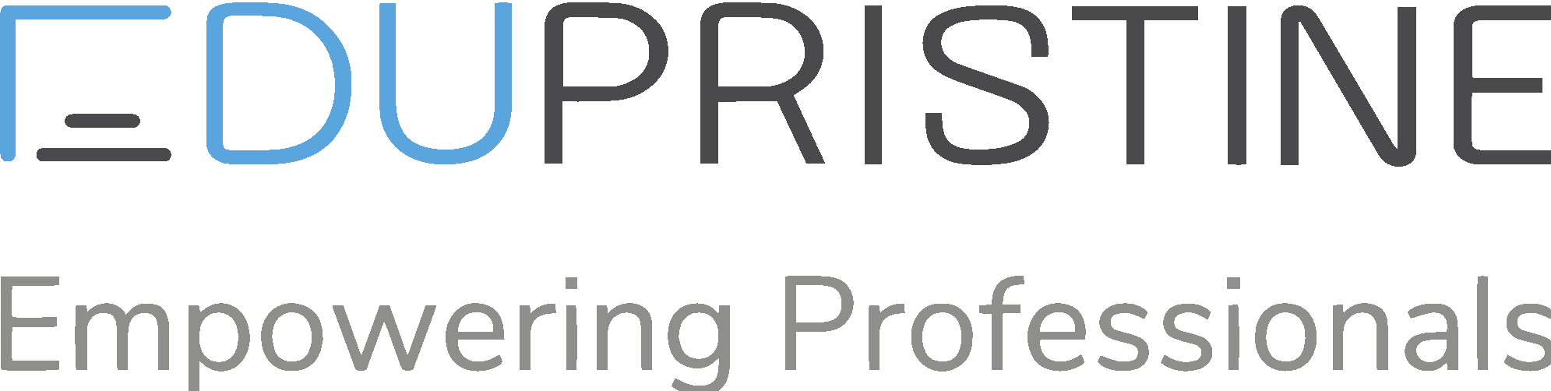

ADTALEM PROFILE – BUSINESS SEGMENTS
Medical &
Healthcare
Financial
Services
Business &
Law
Notes:
Alumni: 86,000 alumni
25 campuses

Slide 6
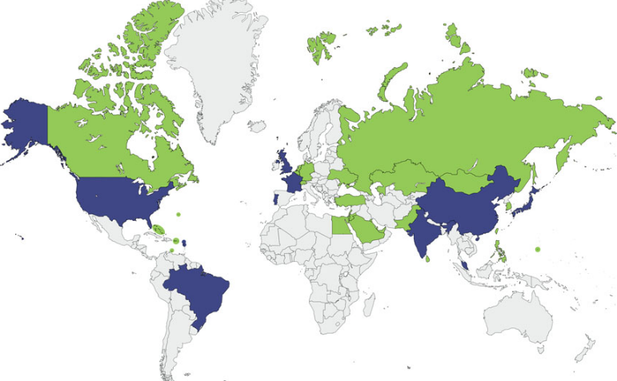
ADTALEM PROFILE - BY THE NUMBERS
4
TEST PREP & CERTIFICATION
WE ARE LEADING PROVIDERS OF:
  MEDICAL DOCTORS (US)
  NURSES (US)
  VETERINARIANS (US)
  CPA TEST PREP (US)
  ANTI-MONEY LAUNDERING CERTIFICATION (GLOBAL)
  LAWYERS (BRASIL)
  ENGINEERS (BRASIL)
8
UNIVERSITIES
12
COUNTRIES
145
LOCATIONS
86K
ALUMNI
70K
CURRENT MEMBERS
120K
CURRENT STUDENTS

Slide 7
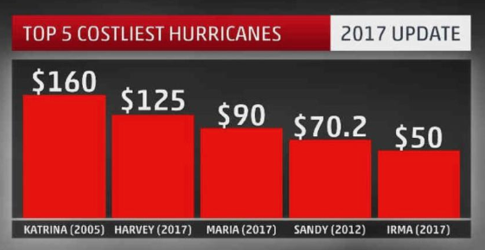
BUSINESS CONTEXT
In September of 2017
Both our medical schools were forced into business continuity situations
  Irma – Impacted AUC
  The most powerful hurricane in Atlantic history.
  185+ mph winds lasted 37 hrs.
  Just 13 days later….
  Maria – Impacted Ross University
  10th most powerful hurricane in Atlantic history.
  Ravaged our island of Dominica, and later Puerto Rico
In billions (USD)

Slide 8
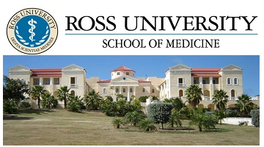
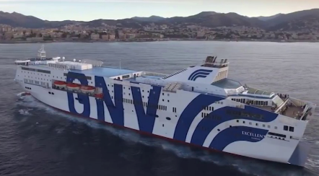
BUSINESS CONTEXT
IT technical agility and speed were critical components of executing our business continuity plans
AUC
Relocated to UK in just 3 weeks
Returned to St. Maarten 1 year later
Ross University
Built a floating medical school on a cruise ship
Built a brand new campus on Barbados

Slide 9
BUSINESS CONTEXT
2 months later, we announced 2 major divestitures
IT was asked to technically separate / divest 25% of our business revenue in 12 months (350+ applications)

Slide 10
BUSINESS CONTEXT
Two potential divestiture paths emerged
Remaining
business
To be divested
Path #1
Path #2

Slide 11
BUSINESS CONTEXT
Adtalem’s strategic plan for the enterprise called
for IT to do more than just business continuity and divestitures
Improve Operations & Reduce Cost
Modernize & Drive Innovation
Prepare for Global Expansion

Slide 12


BUSINESS CONTEXT
We chose the more difficult and risky divestiture path in the short-term
To achieve strategic capabilities for the long-term
STRATEGY
AGILITY &
INNOVATION
Remaining
business
To be divested
FLEXIBILITY
CONTINUITY
Path #1
OPERATIONS
EXPANSION

Slide 13

“We are going to do this the right way”
Given new technologies & accelerated timelines, we selected proven partners and followed best practices
Conducted a 6R’s analysis
Partnered with Integrator
Repurchase
Refactor
Retain
Replatform
Retire
Rehost
Notes:
We all say this at the beginning of an inititiave. And we did everything by the book,
Partnered with an Integrator, someone we new and worked with before.
We conducted an exhaustive study an 6 R’s analysis.
Our preferred approach was to Rehost, or Lift and Shift
We stuck with the AWS Well Architected framework. Mostly. More on that later.
We started in earnest about two years before our eventual deadline.
Question: what tools did we use: a variety of tools, based on
Native tools
Import / export
Third party ansible.

Slide 14


“We started to fail… fast.”
Even though we said we were going to do the right things,
we still encountered problems
Architecture Started Failing
4 Pillar Reboot of
Project
Migrate
15% -20%
Lost Application Team Confidence
Notes:
Migrated 15%-20% of workload, but the project stalled.
Our architecture was not performing as expected, our firewall solution was unreliable
Our application teams lost confidence in the environment.
Because of delays, aged equipment created Operational events, impacted our teams
WE NEEDED A REBOOT

Slide 15




Our Reboot: Four Keys to Success
  Native Architecture
  Partnering with AWS
  Planning & Commitment
  Educating Teams
Notes:
These are the four keys to our reboot
We took lots of actions, but if we were to summarize the key threads, these are the threads.
Native Architecture – we needed to address some foundational design issues.
Partnering with AWS – we engaged deeply with AWS
Planning & Commitment – We increased our
Educating Teams -

Slide 16
Native Architecture

Slide 17
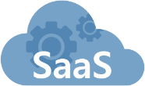

Architect Fail: Planned for a legacy flow
Traditional Traffic Flow
Mobile User
Internet
Switch
1
2. Treated AWS like a traditional DC.
SAAS
Providers
Learning Facility
2
Network Access Point
  VPCs
3. Created hardware constraints.
ATGE HQ
3
Datacenter
1
Notes:
With our traditional data flow, we route most of our users or customers, over our environment and wires to our data center.
Of course, with our SaaS solutions (LMS, email utilities) we have our customers go direct to the provide
Our fundamental mistake was to treat AWS like a data center. We routed everything through our traditional route. It was OK in the beginning, but did not scale.
Finally, we forced some of our vendors to hardware solutions for load balancing and security that proved problematic.

Slide 18
North Bound vs. South Bound
Customer Access
“North Bound”
Administrative Access
“South Bound”
Mobile User
Internet
North Bound
SAAS
Providers
Learning Facility
  VPCs
Network Access Point
ATGE HQ
South Bound
Notes:
We had to treat AWS more like a SaaS and less like a physical DC.
We needed to adopt the North Bound and South Bound concept. We still connect from traditional learning facilities, but we needed to better address our mobile customers.

Slide 19
Partnering with AWS

Slide 20
“Partner is a verb, not a noun.”
We engaged with Amazon Web Services extensively, more like
a consultant than a product company
Part of SteerCo
Go Live Weekends
Enterprise Support
Onsite Weekly
Notes:
Our AWS TAM, Architect and Account Executive is in our office, every week, for a full day
Our Account Manager sat on our Transformation Steering Committee
We engaged our AWS Team on key Go Live Weekends and to review our architecture.
We leveraged Enterprise Support, routinely

Slide 21
Planning & Commitment

Slide 22
Planning & Commitment
Initially, we ran this like any other infrastructure project, but we
needed to treat it like an IT Program.
Planning
Had Project Managers….
  + Added Program Management
  + Added two engineers
Commitment
Had Support of CIO
  + Added support of IT leadership team
Notes:
We ran it like a traditional infrastructure project. This was a mistake.
We needed a programmatic approach, and we needed to expand our scope to the other IT leaders.
The business also agreed to suspend releases, which was a hug accommodation.
We impacted every part of IT
Application teams had huge sub projects, part of the program
We had committed business people
FAQ: Infrastructure Team size. We had five people in our nucleus, and five significant contributors.

Slide 23
Educating our Teams

Slide 24
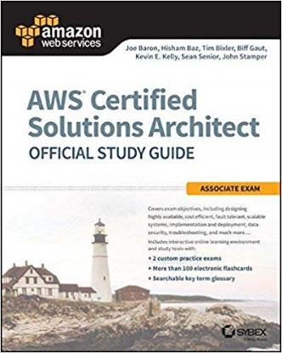
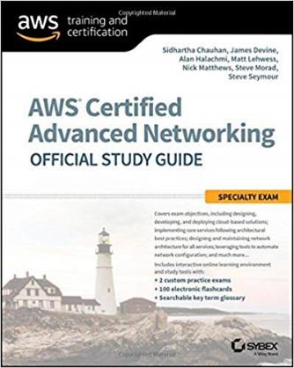
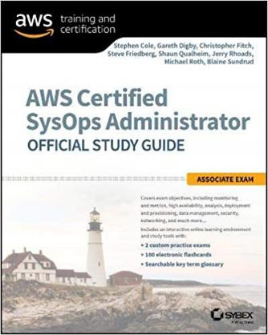





Education of Teams
Infrastructure Teams
hit the Books…..
Mobile and eCommerce teams moved fast
Some teams ….. struggled.
Notes:
Our key architects and engineers trained and pursued Certification.
We leveraged that enthusiasm – they became the crucial nucleus of the team
**Our smartest people had challenges.
We did all of the traditional training – webinars, design sessions, lunch and learns.
We provided direct access to our Account Manager, TAMs and Architects.
The challenge: cloud requires greater environment understanding. It is not like a flat network.

Slide 25
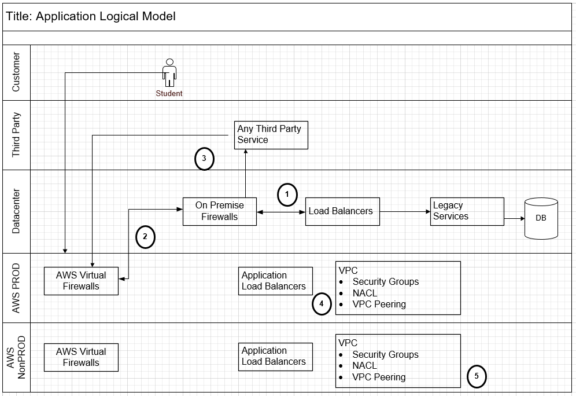
Education of Teams: Provide a System Flow Model
I need to connect to an
on-prem DB.
I need to connect to AWS
I need to connect to a third party.
I need to connect from
Non-Prod to Prod VPC
I need to connect within the Dev and QA VPCs
Notes:
I want to share a few artifact templates that helped us.
We needed to help our teams with a map
some use cases.
and definitions for Security Groups, NACLs, etc.
When we talked about an application, we used these swim lanes to help them land their applications.

Slide 26
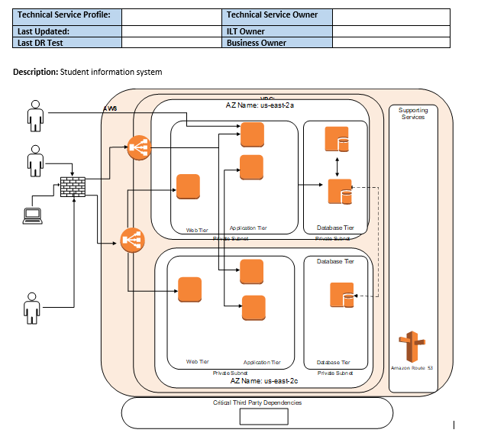
Education of Teams: System Map
Create a System on a Page model
Mirrored AWS Model
Review all maintenance activities: backup plans, patching, etc.
Notes:
We simplified the application map to a single page and we forced everyone into the AWS design model.
We asked teams to catalog all backup plans, patching, maintenance activities. This is a double check. We wanted to make sure we did not lose any processes in the migration.
The column all the way to the right is AWS Microservices – we wanted to encourage use.

Slide 27

Results

Slide 28



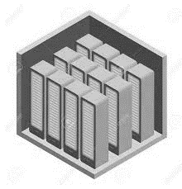
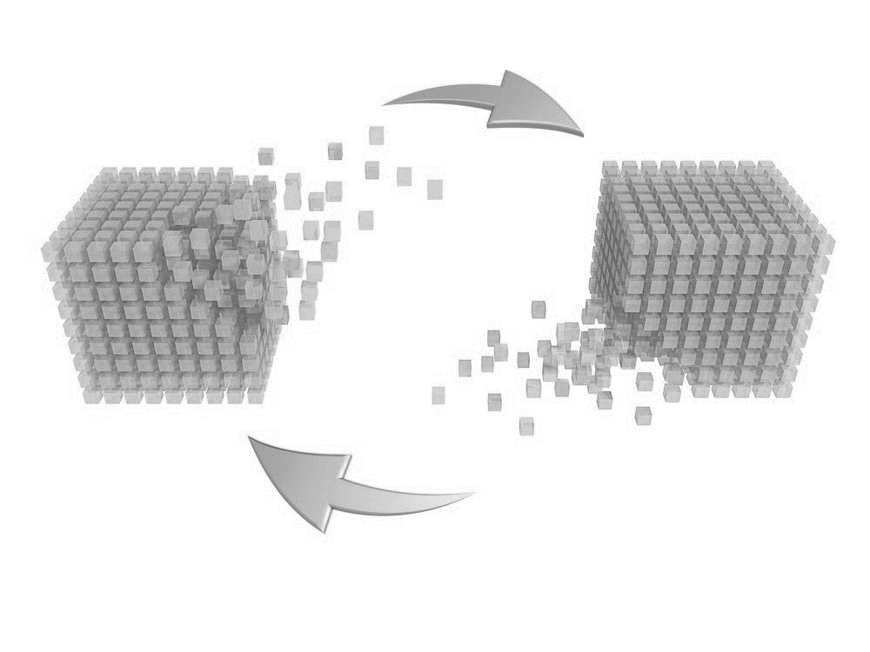
Our Results
Success!
Datacenter
retired
800 servers 7 months
Hit Financial
Targets
Maintained
Operations
Notes:
Migrated final 800 nodes in seven months.
We targeted 1600 nodes to migrate. We optimized to 1100 during migration.
Hit all financial targets, still finding more opportunity
Today, our teams are focused on….
Optimizing, optimizing, optimizing
Chatbots, active projects
Enhanced data analytics platforms
Our teams are focused on….our customer.

Slide 29
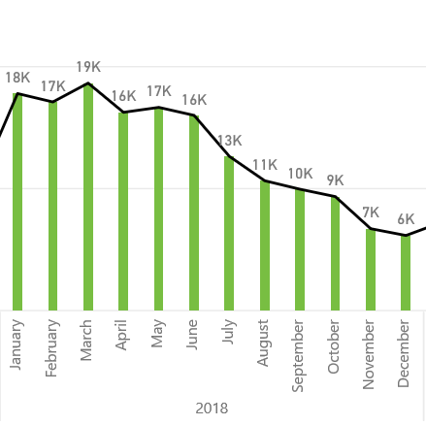
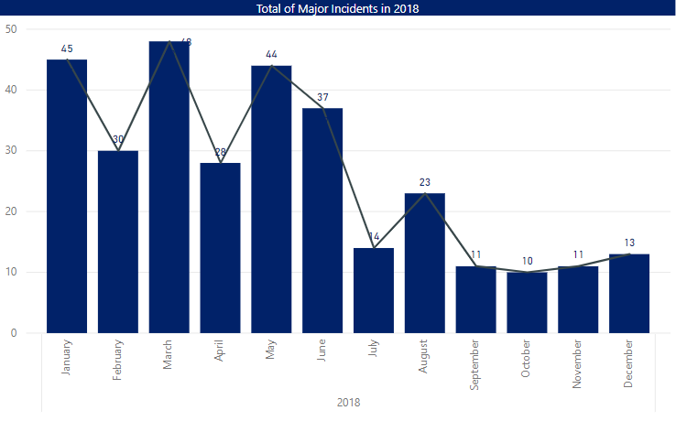
Unexpected Results
Incident Volume Decreased
Service Disruption Decreased

Slide 30
Lessons Learned

Slide 31
Lessons Learned
VPC design is a technical decision, not business.
Group Non-Production in one VPC
Go Native
  AWS backup options
  Encryption in EBS
  RDS
Utilities
  Enterprise Schedulers
  Print Services
  Door Card Readers
Notes:
VPC design is by Technology Architects, not your business lines or institutions
Group all DEV, QA, SIT1, SIT2 in one VPC. Default is off.
Go Native
Drop the Backup licenses for AWS backup options
Drop third party encryption tools, its native in EBS
Convince your DBAs to use RDS
Utilities: The Things you think about least, you will think about most.
Enterprise Schedulers
Print Services
Door Card Readers

Slide 32
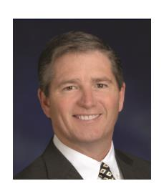
QUESTIONS?
Chris Nash
Senior Vice President & Chief Information Officer for Adtalem Global Education
Board of Trustees for Chamberlain University
Dennis Harding
Vice President of IT Infrastructure & Security Operations

Slide 33
Going All-In: Adtalem’s Cloud Migration Strategy
THANK YOU!
March 21st, 2019

