Slide 1
What Admissions Leaders Think
Results of surveys of admissions directors
and of high school counselors
Thursday, October 25 at 2 p.m. Eastern

Slide 2
Presenters
Scott Jaschik, editor, Inside Higher Ed, scott.jaschik@insidehighered.com
Doug Lederman, editor, Inside Higher Ed, doug.lederman@insidehighered.com

Slide 3
Methodology
Survey of 499 college admissions directors (or senior person in admissions or enrollment management), conducted by Gallup
Survey of 535 high school counselors, conducted by Hanover Research
Complete anonymity of individuals

Slide 4
Filling a Class
For third year in a row, more than 60% of colleges had not met admissions target by May 1.
Only notable exception was public doctoral universities.

Slide 5
May 1 vs. June 1
 | Public doctoral | Public master’s/ bachelor’s | Community college | Private doctoral/ master’s | Private bachelor’s
Met goal by May 1 | 54% | 27% | 26% | 47% | 43%
Didn’t meet goal by May 1, but met by June 1 | 2% | 10% | 8% | 6% | 7%

Slide 6
High Anxiety
 | Public doctoral | Public master’s / bachelor’s | Community colleges | Private doctoral / master’s | Private bachelor’s
% very concerned | 24% | 62% | 54% | 53% | 53%
% moderately concerned | 56% | 27% | 28% | 30% | 35%
% not too concerned | 16% | 7% | 8% | 11% | 6%
% not at all concerned | 8% | 4% | 0% | 6% | 0%

Slide 7
AP Debate

Slide 8
Findings on AP From Counselors
More than half of high school counselors (55%) say students at their schools ”may pass up important educational opportunities” to take as many AP courses as possible.
37% say their high schools have insufficient AP/IB offerings, but figure is 49% at high schools with many low-income students.

Slide 9
Findings on AP From Colleges
Slightly higher proportion view IB courses as rigorous than do AP courses (74% vs. 70%).
62% said they worry students are taking too many AP courses.
Key issue is rigor of courses and an applicant’s transcript, NOT number of AP courses.

Slide 10
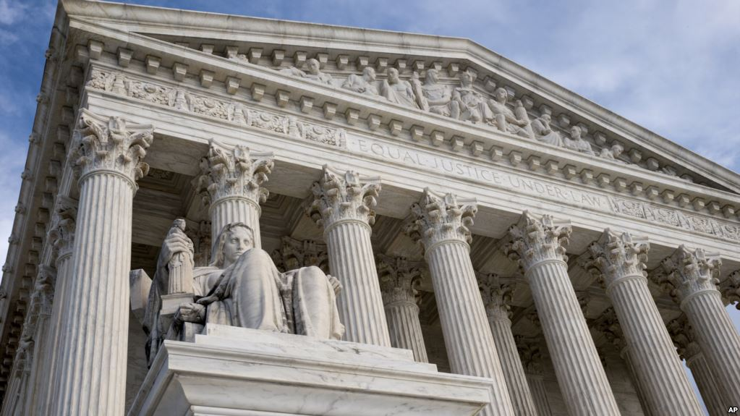
The Harvard Lawsuit and the Supreme Court

Slide 11
Higher Standards for Asian Americans?
39% of admissions directors said that, at their college, Asian American applicants who are admitted have higher grades and test scores than do other admitted applicants. Figure highest at public doctoral (47%).
43% of high school counselors said their Asian American students need higher grades/test scores than others to be admitted to competitive colleges. 36% disagreed.

Slide 12
More on the Suit’s Impact
Almost half (49%) of admissions directors say Harvard lawsuit "has created significant distrust among Asian American applicants and their families" in the admissions process. (Figure over half at doctoral institutions).
More than three-fourths of admissions directors say the public does not understand the concept of holistic admissions.

Slide 13
What About Legacies?

Slide 14
Admissions Testing: The Chicago Impact

Slide 15
Admissions Testing: College Officials’ Views
56% said they thought the move would influence other colleges to follow suit.
17% said that Chicago's decision was prompting their institution to reconsider its testing requirements.
62% said they believed that the way many parents and prospective students refer to average test scores "discourage[s] many students from applying to colleges where they could be admitted and thrive."

Slide 16
Admissions Testing: The View From High Schools
59% of counselors said they wished all colleges went test optional.
Counselors report that their minority and disadvantaged students are most interested in test-optional colleges.
Counselors report that relatively few students know which colleges are test-optional.

Slide 17
The Essay
12% of admissions directors said they gain insights on applicants from SAT essay. Figure was slightly higher (13%) for ACT essay.
75% of admissions directors said the essay portions of the SAT and ACT should be dropped.
51% of admissions directors said a graded high school paper would provide more insight than the scores on the SAT or ACT essay.

Slide 18
Waiting List Frustration

Slide 19
Waiting Lists: How They Are Used
15% said they hadn't admitted anyone from the waiting list in recent years.
68% said they admitted some students but less than 5% of their class.
17% said that they admitted more than 5% that way.

Slide 20
Fears on International Enrollment
57% of college admissions directors are concerned about maintaining current levels of international enrollments.
74% say the policies and rhetoric of the Trump administration make it more difficult to recruit international students.

Slide 21
Strategies on International
57% said that pathways programs will become more important in the years ahead.
42% said their college would need to consider increased spending on scholarships for international students.
39% said they believe that the current environment will prompt more colleges to use recruiting agents paid in part on commission.

Slide 22
Q&A
Your questions
Your ideas for future survey questions

Slide 23
With Thanks …

