Slide 1
How Colleges Are Tackling Affordability
An Inside Higher Ed webcast
Tuesday, May 15
2 p.m. Eastern

Slide 2
Presenters
Scott Jaschik, editor, Inside Higher Ed scott.jaschik@insidehighered.com
Doug Lederman, editor, Inside Higher Ed doug.lederman@insidehighered.com

Slide 3
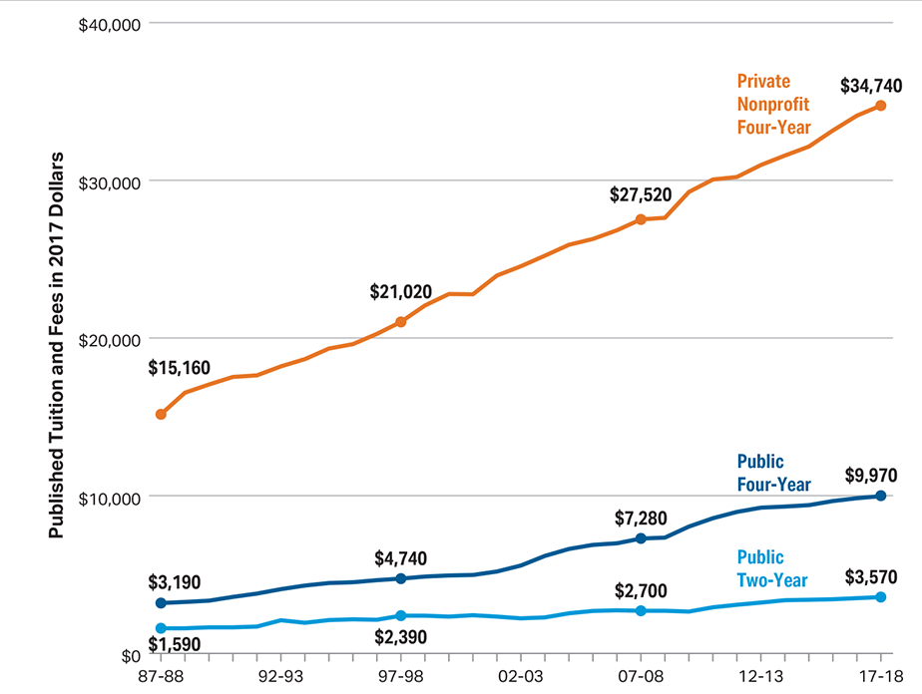
Sticker Prices Over Last 20 Years
--College Board

Slide 4
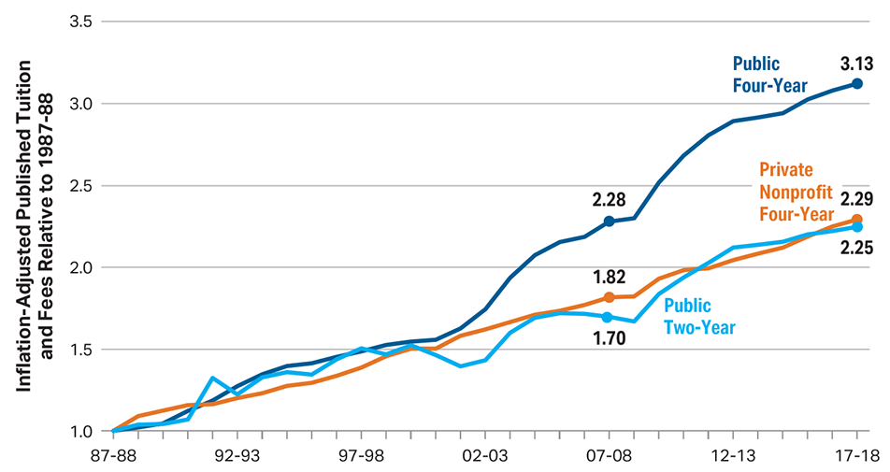
Relative Change in Sticker Prices
--College Board

Slide 5
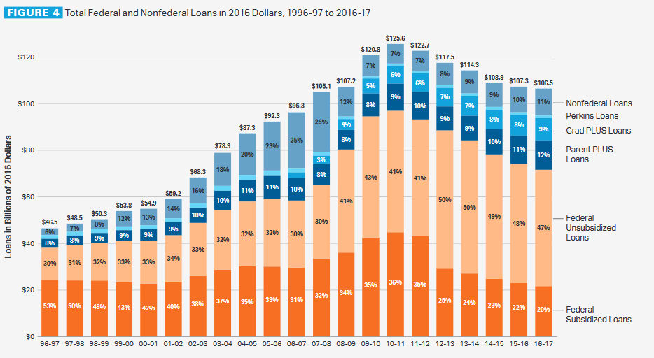
Borrowing Is Down
--College Board

Slide 6
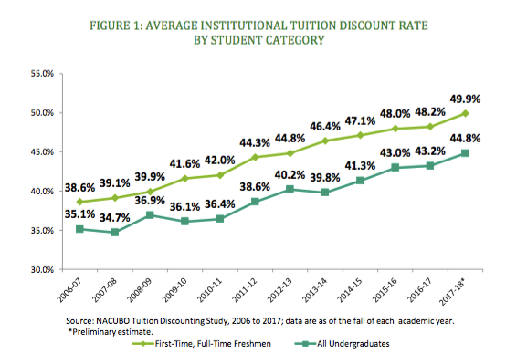
Discounting Is Up
--NACUBO

Slide 7
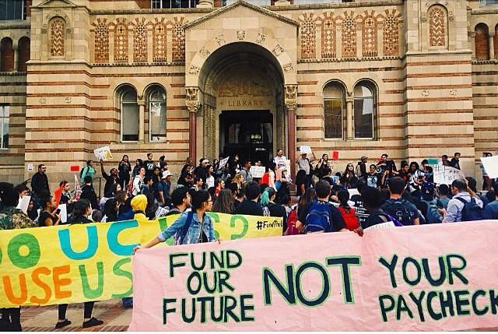
What the Background Data Show
Sticker price isn’t everything
Affordability is relative
Debt matters

Slide 8
Public Strategy: Have a Strategy
Most states don’t
Most states change approaches regularly

Slide 9
Public Strategy: Freezes

Slide 10
Public Strategy: Free

Slide 11
Public Strategy: Mergers

Slide 12
Public Strategy: Online Pricing
--iStock /Auris

Slide 13
Private Strategy: The Reset

Slide 14
Private Strategy: Restraint
Relatively small sticker price changes
Self-imposed spending limits

Slide 15
Private Strategy: Fixed Net Price

Slide 16
Private Strategy: 3 Instead of 4

Slide 17
Private Strategy: Meet Full Need

Slide 18
Strategy for All: Transfer
Community college as a path to public and private four-year programs
Missing links in the strategy

Slide 19
Strategy for All: OER

Slide 20
Strategy for All: Financial Literacy
What students (and most Americans) don’t know
Practical applications of greater literacy

Slide 21
Strategy for All: Graduating in 4

Slide 22
Q&A
Your questions
Ideas for coverage

Slide 23
With Thanks …

