Slide 1
Agile Teaching
An Inside Higher Ed webcast
Thursday, January 10 at 2 p.m. Eastern

Slide 2
Presenters
Scott Jaschik, editor, Inside Higher Ed, scott.jaschik@insidehighered.com
Doug Lederman, editor, Inside Higher Ed, doug.lederman@insidehighered.com

Slide 3
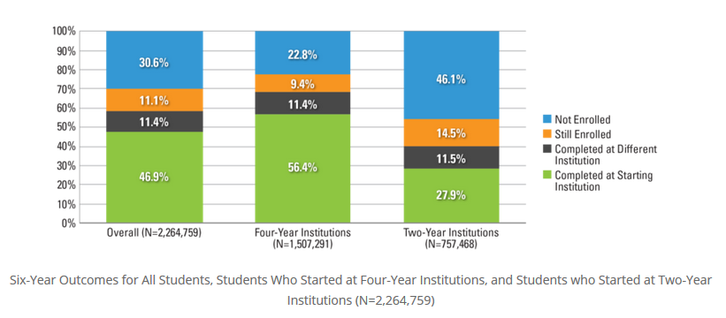
Why Teaching Matters I
--National Student Clearinghouse Research Center

Slide 4
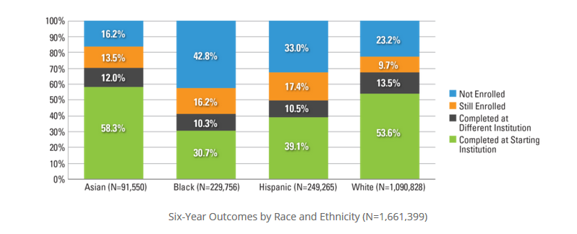
Why Teaching Matters II
--National Student Clearinghouse Research Center

Slide 5
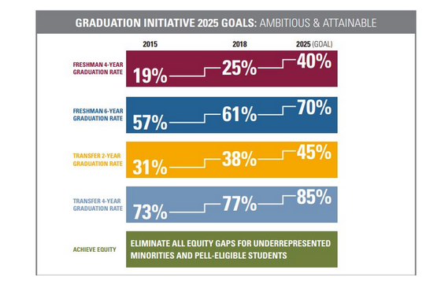
Low Rates Can Change
Data From California State U System

Slide 6
Curriculum I: Doubling Down on the Timeless

Slide 7
Curriculum II: Embracing the Cutting Edge

Slide 8
Curriculum III: Meeting Student Needs

Slide 9
Curriculum IV: Diversifying What Is Taught
--iStock

Slide 10
Curriculum V: Connecting to Careers

Slide 11
The Great (or Not So Great) Laptop Debate
--iStock

Slide 12
Learning Engineers
--iStock

Slide 13
Teaching I: Active, Active, Active
What “active” teaching and learning means
Flipped classrooms (but much more)
Students’ reactions

Slide 14
Teaching II: The Enduring Lecture

Slide 15
Teaching III: Grading

Slide 16
Teaching IV: Writing

Slide 17
Don’t Forget Advising

Slide 18
Q&A
Your questions
Your ideas for future survey questions

Slide 19
With Thanks …

