Slide 1
Shifting Student Behavior: Interventions and Other Strategies to Help Colleges and Students
An Inside Higher Ed webcast
Wednesday, September 12
2 p.m. Eastern
Follow us:

Slide 2
Presenters
Scott Jaschik, editor, Inside Higher Ed scott.jaschik@insidehighered.com
Doug Lederman, editor, Inside Higher Ed doug.lederman@insidehighered.com
Follow us:

Slide 3
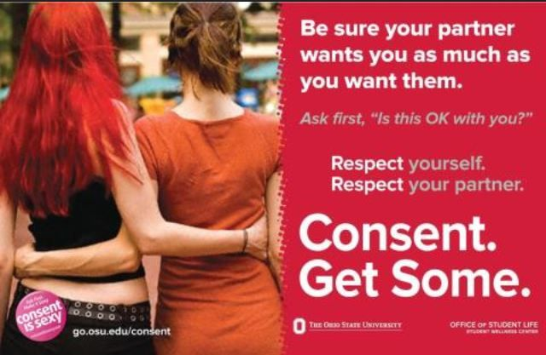
The Traditional Behavior Focus: Not on Academics and Retention

Slide 4
The New Focus on Behavior: Academic and Retention Issues
Poor retention/graduation rates at many colleges
Shifting demographics / decline of the “well prepared college student”
Pressure from accreditors and politicians
Belief in role of education

Slide 5
Choices in High School

Slide 6
Preventing Summer Melt
--iStock

Slide 7
Taking Orientation Seriously

Slide 8
When Placement Is Optional
--iStock

Slide 9
12 Doesn’t Equal 15

Slide 10
Setting Expectations

Slide 11
Early Warning Systems
--iStock

Slide 12
The Power of the Nudge
--iStock

Slide 13
Academic Advising

Slide 14
Financial Advising
--Wikimedia Commons

Slide 15
Challenges
Defining and rewarding the faculty role
Effective sharing of data with people who can act upon it
Privacy laws and expectations
Needs are greatest at institutions with limited resources

Slide 16
Q&A
Your questions
Ideas for coverage

Slide 17
With Thanks …

