Slide 1
The Infrastructure of Connection:
A Better Path Toward Success
Presented by
Beyond a portal

Slide 2
Agenda
Welcome
Introductions
Connection
Interoperability
Personalization
Timing & Usage
Solving Problems
Closing Remarks
http://campus.app

Slide 3
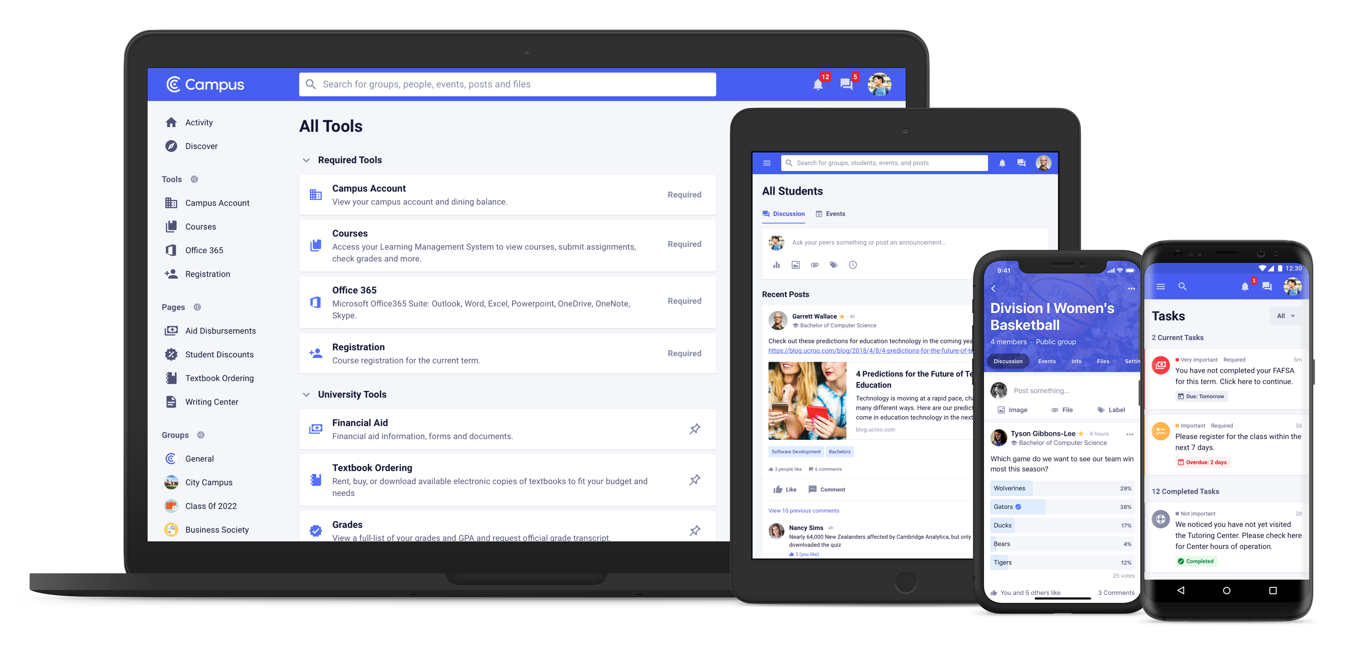
Welcome
http://campus.app

Slide 4
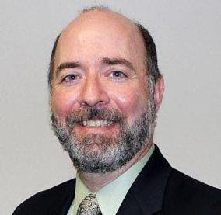
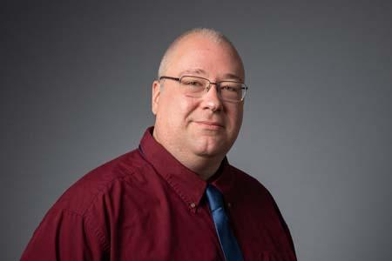
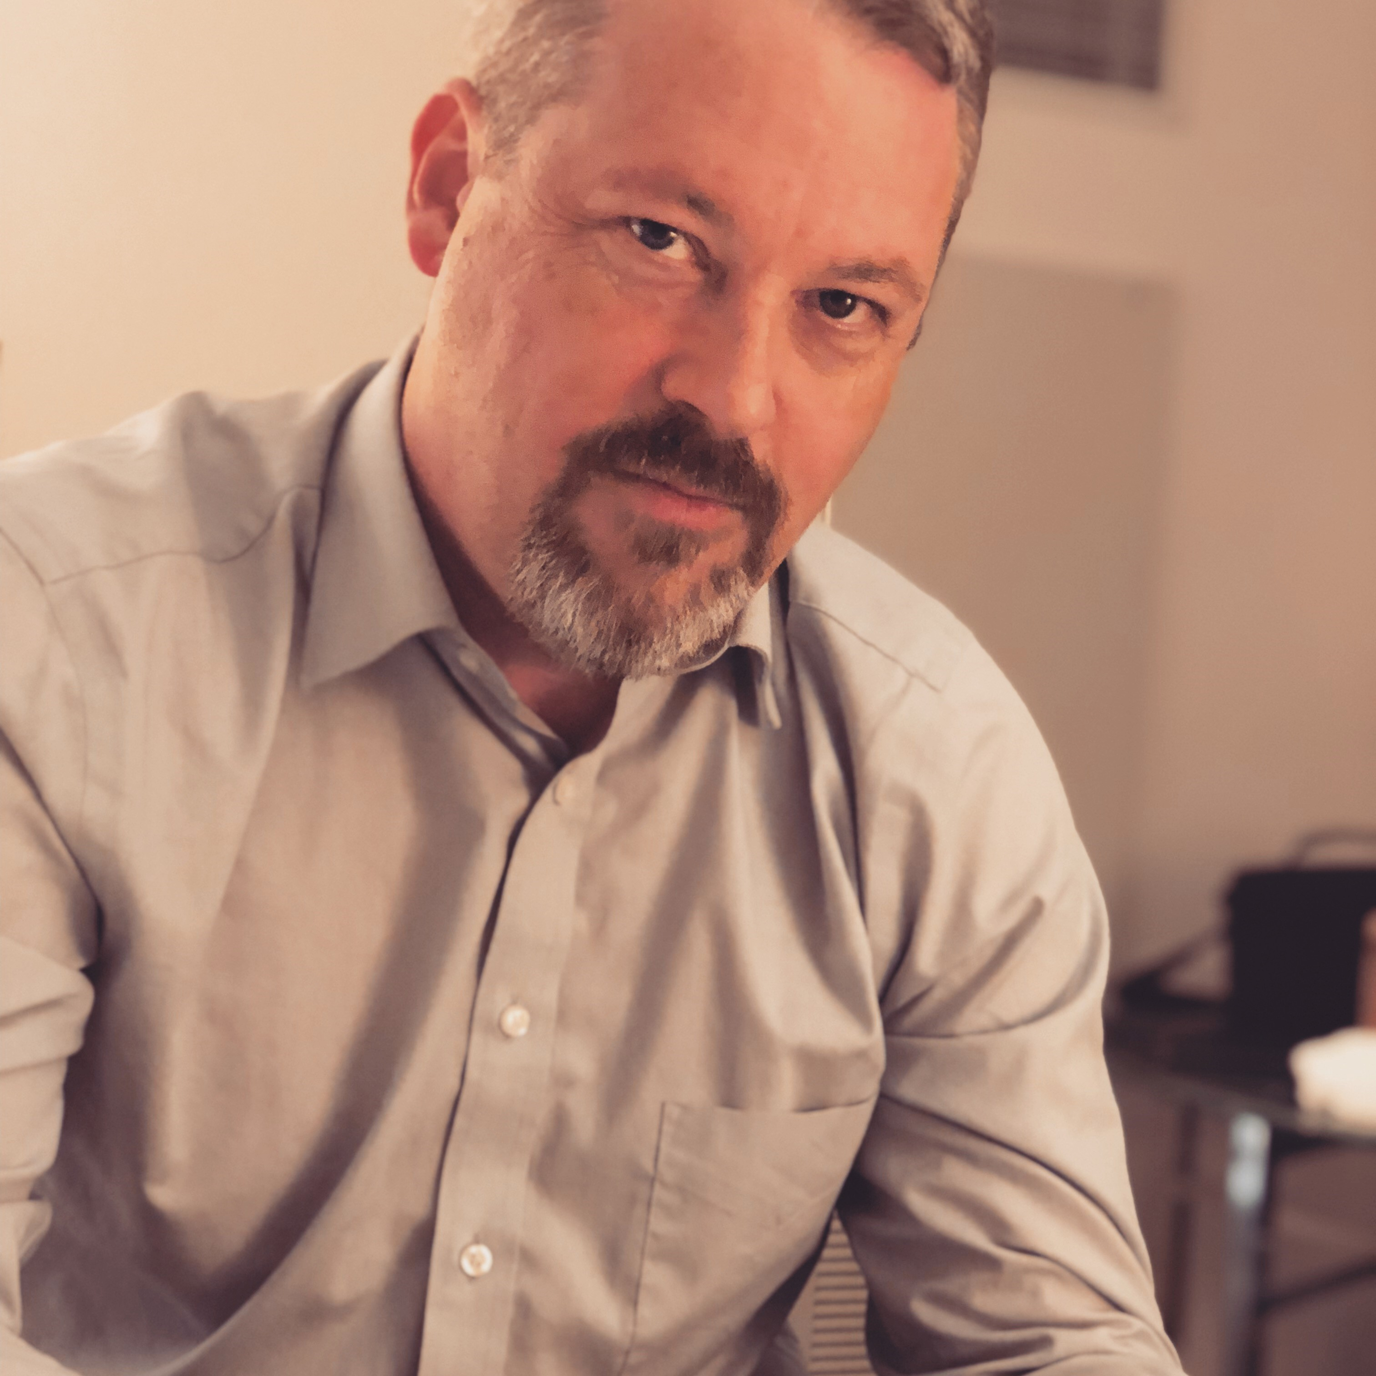
Introductions
Bret Ingerman
Vice President for Information Technology
Tallahassee Community College
Warren Nevins
Director of Information Technology – Continuing Studies
Rutgers University
Mark Leary
Director Academic Technology
Embry Riddle Aeronautical University

Slide 5
A Tale of Three Institutions
Public Community College
- 25,000+ Students - Traditional / Non-traditional - Associates / Bachelors / Certificates - 80% of students go to FSU after graduating
State University
- NJ's largest research University
- Continuing Education - Hundreds of Credit / Non-Credit Programs
Private University
- “Professional Education” specializing in aviation / aerospace
- 130 Campuses
- 20,000+ Students Online

Slide 6
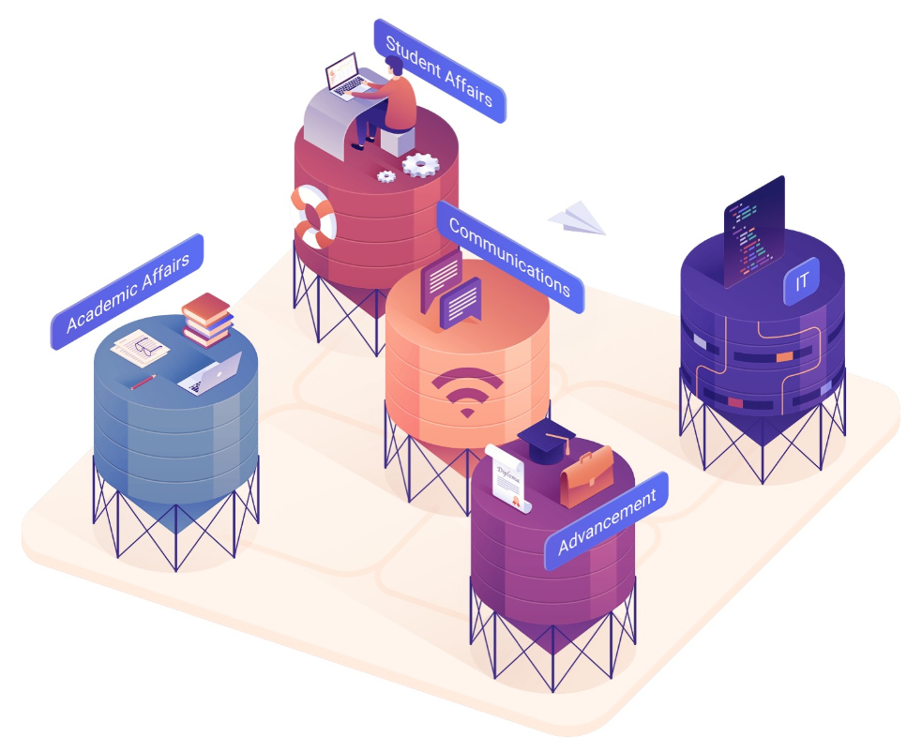
How Do We Define Connection?
http://campus.app

Slide 7
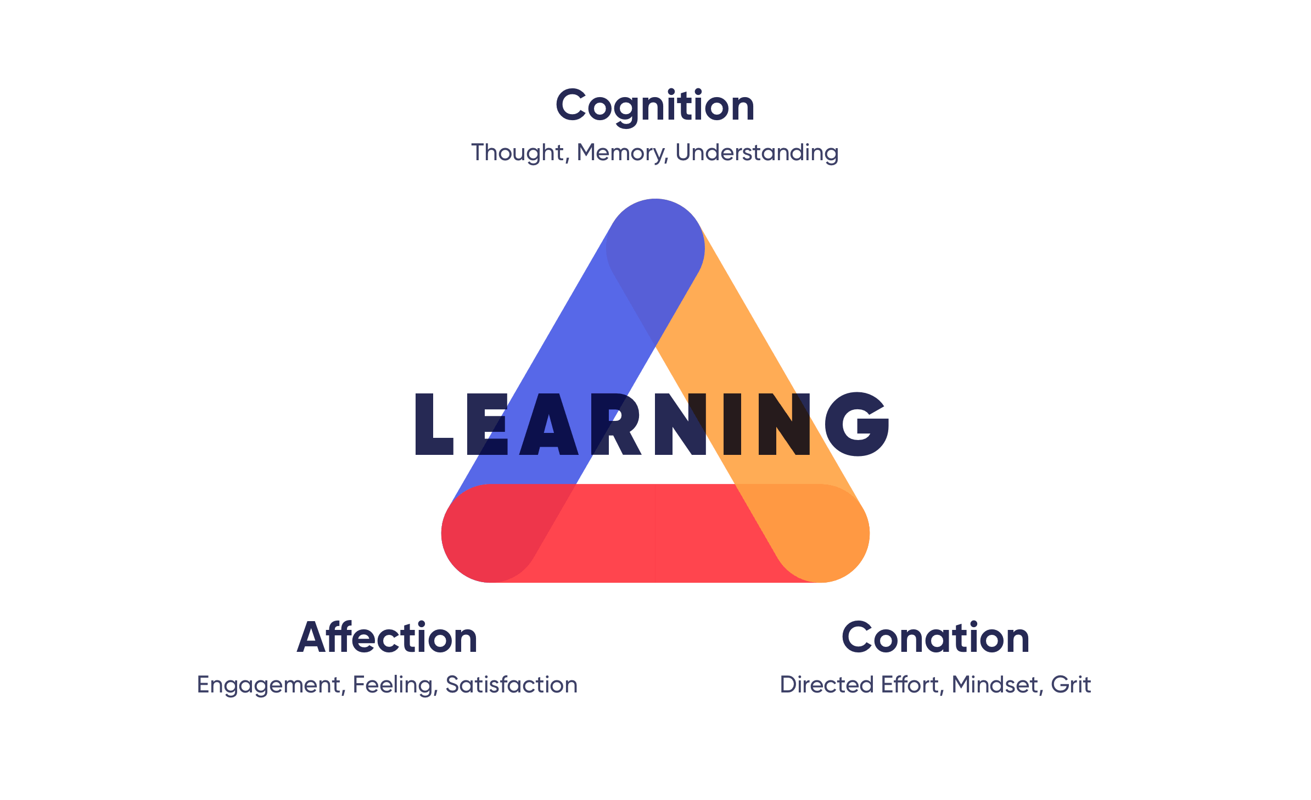
The Power of Connection in Education
http://campus.app

Slide 8
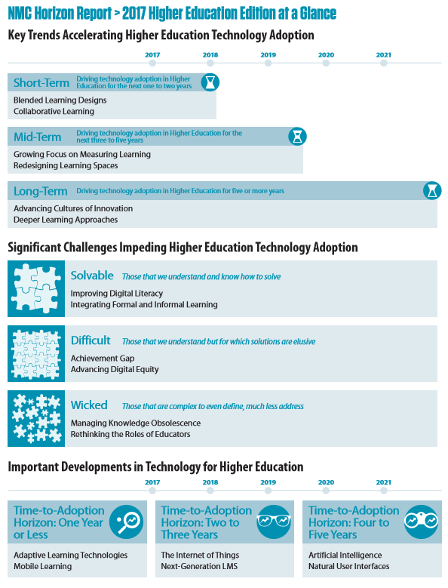
Interoperability
“Bold, tightly integrated digital strategies will be the biggest differentiator between companies that win and companies that don't, and the biggest payouts will go to those that initiate digital disruptions.” McKinsey & Company (Feb 2017)
http://campus.app

Slide 9
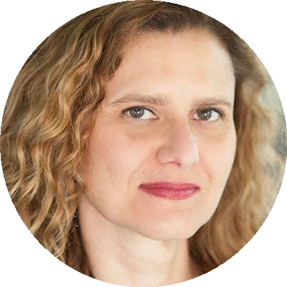
Students Agree
97%
of students believe technology is as important outside the classroom as it is inside
87%
of students report that when applying to college, it was important the school was tech savvy
58%
of students believe that colleges are furthest behind in personalizing their experience
“Students demand a personalized experience that will help them adjust to their new surroundings, optimize their life on campus and connect more deeply with their school experience.”
Mariana Cavalcanti
VP User Experience Ellucian
*Findings from 2017 Ellucian Annual Student Survey
http://campus.app

Slide 10
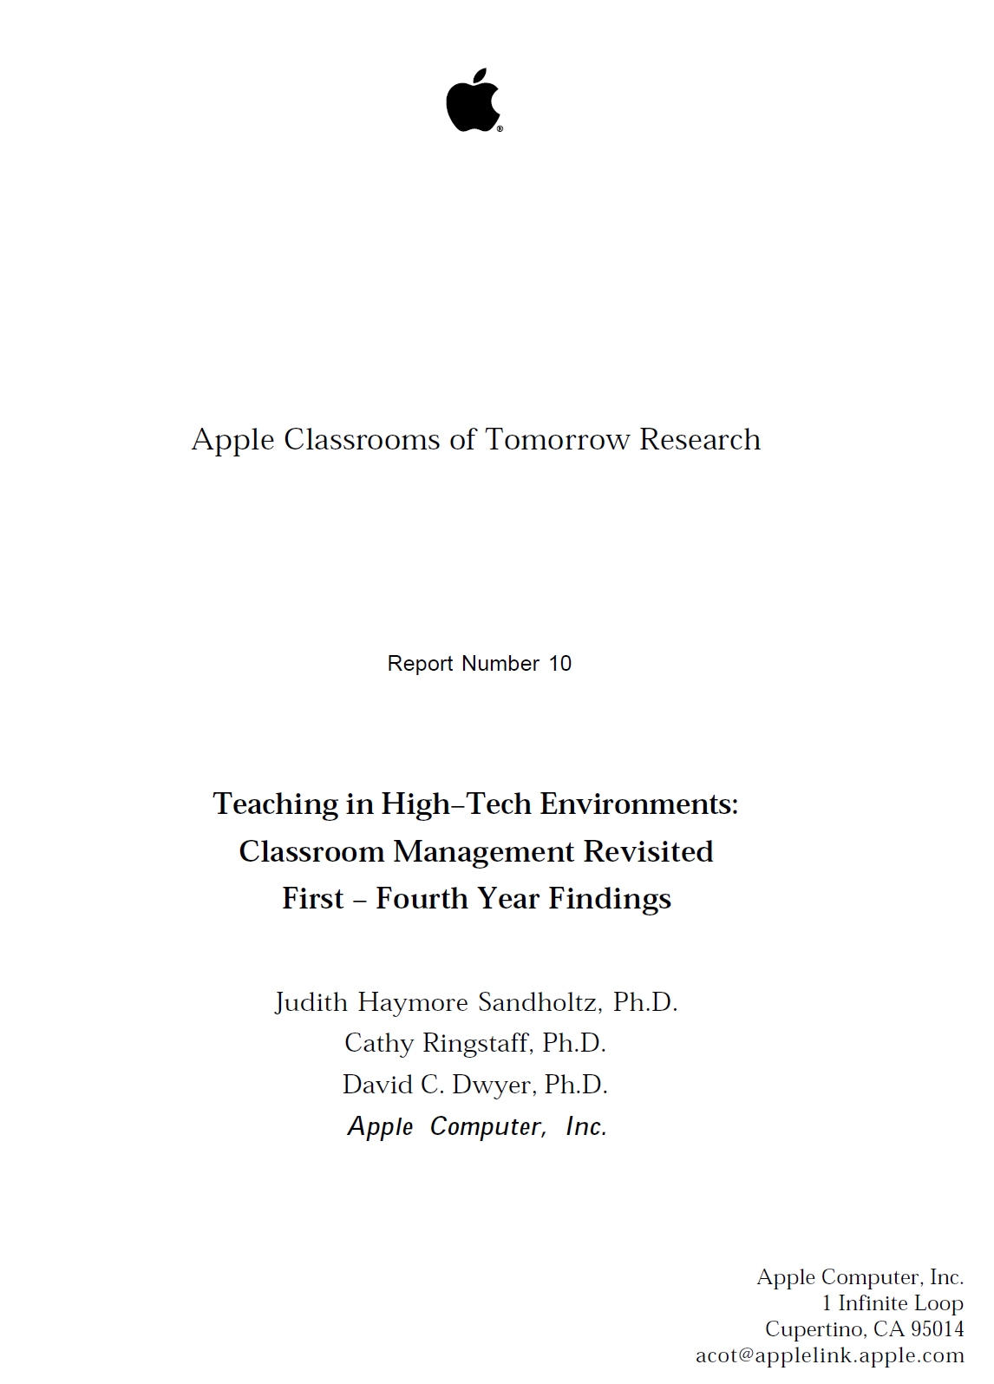
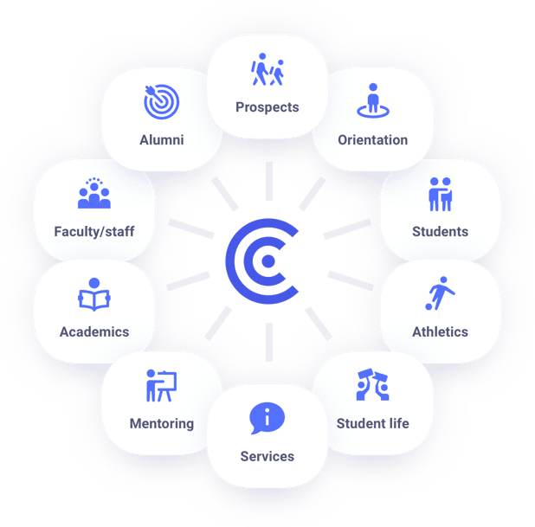
Connecting Across the Lifecycle
http://campus.app

Slide 11
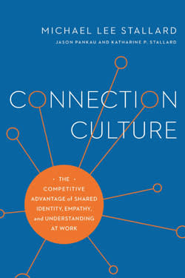
A Culture of Connection
“A lack or a deficiency of connection makes people feel unsupported, left out or lonely. When we feel disconnected, our bodies move into a state called “stress response,” which triggers a “fight or flight” readiness. That’s good if we are facing a short-term threat…
…However, many colleges are under enormous financial pressures to do more with fewer resources to support more students. This reality contributes to a drift toward indifference on campuses because people are so busy they don’t take time to develop supportive relationships. - (Stallard, 2018)
http://campus.app

Slide 12
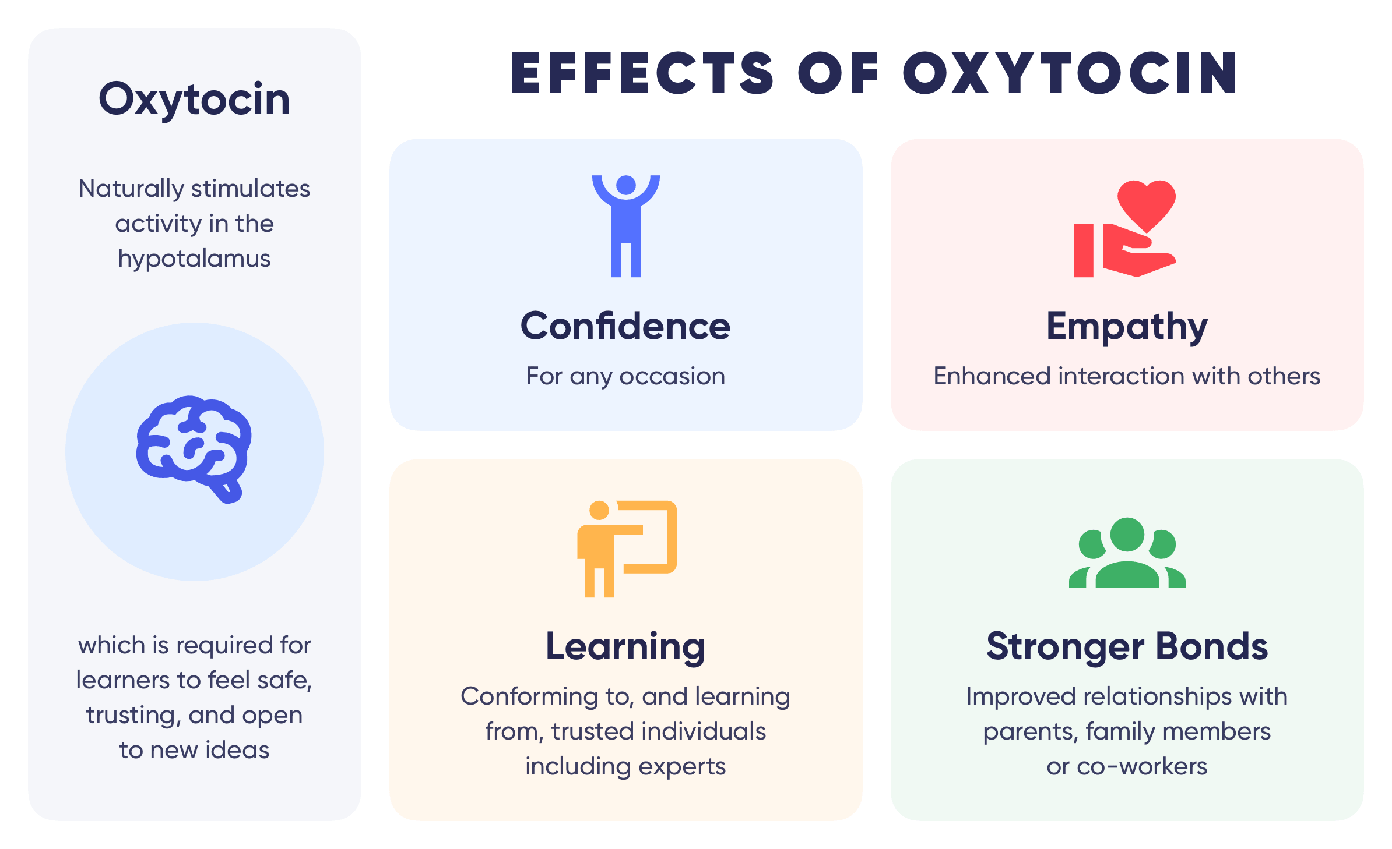
Holistic Connection
“…a key role for oxytocin is not in facilitating social trust per se but in conforming to, and learning from, trusted individuals who are either in-group members and/or perceived experts.” (Zak, Front. Neurosci., 06 February 2019 - https://doi.org/10.3389/fnins.2019.00056)
http://campus.app

Slide 13
Follow Up Questions & Closing Remarks
http://campus.app

Slide 14
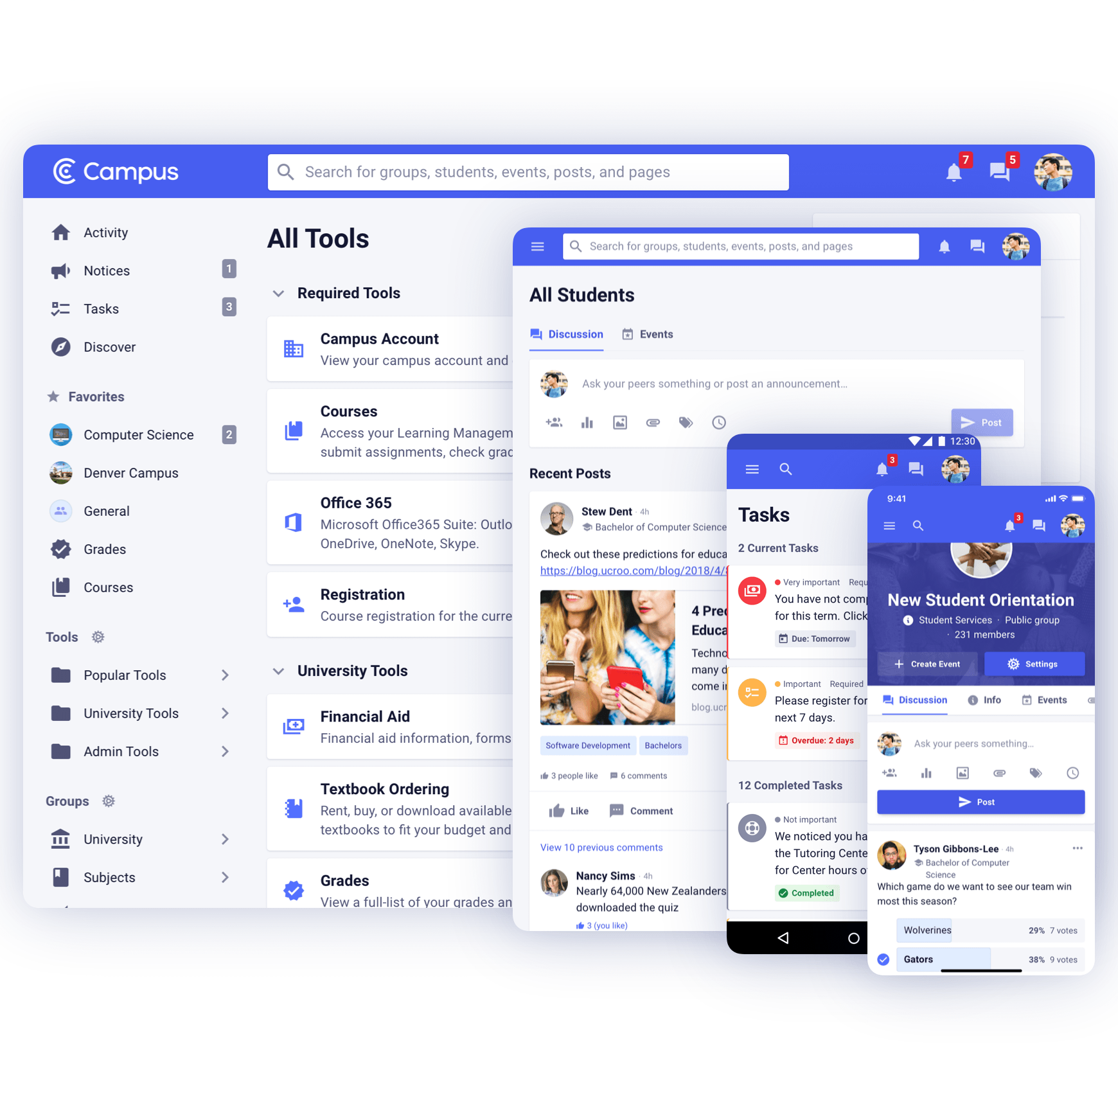
Thank You From Campus
team@campus.app
http://campus.app

