Slide 1


Designing student-centered pathways that scale
Joseph Moreau
Vice Chancellor of Technology
Foothill-De Anza Community College District
Sponsored by
1 February 2018

Slide 2
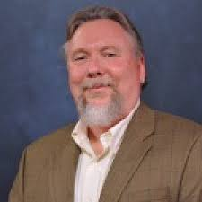
Today’s speaker
Joseph Moreau
Vice Chancellor of Technology
Foothill-De Anza Community College District
Cupertino, California
moreaujoseph@fhda.edu
Notes:
Source: https://www.luminafoundation.org/todays-student
“Typical college student” –median age, employment, family status, etc.
Lives more complex while in school – one size fits all package is less and less relevant to more and more students
In many cases, resembles less and less the students we have been

Slide 3
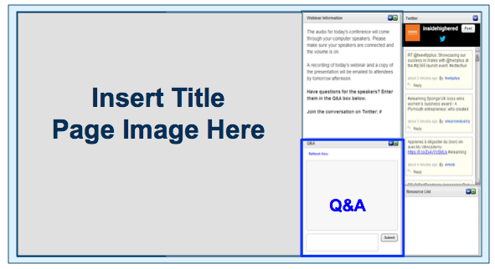
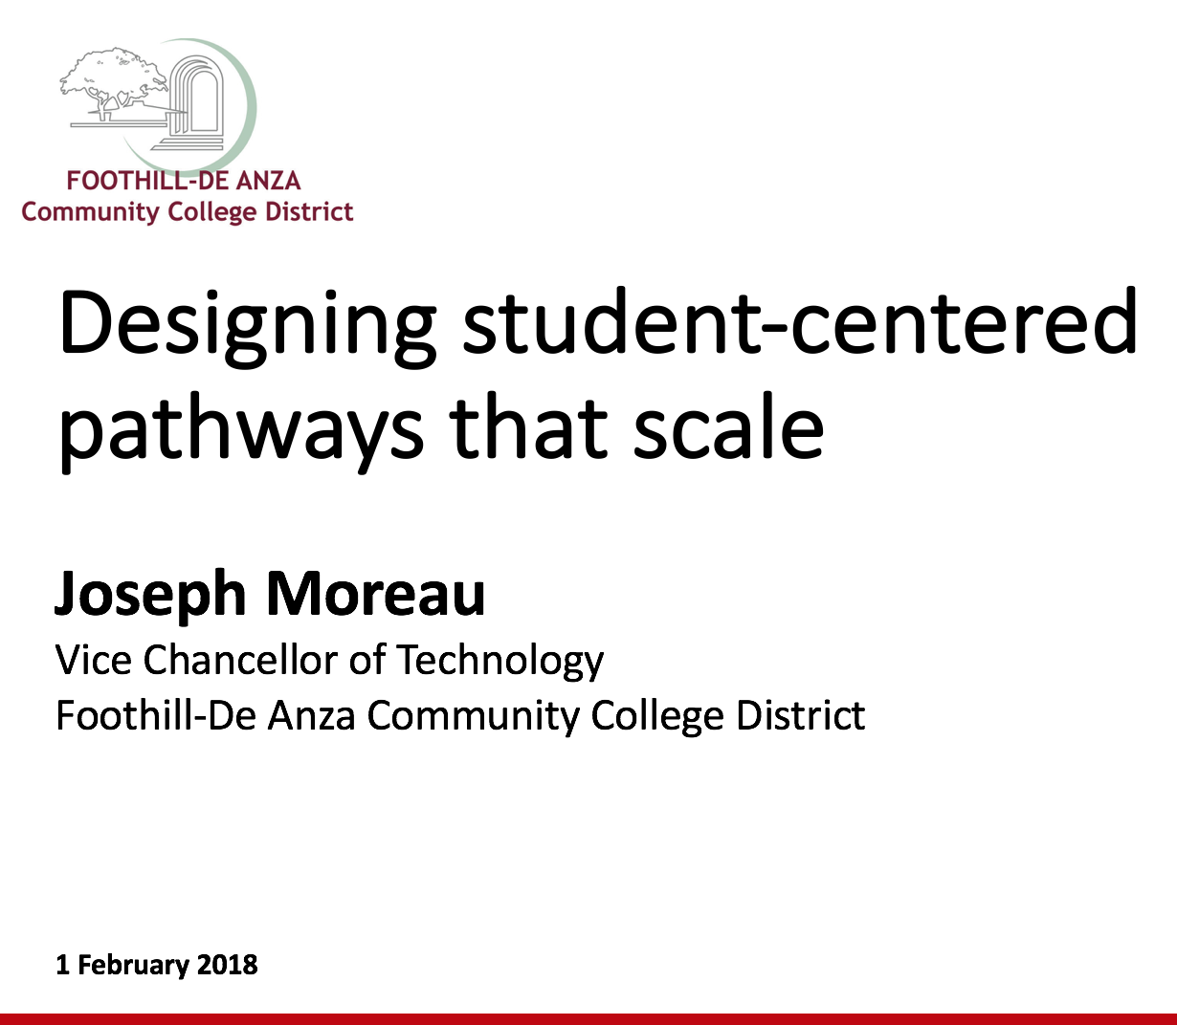
Before we begin
We are using On 24. Please enter questions in the text field at the bottom of the Q&A Window. We are monitoring the discussion and will try to bring the Q&A comments into the conversation.
We are recording the webinar; the webinar archive and slides will be available later today.
Notes:
Source: https://www.luminafoundation.org/todays-student
“Typical college student” –median age, employment, family status, etc.
Lives more complex while in school – one size fits all package is less and less relevant to more and more students
In many cases, resembles less and less the students we have been

Slide 4
Polling questions
1. What is your role at your institution?
Faculty
Staff
Administrator
2. Where do you work?
commnity college / 2-yr institution
4-year, public college or university
4-year, private college or university
District/system office
Other
3. What is your area of responsibility?
Student Services
Academic Affairs
Research & Planning
Information Technology
Other
4. How would you rate the maturing of your institution's "pathways" initiative?
Discover - we have heard about this trend, but have no specific plans in place
Pilot - we have an idea of the direction we want to pursue and are testing an initial approach
Scaling - We have successfully piloted a pathways strategy and are rolling it out institution-wide
Mature - We have been utilizing a pathways strategy for quite some time and continue to refine our model

Slide 5
Who are today’s students?
Notes:
What are their needs? Constraints? Aspirations?
This is a legitimate question we need to continuously ask ourselves.

Slide 6
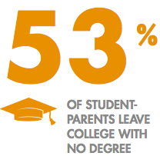
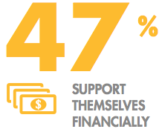
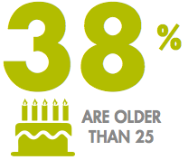


“Typical” student
OLDER THAN 25 AND JUGGLING MORE THAN JUST EDUCATION
ARE PAYING THEIR OWN BILLS – AND OFTEN STRUGGLING FINANCIALLY
STRUGGLING TO GRADUATE
…AND CHANGING
Source: https://www.luminafoundation.org/todays-student
Notes:
Source: https://www.luminafoundation.org/todays-student
“Typical college student” –median age, employment, family status, etc.
Lives more complex while in school – one size fits all package is less and less relevant to more and more students
In many cases, resembles less and less the students we have been

Slide 7
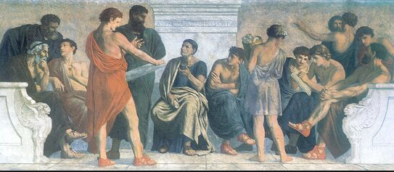
The status quo
Socrates would feel right at home
  Our basic instructional and business models have not evolved in a millennia
“One and done”
  A singular educational experience is intended to last a lifetime
Institution-centric model
  Students are required to comply and navigate with our structure
Status quo is being challenged by learners, alternative providers, employers
There is probably more at stake than we realize
Spangenberg: Aristotle’s School, 1880s
Notes:
Pulled this from a slide deck you and Jory submitted/presented as part of the 115th college proposal.

Slide 8


California Community Colleges
2.3M
students served by California Community Colleges
4%
of community college students transfer to 4-year university within 2 years
1.1M
Anticipated shortage of workers with bachelor’s degrees by 2030
2.5M
adults with ‘some’ or ‘no college’ and no credential
Notes:
Source: http://collegecampaign.org/wp-content/uploads/2017/09/CCO-2017-TransferMazeReport-27.pdf

Slide 9
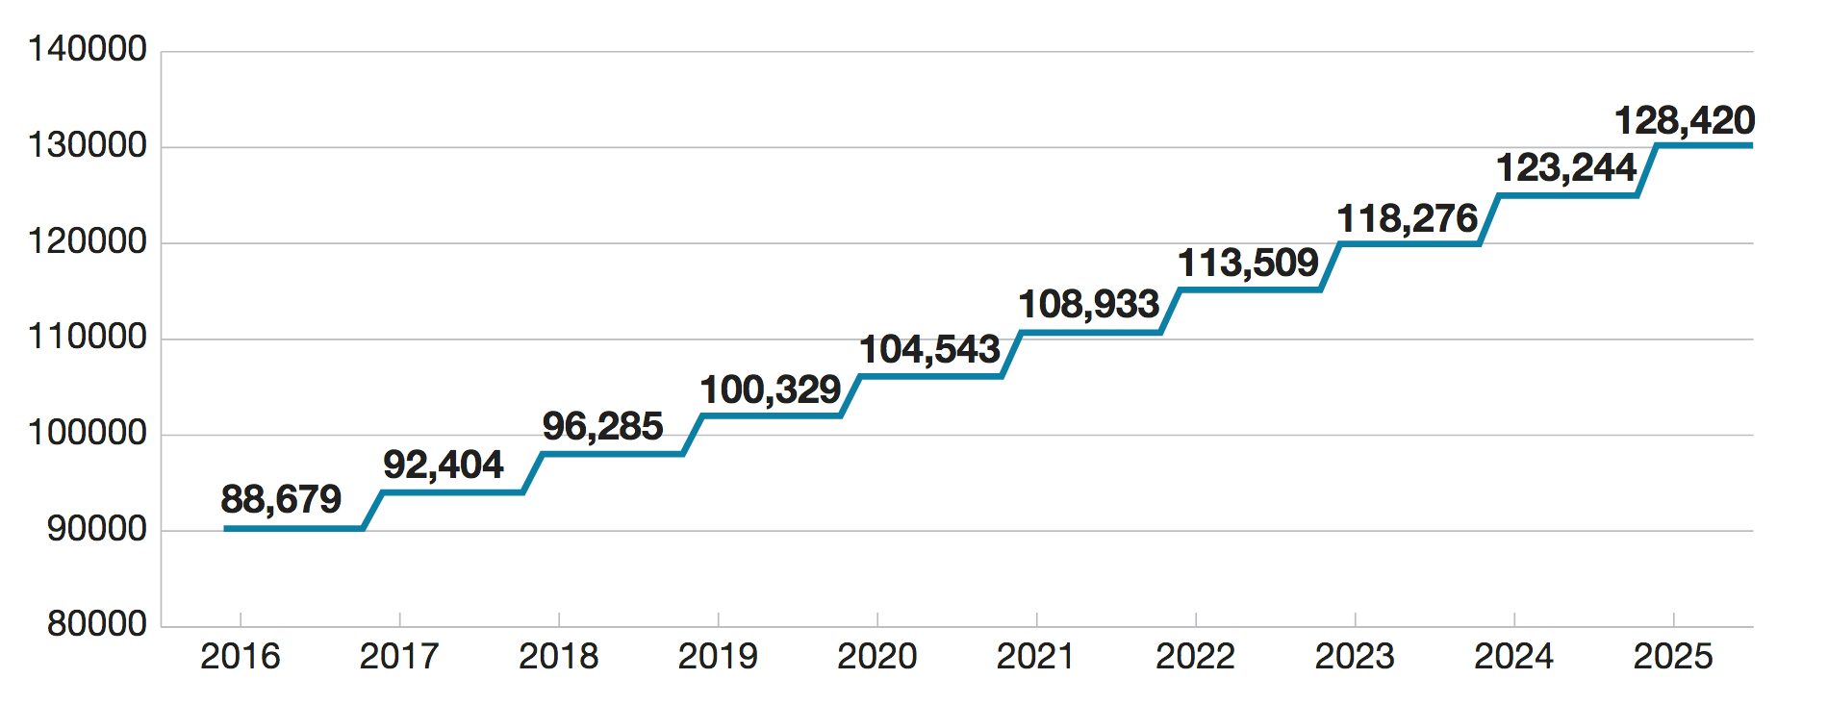
California must transfer more than 100,000 students annually to meet economic demands
Note: Numbers represent the total transfers required each year to meet goal
Source: National Center for Higher Education Management Systems (2017)
Notes:
Source: http://collegecampaign.org/wp-content/uploads/2017/09/CCO-2017-TransferMazeReport-27.pdf

Slide 10
California Community Colleges
Counselor to student ratio
1,016:1
615:1
“How do you know what to ask when you just don’t know what you’re asking about?”
Notes:
Source: http://collegecampaign.org/wp-content/uploads/2017/09/CCO-2017-TransferMazeReport-27.pdf
Note: Transfer Maze report uses the numbers 1016 and 615 for counselor to student ratio. Given that that is a newer report, I chose to use those. Feel free to shift accordingly if you have better information.
Counselors cannot reach every student
And we are not making the information accessible enough for students to get the best use out of that interaction.

Slide 11
Students are different
and dynamic.
What can we do to help them understand their options to advance academically & professionally?

Slide 12
A transformational task
Where the magic happens
Comfort zone
Printed books will never be the equivalent of handwritten codices. Why? Because scribes
display more diligence and industry than printers.
                Johannes Trithemius of Sponheim, 1492
Notes:
Pulled from a deck you and Jory submtted/presented on 115th college proposal.

Slide 13
Intuitive, accessible,
flexible tools give students the opportunity to design and monitor their own pathway.
Notes:
FHDA – better self-service tools for pathway planning (ratio students to counselors) – no way to meet the need doing what we have done (serve adequately by counselors) – we need intuitive, accessible, flexible tools that give them the oppty to design pathways – multiple pathways (visibility to drive decisions) –

Slide 14





Foothill-De Anza Community College District
Guided Pathways Requirements
A technology solution to support our guided pathways efforts must:
  Financial plan
  Transfer plan
  Connect many of the disconnected dots for students
  Ed plan
  Wants,
  capabilities
  Career exploration
  Always up-to-date:
  Ed plans update dynamically as circumstances change
  Optimize ed plans based on individual student needs and goals
  Surface actionable student data that enables us to adjust in an agile manner
  Provide student insight into options available, time and cost associated with different pathways

Slide 15

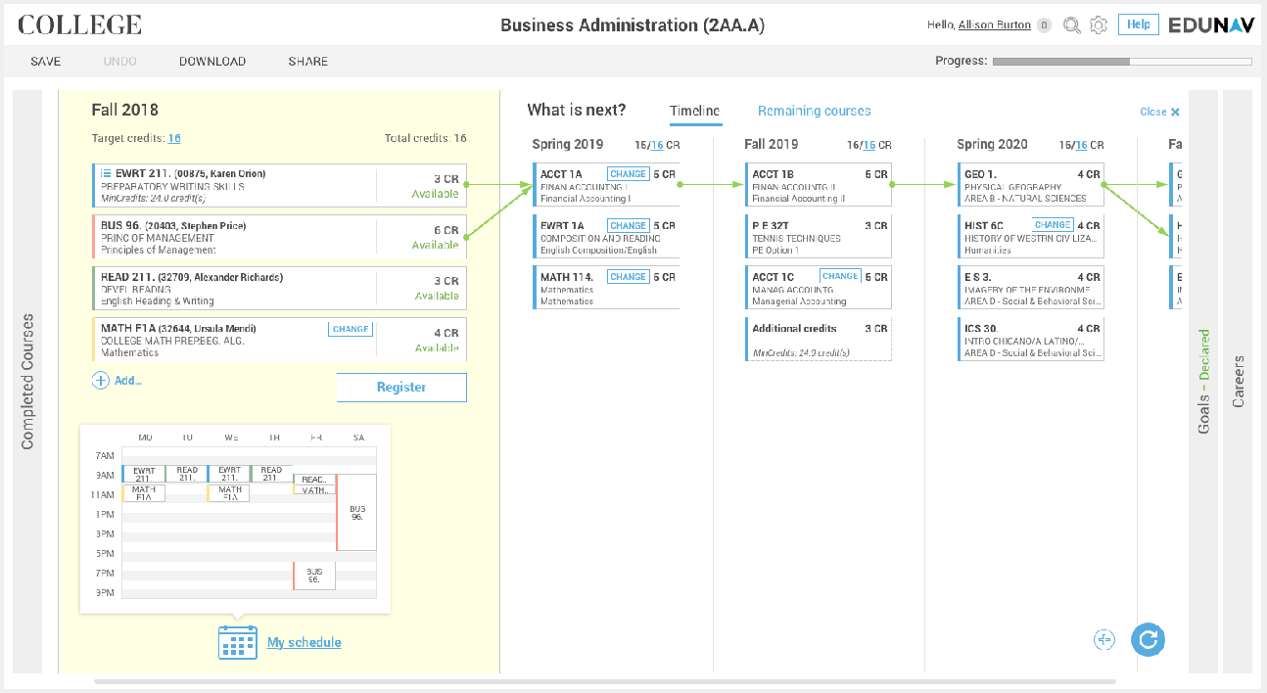
Student feedback
I actually like how organized it is to be able to see what classes to take for next quarter and how far I am from reaching my goal.
Seeing my quarters planned out without the stress of navigating the online catalog was very refreshing.
VERY simple, loved it!
It makes class registration a lot easier since you can see your overall class schedule while signing up for classes.
It's worth it because you are able to change or add any classes that you want. We are able to make our own educational plan for any transfer credit to university.
Notes:
Just begun to understand how we can utilize data – more robust academic planner. To really adjust our plans to meet those needs. Demand forecasting for high demand courses or essential courses with low demand – just now looking at how to utilize it for long-range schedule planning. Data we can extract – better decision making on our part. Provide level agility in cost-effective manner.

Slide 16
California Community Colleges support
Building common understanding of student experience through student journey maps, real-time data analytics, behavioral studies
Coordinating infrastructure resources to make common toolsets available across colleges
Spearheading system integration strategies key to Pathways
Improving key systems and processes critical to the effort (MyPath, application process, financial aid)

Slide 17
Big challenge #1
  How do we serve students with no relationship to an institution?
Notes:
What about students with no relationship to institution, not part of college community, how do we provide them with tool set (e.g. live by foothill, want to go to Long Beach). Discover – best program: not close to home. How will I be served? System trying to figure out. Significant citizens – no college, aren’t sure how to get started – credits but no credentials. If you aren’t admitted, don’t have access to tools. How do we serve those people? Tools out from behind firewalls and to public. When you determine pathway, we can steer you to right inst for you. We know there are many who need support, don’t have relationship. How do we surface resource for them.

Slide 18
Big challenge #2
  How do we surface resources to help students find their best path?
Notes:
What about students with no relationship to institution, not part of college community, how do we provide them with tool set (e.g. live by foothill, want to go to Long Beach). Discover – best program: not close to home. How will I be served? System trying to figure out. Significant citizens – no college, aren’t sure how to get started – credits but no credentials. If you aren’t admitted, don’t have access to tools. How do we serve those people? Tools out from behind firewalls and to public. When you determine pathway, we can steer you to right inst for you. We know there are many who need support, don’t have relationship. How do we surface resource for them.

Slide 19
Big challenge #3
  How does higher ed accommodate the new world of blockchain, student credentials, and student data?
Notes:
What about students with no relationship to institution, not part of college community, how do we provide them with tool set (e.g. live by foothill, want to go to Long Beach). Discover – best program: not close to home. How will I be served? System trying to figure out. Significant citizens – no college, aren’t sure how to get started – credits but no credentials. If you aren’t admitted, don’t have access to tools. How do we serve those people? Tools out from behind firewalls and to public. When you determine pathway, we can steer you to right inst for you. We know there are many who need support, don’t have relationship. How do we surface resource for them.

Slide 20
Big challenge #4
  How do we assess our efforts and engage in continuous improvement strategies?
Notes:
What about students with no relationship to institution, not part of college community, how do we provide them with tool set (e.g. live by foothill, want to go to Long Beach). Discover – best program: not close to home. How will I be served? System trying to figure out. Significant citizens – no college, aren’t sure how to get started – credits but no credentials. If you aren’t admitted, don’t have access to tools. How do we serve those people? Tools out from behind firewalls and to public. When you determine pathway, we can steer you to right inst for you. We know there are many who need support, don’t have relationship. How do we surface resource for them.

Slide 21
Resources and references
California Guided Pathways Project
http://foundationccc.org/What-We-Do/Student-Success/California-Guided-Pathways-Project
Chancellor’s Office Guided Pathways Resources
http://cccgp.cccco.edu/About-Guided-Pathways
Foothill-De Anza Community College District
  Joe Moreau, Vice Chancellor of Technology, moreaujoseph@fhda.edu
  Denise Swett, Vice President of Student Services, Foothill College, swettdenise@fhda.edu
California Community College Chancellors Office
http://californiacommunitycolleges.cccco.edu
EduNav
edunav.com
Notes:
Just begun to understand how we can utilize data – more robust academic planner. To really adjust our plans to meet those needs. Demand forecasting for high demand courses or essential courses with low demand – just now looking at how to utilize it for long-range schedule planning. Data we can extract – better decision making on our part. Provide level agility in cost-effective manner.

Slide 22
Today’s speaker
Joseph Moreau
Vice Chancellor of Technology
Foothill-De Anza Community College District
Cupertino, California
moreaujoseph@fhda.edu
Notes:
Source: https://www.luminafoundation.org/todays-student
“Typical college student” –median age, employment, family status, etc.
Lives more complex while in school – one size fits all package is less and less relevant to more and more students
In many cases, resembles less and less the students we have been

Slide 23
Thank you for joining us!
Notes:
Just begun to understand how we can utilize data – more robust academic planner. To really adjust our plans to meet those needs. Demand forecasting for high demand courses or essential courses with low demand – just now looking at how to utilize it for long-range schedule planning. Data we can extract – better decision making on our part. Provide level agility in cost-effective manner.

