Slide 1
BUILDING MORE ON-RAMPS TO EDUCATION:
ACCESS FOR ALL
March 7, 2018
Notes:
CASEY / MODERATOR OPEN: Greetings and welcome to today’s webinar . . .

Slide 2


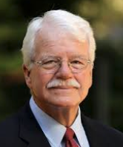
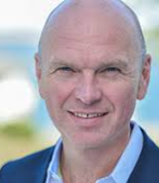
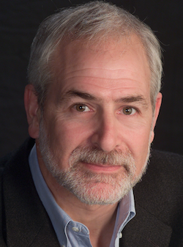
WEBINAR PARTICIPANTS
Jenny Billings
Chair of Study Skills,
Developmental Reading & English and Curriculum English,
Rowan-Cabarrus Community College, Concord and Salisbury, North Carolina
George Miller
Senior Education Advisor to
Cengage Learning
(former Congressman from California and former chair, House Ed & Labor Committee)
Michael Hansen
Chief Executive Officer
Cengage Learning
Casey Green, moderator
Founding Director
The Campus Computing Project and Digital Tweed Blogger,
Inside Higher Ed

Slide 3

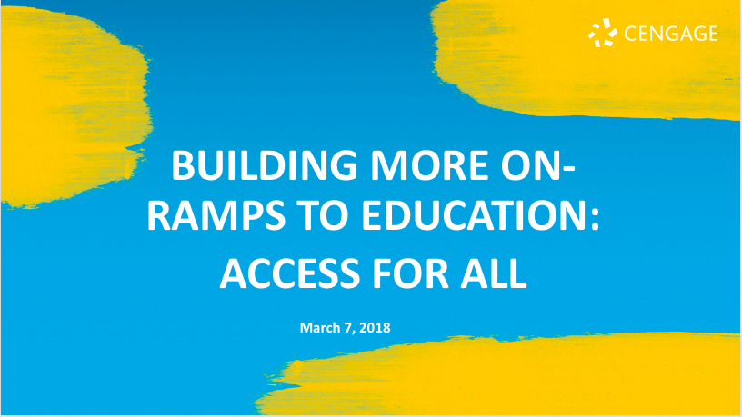
BEFORE WE BEGIN
We are using On24 for today’s webinar. Please enter questions in the text field at the bottom of the Q&A Window.
We are monitoring the discussion and will try to bring the Q&A comments into the conversation.
We are recording the webinar and will send a follow-up email tomorrow that provides the URL to access the presentation and the slides.
Enter Questions here

Slide 4
Quick Poll #1
What do you do? What best describes your job title or campus department?
Faculty member
Department chair or dean
Vice President / Office of the CAO or Provost
Campus bookstore
Other

Slide 5
Quick Poll #2
Where is your campus on “Day One” access to course materials?
No current discussion or strategy
Beginning to have departmental or campus-wide conversations
Beginning conversations with content and curricular resource providers
Pilot projects underway
Current agreement with one or more content and curricular resource providers

Slide 6
What—exactly—does access
to education mean?
Notes:
Begin with Cong. Miller to provide context about pubic policy: emphasis on access and financial aid by feds and state to address the cost of attendance.
Question to Jenny Billings: campus perspectives on access – not just getting in but student success, challenges to continuing enrollment.
Question to Michael Hansen about the expansion in the concept of access to student success and what this means for publishers, a/k/a today as “content and curricular resource providers.”

Slide 7
Why is access important?
Notes:
BEGIN WITH CONG MILLER: historical role of education and higher ed. Individual and societal benefits. 1947 Truman Report: Higher Education for American Democracy. While a college education has clear financial benefits, it also yields significant civic benefits: citizens more engaged, more likely to stay informed and vote, etc.
Jenny Billings: campus perspectives on access – not just getting in but student success, challenges to continuing enrollment.
Michael Hansen: what does the expansive transition from access to student success means for publishers, a/k/a today as “content and curricular resource providers.”

Slide 8
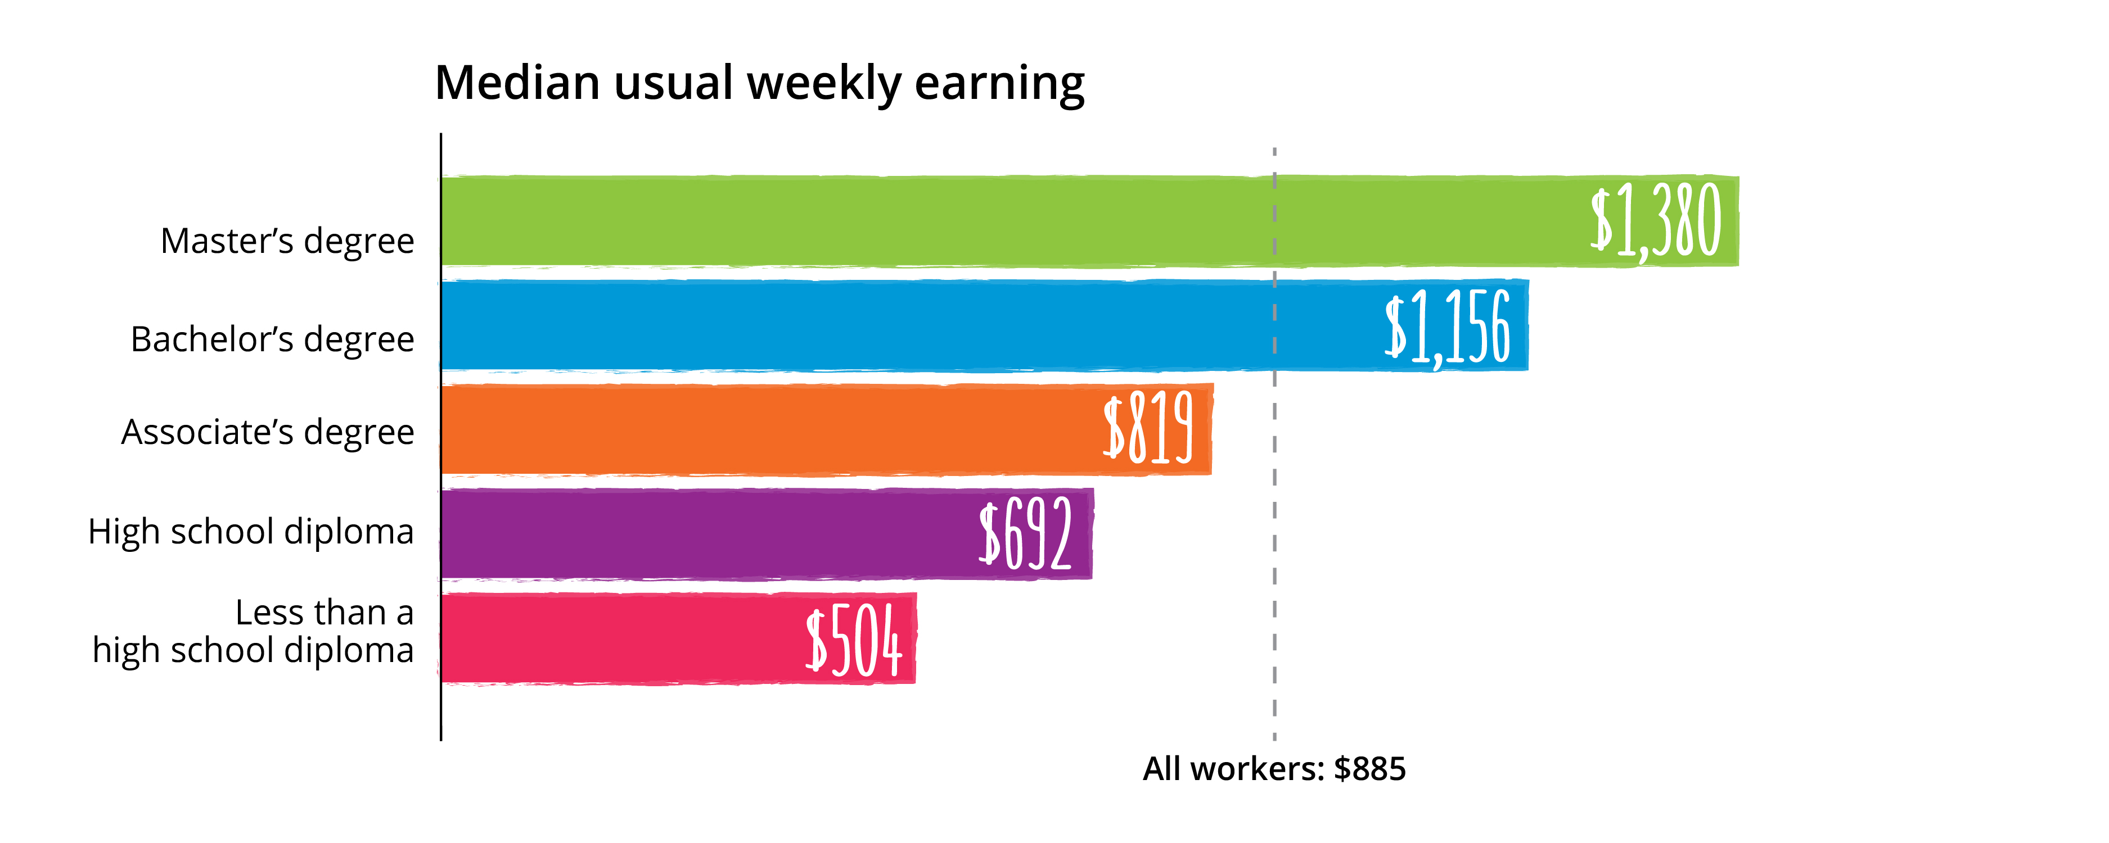
THE VALUE OF A COLLEGE
DEGREE REMAINS IRREFUTABLE
U.S. Earnings by Educational Attainment in 2016:
Note: Data are for persons age 25 and over. Earnings are for full-time wage and salary workers.
Source: U.S. Bureau of Labor Statistics, Current Population Survey |
Source: U.S. Bureau of Labor Statistics, Current Population Survey |
Source: U.S. Bureau of Labor Statistics, Current Population Survey
Notes:
Casey: Let’s look (quickly) at some data about the financial impact of college
A learner’s earning power increases significantly after graduating—as the graph shows postsecondary degrees clearly correlate with income.
[pause to let audience digest slide]

Slide 9












IT’S NOT ALL ABOUT EARNINGS
College grads are more likely to:
volunteer
vote
eat fruits and veggies
wear
seat belts
live longer
describe themselves as happy
Source: U.S. Bureau of Labor Statistics, Current Population Survey
Notes:
But, it’s not all about cash money.
A wonderful study by the Lumina Foundation revealed that college graduates are simply happier and healthier than those who have not completed a postsecondary program.

Slide 10
What are some key access challenges
that confront aspiring learners?
Notes:
TO JENNY BILLINGS: Let’s talk about your students and the access issues and challenges they confront.
TO CONG MILLER: In the policy discussion about student costs, Congress has always looked both at and beyond tuition. Financial aid formulas across all sectors recognize the cost of books and related course materials as part of the cost of college. And, speaking frankly, at times Congress has taken both colleges and text book publishers to task about the rising costs of tuition and of textbooks
TO MICHAEL HANSEN: Access

Slide 11
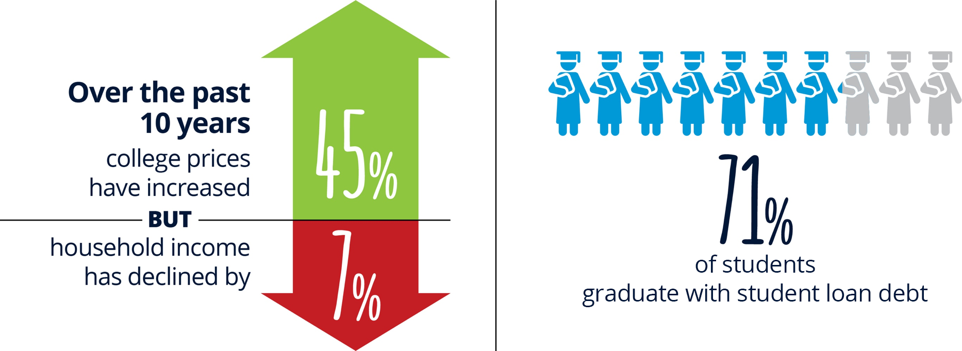
STUDENTS ARE LIMITED BY
CRUSHING COSTS
Source: https://www.luminafoundation.org/files/resources/affordability-benchmark-1.pdf |
Source: http://www.openaccesstextbooks.org/pdf/2016_Florida_Student_Textbook_Survey.pdf
Notes:
CASEY: Lets look at some of the cost data. As you know, a key obstacles facing higher ed students is affordability. The Lumina Foundation reported that college prices have increased by 45% over the past decade, but at the same time, households are bringing in less income. This puts many learners down the path to an educational dead end.
CONG MILLER: comments: (Not what Congress intended or expected.?)
JENNY BILLINGS: reference to student experiences

Slide 12

HIGH COSTS HAVE CONSEQUENCES
Sources: http://www.openaccesstextbooks.org/pdf/2016_Florida_Student_Textbook_Survey.pdf ;
https://ticas.org/sites/default/ﬁles/pub_ﬁles/Debt_Facts_and_Sources.pdf
Notes:
Jenny cites the “consequences of costs” data; adds story from her own experience.
High costs hinder access to education. Even when students do enroll in school, many can’t afford their materials and because of that, they don’t purchase them.
Those students will undoubtedly start class at a disadvantage.
According to a 2016 study completed by Florida Virtual Campus 20% of students have failed their courses because of an inability to afford the materials.
MICHAEL HANSEN: At Cengage we are dedicated to solving the access and affordability problem to usher more learners into postsecondary programs. We aim to build and nurture confident students and open a world of limitless opportunities to any willing learner.

Slide 13
How has technology failed
to enable access?
Notes:
CASEY: Let’s take a minute to talk about the role of technology. Whether you sat or slept through intro economic, you still know that some increment of technology is supposed to improve the product or service and also reduce the costs. That simple assumption has not necessarily play out in higher ed: we can do more, in so many more ways, but costs have not come down.
Comments from Jenny and then Michael

Slide 14

WHAT WE NEED FROM TECHNOLOGY
Technology must be purposeful.
Technology must be personalized.
Technology must to be user-friendly and intuitive.
We can use technology to bridge a lot of gaps, to provide
instant and more affordable access, but we cannot lose the human component.
Notes:
High costs hinder access to education. Even when students do enroll in school, many can’t afford their materials and because of that, they don’t purchase them.
Those students will undoubtedly start class at a disadvantage.
According to a 2016 study completed by Florida Virtual Campus 20% of students have failed their courses because of an inability to afford the materials.

Slide 15
What can we do to solve
the access problem?
Notes:
JENNY BILLINGS: Wave the magic wand, Jenny: Three wishes for strategies to solve address the access problem for students?

Slide 16




IT’S CLEAR. STUDENTS NEED:
&
Access
Affordability
Notes:
MICHAEL: makes transition to Cengage solution.
At Cengage we are dedicated to solving the access and affordability problem to usher more learners into postsecondary programs. We aim to build and nurture confident students and open a world of limitless opportunities to any willing learner.

Slide 17


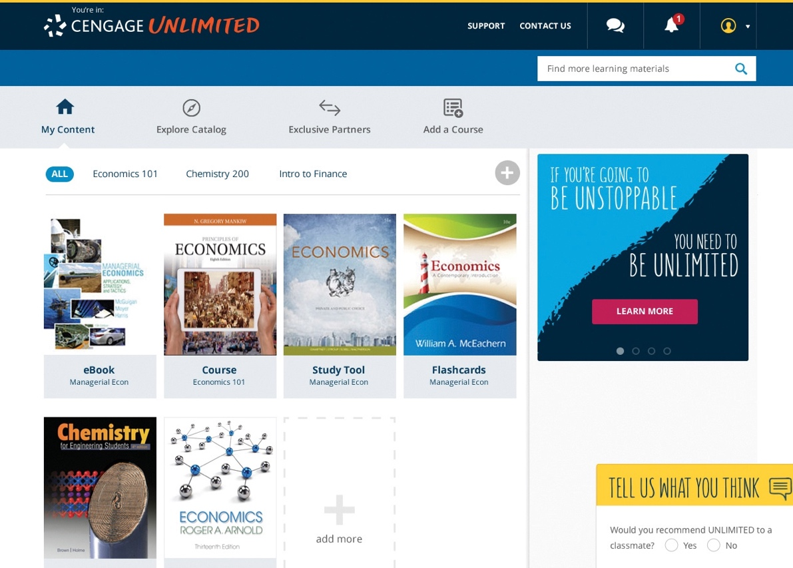
digital subscription for students
all-you-can-learn access to the entire Cengage catalog
$119.99/semester | 179.99/year
available August 2018
Notes:
MICHAEL HANSEN: To do this, we’re launching Cengage Unlimited. Available in August 2018, Cengage Unlimited is a first-of-its-kind digital subscription that gives students complete on-demand access to ALL the digital resources Cengage has to offer for $119.99 per semester or 179.99 a year.
For comparison purposes, as this audience knows too well, many new textbooks, from both Cengage and other providers, cost $125-200 or more. With CENGAGE UNLIMITED, we are offering a rich catalog of primary and supplement course resources to students and faculty.

Slide 18

EXPLORATION ACROSS:
*Including MindTap, WebAssign, SAM, CengageNOW, iLRN and OWL
Notes:
MICHAEL HANSEN: Cengage Unlimited gives students unprecedented access to high-quality materials and instructors can offer students an affordable solution. We are excited we’re offering students this breadth and quality of content to help them meet their goals while keeping costs down.

Slide 19

UNLIMITED BENEFITS
SIGNIFICANT COST SAVINGS, per semester, quarter, year
ACCESS TO A CENGAGE AWARD-WINNING DIGITAL PLATFORM, proven to boost outcomes and increase engagement when assigned by an instructor
A FREE PRINT RENTAL with any activated online course
ALL-YOU-CAN-LEARN ACCESS to over 22,000 digital learning assets, covering more than 70 disciplines and 675 courses.
UNLIMITED ACCESS to hundreds of study guides matched to the most common college courses.
TWELVE-MONTH FREE ACCESS to up to six eBooks in the Cengage Unlimited Digital Locker.
Notes:
MICHAEL HANSEN: Cengage Unlimited gives students unprecedented access to high-quality materials and instructors can offer students an affordable solution. We are excited we’re offering students this breadth and quality of content to help them meet their goals while keeping costs down.
JENNY BILLINGS: Impact and benefit for students and faculty

Slide 20
THE ROWAN-CABARRUS
COMMUNITY COLLEGE EXPERIENCE
Notes:
JENNY BILLINGS: Opportunity for Jenny to discuss early experience with Cengage strategy

Slide 21
RESOURCES & REFERENCES
To learn more about Cengage Unlimited visit: www.cengage.com/unlimited
Rowan-Cabarrus Community College References:
About e-Texts @ RCCC: https://www.rccc.edu/academics/digital-solutions-online-learning-materials-and-e-texts-faqs/
Course Materials Fee:
https://www.rccc.edu/arts-science/course-materials-fee/
Winner of OLC’s Digital Learning Initiative Award (2016):
https://onlinelearningconsortium.org/about/2016-dliaward-recipient-rowan-cabarrus-community-college/

Slide 22
WEBINAR PARTICIPANTS
Jenny Billings
Chair of Study Skills,
Developmental Reading & English and Curriculum English,
Rowan-Cabarrus Community College, Concord and Salisbury, North Carolina
George Miller
Senior Education Advisor to
Cengage Learning
(former Congressman from California and former chair, House Ed & Labor Committee)
Michael Hansen
Chief Executive Officer
Cengage Learning
Casey Green, moderator
Founding Director
The Campus Computing Project and Digital Tweed Blogger,
Inside Higher Ed

Slide 23
THANK YOU!
www.cengage.com/unlimited

