Slide 1
The Great (Forced) Shift to Remote Learning: a Survey of Instructors and Campus Leaders
Jeff Seaman, Director, Bay View Analytics
Jennifer Mathes, CEO, Online Learning Consortium
Will Austin, President, Warren County Community College
Doug Lederman, editor, Inside Higher Ed (moderator)

Slide 2
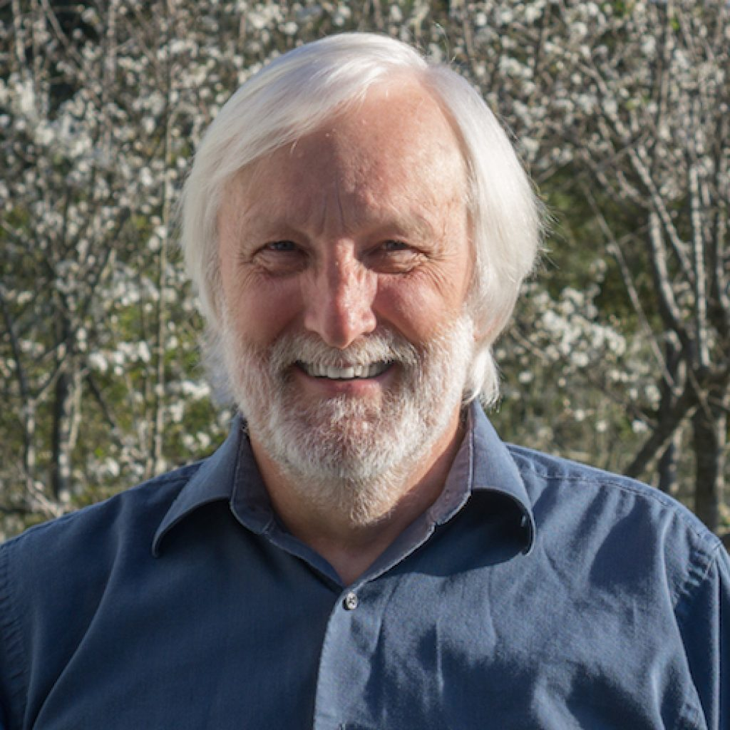
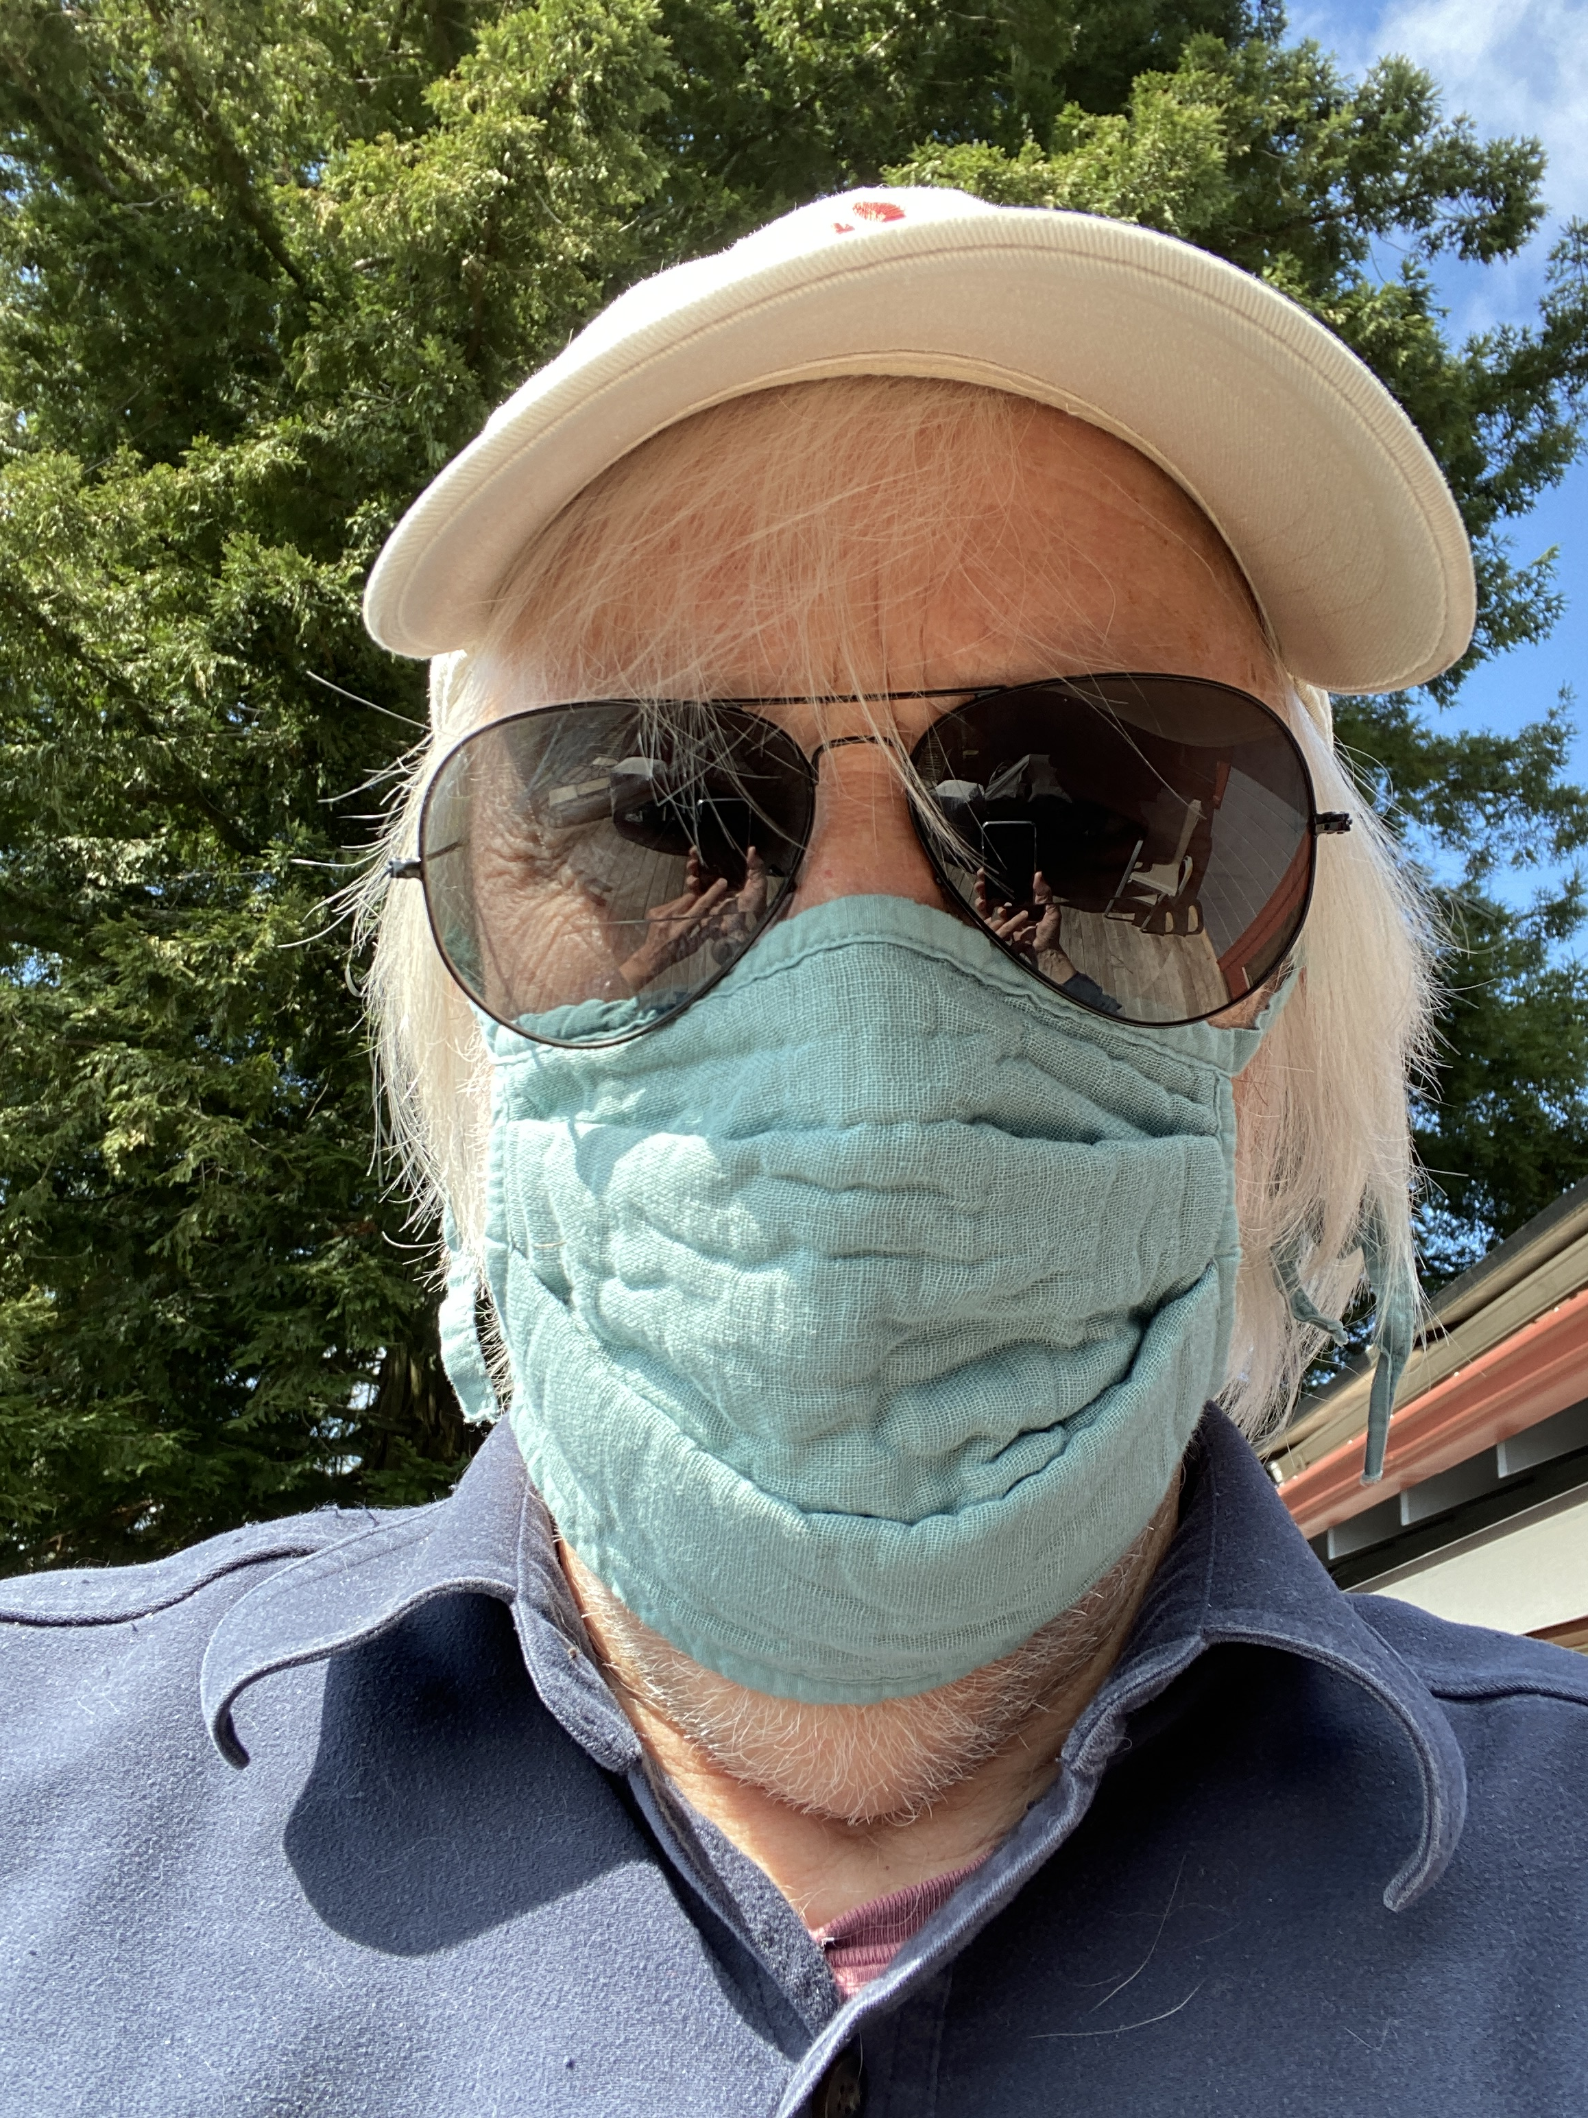
Dr. Jeff Seaman
Director
Bay View Analytics
http://onlinelearningsurvey.com/

Slide 3






Project Partners:
WICHE Cooperative for Educational Technologies
University Professional and Continuing Education Association

Slide 4
Project Goals
One survey for multiple partners so respondents are not bombarded with questions from those who are trying to help
Collaboration
Identify the critical functions and services that institutions need now
Immediate Needs
Guidance to better advocate for institutions - for policy changes and funding in the future
Next Steps

Slide 5
Survey Overview
Survey Design
Quick survey, can be completed in 2 minutes
A single survey for administrators and faculty, flexibly designed to show only the relevant questions for each respondent
Privacy guaranteed
Timed to roll out as respondents are actively adapting to new situation
Survey Process:
Two weeks of data collection: April 6 to April 19, 2020
Completed online
Survey Results:
826 U.S. Higher Education faculty and administrator respondents
Represent 641 different institutions
Merged with the Integrated Postsecondary Education Data System (IPEDS) for institutional characteristics

Slide 6
Resources
Infographic:
www.cengage.com/digital-learning-pulse-survey
Inside Higher Ed (Doug Lederman):
https://www.insidehighered.com/digital-learning/article/2020/04/22/how-professors-changed-their-teaching-springs-shift-remote
Faculty and administrative comment analysis:
http://onlinelearningsurvey.com/covid.html
Survey:
http://babson.qualtrics.com/jfe/form/SV_6J7BbId599n6L1b

Slide 7
Survey Results

Slide 8
Almost everyone moved online
Notes:
Who did not move online: Fully online schools, term had ended, in (remote) location so open longer

Slide 9
Everyone had inexperienced faculty teaching online
Notes:
The model was for the faculty teaching the course to continue, not to switch to some other faculty member with online teaching experience.
Many faculty already teaching online did not have to change – hence the lower percentage

Slide 10
The process was new for most faculty
Notes:
As might be expected, faculty who had never taught online before found themselves teaching in new ways.
The more surprising fi

Slide 11
Courses and teaching had to adjust

Slide 12
Fewer changes for experienced online faculty

Slide 13
It wasn’t just Zoom meetings

Slide 14
Most wanted: Support for Students

Slide 15
Both faculty and administrators have multiple needs

Slide 16
Faculty voices
What lessons can we learn from this experience moving forward? Do all lectures need to be delivered in person? How can we better utilize existing online tools… to be better prepared for another transition should the virus return. (Four-year Private Institution)
So much of teaching is about relationships… Online and real teaching are DIFFERENT and what works in the classroom often does not work online, and vice versa. (Four-year Private Institution)
That I will burn out. This has been a tremendous amount of work and shows no signs of slowing down. (Four-year Private Institution)

Slide 17
Administrative voices
Our number one concern is that we will see a big drop in enrollments. (Four-year Private Institution)
Knowing which of multiple scenarios to plan and prepare for. (Four-year Private Institution)
This stuff is pretty visceral. My stress levels are unbelievable. I hate having my work invade my home--it makes it virtually impossible to "turn-off". (Two-year Institution)

Slide 18
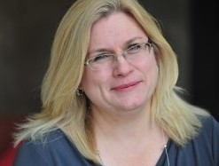
Jennifer Mathes, Ph.D.
Chief Executive Officer
Online Learning Consortium
https://onlinelearningconsortium.org/

Slide 19
Dr. Will Austin
President
Warren County Community College
http://www.warren.edu/

Slide 20
Questions and Answers

Slide 21

With Support From

