Slide 1
One Year Later – Higher Education Students, Faculty, and Institutions Reflect on Digital Learning
Wednesday, April 28, 2021

Slide 2
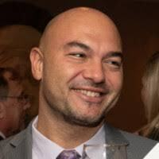
Today's Speakers
Jennifer Mathes OLC
Bernard Polnariev Union County College
Jeff Seaman Bay View Analytics
Nia Williams Ivy Tech Community College

Slide 3
Resources:
https://www.cengage.com/digital-learning-pulse-survey
https://www.bayviewanalytics.com/
https://www.ivytech.edu/
https://onlinelearningconsortium.org/
https://www.ucc.edu/
3

Slide 4
THANK
YOU!

